Slide 1
What Are the Recent Updates to Guideline-driven Care in Non-Advanced Systemic Mastocytosis?
Cem Akin, MD, PhD Professor of Medicine University of Michigan Ann Arbor, MI

Slide 2
Resource Information
About This Resource
These slides are one component of a continuing education program available online at MedEd On The Go titled Non-Advanced Systemic Mastocytosis - When the Best Supportive Care is Not Enough
Program Learning Objectives:
Describe the most recent updates to the World Health Organization (WHO) and NCCN guidelines on classifying non-advanced SM
Explain the advantages and limitations of each criterion and test that are relevant to nonAdvSM
Discuss how to use information from validated assessments for patient symptom reporting and risk stratification to enhance clinical assessment and inform treatment decisions
Explain which specialists are best suited to dealing with each type of symptom common to patients with nonAdvSM
Formulate approaches to provide optimal management of patients with nonAdvSM
MedEd On The Go®
www.mededonthego.com
This content or portions thereof may not be published, posted online or used in presentations without permission.
This content can be saved for personal use (non-commercial use only) with credit given to the resource authors.
To contact us regarding inaccuracies, omissions or permissions please email us at support@MedEdOTG.com

Slide 3
Disclaimer
The views and opinions expressed in this educational activity are those of the faculty and do not necessarily represent the views of Total CME, LLC, the CME providers, or the companies providing educational grants. This presentation is not intended to define an exclusive course of patient management; the participant should use their clinical judgment, knowledge, experience, and diagnostic skills in applying or adopting for professional use any of the information provided herein. Any procedures, medications, or other courses of diagnosis or treatment discussed or suggested in this activity should not be used by clinicians without evaluation of their patient's conditions and possible contraindications or dangers in use, review of any applicable manufacturer’s product information, and comparison with recommendations of other authorities. Links to other sites may be provided as additional sources of information.

Slide 4
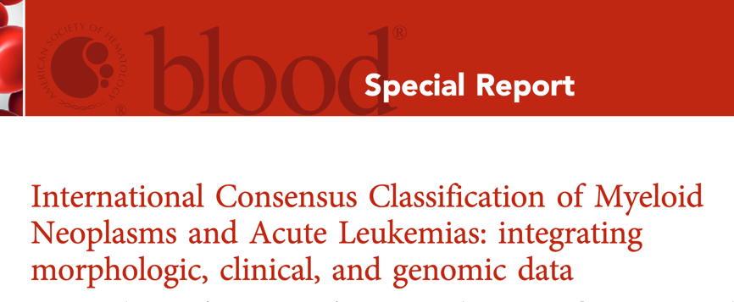
Updates to Diagnostic Criteria, and Classification of Systemic Mastocytosis
Two groups with largely overlapping recommendations
Khoury JD, et al. The 5th edition of the World Health Organization Classification of Haematolymphoid Tumours: Myeloid and Histiocytic/Dendritic Neoplasms. Leukemia. 2022;36(7):1703-19.
Arber DA, et al. International Consensus Classification of Myeloid Neoplasms and Acute Leukemias: integrating morphologic, clinical, and genomic data. Blood. 2022;140(11):1200-28.

Slide 5
Diagnostic Criteria for Systemic Mastocytosis
1 Major and 1 Minor Criteria or 3 Minor Criteria support a Systemic Mastocytosis diagnosis
Major:
Characteristic multifocal dense infiltrates (>15 mast cells per aggregate) in bone marrow or another extracutaneous tissue (tryptase or CD117 immunohistochemistry)
Minor:
Morphology of mast cells: Spindle shaped (in bone marrow aspirate smears)
Detection of a codon 816 c-kit (or another activating) mutation
High sensitivity allele specific or digital droplet PCR (capable of detecting <0.1% allele burden)
Expression of CD2, CD25 or CD30 by the bone marrow mast cell population
Immunohistochemistry (IHC) or flow cytometry
Well-differentiated systemic mastocytosis only expresses CD30
Serum tryptase >20 ng/mL
Not valid if there is an associated myeloid disorder

Slide 6
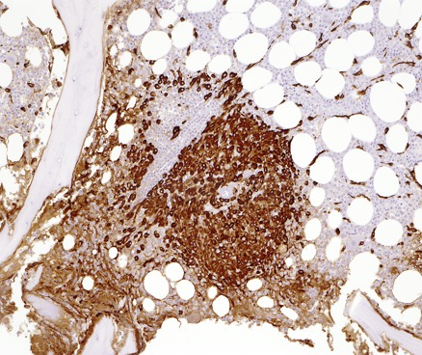
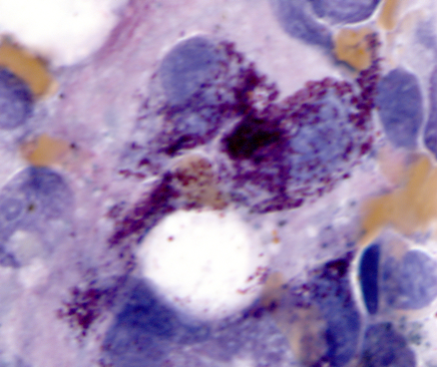
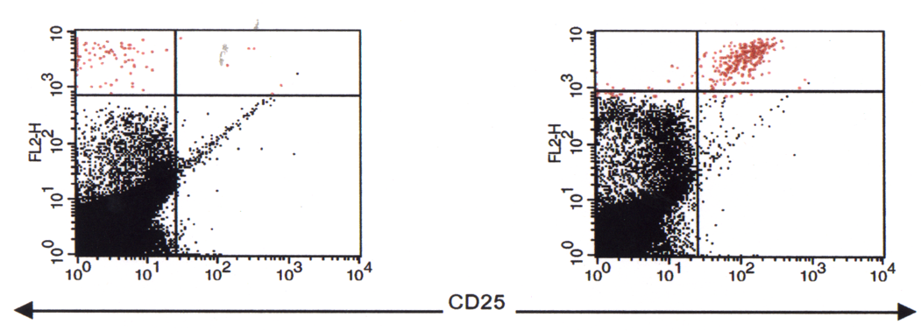
Systemic Mastocytosis (SM)
Compact aggregate of mast cells in bone marrow biopsy stained for tryptase.
Spindle-shaped atypical mast cells in the bone marrow aspirate of a patient with SM.
Flow cytometric analysis of bone marrow aspirate cells stained for CD117 (KIT) on the x-axis, and CD 25 on the y-axis in a patient without mastocytosis.
Flow cytometric analysis of bone marrow aspirate cells stained for CD117 (KIT) on the x-axis, and CD 25 on the y-axis in a patient with mastocytosis.

Slide 7
WHO/ICC Mastocytosis Consensus Classification
Cutaneous mastocytosis
Systemic mastocytosis
Indolent systemic mastocytosis
Bone marrow mastocytosis (new in 2022)
No skin lesions, tryptase <125 ng/mL
Smoldering systemic mastocytosis
B-findings: Bone marrow >30%, tryptase >200, hepatosplenomegaly, dysmyelopoiesis, KIT D816V VAF>10% but no C-findings or associated hematologic neoplasm (AHN)
Systemic mastocytosis with an AHN
SM+ co-existing myeloid neoplasms
Aggressive systemic mastocytosis
C-findings: Liver failure with ascites, malabsorption with weight loss, bone marrow failure, pathologic fractures
Mast cell leukemia
>10% mast cells in circulation or >20% in aspirate smears
Mast cell sarcoma
Non-adv
SM
Adv SM

Slide 8
Management of Non-Advanced Systemic Mastocytosis
Avoidance of mast cell activation triggers
Variable for each patient: e.g., temperature changes, friction, stress, alcohol, exercise, certain drugs (NSAIDs, opioids), Hymenoptera (multiple species)
Screen for osteoporosis
Prophylactic pharmacotherapy for mast cell activation symptoms
Depending on the symptom level, may range from only as needed to daily scheduled multiple anti-mast cell mediator therapies
Management of associated comorbidities
Osteoporosis
Hymenoptera venom allergy

Slide 9
Stepwise Pharmacologic Management of Non-Advanced Systemic Mastocytosis Includes:
Consider prescription of self-injectable epinephrine to all patients!
Non-sedating long acting H1 antihistamine
May be administered BID and supplemented with a shorter-acting antihistamine as needed
May add in case of inadequate response:
Skin symptoms: Leukotriene blocker, H2 antihistamine, (+/- ASA), phototherapy
GI symptoms: H2 antihistamine, PPI, oral cromolyn sodium (may increase GI cramping, diarrhea), leukotriene blocker
Recurrent hypotensive anaphylactic episodes: Leukotriene blocker, H2 antihistamine, ketotifen
For recurrent anaphylaxis, may add:
Omalizumab (off-label)
Glucocorticoids (long-term treatment not preferred)
Clinical trial

Slide 10
Looking for more resources on this topic?
CME/CE in minutes
Congress highlights
Late-breaking data
Quizzes
Webinars
In-person events
Slides & resources
www.MedEdOTG.com

