Slide 1
Areas: A Look at the Importance of Physical Measurements of the Right Heart
Richard Krasuski, MD
Professor of Medicine and Pediatrics
Director, Adult Congenital Heart Disease Center
Director, Hemodynamic Research
Director, Interventional CTEPH Program
Duke University Medical Center
Durham, NC

Slide 2
Disclaimer
The views and opinions expressed in this educational activity are those of the faculty and do not necessarily represent the views of Total CME, LLC, the CME providers, or the companies providing educational grants. This presentation is not intended to define an exclusive course of patient management; the participant should use their clinical judgment, knowledge, experience, and diagnostic skills in applying or adopting for professional use any of the information provided herein. Any procedures, medications, or other courses of diagnosis or treatment discussed or suggested in this activity should not be used by clinicians without evaluation of their patient's conditions and possible contraindications or dangers in use, review of any applicable manufacturer’s product information, and comparison with recommendations of other authorities. Links to other sites may be provided as additional sources of information.

Slide 3



Resource Information
About This Resource
These slides are one component of a continuing education program available online at MedEd On The Go titled Advancing Diagnosis and Risk Assessment in PH
Program Learning Objectives:
Gain and understanding of the new guidelines and algorithms developed to detect PH early in the community
Identify appropriate circumstances to implement 3 or 4 strata risk assessments.
Enable early recognition of sub-populations of patients who are at high risk and identify appropriate screening candidates
MedEd On The Go®
www.mededonthego.com
This content or portions thereof may not be published, posted online or used in presentations without permission.
This content can be saved for personal use (non-commercial use only) with credit given to the resource authors.
To contact us regarding inaccuracies, omissions or permissions please email us at support@MedEdOTG.com

Slide 4
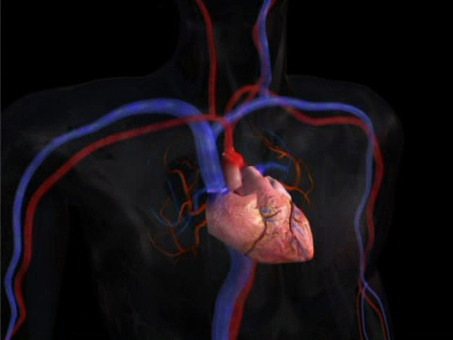
The Right Heart - Challenging to Image: Multiple Views Needed
Imaging from multiple different angles obtains the most
comprehensive assessment of right heart size, shape, function, and hemodynamics
Parasternal Short Axis:
  RVOT
Apical 4-Chamber:
  RV
  RA
Subcostal:
  RV wall thickness
  IVC dimension and collapsibility
Parasternal
Apical
Subcostal
Notes:
4
Pickup: Forfia, slide 5

Slide 5
Measurements Used for Quantification of Right Heart: The ASE Guidelines
Parameter | View | Abnormal Value | Significance
RV dimensions | Apical 4-chamber | Dimension >42 mm (base) | RV enlargement
 |  | Dimension >35 mm (mid level)
 |  | Longitudinal dimension >86 mm
RA dimensions | Apical 4-chamber | RA area >18 cm² | RA enlargement
 |  | RA length >53 mm
 |  | RA diameter >44 mm
RV wall thickness | Subcostal (in diastole) | Thickness >5 mm | RVH - RV pressure overload
Abnormal values generally defined as being 2 standard deviations outside population mean
Notes:
5
Rudski 2010, p 686, col 2, para 4-5; p 687, Table 1; col 1; col 2, para 1

Slide 6
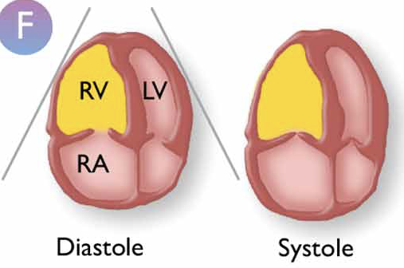
Structural Assessments of the Right Heart: Fractional Area Change of the Right Ventricle
FAC = (RVEDA – RVESA)/RVEDA = (35.4-18.3)/35.4 = 48%
FAC | Ejection Fraction
60% | 75%
50% | 66%
40% | 54%
30% | 42%
20% | 29%
10% | 15%

Slide 7
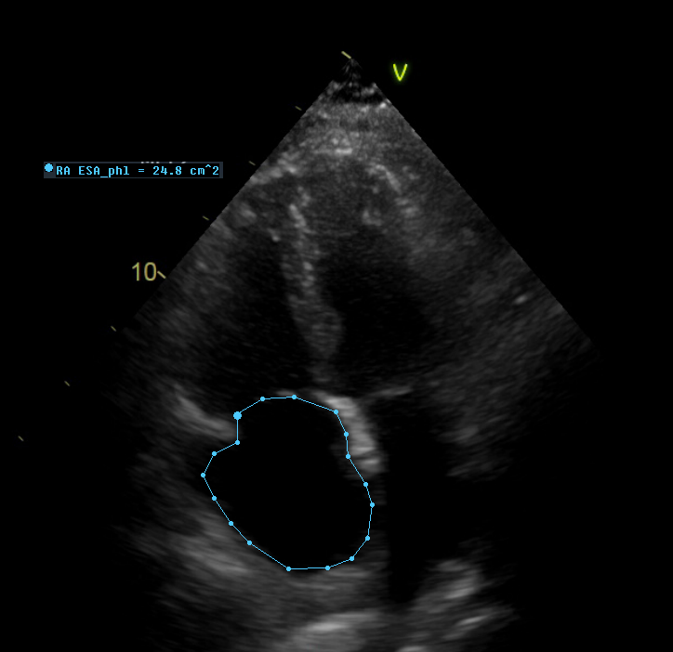
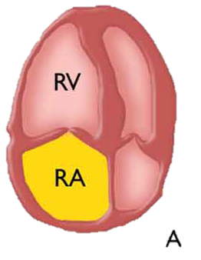
Structural Assessments of the Right Heart:
Right Atrial Area Assessment
RA > 18 cm²
Enlarged right atrial area
(> 18 cm²);
4-chamber view

Slide 8
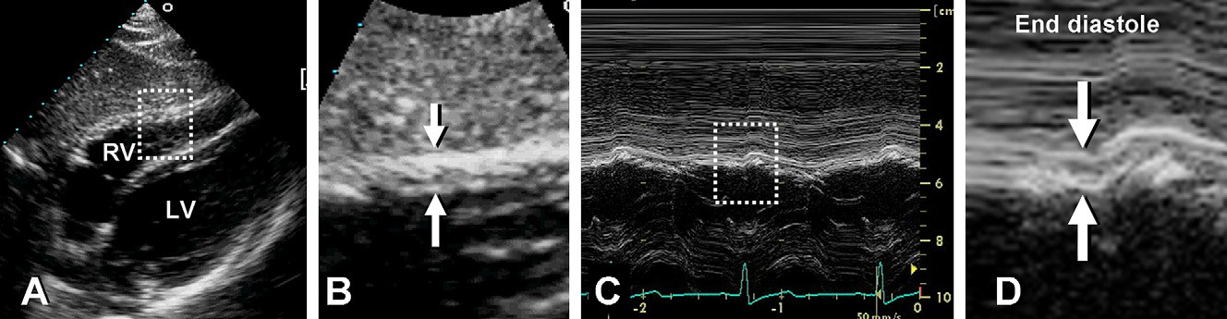
Assessment for Right Ventricular Hypertrophy
Measurement of End-diastolic Right Ventricular Wall Thickness
Subcostal 2-dimensional image of right ventricular wall.
Magnified region outlined in (A) with right ventricular wall thickness indicated by arrows.
M-mode image corresponding to arrows
Magnified region outlined in (C) with arrows indicating wall thickness at end-diastole.
Thickness >5 mm indicates RV hypertrophy and may suggest RV pressure overload in the absence of other pathologies.
Notes:
8
Figure: Rudski 2010. p 693, fig 5
Bullet: Rudski 2010, p 687, col 1, para 2

Slide 9



Looking for more resources
on this topic?
CME/CE in minutes
Congress highlights
Late-breaking data
Quizzes
Webinars
In-person events
Slides & resources
www.MedEdOTG.com

