Slide 1
What Is The Evidence Supporting CLDN18.2 Targeting in Frontline Management Of G/GEJ Cancers
Samuel J. Klempner, MD
Gastrointestinal Oncology
Massachusetts General Hospital Cancer Center
Harvard Medical School
Boston, MA

Slide 2



Resource Information
About This Resource
These slides are one component of a continuing education program available online at MedEd On The Go titled Navigating Challenges in Metastatic Gastric/GEJ Cancer Management: Advancements in Biomarker-Directed Therapies
Program Learning Objectives:
Describe relevant molecular biomarkers and how they relate to clinical characteristics of G/GEJ cancers
Discuss the impact molecular biomarkers have on treatment selection in metastatic G/GEJ cancers
Evaluate clinical data with current and investigational combination regimens for the first-line treatment of advanced G/GEJ cancers
Identify adverse effects associated with individual components of combination regimens and their prophylactic and management strategies in the setting of advanced or metastatic G/GEJ cancers
Implement strategies to provide holistic, multidisciplinary care for patients with advanced or metastatic G/GEJ cancers
Evaluate recent practice-changing data to inform treatment strategies for patients with G/GEJ cancers
MedEd On The Go®
www.mededonthego.com
This content or portions thereof may not be published, posted online or used in presentations without permission.
This content can be saved for personal use (non-commercial use only) with credit given to the resource authors.
To contact us regarding inaccuracies, omissions or permissions please email us at support@MedEdOTG.com

Slide 3
Disclaimer
The views and opinions expressed in this educational activity are those of the faculty and do not necessarily represent the views of Total CME, LLC, the CME providers, or the companies providing educational grants. This presentation is not intended to define an exclusive course of patient management; the participant should use their clinical judgment, knowledge, experience, and diagnostic skills in applying or adopting for professional use any of the information provided herein. Any procedures, medications, or other courses of diagnosis or treatment discussed or suggested in this activity should not be used by clinicians without evaluation of their patient's conditions and possible contraindications or dangers in use, review of any applicable manufacturer’s product information, and comparison with recommendations of other authorities. Links to other sites may be provided as additional sources of information.

Slide 4
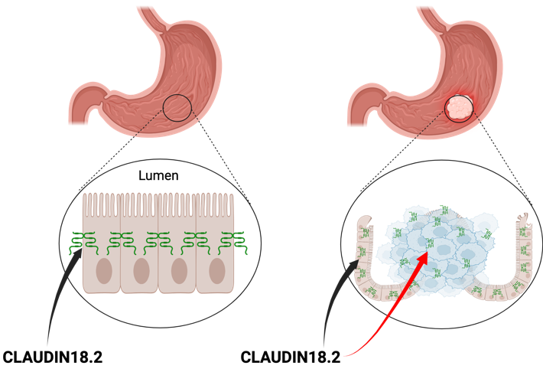
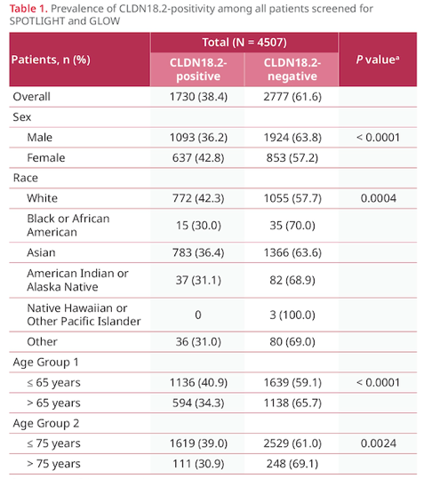
CLDN18.2: A Common GC/GEJ Biomarker
Created on biorender.com

Slide 5
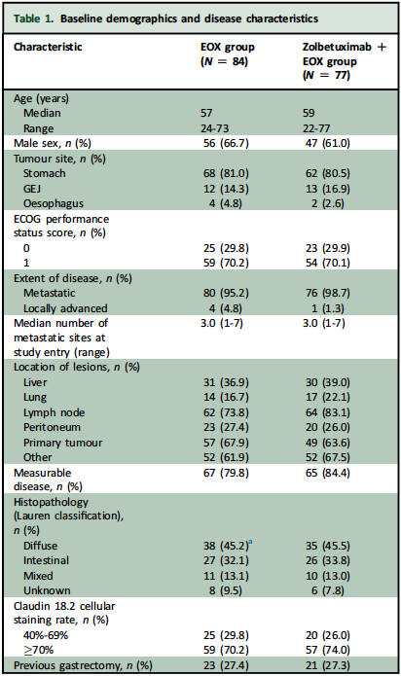
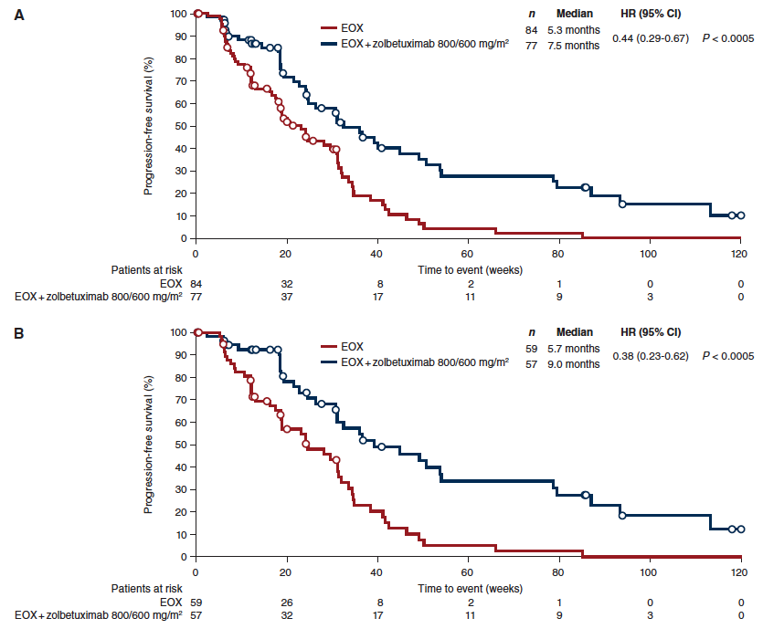
CLDN18.2: Early Evidence for Targeting

Slide 6
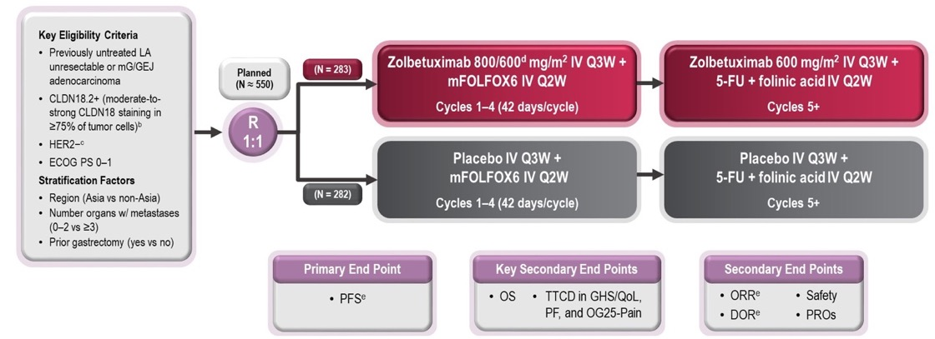
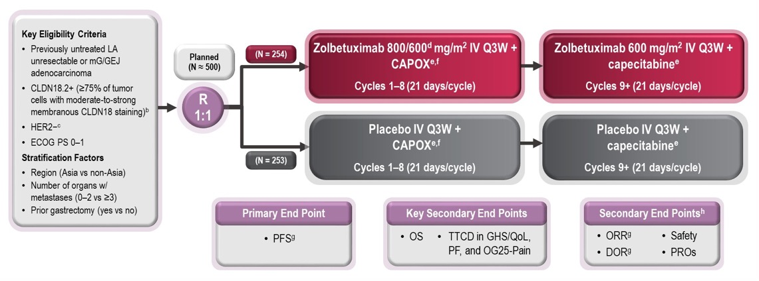
CLDN18.2: Validation in Phase III
SPOTLIGHT
Parallel phase III trials
Differ by the chemotherapy backbone
Central CLDN18.2 testing
PFS = Primary endpoint
OS = Secondary endpoint
GLOW

Slide 7
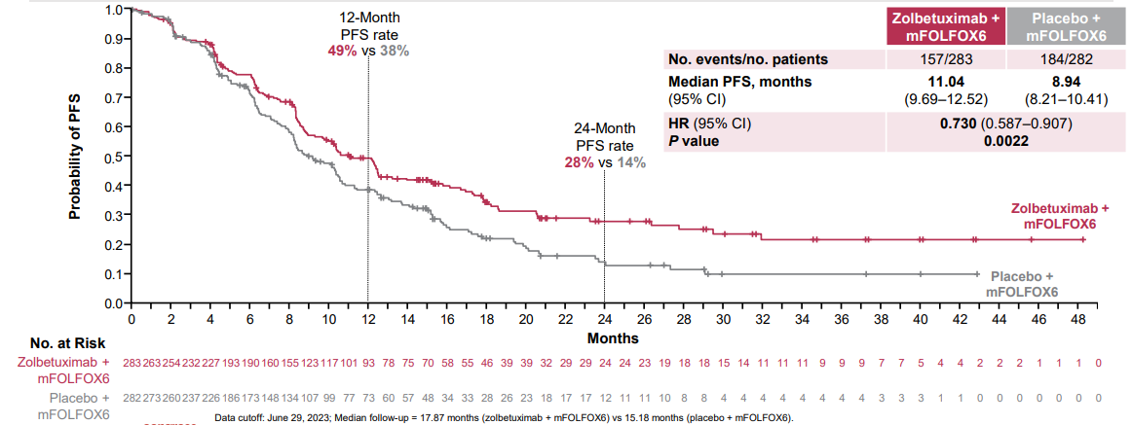
CLDN18.2 Validation in Phase III: SPOTLIGHT

Slide 8
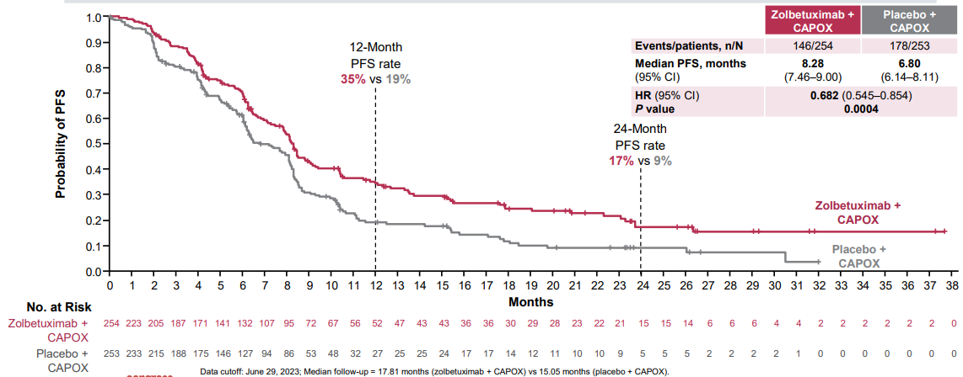
CLDN18.2 Validation in Phase III: GLOW

Slide 9
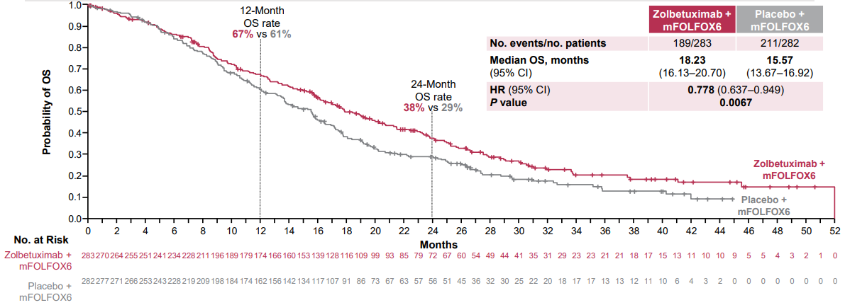
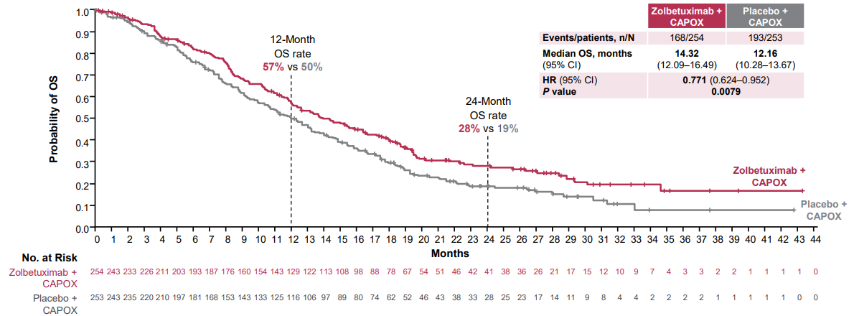
Overall Survival in SPOTLIGHT and GLOW
SPOTLIGHT
GLOW

Slide 10
Cross Trial Contextualization in GC/GEJ
Trial | Approach | mPFS in ITT | 12-month PFS rate ITT | 24-month PFS rate ITT | mOS in ITT | 12-month OS rate in ITT | 24-month OS rate in ITT
KN-811¹ | 5FU/oxaliplatin/trastuzumab +/- pembrolizumab | 10.0 vs 8.1 (HR 0.73) | NR | 25% vs 14% | 20.0 vs 16.8 (HR 0.84) | NR | NR
CM-649² | 5FU/oxaliplatin +/- nivolumab | 7.7 vs 6.9 (HR 0.79) | 33% vs 24% | 16% vs 10% | 13.8 vs 11.6 (HR 0.79) | 55% vs 48% | 28% vs 19%
KN-859³ | 5FU/platinum +/- pembrolizumab | 6.9 vs 5.6 (HR 0.76) | 29% vs 19% | 18% vs 9% | 12.9 vs 11.5 (HR 0.78) | 53% vs 47% | 28% vs 19%
GLOW⁴ | CAPOX +/- Zolbetuximab | 8.2 vs 6.8 (0.69) | 35% vs 19% | 17% vs 9% | 14.4 vs 12.2 (HR 0.77) | 57% vs 50% | 28% vs 19%
SPOTLIGHT⁵ | FOLFOX +/- Zolbetuximab | 10.6 vs 8.7 (HR 0.75) | 49% vs 38% | 28% vs 14% | 18.2 vs 15.5 (HR 0.75) | 67% vs 61% | 38% vs 29%

Slide 11
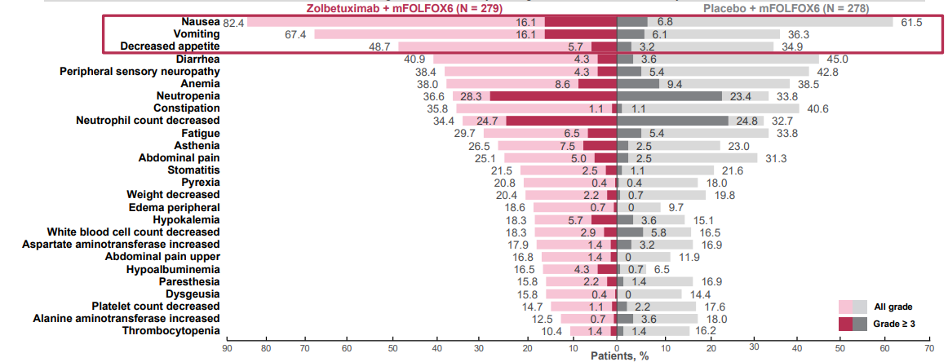
CLDN18.2: Adverse Events
The most common TRAEs with zolebetuximab + mFOLFOX6 were nausea and vomiting as on-target effects

Slide 12
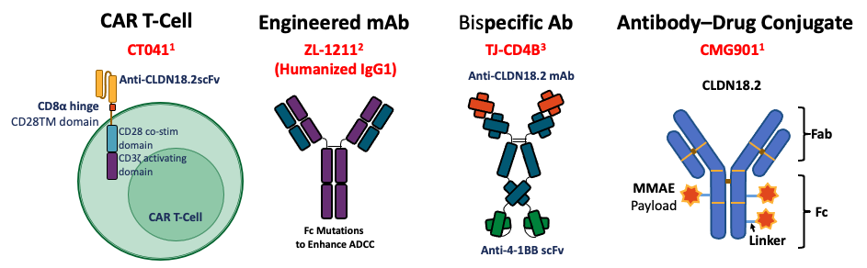
CLDN18.2: Other Targeting Strategies

Slide 13
Key Takeaways
CLDN18.2+ is observed in 35-40% of all GC/GEJ adenocarcinomas
CLDN18.2 is a validated target in GC/GEJ adenocarcinomas
Combining the anti-CLDN18.2 mAb zolbetuximab with standard frontline 5FU/oxaliplatin improves PFS and OS in CLDN18.2+ GC/GEJ
There are multiple ongoing CLDN18.2-directed trials and approaches

Slide 14



Looking for more resources on this topic?
CME/CE in minutes
Congress highlights
Late-breaking data
Quizzes
Webinars
In-person events
Slides & resources
www.MedEdOTG.com

