Slide 1
What Is the Current Standard for First-Line Treatment of Metastatic HER2-Negative G/GEJ Cancers?
Yelena Y. Janjigian, MD
Chief
Gastrointestinal Oncology Service
Memorial Sloan Kettering Cancer Center
New York, NY

Slide 2



Resource Information
About This Resource
These slides are one component of a continuing education program available online at MedEd On The Go titled Navigating Challenges in Metastatic Gastric/GEJ Cancer Management: Advancements in Biomarker-Directed Therapies
Program Learning Objectives:
Describe relevant molecular biomarkers and how they relate to clinical characteristics of G/GEJ cancers
Discuss the impact molecular biomarkers have on treatment selection in metastatic G/GEJ cancers
Evaluate clinical data with current and investigational combination regimens for the first-line treatment of advanced G/GEJ cancers
Identify adverse effects associated with individual components of combination regimens and their prophylactic and management strategies in the setting of advanced or metastatic G/GEJ cancers
Implement strategies to provide holistic, multidisciplinary care for patients with advanced or metastatic G/GEJ cancers
Evaluate recent practice-changing data to inform treatment strategies for patients with G/GEJ cancers
MedEd On The Go®
www.mededonthego.com
This content or portions thereof may not be published, posted online or used in presentations without permission.
This content can be saved for personal use (non-commercial use only) with credit given to the resource authors.
To contact us regarding inaccuracies, omissions or permissions please email us at support@MedEdOTG.com

Slide 3
Disclaimer
The views and opinions expressed in this educational activity are those of the faculty and do not necessarily represent the views of Total CME, LLC, the CME providers, or the companies providing educational grants. This presentation is not intended to define an exclusive course of patient management; the participant should use their clinical judgment, knowledge, experience, and diagnostic skills in applying or adopting for professional use any of the information provided herein. Any procedures, medications, or other courses of diagnosis or treatment discussed or suggested in this activity should not be used by clinicians without evaluation of their patient's conditions and possible contraindications or dangers in use, review of any applicable manufacturer’s product information, and comparison with recommendations of other authorities. Links to other sites may be provided as additional sources of information.

Slide 4
Current ASCO & NCCN Guidelines for First-Line Treatment of Metastatic HER2-Negative G/GEJ Cancers
Gastric adenocarcinoma
CPS 0
Chemo alone
CPS 1-5
Consider nivolumab + chemo
Tumor Type
PD-L1 Status
First-Line Therapy
CPS > 5
Nivolumab + chemo
Esophageal/GEJ adenocarcinoma
CPS 0 / TPS 0
Chemo alone
CPS 1-5
Consider nivolumab + chemo
Tumor Type
PD-L1 Status
First-Line Therapy
CPS 1-10
Consider pembrolizumab + chemo
CPS > 5
Nivolumab + chemo

Slide 5
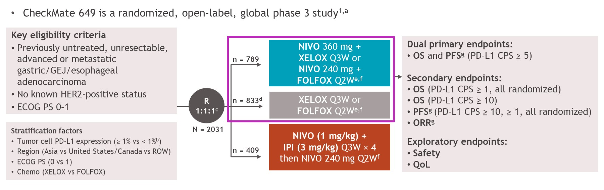
CheckMate-649: Nivolumab + Chemotherapy Versus Chemotherapy as First-Line Treatment for HER2-Negative Advanced G/GEJ Cancer
Study Design:

Slide 6
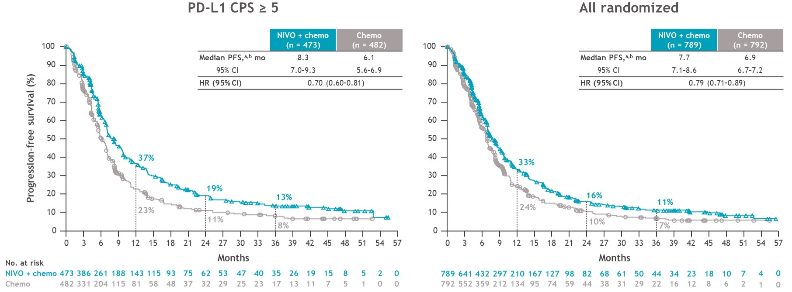
CheckMate-649 Progression-Free Survival:
36-Month Follow-Up
PFS benefit with NIVO + chemo versus chemo was maintained with longer follow-up in PD-L1 CPS > 5 and all randomized populations

Slide 7
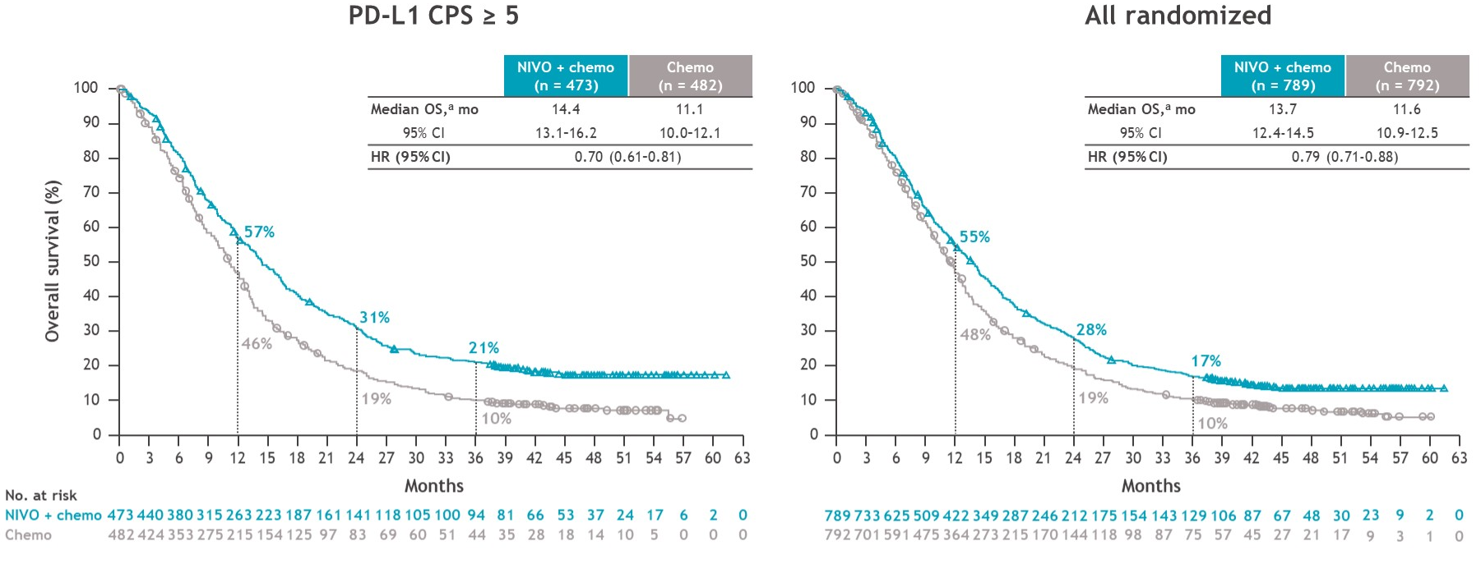
CheckMate-649 Overall Survival: 36-Month Follow-Up
Clinically meaningful improvement in OS with NIVO + chemo versus chemo was maintained with longer follow-up in PD-L1 CPS > 5 and all randomized populations

Slide 8
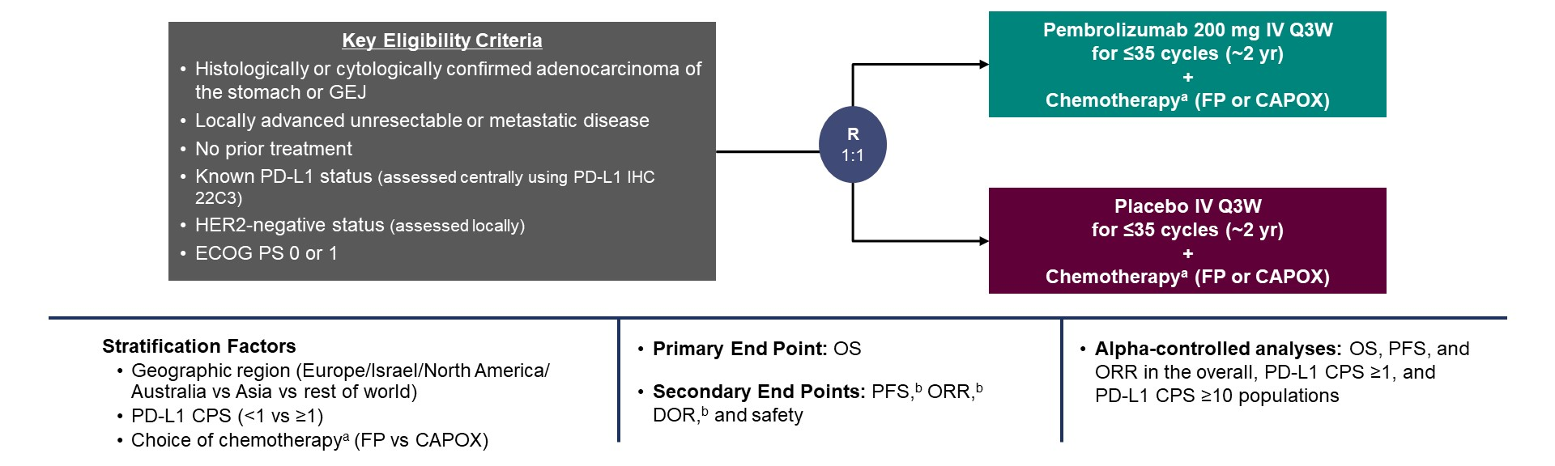
KEYNOTE-859: Pembrolizumab + Chemotherapy Versus Chemotherapy in Advanced HER2-Negative G/GEJ Cancers:
Outcomes in Protocol-Specified PD-L1-Selected Populations
Study Design: Randomized, Double-Blind, Phase 3 Trial

Slide 9
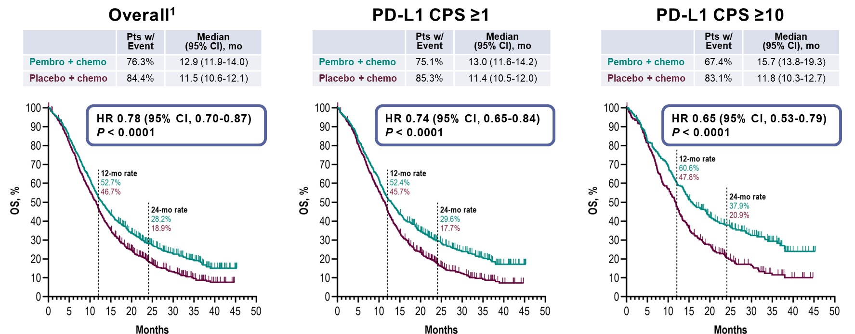
KEYNOTE-859 Primary Endpoint: Overall Survival

Slide 10
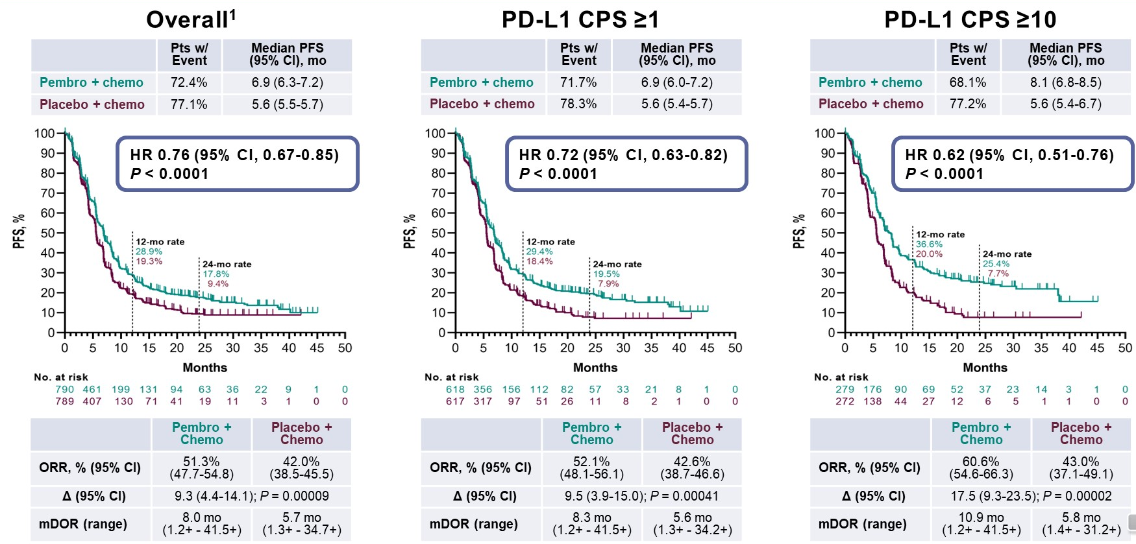
KEYNOTE-859 Secondary Endpoints: PFS, ORR, and DOR

Slide 11
Summary
Historically, the 5-year overall survival rate for advanced gastric cancer has been less than 10%
The addition of an anti-PD-1 inhibitor to chemotherapy improves survival in the first-line treatment of advanced HER2-negative G/GEJ cancers
Based on results from the KEYNOTE-859 trial, pembrolizumab with chemotherapy was approved by the FDA on November 16th, 2023 for metastatic HER2-negative G/GEJ cancers, regardless of tumor PD-L1 expression

Slide 12



Looking for more resources
on this topic?
CME/CE in minutes
Congress highlights
Late-breaking data
Quizzes
Webinars
In-person events
Slides & resources
www.MedEdOTG.com

