Slide 1
Epidemiology of Cardiovascular Disease in Narcolepsy
Lee A. Surkin, MD, FACC, FCCP, FASNC, FAASM
Founder, American Academy of Cardiovascular Sleep Medicine
President, Empire Sleep Medicine
Chief Medical Officer, VirtuOx Inc.
Chief Medical Officer, Nexus Dental Systems
Greenville, NC

Slide 2



Resource Information
About This Resource
These slides are one component of a continuing education program available online at MedEd On The Go titled Narcolepsy: The Life Essential 8 Connection
Program Learning Objectives:
Improve the accuracy and timing when diagnosing patients suffering from narcolepsy
Educate HCPs on how narcolepsy increases cardiovascular risk
Address how treatment of narcolepsy can improve sleep, which is a pillar of the AHA Life Essential 8, albeit with the caveat of a potentially high salt load
MedEd On The Go®
www.mededonthego.com
This content or portions thereof may not be published, posted online or used in presentations without permission.
This content can be saved for personal use (non-commercial use only) with credit given to the resource authors.
To contact us regarding inaccuracies, omissions or permissions please email us at support@MedEdOTG.com

Slide 3
Disclaimer
The views and opinions expressed in this educational activity are those of the faculty and do not necessarily represent the views of Total CME, LLC, the CME providers, or the companies providing educational grants. This presentation is not intended to define an exclusive course of patient management; the participant should use their clinical judgment, knowledge, experience, and diagnostic skills in applying or adopting for professional use any of the information provided herein. Any procedures, medications, or other courses of diagnosis or treatment discussed or suggested in this activity should not be used by clinicians without evaluation of their patient's conditions and possible contraindications or dangers in use, review of any applicable manufacturer’s product information, and comparison with recommendations of other authorities. Links to other sites may be provided as additional sources of information.

Slide 4
Narcolepsy – Clinical Characteristics
Narcolepsy is a chronic neurologic sleep disorder
Five predominant symptoms – excessive daytime sleepiness; cataplexy; disrupted nighttime sleep; sleep related hallucinations; and sleep paralysis
Onset of symptoms typically in childhood or adolescence

Slide 5
Blunted Nocturnal BP Dipping
Defined as a <10% decrease in BP during sleep
Associated with increased CV mortality and morbidity, independent of BP and CV risk factors1 and CHF²
More common in narcolepsy vs. controls
31% vs 3% (p=0.002)³
Consistent when controlling for sympathetic activity in NREM sleep4
Associated with increased sleep fragmentation, arousals, PLMS and PLMS with arousals⁵

Slide 6
Cardiovascular and Cardiometabolic Comorbidities Associated With Narcolepsy
Odds Ratio
Obesity
Hypertension
Diabetes
Dyslipidemia

Slide 7
Narcolepsy and Cardiovascular Disease
BOND study 2017
Odds Ratio
Black J, Reaven NL, Funk SE, et al. Sleep Med. 2017 May;33:13-18.

Slide 8
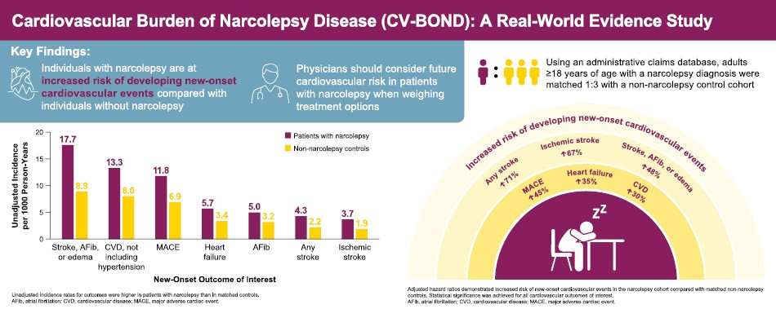

Slide 9
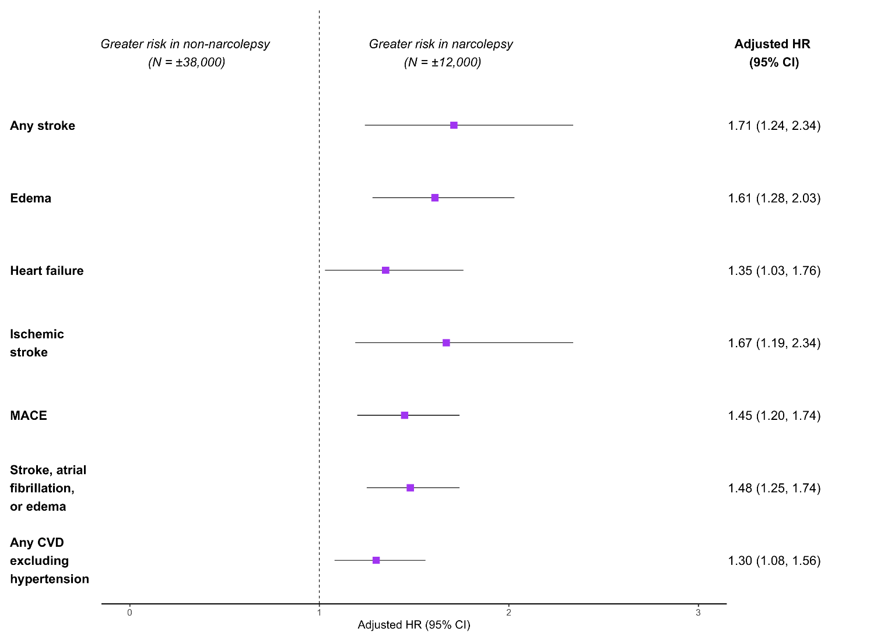
CV-BOND Study
Adjusted Hazard Ratios for Incidence of Newly-Diagnosed Cardiovascular/Renal Conditions in Patients with Narcolepsy and Matched Non-Narcolepsy Controls

Slide 10
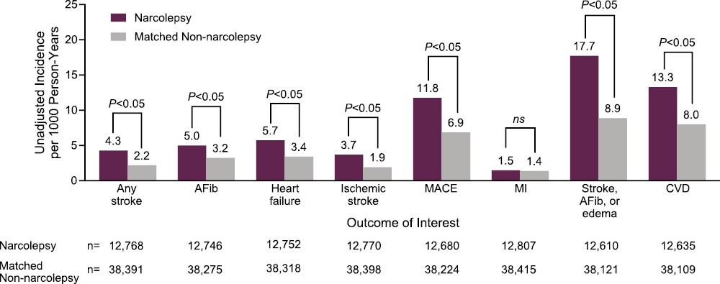
CV BOND: Unadjusted incidence rates for new-onset cardiovascular events in patients with narcolepsy and matched non-narcolepsy controls

Slide 11



Looking for more resources on this topic?
CME/CE in minutes
Congress highlights
Late-breaking data
Quizzes
Webinars
In-person events
Slides & resources
www.MedEdOTG.com

