Slide 1
Management of Chronic Cough: Pharmacological and Nonpharmacological Modalities to Enhance the Patient Experience
Peter Dicpinigaitis, MD
Professor of Medicine, Albert Einstein College of Medicine
Director, Cough Center, Montefiore Medical Center
Bronx, NY

Slide 2
Disclaimer
The views and opinions expressed in this educational activity are those of the faculty and do not necessarily represent the views of TotalCME, Inc., the CME providers, or the companies providing educational grants. This presentation is not intended to define an exclusive course of patient management; the participant should use their clinical judgment, knowledge, experience, and diagnostic skills in applying or adopting for professional use any of the information provided herein. Any procedures, medications, or other courses of diagnosis or treatment discussed or suggested in this activity should not be used by clinicians without evaluation of their patient's conditions and possible contraindications or dangers in use, review of any applicable manufacturer’s product information, and comparison with recommendations of other authorities. Links to other sites may be provided as additional sources of information.

Slide 3
Definitions: Chronic Cough and Refractory Chronic Cough
Chronic cough – cough that has been present > 8 weeks
Refractory chronic cough – chronic cough that persists despite appropriate therapeutic trials aimed at known underlying causes of chronic cough

Slide 4
Treatment of Chronic Cough: Diagnostic-Therapeutic Trials
Upper Airway Cough Syndrome; PNDS; rhinitis
Oral First-Generation Antihistamine
Inhaled Corticosteroids
Inhaled Ipratropium
Asthma; non-asthmatic eosinophilic bronchitis
Oral Steroids
Inhaled Steroids
LTRAs
GERD (acid- and non-acid; liquid/gaseous components)
Acid-Suppression Therapy (high-dose PPI)
Anti-Reflux Lifestyle Measures
Prokinetic Agents (Metoclopramide)

Slide 5
Therapeutic Options for RCC (All Off-Label)
Narcotics (Hydrocodone, Codeine, Morphine)
Amitriptyline
Gabapentin
Speech-language therapy

Slide 6
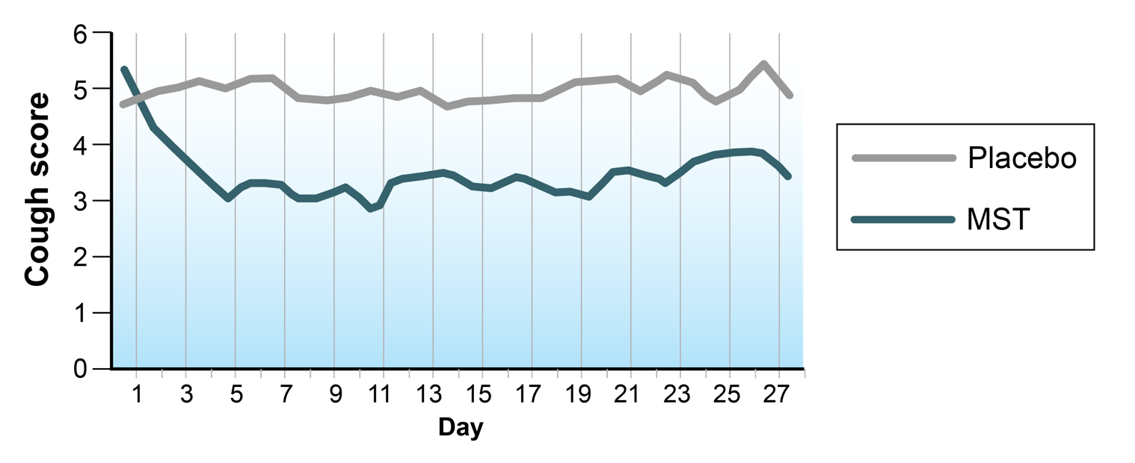
Opiate Therapy for RCC
Mean of daily diary cough scores

Slide 7
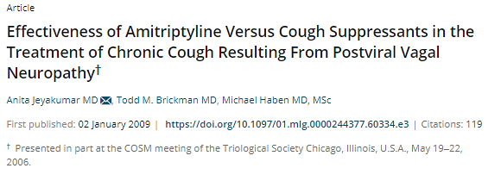

Amitriptyline for RCC

Slide 8
Amitriptyline for RCC
Begin with 10 mg qhs dose for 1 month
Increase dose to ≥ 25 mg nightly
Limiting side effects: sedation, dry mouth
No RCTs evaluating amitriptyline in cough

Slide 9
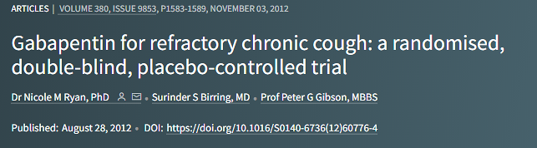
Gabapentin for RCC
Summary
Background
Refractory chronic cough causes substantial symptoms and quality-of-life impairment. Similarities between central reflex sensitisation in refractory chronic cough and neuropathic pain suggest that neuromodulators such as gabapentin might be effective for refractory chronic cough. We established the efficacy of gabapentin in patients with refractory chronic cough.
Methods
This randomised, double-blind, placebo-controlled trial was undertaken at an outpatient clinic in Australia. Adults with refractory chronic cough (>8 weeks' duration) without active respiratory disease or infection were randomly assigned to receive gabapentin (maximum tolerable daily dose of 1800 mg) or matching placebo for 10 weeks. Block randomisation was done with randomisation generator software, stratified by sex. Patients and investigators were masked to assigned treatment. The primary endpoint was change in cough-specific quality of life (Leicester cough questionnaire (LCQ) score) from baseline to 8 weeks of treatment, analysed by intention to treat. This study is registered with the Australian New Zealand Clinical Trials Registry, number ACTRN12608000248369.
Findings
62 patients were randomly assigned to gabepentin (n=32) or placebo (n=30) and ten patients withdrew before the study end. Gabapentin significantly improved cough-specific quality of life compared with placebo (between-group difference in LCQ score during treatment period 1.80, 95% CI 0.56-104; p=0.004; number needed to treat of 3·58). Side-effects occurred in ten patients (31%) given gabapentin (the most common being nausea and fatigue) and three (10%) given placebo.
Interpretation
The treatment of refractory chronic cough with gabapentin is both effective and well tolerated. These positive effects suggest that central reflex sensitisation is a relevant mechanism in refractory chronic cough.
Funding
National Health and Medical Research Council of Australia and Hunter Medical Research Institute, Newcastle, Australia.

Slide 10
Gabapentin for RCC
Lancet study: titration goal to 600 mg TID
My goal: 300 mg TID Begin 300 mg nightly as tolerated Every few days, titrate up to bid, then TID If 300 mg dose is not tolerated, attempt 100 mg TID titration

Slide 11
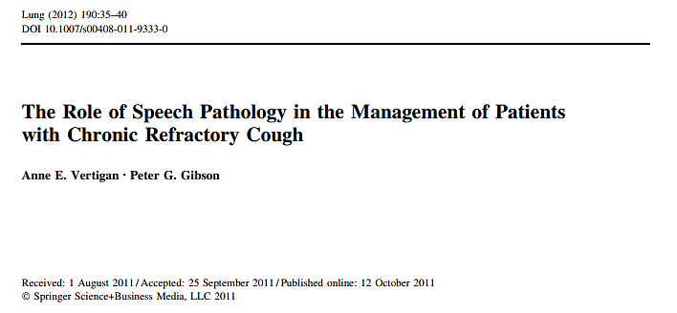
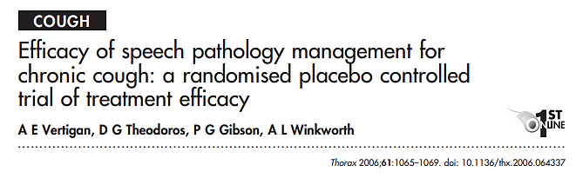
Speech/Language Therapy for RCC

Slide 12
Therapeutic Options for RCC: Relevance to Current Clinical Practice
Narcotics (hydrocodone, codeine, morphine)
Amitriptyline
Gabapentin
Speech-language therapy
Some of these therapeutic options will work for some patients
Therefore, it is essential to rule out
a reversible cause of chronic cough
before assigning a diagnosis of RCC!

