Slide 1
Key Components of the Evaluation of a Patient With Chronic Cough – Diagnostic/Therapeutic Algorithm
Michael S. Blaiss, MD
Clinical Professor
Medical College of Georgia at Augusta University
Augusta, GA

Slide 2
Disclaimer
The views and opinions expressed in this educational activity are those of the faculty and do not necessarily represent the views of TotalCME, Inc., the CME providers, or the companies providing educational grants. This presentation is not intended to define an exclusive course of patient management; the participant should use their clinical judgment, knowledge, experience, and diagnostic skills in applying or adopting for professional use any of the information provided herein. Any procedures, medications, or other courses of diagnosis or treatment discussed or suggested in this activity should not be used by clinicians without evaluation of their patient's conditions and possible contraindications or dangers in use, review of any applicable manufacturer’s product information, and comparison with recommendations of other authorities. Links to other sites may be provided as additional sources of information.

Slide 3
Classification
Acute cough
~ maximum of 3 weeks
Subacute cough
~ 3 to 8 weeks
Chronic cough
~ more than 8 weeks

Slide 4
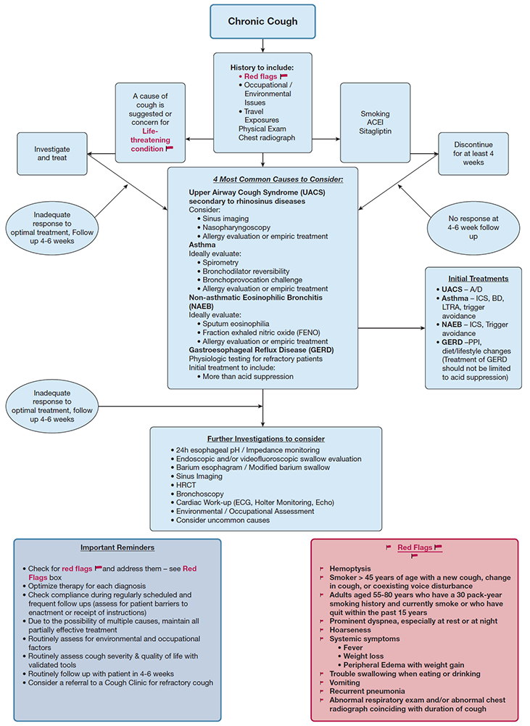
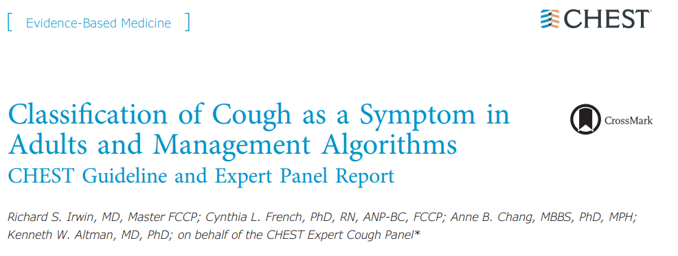
CHEST Guidelines

Slide 5
Initial Assessment of Chronic Cough
History: Important details to uncover
Duration of cough
Triggers of cough (environmental exposures, occupational exposures, travel exposures)
Smoking history
Previous evaluations and treatments
Medications that can cause chronic cough
ACE inhibitors
Physical examination and chest x-ray

Slide 6
Red Flags in Chronic Cough
Hemoptysis
Smoker > 45 years of age with a new cough, change in cough, or coexisting voice disturbance
Adults aged 55-80 years who have a 30 pack-year smoking history and currently smoke or who have quit within the past 15 years
Prominent dyspnea, especially at rest or at night
Hoarseness
Systemic symptoms
Fever
Weight loss
Peripheral Edema with weight gain
Trouble swallowing when eating or drinking
Vomiting
Recurrent pneumonia
Abnormal respiratory exam and/or abnormal chest radiograph coinciding with duration of cough

Slide 7
Considerations for Chronic Cough 4 Most Common Causes to Consider:
Considerations for Chronic Cough
Upper Airway Cough Syndrome (UACS) secondary to rhinosinus diseases
Consider:
Sinus imaging
Nasopharyngoscopy
Allergy evaluation or empiric treatment
Asthma
Ideally evaluate:
Spirometry
Bronchodilator reversibility
Bronchoprovocation challenge
Allergy evaluation or empiric treatment
Non-asthmatic Eosinophilic Bronchitis (NAEB)
Ideally evaluate:
Sputum eosinophilia
Fraction exhaled nitric oxide (FENO)
Allergy evaluation or empiric treatment
Gastroesophageal Reflux Disease (GERD)
Physiologic testing for refractory patients. Initial treatment to include:
More than acid suppression

Slide 8
Further Investigations to Consider
24h esophageal pH / impedance monitoring
Endoscopic and/or videofluoroscopic swallow evaluation
Barium esophagram / modified barium swallow
Sinus imaging
HRCT
Bronchoscopy
Cardiac work-up (ECG, Holter Monitoring, Echo)
Environmental / occupational assessment
Consider uncommon causes

Slide 9
Chronic Cough (CC)
>8 weeks with cough
Associated / underlying medical conditions are identified and treated per guidelines,
but cough persists
Associated / underlying medical conditions
are not identified by the investigator
Refractory Chronic Cough (RCC)
Unexplained Chronic Cough (UCC)
Occurs more often in women than men
Peaks in fifth and sixth decades of life

