Slide 1
Guideline Implementation and Referral Management of Patients with Chronic Cough
Rachel M. Taliercio, DO
Vice Chair, Department of Pulmonary Medicine
Institute Experience Officer, Respiratory Institute
Assistant Professor of Medicine, Lerner College of Medicine
Cleveland Clinic
Cleveland, OH

Slide 2
Disclaimer
The views and opinions expressed in this educational activity are those of the faculty and do not necessarily represent the views of TotalCME, Inc., the CME providers, or the companies providing educational grants. This presentation is not intended to define an exclusive course of patient management; the participant should use their clinical judgment, knowledge, experience, and diagnostic skills in applying or adopting for professional use any of the information provided herein. Any procedures, medications, or other courses of diagnosis or treatment discussed or suggested in this activity should not be used by clinicians without evaluation of their patient's conditions and possible contraindications or dangers in use, review of any applicable manufacturer’s product information, and comparison with recommendations of other authorities. Links to other sites may be provided as additional sources of information.

Slide 3
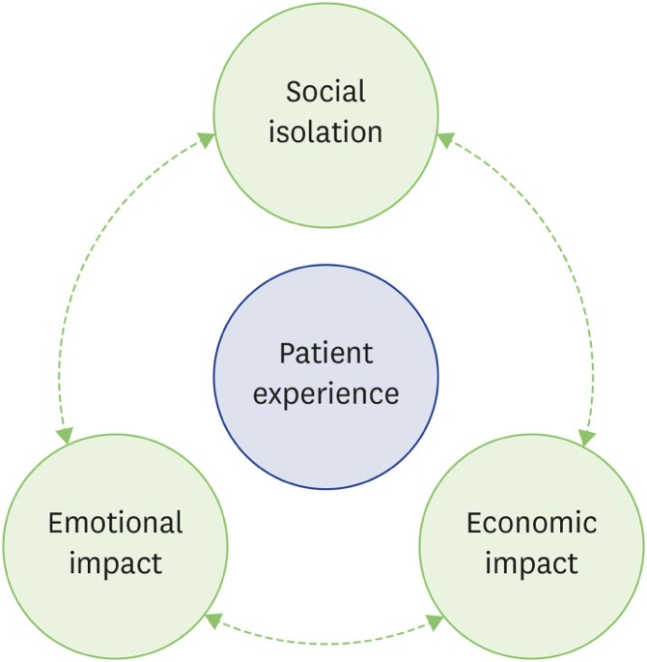
The Patient Experience
Median Cough Duration: 8 weeks to 10 years
Patients’ symptoms and the impact they face are minimized
Stuck in the system
Most patients see 10 or more specialists to get relief
Social isolation, economic impact, and emotional impact of the diagnoses
Patients are unable to comfortably attend social outings (i.e., going to the movie theater)
Social awkwardness from going to work with a cough (especially during the COVID-19 pandemic)

Slide 4
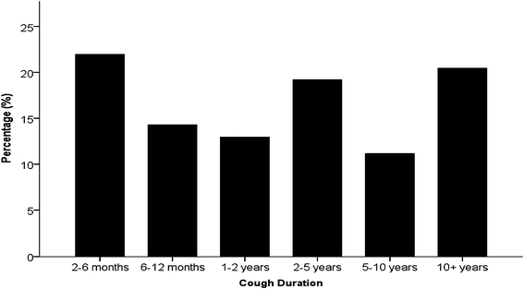
Time to Formal Diagnosis
Primary Care Providers handle cough as a primary complaint
Assumption that a certain course of medication “fixes” the cough without follow-up
Sometimes patients see up to 10 specialists for chronic cough resolution
Patients are referred to a gynecologist for secondary concerns like stress incontinence
Importance not overtesting
Avoid patient fatigue
Consider psychosocial and time impacts

Slide 5
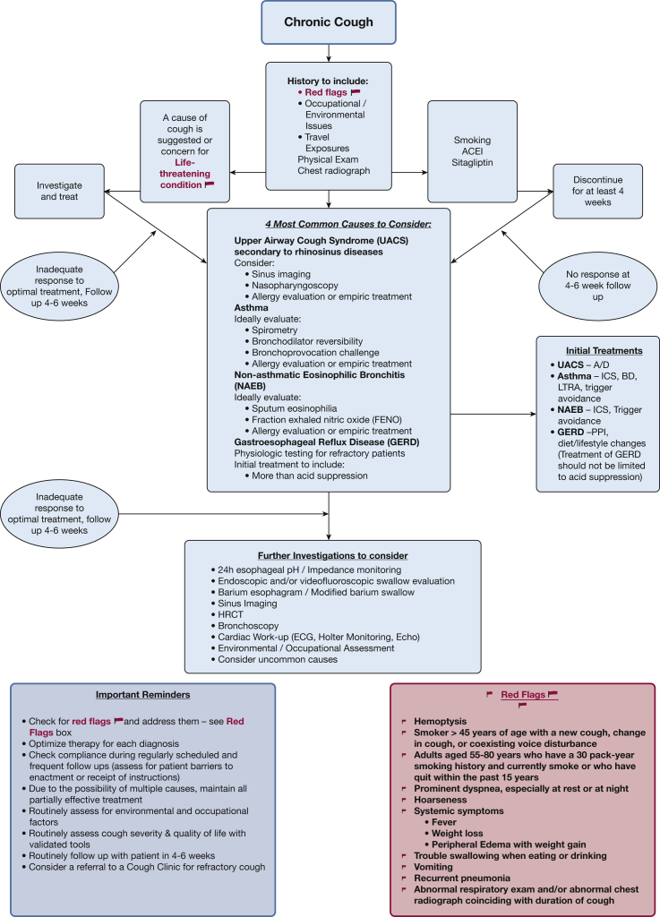
Chronic Cough CHEST Guidelines

Slide 6
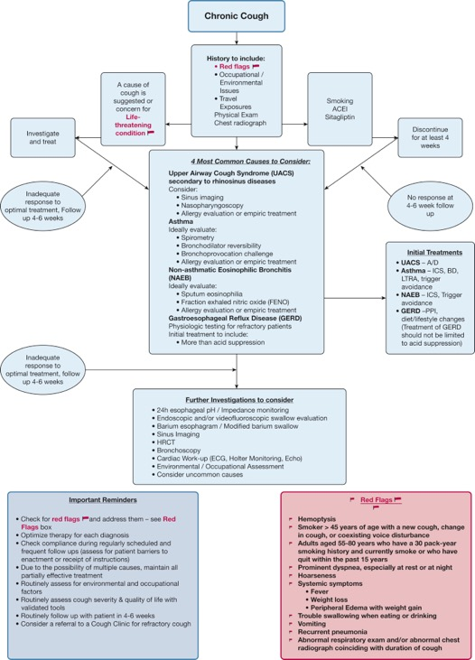
Chronic Cough CHEST Guidelines
Chronic Cough
History to include:
Red Flags
Occupational / Environmental Issues
Travel Exposures
Physical Exam
Chest radiograph
A cause of
cough is
suggested or
Concern for
Life-
threatening
condition
Smoking
ACEI
Sitagliptin
Investigate
and treat
Discontinue
For at least 4
weeks

Slide 7
Chronic Cough CHEST Guidelines
4 Most Common Causes to Consider:
Upper Airway Cough Syndrome (UACS)
Secondary to rhinosinus diseases
Consider:
Sinus imaging
Nasopharyngoscopy
Allergy evaluation or empiric treatment
Asthma
Ideally evaluate Spirometry
Bronchodilator reversibility
Bronchoprovocation challenge
Allergy evaluation or empiric treatment
Non-asthmatic Eosinophilic Bronchitis
(NAEB)
Ideally evaluate:
Sputum eosinophilia
Fraction exhaled nitric oxide (FENO)
Allergy evaluation or empiric treatment
Gastroesophageal Reflux Disease (GERD)
Physiologic testing for refractory patients
Initial treatment to include:
More than acid suppresion
Initial Treatments
UACS – A/D
Asthma – ICS, BD,
LTRA, Trigger avoidance
NAEB – ICS, Trigger avoidance
GERD – PPI,
Dies/lifestyle changes
(Treatment of GERD
should not be limited
to acid suppression)

Slide 8
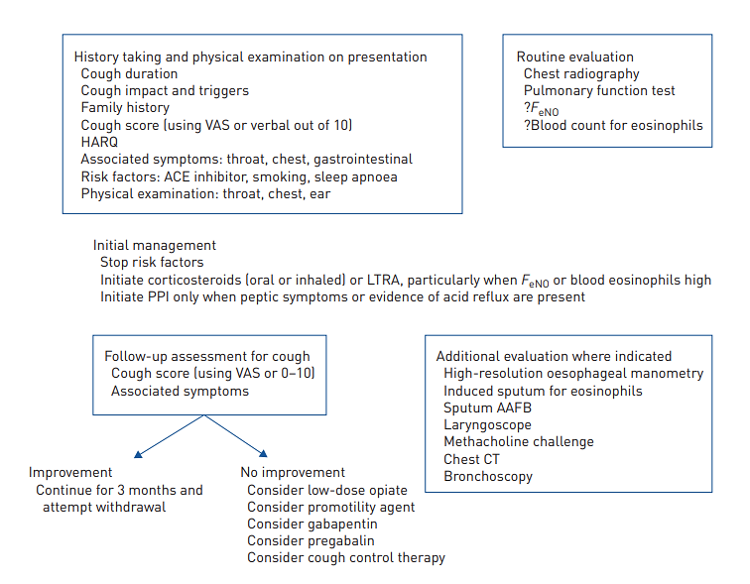
Process Timeline for Chronic Cough

Slide 9
Steps in Chronic Cough Management
Initial clinical evaluation
Checking for warning signs
Environmental and occupational assessment
Drugs intake (ACE inhibitor)
Most frequent causes assessment and treatment
Asthma and cough-variant asthma
Non-asthmatic eosinophilic bronchitis
Gastroesophageal reflux disease
Upper airway cough syndrome
Consider other causes in case of inadequate response to treatment
Non-asthmatic pulmonary diseases
Obstructive sleep apnea
Cardiac arrythmias
Somatic cough syndrome
Consider refractory chronic cough

