Slide 1
Understanding the Etiology and Pathophysiology of Chronic Cough and its Impact on Patient’s Quality of Life
Peter Dicpinigaitis, MD
Professor of Medicine, Albert Einstein College of Medicine
Director, Cough Center, Montefiore Medical Center
Bronx, NY

Slide 2
Disclaimer
The views and opinions expressed in this educational activity are those of the faculty and do not necessarily represent the views of TotalCME, Inc., the CME providers, or the companies providing educational grants. This presentation is not intended to define an exclusive course of patient management; the participant should use their clinical judgment, knowledge, experience, and diagnostic skills in applying or adopting for professional use any of the information provided herein. Any procedures, medications, or other courses of diagnosis or treatment discussed or suggested in this activity should not be used by clinicians without evaluation of their patient's conditions and possible contraindications or dangers in use, review of any applicable manufacturer’s product information, and comparison with recommendations of other authorities. Links to other sites may be provided as additional sources of information.

Slide 3
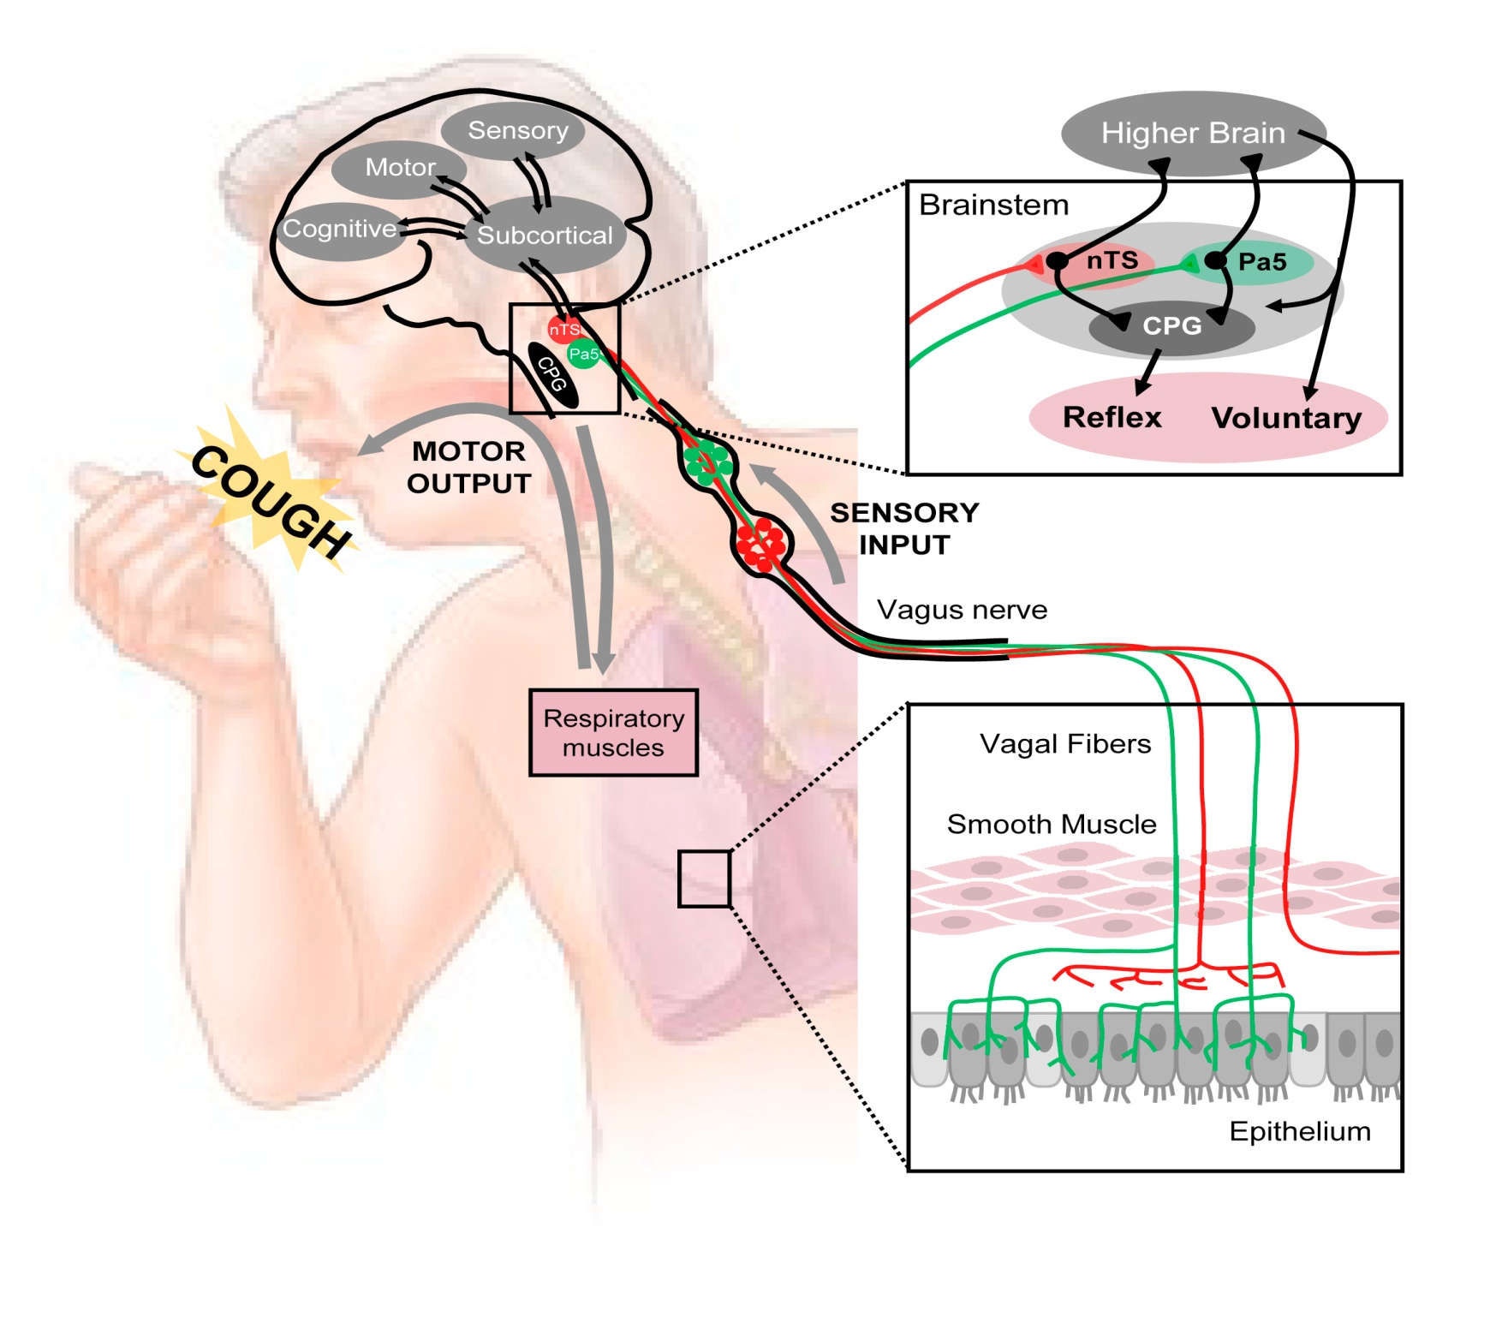

Slide 4
Etiologies of Chronic Cough
Nonsmoker; not on ACE inhibitor; normal/stable CXR
Upper Airway Cough Syndrome (PNDS, rhinitis)
Asthma
GERD (LPR)
Non-asthmatic eosinophilic bronchitis

Slide 5
Treatment of Chronic Cough Diagnostic-Therapeutic Trials
Upper Airway Cough Syndrome; PNDS; rhinitis
Oral 1st generation antihistamine
Inhaled corticosteroids
Inhaled ipratropium
Asthma; non-asthmatic eosinophilic bronchitis
Oral steroids
Inhaled steroids
LTRAs
GERD (acid- and non-acid; liquid/gaseous components)
Acid-suppression therapy (high-dose PPI)
Anti-reflux lifestyle measures
Pro-kinetic agent (metoclopramide)

Slide 6
Refractory Chronic Cough (RCC)
Chronic cough that persists despite appropriate therapeutic trials for UACS/PNDS, asthma/NAEB, and GERD

Slide 7
Refractory Chronic Cough Can Have a Tremendous Effect on Quality of Life
Anxiety
Depression
Physical Discomfort
Chest/throat discomfort
Interference with sleep
Urinary incontinence (in women)

Slide 8
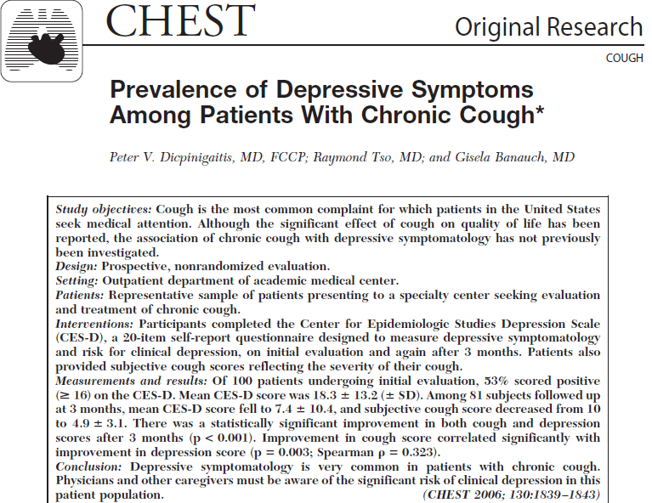

Slide 9
Of 100 patients undergoing initial evaluation, 53% scored positive
(≥ 16) on the CES-D. Mean CES-D score was 18.8 ± 13.2 (± SD)

Slide 10

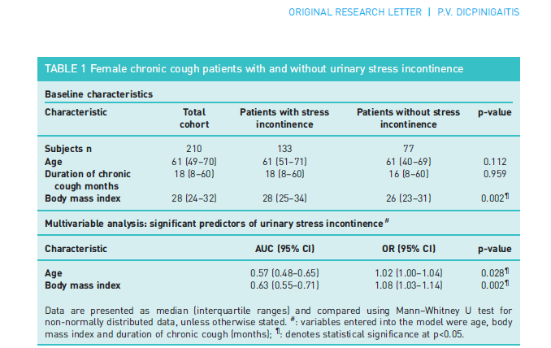

Slide 11
Conclusion
Chronic cough is a common symptom that may be treated after identifying reversible causes
RCC persists despite all appropriate therapeutic trials
RCC can take a tremendous toll in terms of quality of life not only for the patient, but also for spouses, family members, and co-workers

