Slide 1





Saturday, September 9, 2023
9:00am – 3:00pm PT
UCLA Covel Commons | Los Angeles, CA
This activity is supported by independent educational grants from Actelion Pharmaceuticals US, Division of Janssen Pharmaceuticals and United Therapeutics Corporation.
Jointly provided by the Global Learning Collaborative (GLC) and Total CME, LLC.

Slide 2



Resource Information
About This Resource
These slides are one component of a continuing education program available online at MedEd On The Go titled West Regional Pulmonary Hypertension Summit – A Case-Based Look At Diagnosis and Treatment
Program Learning Objectives:
Review essentials of the updated ERS/ESC diagnostic and treatment guidelines and emerging medical entities for treatment
Discuss current concepts on diagnosis and treatment of CTEPH and CTED with a real-world focus
Debate the importance and practice of screening for, diagnosing, and treating PAH associated with connective tissue disease
Learn the essentials of cardiopulmonary exercise testing for the detection and diagnosis of pulmonary hypertension
Consider lessons from the symposium in light of real-world case examples
MedEd On The Go®
www.mededonthego.com
This content or portions thereof may not be published, posted online or used in presentations without permission.
This content can be saved for personal use (non-commercial use only) with credit given to the resource authors.
To contact us regarding inaccuracies, omissions or permissions please email us at support@MedEdOTG.com

Slide 3
Disclaimer
The views and opinions expressed in this educational activity are those of the faculty and do not necessarily represent the views of Total CME, LLC, the CME providers, or the companies providing educational grants. This presentation is not intended to define an exclusive course of patient management; the participant should use their clinical judgment, knowledge, experience, and diagnostic skills in applying or adopting for professional use any of the information provided herein. Any procedures, medications, or other courses of diagnosis or treatment discussed or suggested in this activity should not be used by clinicians without evaluation of their patient's conditions and possible contraindications or dangers in use, review of any applicable manufacturer’s product information, and comparison with recommendations of other authorities. Links to other sites may be provided as additional sources of information.

Slide 4
Cardiopulmonary Exercise Testing in Pulmonary Arterial Hypertension – Part II
VIDEO DEMO:
Christopher Cooper, MD, PhD
David Geffen School of Medicine, UCLA
Los Angeles, CA
Alex Sherman, MD
David Geffen School of Medicine, UCLA
Los Angeles, CA

Slide 5
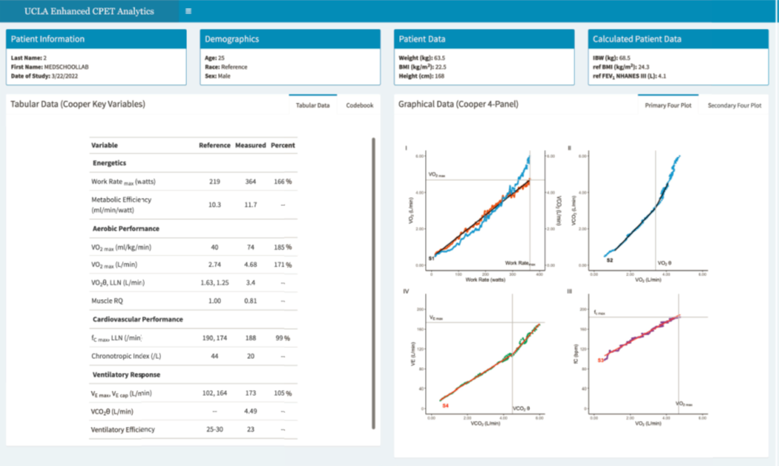
Enhanced Cardiopulmonary Exercise Test Analysis ©
Based on identifying 10 key variables and creating 4 key plots
Provides short or extended tabular reports
Utilizes innovative algorithms and detection tools
Displays key data in an understandable 4-panel format
Facilitates rapid clinical interpretation
Generates customized institutional reports
Supports multiple languages

Slide 6
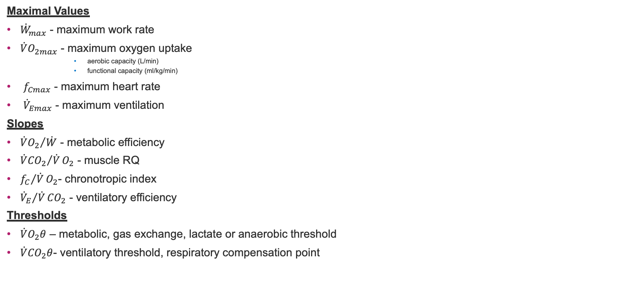
Key Variables of the Response to Incremental Exercise
Those that are essential include 4 maximum values, 4 slopes and 2 thresholds
Maximal Values
${\dot{W}}_{max}$ - maximum work rate
${\dot{V}O}_{2max}$ - maximum oxygen uptake
  aerobic capacity (L/min)
  functional capacity (ml/kg/min)
$f_{Cmax}$ - maximum heart rate
${\dot{V}}_{Emax}$ - maximum ventilation
Slopes
${\dot{V}O_{2}}/{\dot{W}}$ - metabolic efficiency
${\dot{V}{CO}_{2}}/{\dot{V}}O_{2}$ - muscle RQ
${f_{C}}/{\dot{V}}O_{2}$- chronotropic index
${{\dot{V}}_{E}}/{\dot{V}}{CO}_{2}$ - ventilatory efficiency
Thresholds
$\dot{V}O_{2}θ$ – metabolic, gas exchange, lactate or anaerobic threshold
$\dot{V}{CO}_{2}θ$- ventilatory threshold, respiratory compensation point

Slide 7
Stepwise Approach for Interpretation of Graphical Data
Step 1: Evaluate the test protocol and the energetic response
© UCLA Technology Development Group 2023

Slide 8
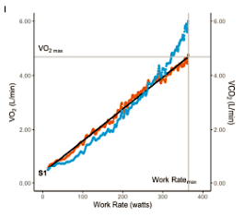
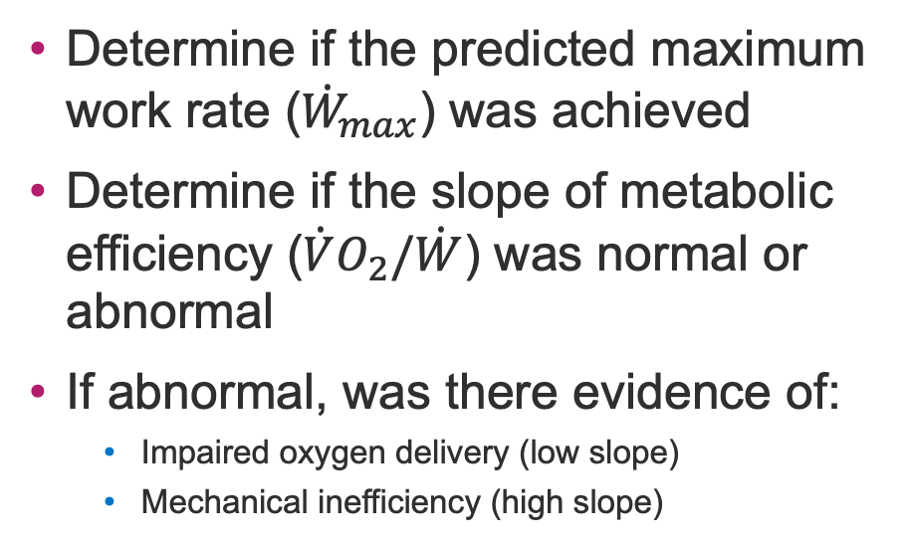
Step 1: Evaluate the Test Protocol and Energetic Response
Plot 1: Variables: ${\dot{W}}_{max}$and $\dot{V}O_{2}/\dot{W}$
Determine if the predicted maximum work rate (${\dot{W}}_{max}$) was achieved
Determine if the slope of metabolic efficiency ($\dot{V}O_{2}/\dot{W}$) was normal or abnormal
If abnormal, was there evidence of:
  Impaired oxygen delivery (low slope)
  Mechanical inefficiency (high slope)

Slide 9
Stepwise Approach for Interpretation of Graphical Data
Step 2: Evaluate aerobic performance
© UCLA Technology Development Group 2023

Slide 10
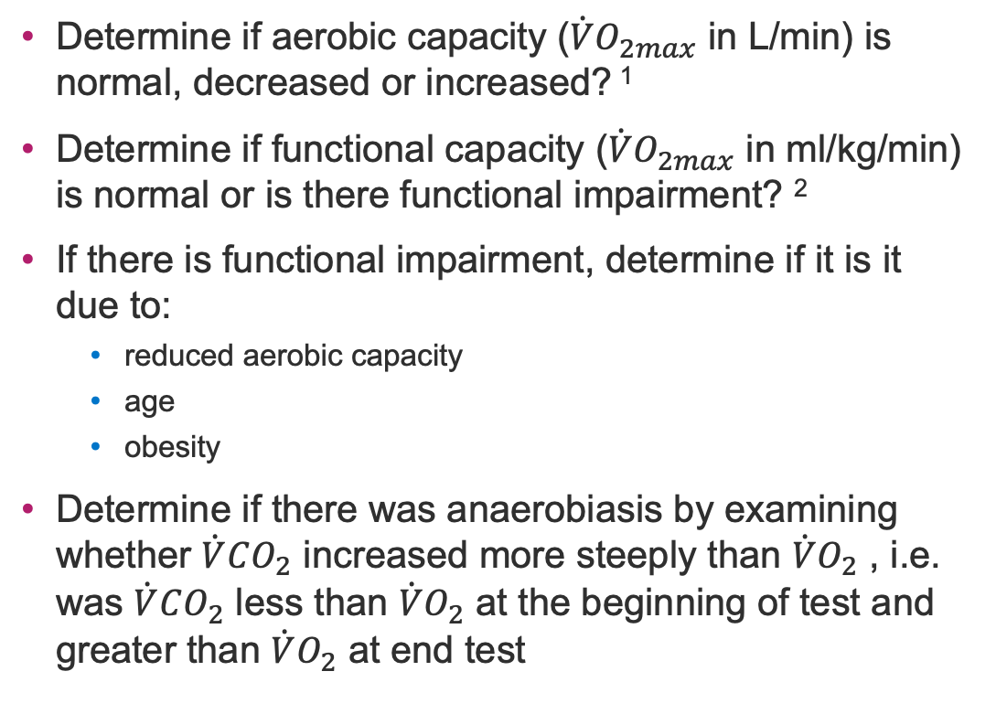
Step 2: Evaluate Aerobic Performance
Plot 1: Variables $\dot{V}O_{2max}$ $, \dot{V}O_{2} and$ $\dot{V}CO_{2}$
Determine if aerobic capacity ($\dot{V}O_{2max}$ in L/min) is normal, decreased or increased? ¹
Determine if functional capacity ($\dot{V}O_{2max}$ in ml/kg/min) is normal or is there functional impairment? ²
If there is functional impairment, determine if it is it due to:
  reduced aerobic capacity
  age
  obesity
Determine if there was anaerobiasis by examining whether $\dot{V}CO_{2}$ increased more steeply than $\dot{V}O_{2}$ , i.e. was $\dot{V}CO_{2}$ less than $\dot{V}O_{2}$ at the beginning of test and greater than $\dot{V}O_{2}$ at end test

Slide 11
Stepwise Approach for Interpretation of Graphical Data
Step 3: Evaluate anaerobic metabolism
© UCLA Technology Development Group 2023

Slide 12
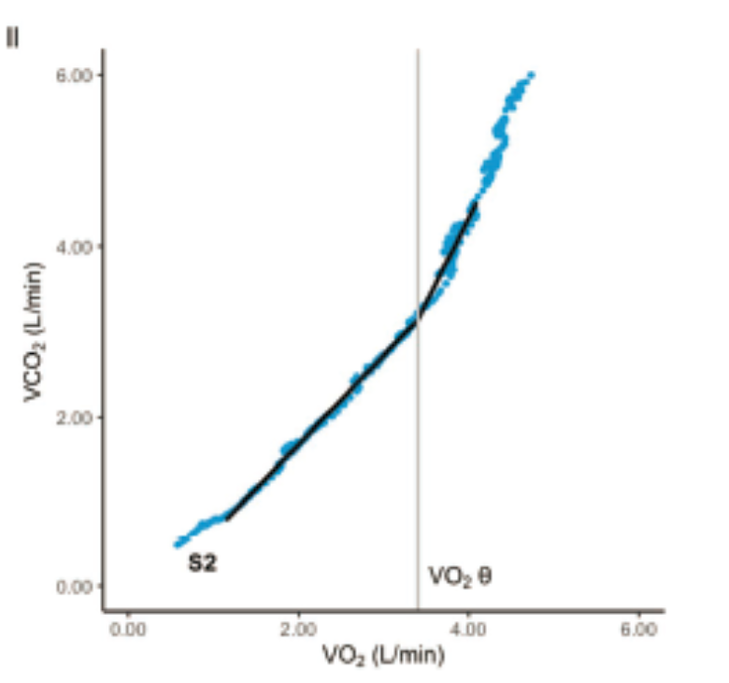
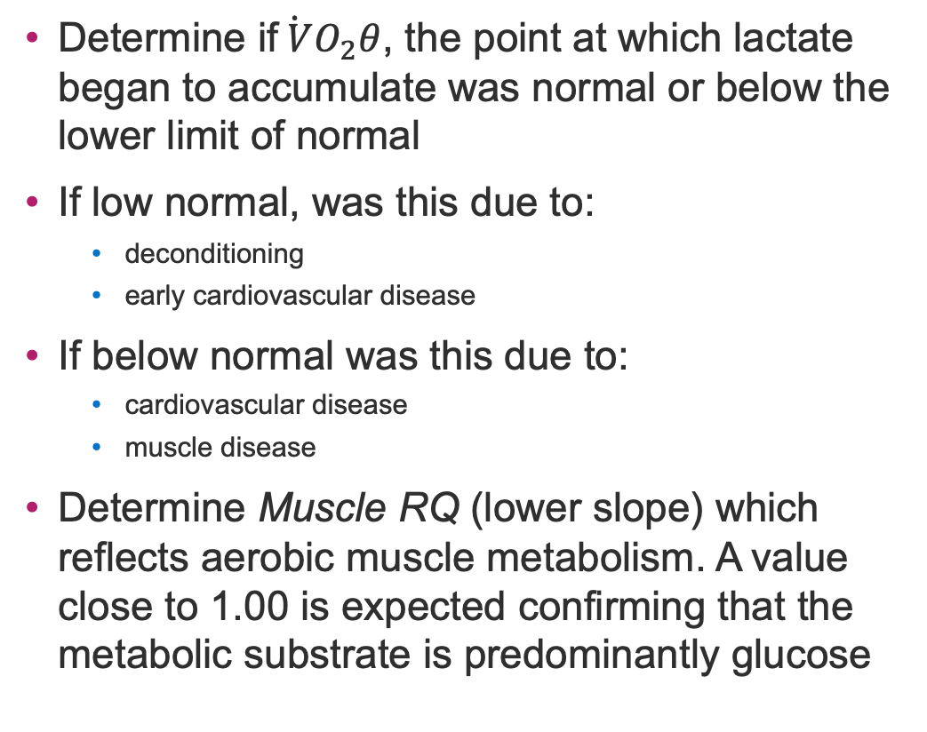
Step 3: Evaluate Anaerobic Metabolism
Plot 2: Variable $\dot{V}O_{2}θ and Muscle RQ$
Determine if$\dot{ V}O_{2}θ$, the point at which lactate began to accumulate was normal or below the lower limit of normal
If low normal, was this due to:
  deconditioning
  early cardiovascular disease
If below normal was this due to:
  cardiovascular disease
  muscle disease
Determine Muscle RQ (lower slope) which reflects aerobic muscle metabolism. A value close to 1.00 is expected confirming that the metabolic substrate is predominantly glucose

Slide 13
Stepwise Approach for Interpretation of Graphical Data
Step 4: Evaluate the ventilatory response
© UCLA Technology Development Group 2023

Slide 14
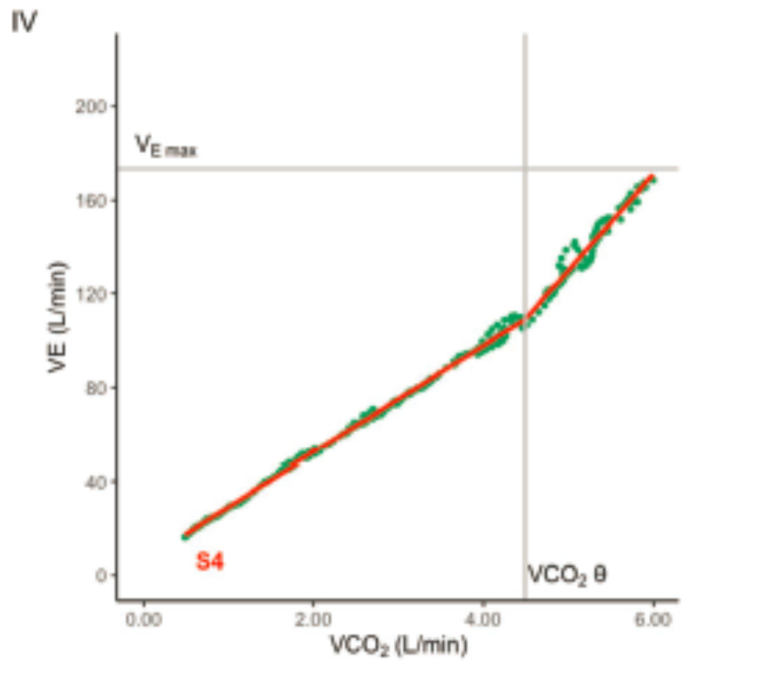
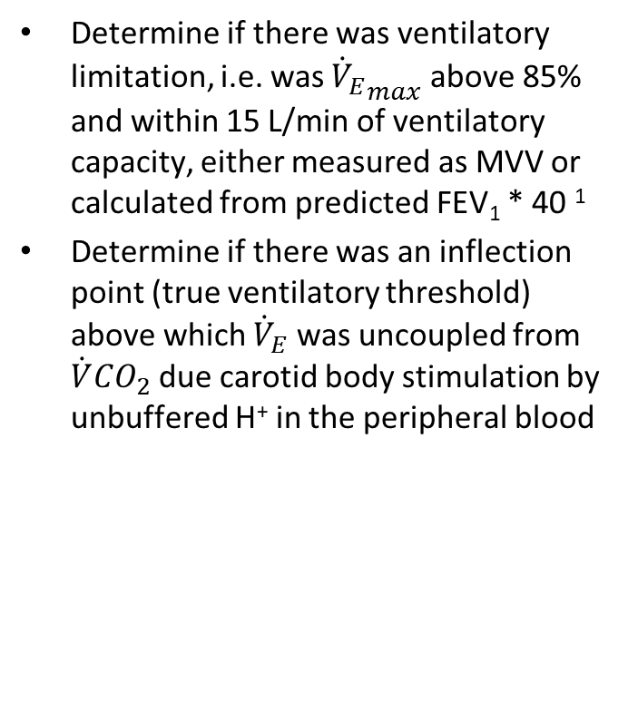
Step 4: Evaluate the ventilatory response
Plot 4: Variables VE (slope) and $\dot{V}CO_{2}θ$
Determine if there was ventilatory limitation, i.e. was ${{\dot{V}}_{E}}_{max}$ above 85% and within 15 L/min of ventilatory capacity, either measured as MVV or calculated from predicted FEV₁ * 40 ¹
Determine if there was an inflection point (true ventilatory threshold) above which ${\dot{V}}_{E}$ was uncoupled from $\dot{V}{CO}_{2}$ due carotid body stimulation by unbuffered H⁺ in the peripheral blood
Cooper CB, Storer TW. Exercise testing and interpretation. A practical approach. Cambridge University Press, 2001.

Slide 15
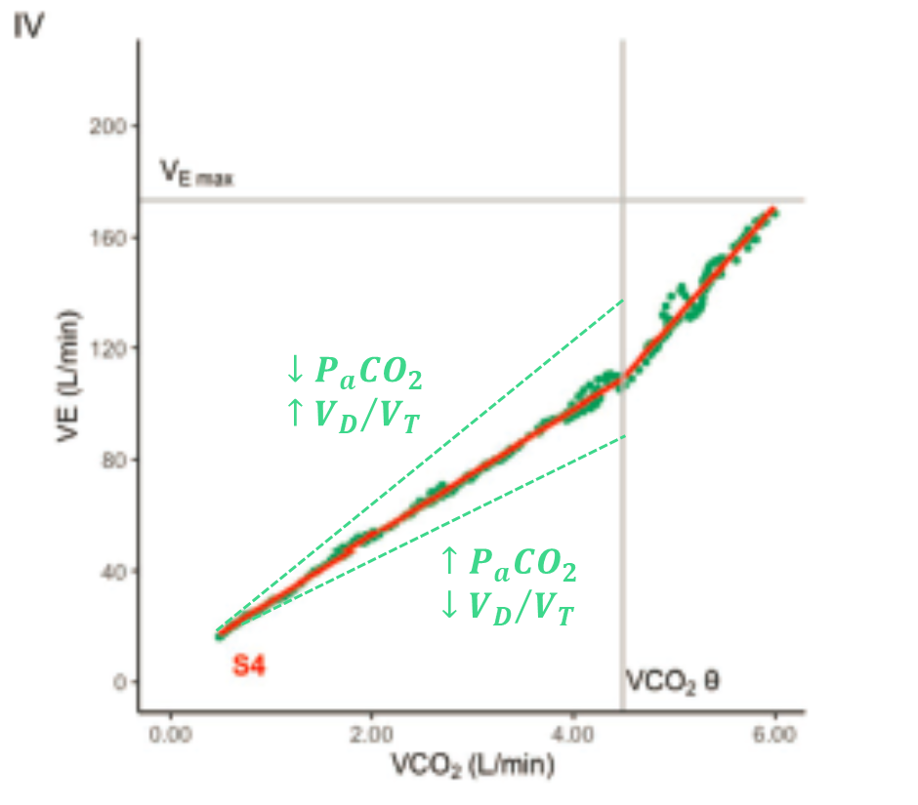
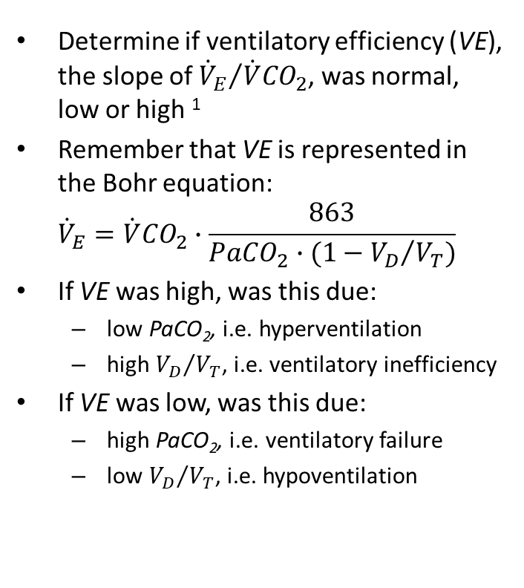
Step 4: Evaluate the ventilatory response
Plot 4: Variables VE (slope), PaCO₂ and VD/VT
Determine if ventilatory efficiency (VE), the slope of ${{\dot{V}}_{E}}/{\dot{V}{CO}_{2}}$, was normal, low or high ¹
Remember that VE is represented in the Bohr equation:
${\dot{V}}_{E}=\dot{V}{CO}_{2}∙\frac{863}{PaCO_{2}∙(1−{V_{D}}/{V_{T})}}$
If VE was high, was this due:
  low PaCO₂, i.e. hyperventilation
  high ${V_{D}}/{V_{T}}$, i.e. ventilatory inefficiency
If VE was low, was this due:
  high PaCO₂, i.e. ventilatory failure
  low ${V_{D}}/{V_{T}}$, i.e. hypoventilation
Cooper CB, Storer TW. Exercise testing and interpretation. A practical approach. Cambridge University Press, 2001.

Slide 16
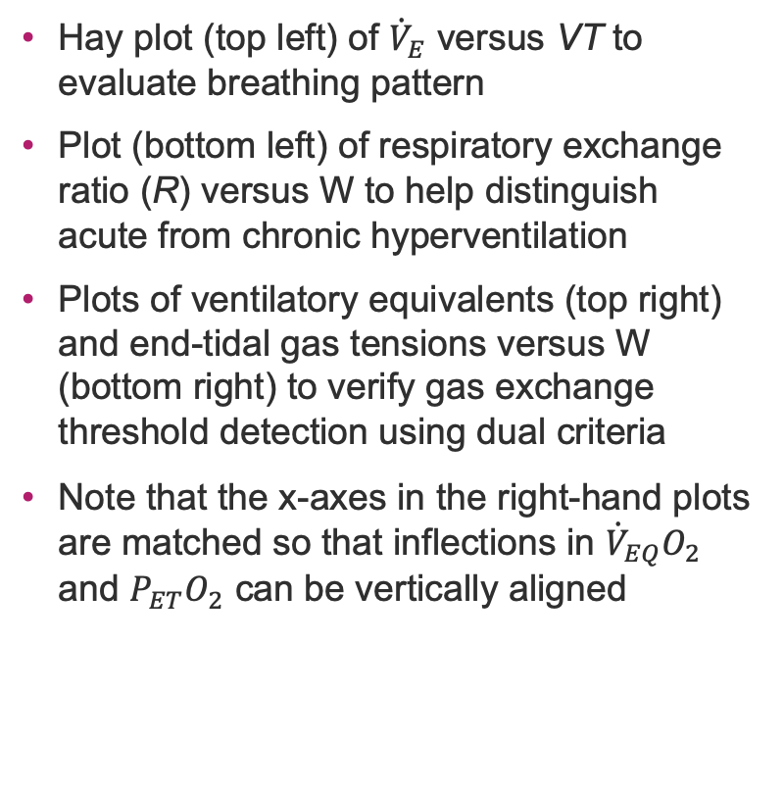
Supplementary Breathing Pattern and Gas Exchange Plots
Shows breathing pattern, gas exchange and allows threshold verification
Hay plot (top left) of ${\dot{V}}_{E}$ versus VT to evaluate breathing pattern
Plot (bottom left) of respiratory exchange ratio (R) versus W to help distinguish acute from chronic hyperventilation
Plots of ventilatory equivalents (top right) and end-tidal gas tensions versus W (bottom right) to verify gas exchange threshold detection using dual criteria
Note that the x-axes in the right-hand plots are matched so that inflections in ${\dot{V}}_{EQ}O_{2}$ and ${P_{ET}O}_{2}$ can be vertically aligned

Slide 17
Stepwise Approach for Interpretation of Graphical Data
Step 5: Evaluate the Cardiovascular Response
© UCLA Technology Development Group 2023

Slide 18
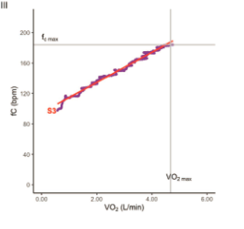

Step 5: Evaluate the Cardiovascular Response
Plot 3: Variables $fC_{max}$ and $\dot{V}O_{2max}$
Determine if there was cardiovascular limitation, i.e. was $fC_{max}$ greater than the lower limit of normal, i.e. within 16/min of the age-predicted maximum heart rate

Slide 19
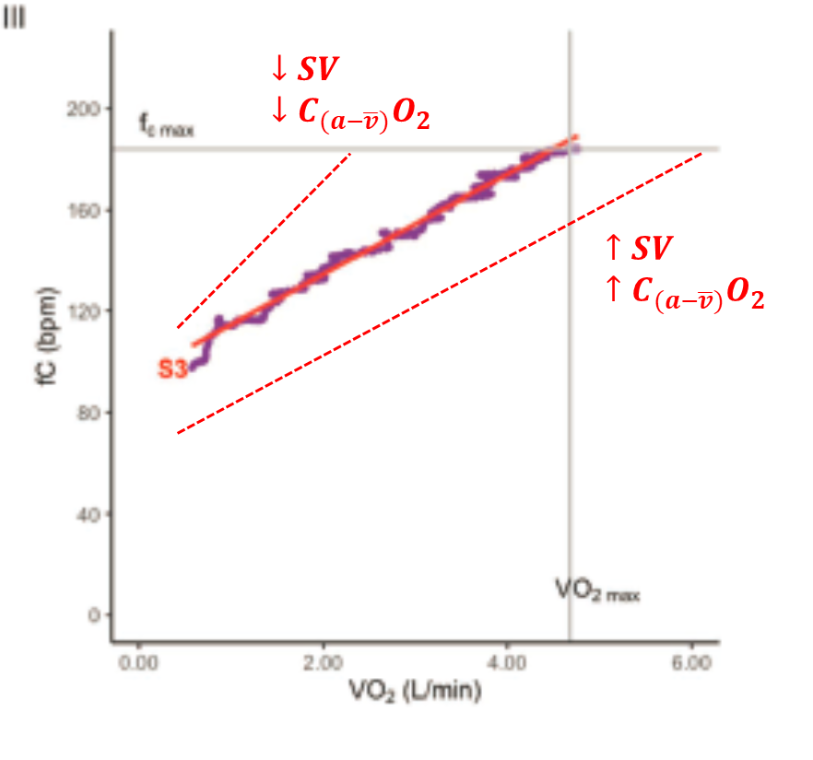
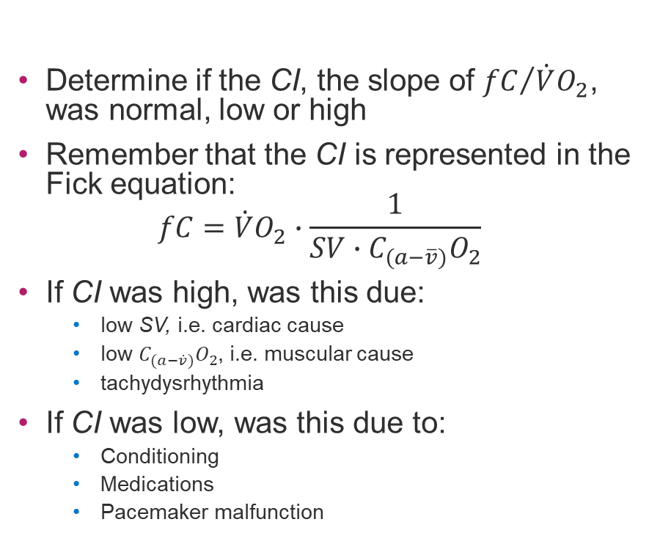
Step 5: Evaluate the Cardiovascular Response
Plot 3: Variables CI (slope), SV and $C_{(a−\overline{v})}O_{2}$
Determine if the CI, the slope of ${fC}/{\dot{V}O_{2}}$, was normal, low or high
Remember that the CI is represented in the Fick equation:
$fC=\dot{V}O_{2}∙\frac{1}{SV∙C_{(a−\overline{v})}O_{2}}$
If CI was high, was this due:
  low SV, i.e. cardiac cause
  low $C_{(a−\dot{v})}O_{2}$, i.e. muscular cause
  tachydysrhythmia
If CI was low, was this due to:
  Conditioning
  Medications
  Pacemaker malfunction
CI, chronotropic index.

Slide 20
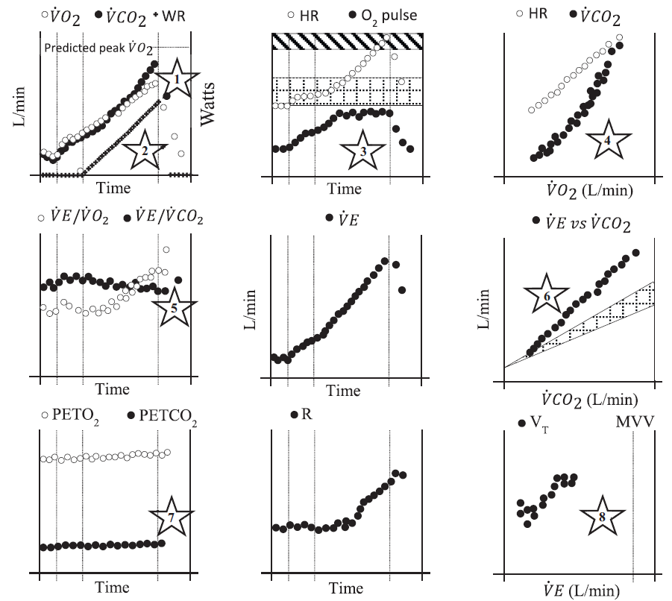
Identifying PAH on CPET
Classic findings of pulmonary vascular disease on CPET
Reduced peak VO2
Reduced VO2/WR slope
Early metabolic threshold
Early plateau and low peak oxygen pulse
High chronotropic index
High VE/VCO2 slope, high nadir VE/VCO2
Arterial hypoxemia with high A-a gradient
High deadspace fraction
Low PETCO2 at metabolic threshold, typically < 3 mmHg higher than rest (or possibly lower)
No pulmonary mechanical limitation (ie high breathing reserve)
Sherman AE, Saggar R. Cardiopulmonary Exercise Testing in Pulmonary Arterial Hypertension. Heart Fail Clin. 2023 Jan; 19(1):35-43. doi: 10.1016/j.hfc.2022.08.015. PMID 36435571

Slide 21
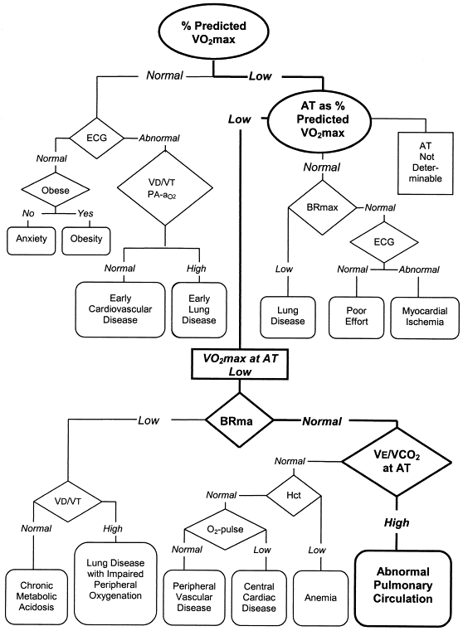
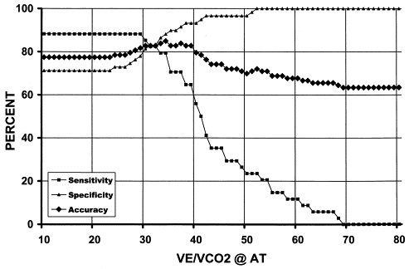
CPET in Diagnosis
CPET can identify pulmonary vascular limitations to exercise
Low peak VO₂ - (58%)
Low AT as % predicted peak VO₂ – (38%)
Normal breathing reserve – (8L/min)
High VE/VCO₂ at AT – (34)
88% specific, 85% accurate

Slide 22
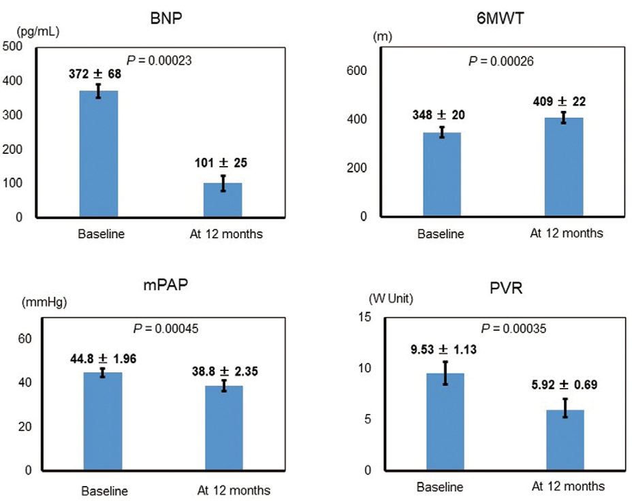
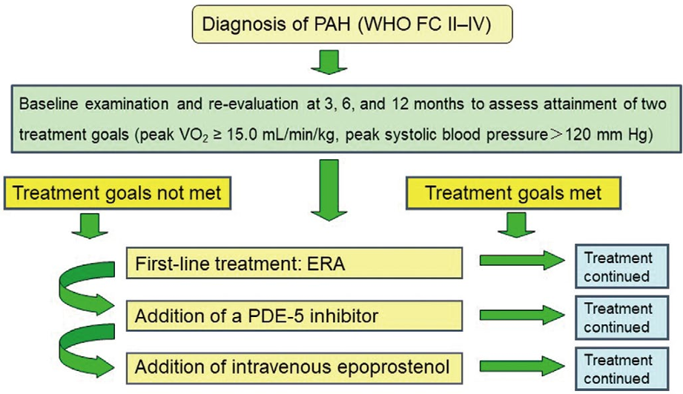
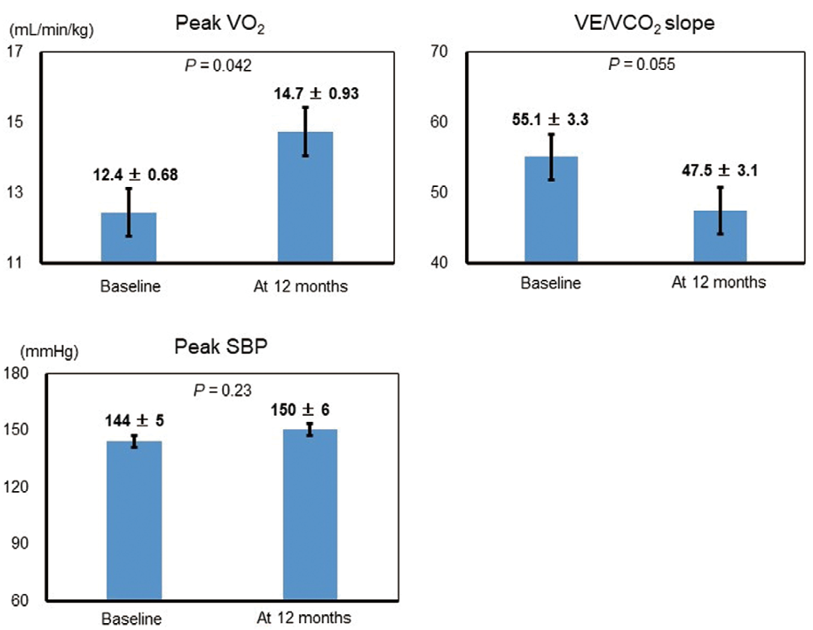
CPET in PAH Treatment Response
GOODEYE Trial
42 newly diagnosed PAH patients
Exercise capacity and hemodynamics were improved in CPET-guided therapy group and survival trended towards improvement
Hirashiki A, et al. Circ Rep. 2019; 1(7):303-11.

Slide 23
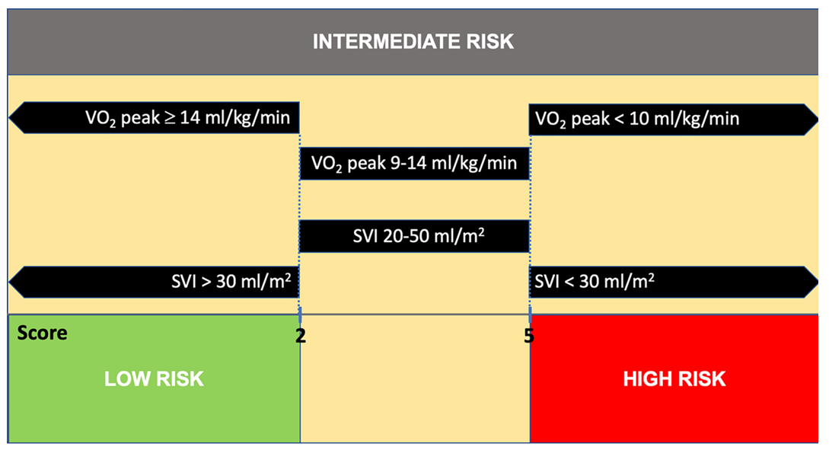
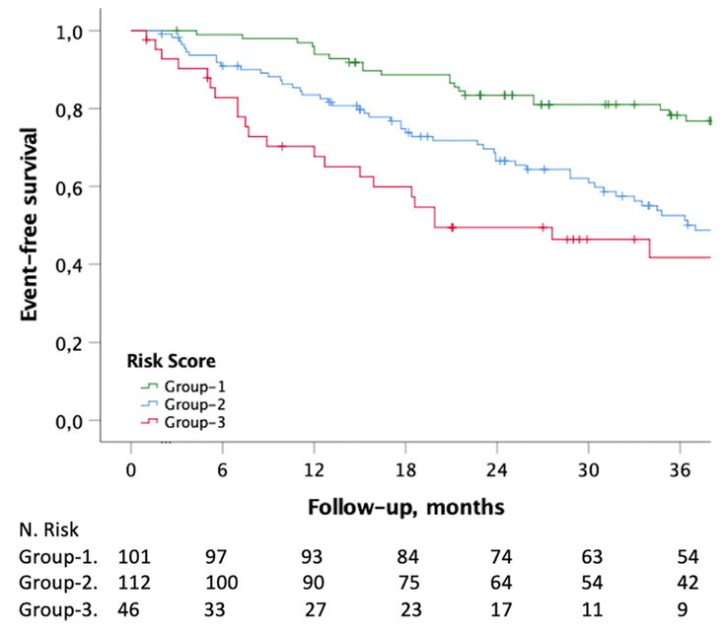
CPET in Prognosis
Low peak VO₂ (<10.4 mL/kg/min) and peak systolic BP less than 120 mmHg have poorer 12-month survival
Intermediate risk PAH patients may be further risk-stratified by VO₂ and stroke volume index
Wensel R, et al. Circulation. 2002; 106(3):319-24; Badagliacca R, et al. J Heart Lung Transplant. 2022; 41(6):780-90.

Slide 24
Summary
What we have reviewed
An enhanced report showing a table of 10 key variables compared with their reference values
A 4-panel graphical display showing the derivations of those 10 key variables
A stepwise approach to interpretation using the 4-panel display including
  Energetic response
  Aerobic response
  Anaerobic metabolism
  Cardiovascular response
  Ventilatory response
Utility of CPET in aiding diagnosis, treatment response, and prognosis in pulmonary arterial hypertension

Slide 25



Looking for more resources
on this topic?
CME/CE in minutes
Congress highlights
Late-breaking data
Quizzes
Webinars
In-person events
Slides & resources
www.MedEdOTG.com

