Slide 1




Saturday, September 9, 2023
9:00am – 3:00pm PT
UCLA Covel Commons | Los Angeles, CA
This activity is supported by independent educational grants from Actelion Pharmaceuticals US, Division of Janssen Pharmaceuticals and United Therapeutics Corporation.
Jointly provided by the Global Learning Collaborative (GLC) and Total CME, LLC.

Slide 2



Resource Information
About This Resource
These slides are one component of a continuing education program available online at MedEd On The Go titled West Regional Pulmonary Hypertension Summit – A Case-Based Look At Diagnosis and Treatment
Program Learning Objectives:
Review essentials of the updated ERS/ESC diagnostic and treatment guidelines and emerging medical entities for treatment
Discuss current concepts on diagnosis and treatment of CTEPH and CTED with a real-world focus
Debate the importance and practice of screening for, diagnosing, and treating PAH associated with connective tissue disease
Learn the essentials of cardiopulmonary exercise testing for the detection and diagnosis of pulmonary hypertension
Consider lessons from the symposium in light of real-world case examples
MedEd On The Go®
www.mededonthego.com
This content or portions thereof may not be published, posted online or used in presentations without permission.
This content can be saved for personal use (non-commercial use only) with credit given to the resource authors.
To contact us regarding inaccuracies, omissions or permissions please email us at support@MedEdOTG.com

Slide 3
Disclaimer
The views and opinions expressed in this educational activity are those of the faculty and do not necessarily represent the views of Total CME, LLC, the CME providers, or the companies providing educational grants. This presentation is not intended to define an exclusive course of patient management; the participant should use their clinical judgment, knowledge, experience, and diagnostic skills in applying or adopting for professional use any of the information provided herein. Any procedures, medications, or other courses of diagnosis or treatment discussed or suggested in this activity should not be used by clinicians without evaluation of their patient's conditions and possible contraindications or dangers in use, review of any applicable manufacturer’s product information, and comparison with recommendations of other authorities. Links to other sites may be provided as additional sources of information.

Slide 4

Link Between Parenchymal Lung Disease and PH
Rajan Saggar, MD
David Geffen School of Medicine, UCLA
Los Angeles, CA

Slide 5
Group 3 PH
Definition Precapillary PH
mPAP >20 mmHg
PAWP <15 mmHg
PVR >2 Wood Units
Humbert M, et al. Eur Respir J. 2022; in press: 2200879

Slide 6
Discussion Points
Background of PH complicating COPD and PF
  Clinical predictors of PH complicating PF: How should Group 3 PH be targeted for therapy?
Pulmonary vascular pathology in PF
Gas exchange in PF, PH, and PF-PH
Group 3 PH circulatory limitation signature and registry data
Clinical phenotype for PAH-targeted therapy moving forward in PF-PH and therapeutics
PF, pulmonary fibrosis.

Slide 7
Discussion Points
Background of PH complicating COPD and PF
  Clinical predictors of PH complicating PF: How should Group 3 PH be targeted for therapy?
Pulmonary vascular pathology in PF
Gas exchange in PF, PH, and PF-PH
Definition of Group 3 PH (heterogeneity)
Clinical phenotype for PAH-targeted therapy moving forward in PF-PH and therapeutics

Slide 8
COPD and Pulmonary Hypertension:
COPD-PH is Slow to Evolve and Rarely Severe
Slow ‘natural history’ of progression of PH in moderate COPD
  mean ∆ 0.4mmHg/year in mPAP; 25% developed PH over an average 5-year period
  mean ∆ 0.65mmHg/year (no PH group); ∆ 0.39mmHg/year (+PH group) over average 7 to 8-year period
Mild to moderate PH in severe COPD
  mPAP 26.3+5.2mmHg for cohort
      mPAP 20 to 35 (86%); mPAP greater than 35mmHg (5%)
  elevated PAWP (14.1+4.7mmHg)
  No ventricular interdependence; O2 delivery not compromised with PH; and no correlation of lung volume with mPAP, RAP, or PAWP
Kessler R, et al. Am J Respir Crit Care. 2001; 164(2):219-24;
Weitzenblum E, et al. Am Rev Respir Dis. 1984; 130(6):993-98;
Scharf SM, et al. Am J Respir Crit Care. 2002;166(3):314-22.

Slide 9
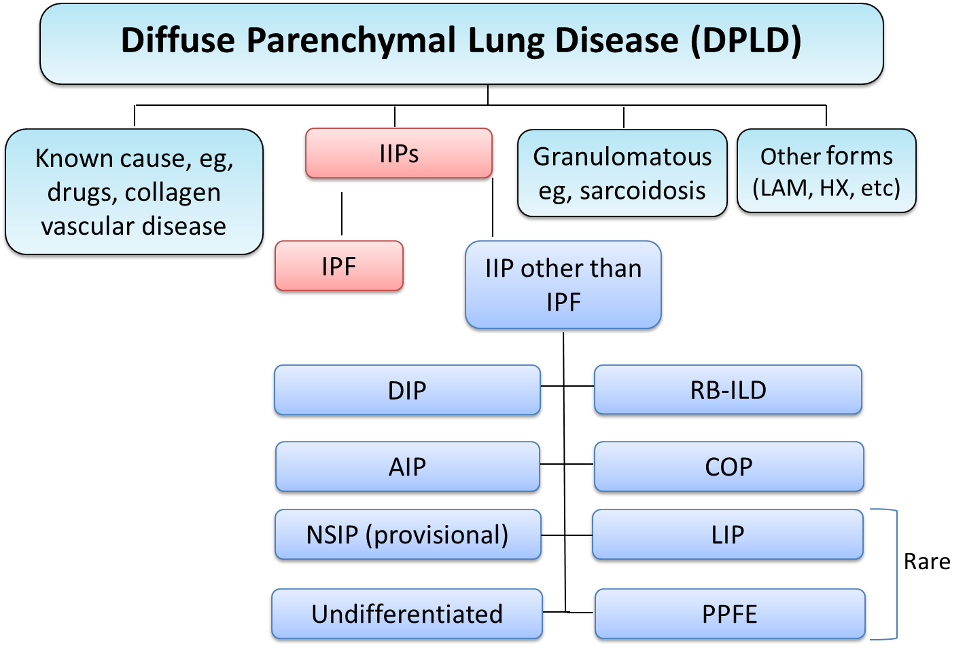
Interstitial Lung Disease is Heterogeneous:
Etiology, Natural History, Risk for PH and the Subsequent Natural History of that PH
Determined by MDD (pulmonary, pathology, radiology)
IPAF
Usually Excluded
From PF-PH trials
Usually Excluded from PF-PH trials
Most common IIP (47-71%)
CPFE ??
Second most common IIP(13-48%)
Travis WD, et al. Respir Crit Care Med. 2013; 188(6):733-48.
AIP, acute interstitial pneumonia; COP, cryptogenic organizing pneumonia; DIP, desquamative interstitial pneumonia; IIP, idiopathic interstitial pneumonias; IPAF, interstitial pneumonia with autoimmune features; IPF, idiopathic pulmonary fibrosis; LIP, lymphocytic interstitial pneumonia; NISP, non-specific interstitial pneumonia; PPFE, pleuro-parenchymal fibro-elastosis; RBILD, respiratory bronchiolitis interstitial lung disease.

Slide 10
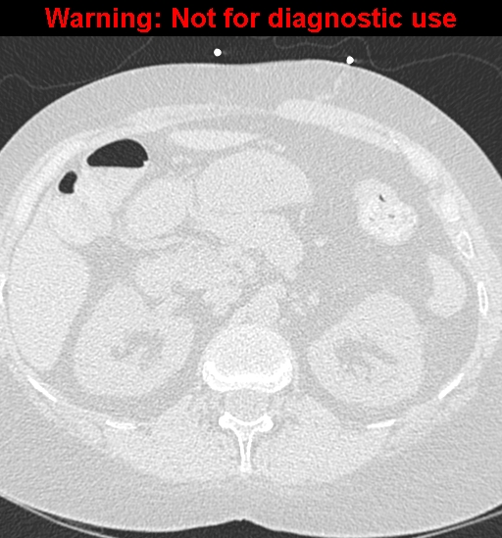
Patient “BP”
Can you predict PH from the imaging?
(PAP 30/13/19; FVC 37% of predicted)
In the setting of advanced fibrotic lung disease, neither the degree of restriction by spirometry nor any imaging variables reliably predict the presence of PF-PH

Slide 11
Baseline Factors Influencing Survival: IPF
Poor Survival:
moderate/severe [hurrying on the flat or after one flight of stairs/breathless at rest or on minimal exertion]dyspnea (3.5-yrs)
DLco less than 35%
SaO₂ less than or equal to 88% during the 6MWT
  4-fold increase death
mPAP greater than or equal to 25mmHg
  1-year mortality 28%
HRCT definite UIP and biopsy UIP
  Survival 2.1 years
HRCT indeterminate and biopsy UIP
  Survival 5.8 years
Better Survival:
mild dyspnea [hurrying on hills or after two flights of stairs] (8-yrs)
DLco greater than 35%
SaO₂ greater than 88% during the 6MWT
mPAP less than 25mmHg
  1-year mortality 5.5%
HRCT indeterminate and biopsy NSIP
  Survival 9.1 years
Turner-Warwick M, et al. Thorax. 1980; 35(3):171-80; Latsi PI, et al. Am J Respir Crit Care Med. 2003; 168(5):531-37; Lama VN, et al. Am J Respir Crit Care Med. 2003; 168(9):1084-90; Flaherty KR, et al. Thorax. 2003; 58(2):143-48; Lettieri CJ, et al. Chest. 2006; 129(3):746-52; Rose L, et al. JHLT. 2019; 38(2):145-55.

Slide 12
PH Complicating PF
Rational Target for Therapy?
Echo estimates of sPAP have strong correlation with survival in IPF
  sPAP greater than 50mmHg: median survival 0.7 years
  sPAP less than 50mmHg: median survival greater than 4 years
  For the cohort where sPAP unobtainable: median survival 2.3 years
Limited RHC data in IPF:
  mPAP greater than or equal to 25 mmHg
    (+) PH: 1 year mortality 28%
    (-) PH: 1 year mortality 5.5%
      Need for supplemental oxygen (pox<88% or paO2<55mmHg at rest) AND DLCO less than 40% predicted had Se 65% and Sp 94.1% for PH (defined as mPAP>25)
      No PFT parameter predicted early mortality
  PVR:
  PVR greater than or equal to 6.23 WU: 8-fold increased 1-year mortality (DFLD)
    PVR greater than 6 WU: 1-year survival 47% (CPFE)
    PVR greater than 8 WU: 1-year survival ~65% (DFLD)
CPFE, combined pulmonary fibrosis and emphysema; DFLD, diffuse fibrotic lung disease; PVR, pulmonary vascular resistance.
Nadrous HF, et al. Chest. 2005;128(4):2393-9; Lettieri CJ, et al. Chest. 2006; 129(3):746-52; Corte TJ, et al. Thorax. 2009; 64(10):883-8; Cottin V, et al. Eur Respir J. 2010; 35:105-11; Olsson KM, et al. Eur Respir J. 2021;58:2101483.

Slide 13
Guidelines for Lung Transplantation: IPF
Histological or radiographic evidence of UIP and one of the following:
  DLco less than 40%
  Decline FVC greater than or equal to 10% in 6 months
  Pulmonary Hypertension
  SaO₂ less than or equal to 88% during 6MWT
Other types of pulmonary fibrosis share similar recommendations
Weill D, et al. J Heart Lung Transplant. 2015;34(1):1-15.

Slide 14
Discussion Points
Background of PH complicating COPD and PF
  Clinical predictors of PH complicating PF: How should Group 3 PH be targeted for therapy?
Pulmonary vascular pathology in PF
Gas exchange in PF, PH, and PF-PH
Group 3 PH circulatory limitation signature and registry data
Clinical phenotype for PAH-targeted therapy moving forward in PF-PH and therapeutics

Slide 15
Vascular Pathology in IPF
A Pan-Vasculopathy Readily Distinguishable from Group I PAH
Explanted lung tissue (n=26); mPAP (30.4+/- 7.4; range 18- to 50); 73% of cohort had PH
Pathology is homogenous in areas of dense pulmonary fibrosis but variable in architecturally preserved areas
  About 2/3 with occluded venules; all patients with iron deposition interstitium/alveolar macrophage
  About 2/3 of patients with occluded venules showed capillary duplication
  Venular >> arteriolar involvement
  No association between venular occlusion and mPAP
Colombat M, et al. Hum Pathol. 2007;38(1):60-5.

Slide 16
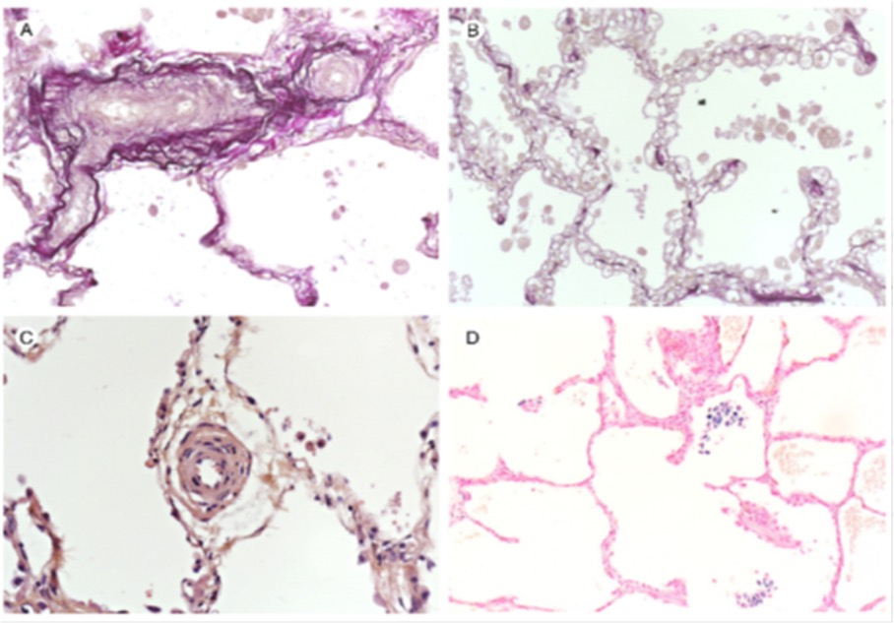
Vascular Pathology in IPF
A Pan-Vasculopathy Similar to SSc-PAH and Readily Distinguishable from Group I PAH
Colombat M, et al. Hum Pathol. 2007;38(1):60-5.

Slide 17
Discussion Points
Background of PH complicating COPD and PF
  Clinical predictors of PH complicating PF: Should Group 3 PH be targeted for therapy?
Pulmonary vascular pathology in PF
Gas exchange in PF, PH, and PF-PH
Group 3 PH circulatory limitation signature and registry data
Clinical phenotype for PAH-targeted therapy moving forward in PF-PH and therapeutics

Slide 18
General Principles Regarding the V/Q Spectrum & Gas Exchange in Idiopathic PAH vs. PF (without PH)
At rest: Relatively preserved V/Q spectrum in patients with both IPF (without PH) and iPAH
  IPF (without PH)→ 20% of Aa gradient due to diffusion; 80% due to V/Q inequality (1.2 to 8.5% shunt, depending on study)
  iPAH→ less than 10% perfusion to low V/Q, or shunt
During exercise: The V/Q spectrum in both IPF (without PH) and iPAH is relatively preserved despite predictable widening of Aa gradient
  IPF (without PH)→ 40% of Aa gradient due to diffusion; 60% due to V/Q inequality
  iPAH→ hypoxemia driven by a low mixed venous oxygen which (for a given PAO2) augments the vulnerability of oxygen exchange to diffusion limitation
Hypoxic vasoconstriction may be attenuated with worsening PH
Dantzker DR, Bower JS. J Clin Invest. 1979; 64(4):1050-55; Agusti AG et al. Am Rev Respir Dis. 1991; 143(2):219-25; Dantzker DR, et al. Am Rev Respir Dis. 1984; 130(3):412-6;
Blanco I, et al. J Appl Physiol. 2011; 110(3):638-45; Wagner PD. Clin Physiol. 1982; 2(2):105-15.

Slide 19
Acute Administration MIGET Studies in PF-PH & Group I PAH
Increased intrapulmonary shunt does not necessarily translate to worsened paO2
 | PF Type or Group I PAH | n | PH | Drug | Aggressive uptitration | Exercise | V/Q inequality
Ghofrani (2002) | Heterogeneous PF | 16 | Y (mPAP 41 median) | iNO/epo/sild | Y | N | increased shunt (4.8%-16.8%) and hypoxemia with epo; unchanged PVR/SVR
Blanco (2010) | IPF | 7 | N (mPAP 20 on RA) | iNO | - | Y | iNO does not affect V/Q inequality while improving pulmonary hemodynamics (but no effect on CO)
Gunther (2007) | IPF | 12 | N (mPAP 22.4) | bosentan | - | N | decrease in % shunt; no change in gas exchange
Agusti (1991) | IPF | 15 | N (mPAP 20) | O2 | - | Y | ↑log SD Q to 100% oxygen at rest→↓V/Q inequality at rest & exercise→↓exercise PAP→↓exercise hypoxemia
Walmrath (1995) | Heterogeneous PF | 6 | Y (mPAP 38) | inhPGI2 | - | N | worsened paO2 and P/F ratio and nonsignificant increases in shunt and low V/Q perfusion
Olschewski (1999) | Heterogeneous PF | 8 | Y (mPAP 40.2) | IV iloprost | Y | N | worsened shunt (5.1% to 23.1%); nonsignificant decrease in SaO2; PVR/SVR unchanged
Dantzker (1981) | Group I PAH CTEPH | 15 | Y (range mPAP 42- to 80) | O2/nitropr/isop | Y | N | worsened V/Q inequality (increase shunt, increase perfusion to low V/Q, or both)
Bratel (2007) | Group I PAH | 7 | Y (mPAP 49) | epo/inh ilop | Y | N | epo ↑shunt, PVR/SVR, HR, svO2; no change in paO2 or SaO2

Slide 20
Clinical Trials in Pulmonary Fibrosis +/-Pulmonary Hypertension
In general, paO2 and SaO2 are not affected or marginally affected by chronic PH-targeted therapies
Study | n | Study Design | ILD subtype | Endpoint | PH (degree) | Outcome | BL FVC% | BL DLCO% | ABG | Oxygenation | Exclusion
Active (2007) | 51 | RCBPCT | IPF | Safety | mPAP>25 or Echo RVSP>35 | Safety | N/A | N/A | N/A | N/A | N/A
BUILD 1 (2007) | 158 | RDBPCT | IPF | 6MW | none to mild | (-) | 65.9 | 42.3 | Y | no ∆SpO2 or AA gradient | RVSP>50; FVC<50; DLCO<30; TR>3.2
BUILD 2 (2010) | 163 | RDBPCT | SSc | 6MW | none to mild | (-) | 67.6 | 45.3 | N | no comment | FVC<40; DLCO<30; RVSP>50; pox<84% RA rest
BUILD 3 (2011) | 616 | RDBPCT | IPF(surgical) | M&M | unknown | (-) | 74.9 | 47.7 | Y (BL) | paO2 81; 12.3% required O2 at rest | FVC<50; DLCO <30; >5% HC
BPHIT (2014) | 60 | RDBPCT | IPF(46) or fibrotic NSIP(14) | PVRi (>20%) | mPAP>25 and PAWP<15 | (-) | 55.7 | 21.3 | N | no difference
Artemis IPF (2013) | 494 | RDBPCT | IPF | M&M | 9.7% (+)PH; mPAP 20.3 | (-) | 69.9 | 42 | N | no comment | >5% HC; NYHA III
Music IPF | 178 | RDBPCT | IPF | ∆FVC | unknown | (-) | 76.1 | 46.5 | Y | paO2 77.9 | FVC<50; DLCO<30; >5% HC
ARIES 3 (2012) | 21/224 | Open label | Not Reported | 6MW | mPAP>35; PVR>3.5 | (-) | - | - | N | no comment | FVC<60
Sildenafil (2007) | 14 | Open label | IPF | 6MW | mPAP>25 or RVSP>35 | (+) | 69.6 | 32.4 | N | no comment | -
Sildenafil (2010) | 15 | Retrospective | Heterogeneous (6 IIP; 5 sarcoid; 2 PM; 1 HP; 1 EG) | N/A | mPAP 41.3 | ↓BNP & ↑6MW | 52.6 | 23.8 | Y | no ∆paO2 (n=9) | -
Sildenafil (2010) | 180 | RDBPCT | IPF (DLCO<35) | 6MW(20%) | unknown | (-) | 54.9 | 25.8 | Y | paO2 66.2; ↑paO2 & DLCO | resting pox<92% on 6 liters O2
Riociguat (2013) | 22 | Open label | Heterogeneous18 IIP; 3 sarcoid; 1 SSc | safety | mPAP>30; PVR>5 | equivocal | 67 | 27 | Y | no ∆SpO2; +significant ↓paO2 | background PH Rx; paO2<50 on RA
Parenteral treprostinil (2014) | 15 | Open label | Heterogeneous (no sarcoid or CTD) | 6MW | mPAP>35; PVR>3 | (+) | 67 | 24 | N | no ∆SpO2 at rest or at nadir of 6MW test | sarcoidosis; connective tissue disease
Riociguat (2016) | 140 | RDBPCT | IIP only | 6MW | mPAP>25 | (-) | >45 | N/A | Y | N/A | any known etiology of pulmonary fibrosis

Slide 21
Discussion Points
Background of PH complicating COPD and PF
  Clinical predictors of PH complicating PF: Should Group 3 PH be targeted for therapy?
Pulmonary vascular pathology in PF
Gas exchange in PF, PH, and PF-PH
Group 3 PH circulatory limitation signature and registry data
Clinical phenotype for PAH-targeted therapy moving forward in PF-PH and therapeutics

Slide 22
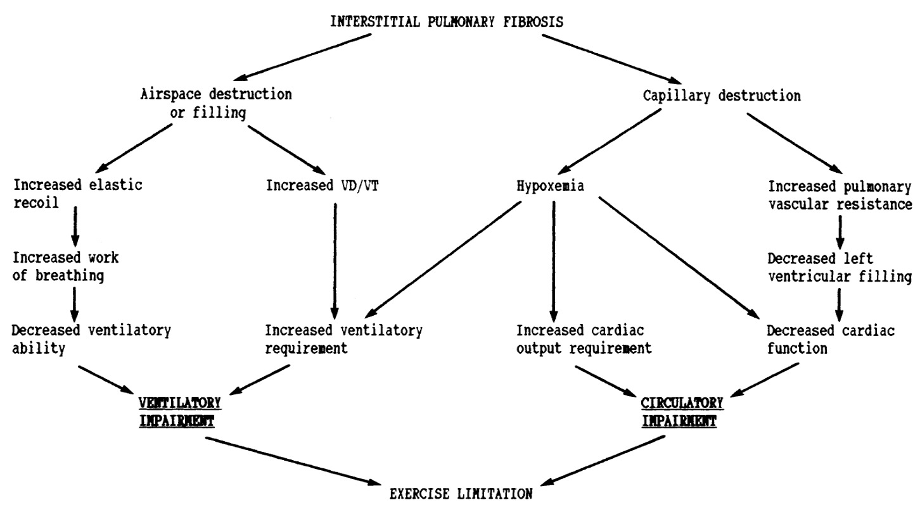
Gas Exchange Impairment
LAT (% predicted)
VO₂/WR (ml/min/W)
O₂ pulse (% predicted at max HR)
VCO₂/VO₂ slope (after LAT; “S2”)
Breathing Reserve (MVV minus peak V_{E})
Breathing Frequency peak exercise
V_{T}/IC at peak exercise
Adapted from Hansen, JE, Wasserman, K. Chest. 1996;109(6):1566–76.

Slide 23
Circulatory Limitation (Similar to IPAH) is a Feature of Significant PH Complicating PF
IPF(+PH; RVSP>50mmHg), compared to IPF(-PH), has the following CPX profile:
  Decreased maximum work
  Decreased VO2 max
  Decreased O2 pulse
  Decreased anaerobic threshold
Strongest correlation of sPAP with VE/VCO2 at anaerobic threshold
VE vs. VCO2 slopepred cutoff >152% was the strongest CPET predictor of PH (median mPAP 34); superior to any PFT parameter
Boutou AK, et al. Respirology. 2011;16:947-52; Glaser S, et al. Respir Med. 2009; 103(2):317-24; Glaser S, et al. PLoS One. 2013;8(6):e65643.

Slide 24
“Real World” Group 3 PH Registry Experience
What Can We Learn?
 | N _{Total} | N _{Group 3} | Age | Incident | PH Definition | Hemodynamic | FVC% (ILD only) | 3 yr Survival | Definition of Lung Disease
ASPIRE | 1344 (9 yr) | 178 | 66+11 | Yes | mPA>25 PAWP<15 PVR>240 | mPA: 41+11 PVR: 6.7+4.7 | 66+25 | 44% (all lung disease) 16% (ILD only) 40% (CTD-ILD only) | Significant parenchymal lung disease, regardless of spirometry CTD-PH as below in UK Registry
COMPERA | 949 (5 yr) | 151 | 71+11 | Yes | mPA>25 PAWP<15 | mPA: 37+9 PVR: 8.1+3.4 | 63+20 TLC: 69+17 | 34% (ILD only) | Investigator; based on current guidelines
Scottish Registry | 244 (14 yr) | 118 | 67+9 | Yes | mPA>35 PAWP<15 | mPA: 47 [42-51] PVR: 10.7[8.3-14.7] | 74 [65-92] | 39% (all lung disease) 19% (ILD only) | Investigator; no specific criteria
UK Registry⁴ (SSc-ILD only) | 343 (5 yr) | 86 | 58+11 | Yes | mPA>25 PAWP<15 PVR>240 | mPA: 40+17.5 PVR: 8.8+ 7.4 | N/A | 30% (SSc-ILD only) | FVC<60% or Moderate-severe fibrosis (>1/3 lung fields on HRCT chest)
Compera (COPD only) | 864 | 375 | 69+9 | Yes | mPAP >25 PAWP<15 | mPA: 40+10 PVR: 7.7+3.2 | N/A | 38% (moderate and severe PH-COPD) | Investigator based diagnosis post-BD FEV1<70%
In all the above registries, survival was time from diagnostic RHC to either death, lung transplantation, or censor date
Hurdman J, et al. Eur Respir J. 2012; 39:945-55; Hoeper MM, et al. Plos One. 2015; 10(12):e0141911;
Brewis MJ, et al. Eur Respir J. 2015; 46:1378-89; Condliffe R, et al. Am J Respir Crit Care Med. 2009; 179(2):151-7;
Vizza CD, et al. Chest. 2021; 160(2):678-89.

Slide 25
Discussion Points
Background of PH complicating COPD and PF
  Clinical predictors of PH complicating PF: Should Group 3 PH be targeted for therapy?
Pulmonary vascular pathology in PF
Gas exchange in PF, PH, and PF-PH
Group 3 PH circulatory limitation signature and registry data
Clinical phenotype for PAH-targeted therapy moving forward in PF-PH and therapeutics

Slide 26
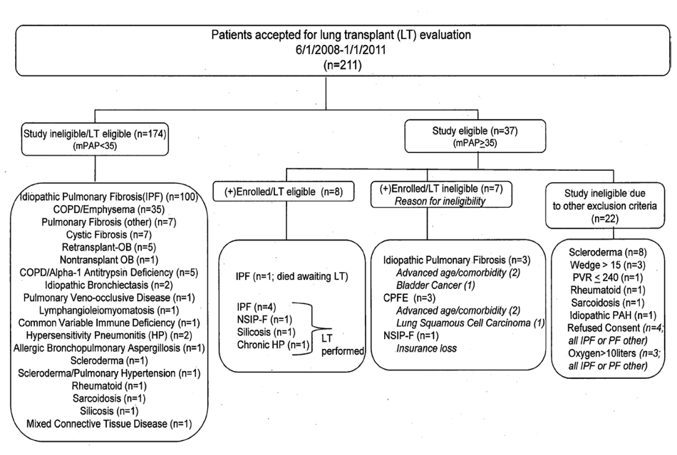
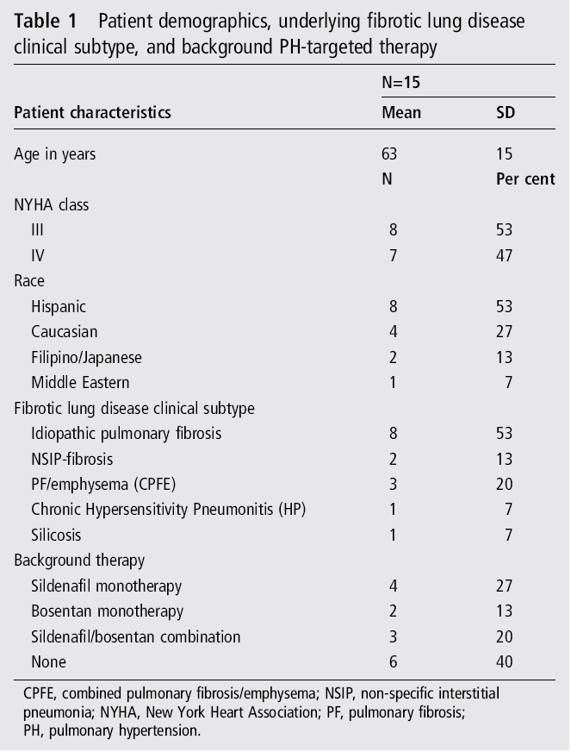
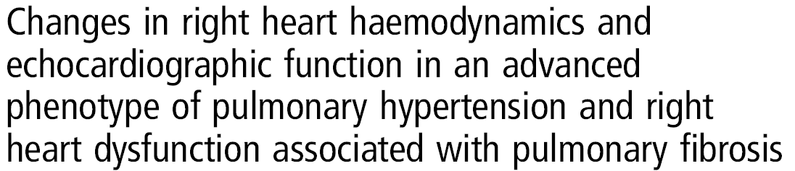
With PF, a Homogeneous Advanced PH Phenotype (Not a Homogenous PF Subtype), May Be the Key to Successful Therapy n=15 hypoxic, pre-lung transplant PF patients treated with infusional treprostinil; mPAP greater than 35; PVR greater than 3; +baseline RV dysfunction
Saggar R, et al. Thorax. 2014;69(2):123-9.

Slide 27
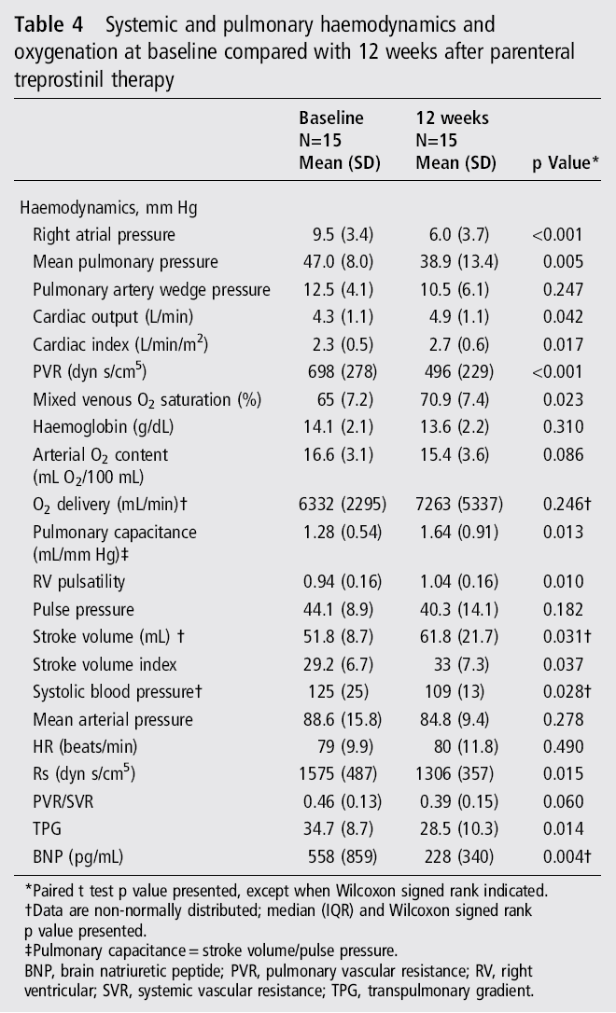
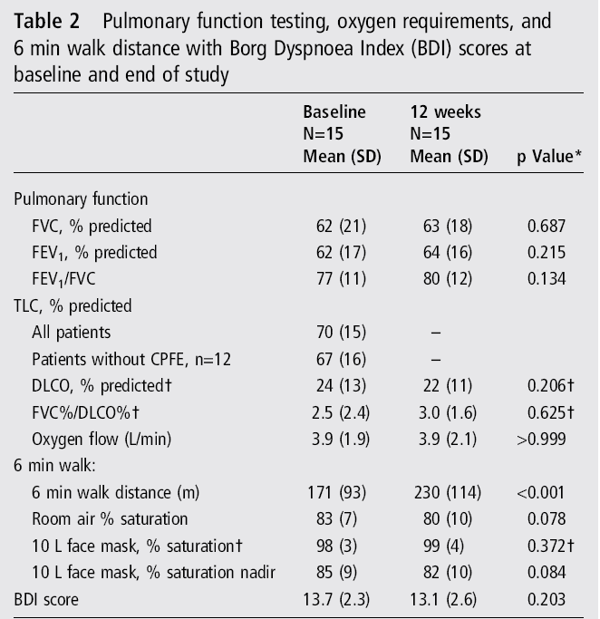

Importance of the Advanced PF-PH Clinical Phenotype
no evidence for worsened hypoxemia
improved pulmonary hemodynamics,
SF-36, RV function, 6MWD, & BNP
Saggar R, et al. Thorax. 2014;69(2):123-9.

Slide 28
RV Dysfunction May Be Necessary for PH-Targeted Therapy Success
Sildenafil IPF-NET study: evaluation of 119 echocardiograms prior to sildenafil vs. placebo
  Patients with RV systolic dysfunction and sildenafil had preservation of exercise capacity and improved QOL, compared to placebo
Han MK, et al. Chest. 2013;143(6):1699-1708; Saggar R, et al. Thorax. 2014;69(2):123-9.

Slide 29
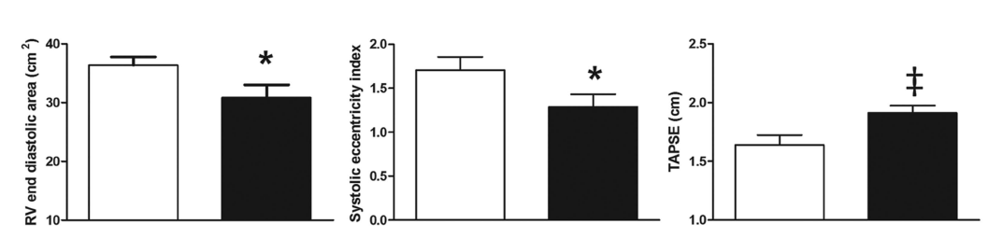
RV Dysfunction May Be Necessary for PH-Targeted Therapy Success
Sildenafil IPF-NET study: evaluation of 119 echocardiograms prior to sildenafil vs. placebo
  Patients with RV systolic dysfunction and sildenafil had preservation of exercise capacity and improved QOL, compared to placebo
Han MK, et al. Chest. 2013;143(6):1699-1708; Saggar R, et al. Thorax. 2014;69(2):123-9.

Slide 30
Inhaled Treprostinil FDA Approved for Group 3 PH 5/2022
Waxman A, et al. NEJM. 2021;384(4):325-34.

Slide 31
Inhaled Treprostinil FDA Approved for Group 3 PH 5/2022
Clinical worsening defined as any one of the following: Hospitalization for cardiopulmonary indication; a decrease in 6-minute walk distance greater than 15% from baseline directly related to disease under study at 2 consecutive visits; death from any cause; or lung transplantation

Slide 32
Inhaled NO: Outpatient and Ambulatory
iNO-PF study (phase 2b/3a RCT, placebo controlled)
Dose of iNO is mcg/kg IBW per hour
Cohort 1 allowed for assessment of safety and multiple exploratory endpoints with inhaled NO
Patients were classified as low or intermediate/high probability for PH based on central review echocardiography (ERS/ESC guidelines); 70% of the entire cohort was IPF and were intermediate to high probability for PH; RHC not necessary
Continuous wrist pulse oximetry and wrist actigraphy
NO, nitric oxide.
Nathan SD, et al. Chest. 2020; 158(2):637-45.

Slide 33
Echocardiographic Assessment of PH in Symptomatic Patients with Suspicion of PH
Galie N, et al. Eur Respir J. 2015; 46:903-75.

Slide 34
Inhaled NO: Outpatient and Ambulatory
Unfortunately, negative phase 3 study which read out recently Q3 2023
Nathan SD, et al. Chest. 2020; 158(2):637-45.

Slide 35
Sildenafil Monotherapy, or in Addition to, Anti-Fibrotic Therapy: All Trials Negative
STEP-IPF Study: sildenafil versus placebo (12 weeks);
  primary endpoint was 6MW
  IPF with DLCO less than 35%
  Post-hoc suggested improved 6MW and HRQL in patients with echocardiographic evidence for RV dysfunction and/or hypertrophy
In stage Study: sildenafil/placebo added to nintedanib (24 weeks)
  primary endpoint was change in SGRQ at 12 and 24 weeks
  IPF with DLCO less than 35%; stratified by baseline presence of echocardiographic right heart dysfunction (RV systolic dysfunction, RVH, RVE, or RAE) (per investigator)
Sildenafil/placebo added to pirfenidone: (52 weeks)
  Primary endpoint was composite endpoint including disease progression over 52 weeks defined as greater than 15% decline in 6MW from baseline, non-elective respiratory-related hospital admission, or all-cause mortality
  IPF with DLCO less than 40% and either ‘at risk for PH’ (prior RHC with mPAP>20 and PAWP<15) or intermediate/high probability of having PH based on echocardiogram (ERS/ESC guidelines) (unclear if central review)
Zisman DA, et al. N Engl J Med. 2010; 270(22):2083-92; Behr J, et al. Am J Respir Crit Care Med. 2019; 200(12):1505-12; Behr J, et al. Lancet Resp Med. 2021;9:85-95.

Slide 36
Competing Risks for Morbidity and Mortality
Intrinsic Heterogeneity in Progression of Various ILDs and the Associated Pulmonary Vascular Disease
ILD primary determinant of outcomes
PH primary determinant of outcomes
Decreasing:
-FVC%
-DLco%
-6MWD
-Oxygen
Inflection point
Progression of interstitial lung disease
Increasing:
-mPAP
-PVR
Decreasing:
-RV function
A
Vascular ablation & vasculopathy
Time
Unanticipated Insults:
-acute exacerbation/natural history
-infection/comorbidities/age

Slide 37
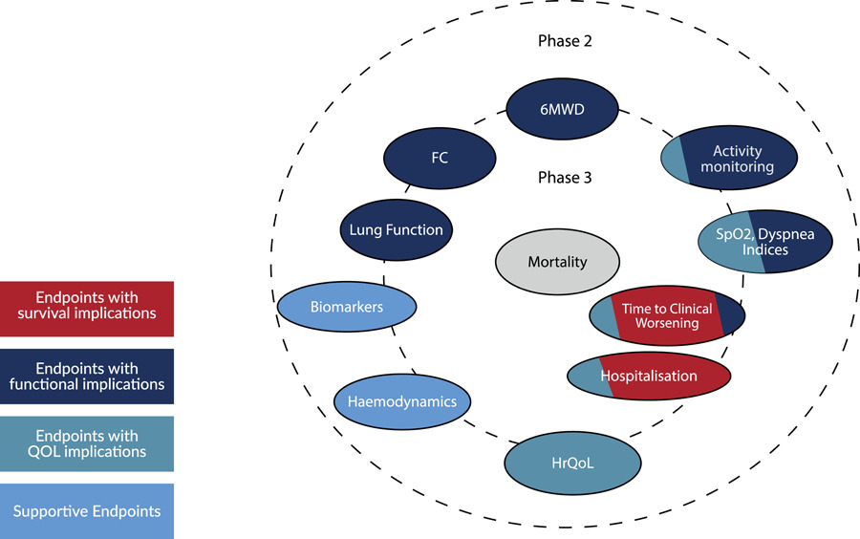
Clinical Trial Design and Endpoints:
A Consensus Statement from the Pulmonary Vascular Research Institute's Innovative Drug Development Initiative
Group 3 Pulmonary Hypertension
Pulmonary Hypertension in Interstitial Lung Disease:
Nathan SD, et al. Pulm Circ. 2022; 12(4):e12178.

Slide 38
Conclusions
It is difficult to clinically predict PH complicating PF (inherent heterogeneity); in general, these patients are hypoxic (usually at rest), and with ↓DLCO
The pathology of PF-PH is very different from Group I PAH and is most consistent with a pan-vasculopathy in architecturally preserved lung
While there may be V/Q mismatch, resultant hypoxemia does NOT appear to be a feature of chronic PH-targeted therapy trials in PF +/- PH

Slide 39
Conclusions
Inhaled treprostinil is the only FDA approved medication for Group 3 PH
The appropriate clinical PF-PH phenotype likely to respond to PH-targeted therapy is circulatory-limited and may include:
  Advanced pulmonary hemodynamics (mPAP>35; PVR>6 WU)
  Echocardiographic RV dysfunction at baseline ( TAPSE, eccentricity index and RV end diastolic area)
  Baseline CPET profile similar to Group I PAH (circulatory limitation)
Our group has clinically demonstrated safe and efficacious use of infusional prostanoid therapy for PF-PH in the pre-lung transplant setting (heterogeneous PF) and with SSc-PF-PH

Slide 40
Conclusions
Future clinical trial designs should consider the following inclusion criteria
  the advanced PH phenotype
  measures of RV dysfunction by echocardiography
  Stable PF phenotype (CTD, chronic HP, IPAF)
Generally, avoid PH-therapy in older patients with IPF and mild “reactive” PH without RV dysfunction or circulatory limitation
Failures in future clinical trials in PF-PH should only be due to the wrong drug and not clinical trial design

Slide 41



Looking for more resources
on this topic?
CME/CE in minutes
Congress highlights
Late-breaking data
Quizzes
Webinars
In-person events
Slides & resources
www.MedEdOTG.com

