Slide 1
The EchoRight Smart Phone App: Emerging Tools for Echocardiography in PH
Vallerie V. McLaughlin, MD Associate Chief Clinical Officer, Cardiovascular Services Director, Pulmonary Hypertension Program University of Michigan Ann Arbor, MI

Slide 2
Disclaimer
The views and opinions expressed in this educational activity are those of the faculty and do not necessarily represent the views of TotalCME, Inc., the CME providers, or the companies providing educational grants. This presentation is not intended to define an exclusive course of patient management; the participant should use their clinical judgment, knowledge, experience, and diagnostic skills in applying or adopting for professional use any of the information provided herein. Any procedures, medications, or other courses of diagnosis or treatment discussed or suggested in this activity should not be used by clinicians without evaluation of their patient's conditions and possible contraindications or dangers in use, review of any applicable manufacturer’s product information, and comparison with recommendations of other authorities. Links to other sites may be provided as additional sources of information.

Slide 3
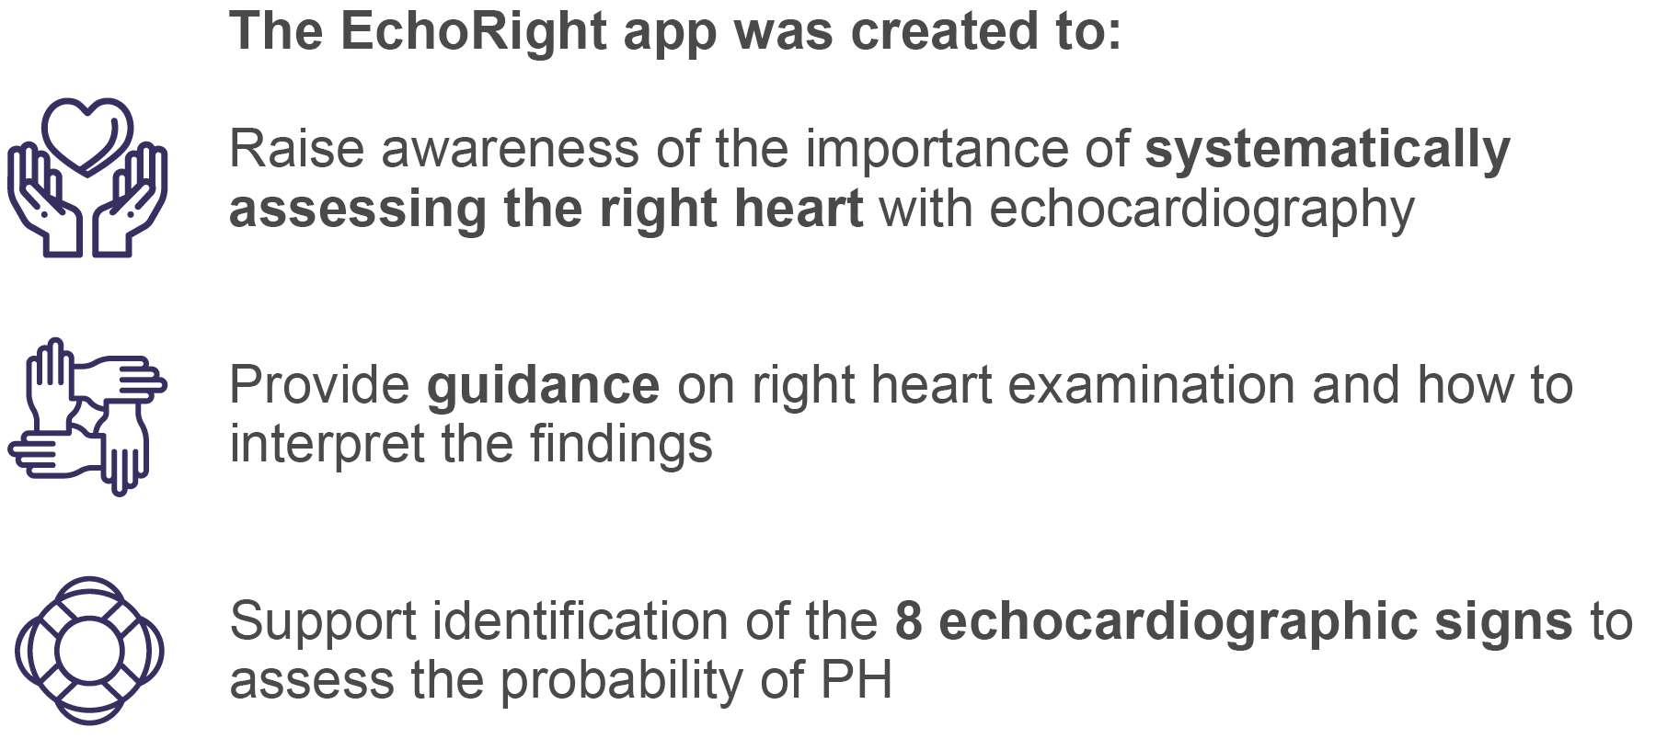
The EchoRight App

Slide 4
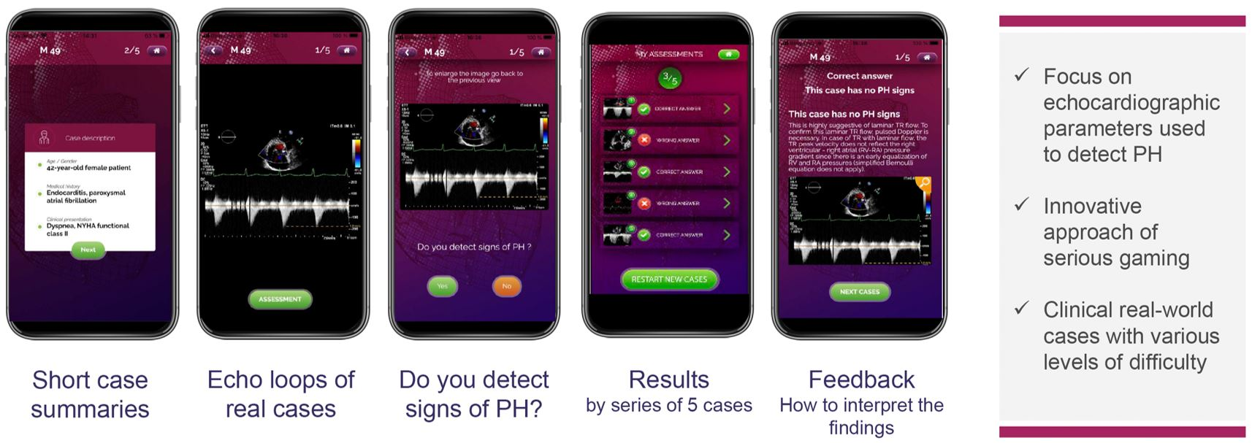
The Format of the EchoRight Pro App

Slide 5
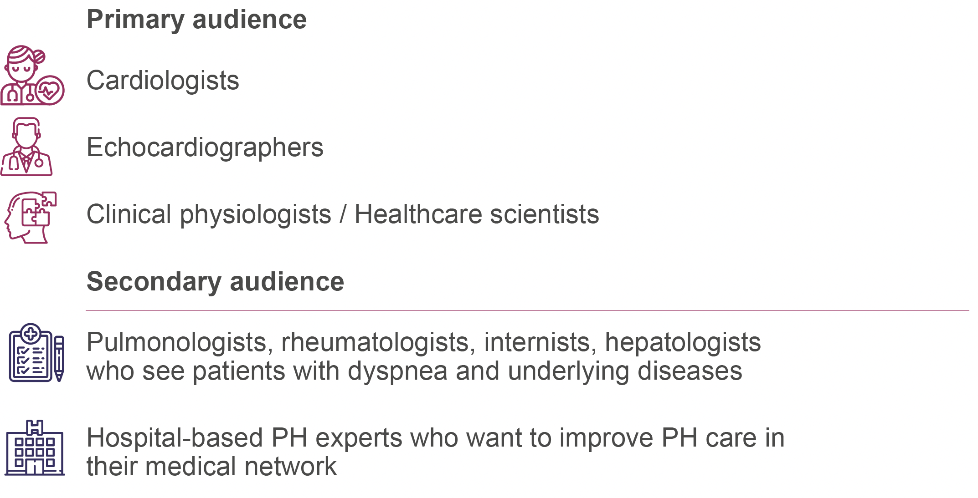
Target Audiences

Slide 6
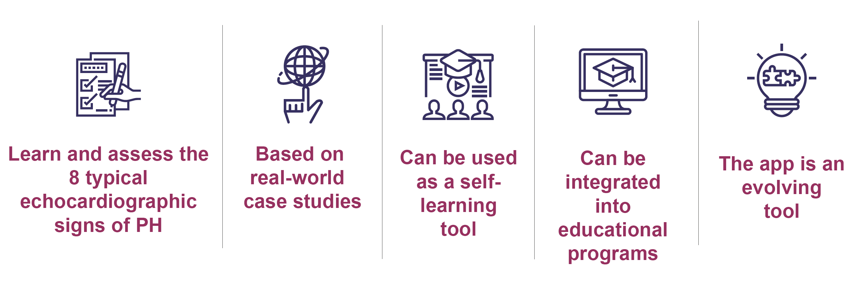
Learning Benefits of the Echo Right App

Slide 7
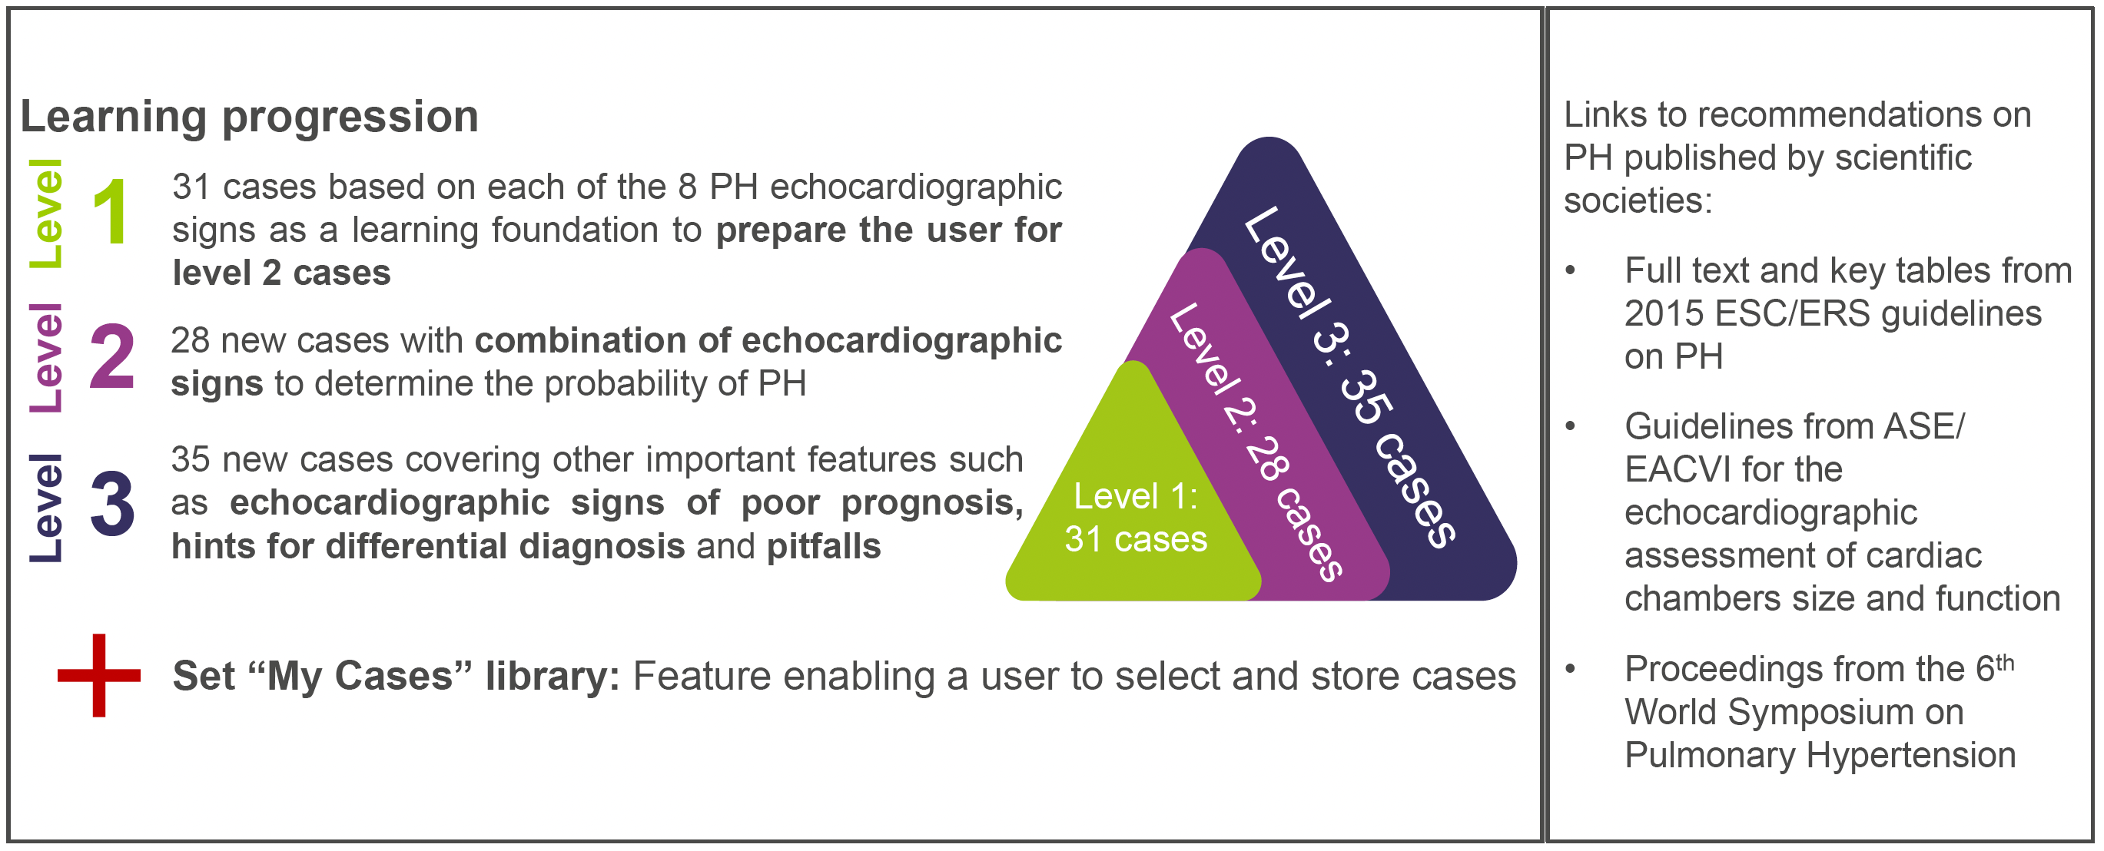
Benefits of EchoRight

Slide 8
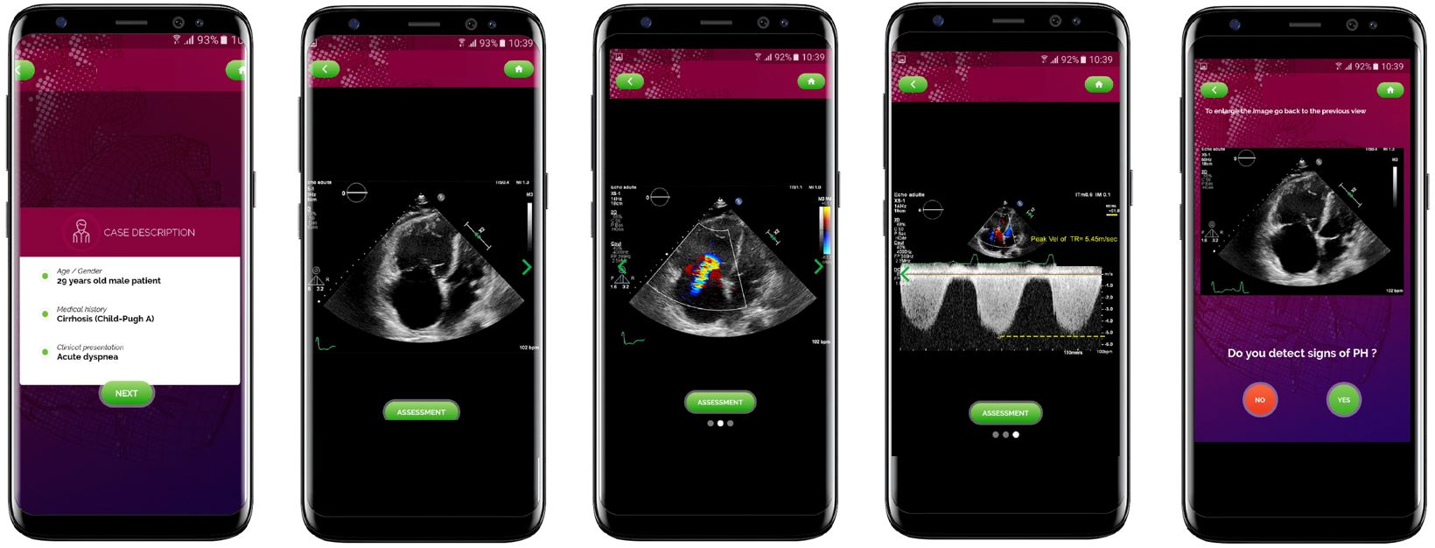
An Example Case From EchoRight: Looking at Peak Tricuspid Regurgitation Velocity

Slide 9
