Slide 1
Using Echocardiography to Complement Risk Assessment
Ahmed S. Sadek, MD
Assistant Professor, Medicine
Pulmonary Hypertension, Right Heart Failure and CTEPH program
Cardiology Division
Lewis Katz School of Medicine
Temple University
Philadelphia, PA

Slide 2
Disclaimer
The views and opinions expressed in this educational activity are those of the faculty and do not necessarily represent the views of TotalCME, Inc., the CME providers, or the companies providing educational grants. This presentation is not intended to define an exclusive course of patient management; the participant should use their clinical judgment, knowledge, experience, and diagnostic skills in applying or adopting for professional use any of the information provided herein. Any procedures, medications, or other courses of diagnosis or treatment discussed or suggested in this activity should not be used by clinicians without evaluation of their patient's conditions and possible contraindications or dangers in use, review of any applicable manufacturer’s product information, and comparison with recommendations of other authorities. Links to other sites may be provided as additional sources of information.

Slide 3
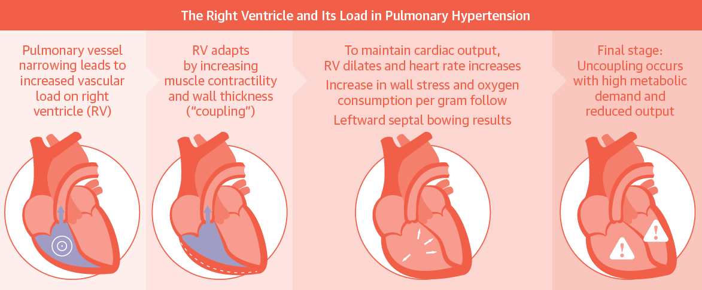
Risk in Pulmonary Hypertension is Dependent on Right Ventricular Adaptation to Increased Load – RV-PA Coupling
The consequence of pulmonary hypertension for the right ventricle. Initially, coupling of the ventricle to the high arterial load is maintained by increasing contractility, subsequently followed by dilation and finally uncoupling

Slide 4
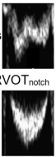
Echocardiogram Provides Direct Assessment of
RV-PA Uncoupling: Similar to RHC
Yes
C
B
0 1 2 3 4 5 6
PVR
A
C
B
PVR
*RVOTnotch
TAPSE
0.8 1 1.2 1.4 1.6 1.8 2
No
A
primary RV “pump” dysfunction (not PH)
RV adaptation to PVR
RV-PA uncoupling
1 1.2 1.4 1.6 1.8 2.0
TAPSE
Cardiac Output/Index

Slide 5
TAPSE: A Stronger Predictor of Survival than PVR in PH
HAZARD RATIOS FOR DEATH IN PULMONARY ARTERIAL HYPERTENSION COHORT
Variable | Unadjusted HR (95% CI, p value) | Adjusted HR (95% CI, p value)*
Age | 1.01 (0.98–1.05, p = 0.48 | N/A
Baseline WHO | 6.8 (2.50–18.55, p < 0.001) | (C) (D) | 11.60 (2.62–51.57, p< 0.01) 9.29 (1.91–45.11, p < 0.01)
Baseline therapy (yes or no) | 0.53 (0.20–1.39, p = 0.20) | N/A
Eccentricity index, diastole | 6.14 (1.03–36.48, p = 0.05) | (C) (D) | 2.60 (0.20–34.01, p = 0.47) 3.70 (0.40–34.33, p = 0.25)
Right atrial area index | 1.24 (1.12–1.38, p < 0.001) | †
RV fractional area change | 0.92 (0.86–0.96, p =0.02) | (C) (D) | 0.94 (0.82–1.08, p = 0.39) 0.94 (0.88–1.00, p =0.05)
Tricuspid regurgitation | 2.59 (1.39–4.81, p = 0.003) | (C) (D) | 1.68 (0.84–3.40, p = 0.15) 1.24 (0.60–2.53, p = 0.56)
Pericardial effusion | 1.69 (1.12–2.54, p = 0.01) | (C) (D) | 1.78 (1.13–2.82, p = 0.01) 1.76 (1.11–2.78, p = 0.02)
TAPSE (continuous) | 1.17 (1.04–1.32, p < 0.01) | 1.16 | (1.03–1.28, p = 0.01)
TAPSE (dichotomous) | 5.69 (1.30–24.95, p = 0.01) | 7.03 | (1.49–33.18, p = 0.01)
Right atrial pressure | 1.22 (1.12–1.35, p < 0.001) | (C) (D) | 1.12 (1.00–1.24, p = 0.04) 1.10 (0.98–1.24, p =0.09)
Mean PAP | 1.00 (0.96–1.04, p = 0.88) | †
Cardiac index | 0.43 (0.18–1.02, p = 0.05) | †
PVR | 1.07 (0.99–1.16, p = 0.10) | †
PA oxygen saturation | 0.88 (0.83–0.94, p < 0.001) | †
Values shown represent hazard ratios (HR) adjusted for multivariable model with TAPSE as a continuous (C) or dichotomous (D) variable along with baseline WHO functional class, and pericardial effusion

Slide 6
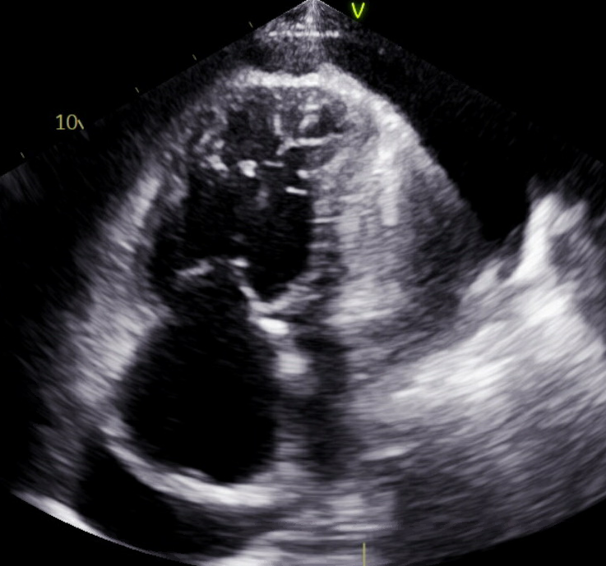
ESC/ERS 2022 PH Guidelines Risk Stratification by Echocardiogram
Determinants of prognosis (estimated 1-year mortality) | Low risk (<5%) | Intermediate risk (5%–20%) | High risk (>20%)
Echocardiography | RA area <18 cm² TAPSE/sPAP >0.32 mm/mmHg No pericardial effusion | RA area 18–26 cm² TAPSE/sPAP 0.19–0.32 mm/mmHg Minimal pericardial effusion | RA area >26 cm² TAPSE/sPAP <0.19 mm/mmHg Moderate or large pericardial effusion
Pericardial
Effusion
RAE

Slide 7
Echocardiogram Adds Specificity to Other Noninvasive Parameters
Traditional noninvasive risk stratification
Parameter​ | Low Risk​ | Intermediate Risk​ | High Risk​
WHO-FC​ | I or II​ | III​ | IV​
6MWD, m​ | > 440​ | 165-440​ | <165​
NT-proBNP (BNP), ng/L​ | <300 (<50)​ | 300-1400 (50-300)​ | >1400 (>300)​
Subjective, confounded by comorbid conditions
Confounded by comorbid conditions
Decreased In obesity, increased renal disease

Slide 8
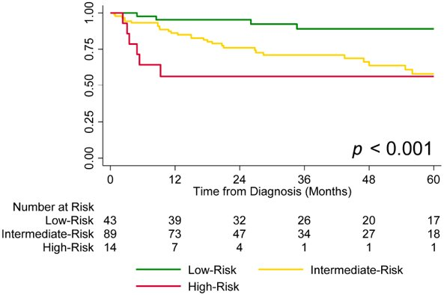
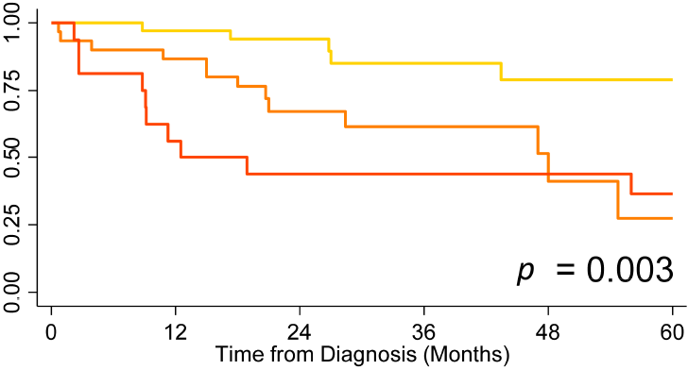
TAPSE/TR Severity Can Sub-Stratify Traditional Intermediate Risk Groups Into Low-Intermediate and High-Intermediate Risk Groups
Transplant-free survival using traditional 3-strata risk model
Transplant-free survival using tricuspid annular plane systolic excursion (TAPSE) and tricuspid regurgitation (TR) to stratify intermediate-risk patients
Group 1
Group 2
Group 3
Group 1: TAPSE ≥ 19 mm and no/trace/mild TR
Group 2: TAPSE < 19 mm or moderate/severe TR
Group 3: TAPSE < 19 mm and moderate/severe TR

Slide 9
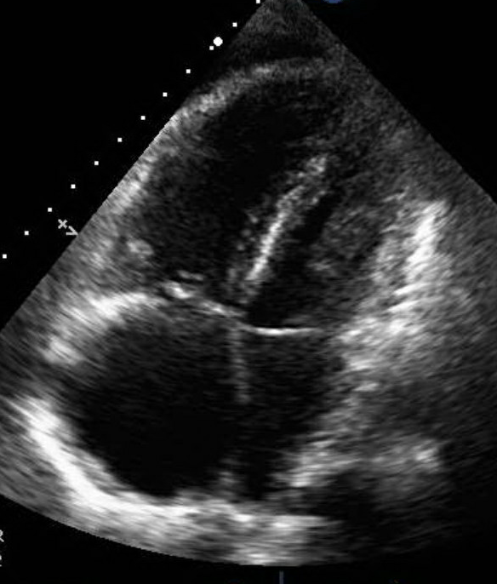
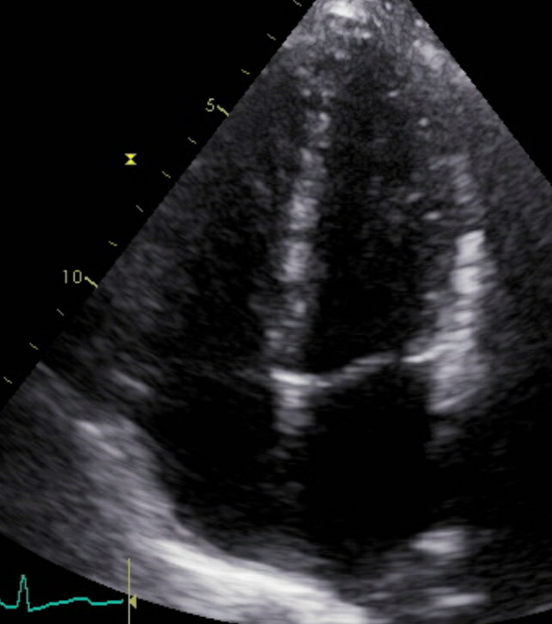
53 y.o. F with CTD-ILD Admitted with HF
Parameters​ Pre-treatment
WHO-FC​ | IIIB
6MWD | 260 m
BNP | 2,283 ng/L
TAPSE | 15 mm
Pericardial effusion | Moderate
Parameters​ Post-treatment
WHO-FC​ | III
6MWD | 350 m
BNP | 33 ng/L
TAPSE | 20 mm
Pericardial effusion | absent

