Slide 1
Making the Most of the Echo Report (VEST)
Ahmed S. Sadek, MD
Assistant Professor, Medicine
Pulmonary Hypertension, Right Heart Failure and CTEPH program
Cardiology Division
Lewis Katz School of Medicine
Temple University
Philadelphia, PA

Slide 2
Disclaimer
The views and opinions expressed in this educational activity are those of the faculty and do not necessarily represent the views of TotalCME, Inc., the CME providers, or the companies providing educational grants. This presentation is not intended to define an exclusive course of patient management; the participant should use their clinical judgment, knowledge, experience, and diagnostic skills in applying or adopting for professional use any of the information provided herein. Any procedures, medications, or other courses of diagnosis or treatment discussed or suggested in this activity should not be used by clinicians without evaluation of their patient's conditions and possible contraindications or dangers in use, review of any applicable manufacturer’s product information, and comparison with recommendations of other authorities. Links to other sites may be provided as additional sources of information.

Slide 3
The Virtual Echocardiography Screening Tool (VEST)
Goal: scoring system distinguish between PH_{LHD} and PH_{PVD,} utilizing only echocardiography report when images/expertise are not available
Derived scores range from -3 to +3 with positive scores suggesting a higher probability of PH_{PVD} and negative scores suggesting higher probability of PH_{LHD}
PH_{PVD:} MPAP > 25 mm Hg, PVR> 3 WU, PCWP <15
Scoring parameters readily available in most echo reports
Subjects without all three variables (n = 58) reported were excluded from the analysis
Echocardiographic Parameter | Yes | No
Mitral E:e’, lateral ≤10ª | +1 | -1
Qualitative left atrial size normal or mildly enlarged | +1 | -1
Systolic interventricular septal flattening | +1 | -1

Slide 4
The Virtual Echocardiography Screening Tool (VEST)
Goal: scoring system distinguish between PH_{LHD} and PH_{PVD,} utilizing only echocardiography report when images/expertise are not available
Derived scores range from -3 to +3 with positive scores suggesting a higher probability of PH_{PVD} and negative scores suggesting higher probability of PH_{LHD}
PH_{PVD:} MPAP > 25 mm Hg, PVR> 3 WU, PCWP <15
Scoring parameters readily available in most echo reports
Subjects without all three variables (n = 58) reported were excluded from the analysis
WHO Group I (PAH)
WHO Group II (Left Heart Failure)
Echocardiographic Parameter | Yes | No
Mitral E:e’, lateral ≤10ª | +1 | -1
Qualitative left atrial size normal or mildly enlarged | +1 | -1
Systolic interventricular septal flattening | +1 | -1

Slide 5
Performance of the VEST for Prediction of PH_{PVD}
VEST >0 was 80.0% sensitive and 75.6% specific for PH_{PVD} with an AUC of 0.81
VEST score of +3 was 92.7% specific with positive predictive value of 88%
This significantly improved prediction of PH_{PVD} when compared to PASP_{DE} which had an AUC of only 0.56
VEST score in validation cohort was 100.0% sensitive and 75.0% specific for PH_{PVD} with an AUC of 0.94
Majority of patients with a positive VEST score who did not meet criteria for PH_{PVD} had score of +1 and mixed physiology PH (PVR > 3 WU, PCWP > 15 mm Hg, mean PVR 4.3 WU)

Slide 6
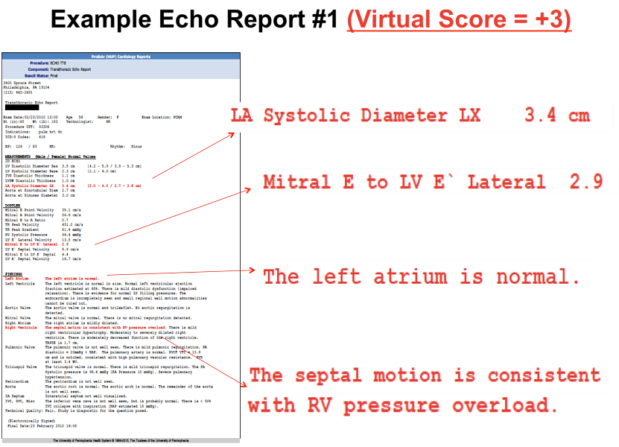
Example 1: Converting Echo Report Into a VEST Score

Slide 7
Example 2: Converting Echo Report Into a VEST Score
Left Ventricle: Low normal systolic function. Estimated EF of 50% in the range of 50% - 55%. LV mildly to moderately dilated. Increased LV mass index. Findings consistent with eccentric hypertrophy. Normal wall thickness
Intraventricular Septum: Septal motion is normal.
Aortic Valve: Valve is trileaflet. Moderate thickening. Moderately calcified. Moderate annular calcification. Moderately restricted motion of the right cusp. Mild stenosis. AV peak velocity is 2.28 m/s. AV peak gradient is 20.74 mmHg. AV mean gradient is 11.71 mmHg. AV Doppler vel index VTI is 0.43. AV Doppler vel index peak velocity is 0.47
Left Atrium: LA is severely dilated. LA volume index is 115.56 ml/m²
Right Ventricle: Low normal systolic function. RV is mildly dilated
Pulmonic Valve: Moderate pulmonary hypertension is present
Tricuspid Valve: Mild transvalvular regurgitation with a centrally directed jet
Right Atrium: RA is severely dilated
Diastolic Filling
MV pk E vel = 1.7 m/s
MV lat E/e' ratio = 24.2
MV Sept E/e' ratio = 28.3
MV avg E/e' ratio = 26.1
MV pk A vel = 0.49 m/s
TR pk vel = 3.63 m/s
MV E/A ratio = 3.47
MV e' lateral = 0.07 m/s
MV e' septal = 0.06 m/s

Slide 8
Examples: Hemodynamics
Example #1: Score +3
Example #2: Score -3
mPAP = 44 mmHg
PAWP = 6 mmHg
PVR = 8.6 WU
LA small
E/e’ 2.9
Septal flattening
mPAP = 46 mmHg
PAWP = 27 mmHg
PVR = 2.2 WU
LA enlarged
E/e’ 24.2
No septal flattening

