Slide 1
Differentiating Group 1 PH From Group 2 PH Using Echo
Bettia Edith Celestin, MD
Post-Doctoral Researcher
Stanford Medicine
Palo Alto, CA

Slide 2
Disclaimer
The views and opinions expressed in this educational activity are those of the faculty and do not necessarily represent the views of TotalCME, Inc., the CME providers, or the companies providing educational grants. This presentation is not intended to define an exclusive course of patient management; the participant should use their clinical judgment, knowledge, experience, and diagnostic skills in applying or adopting for professional use any of the information provided herein. Any procedures, medications, or other courses of diagnosis or treatment discussed or suggested in this activity should not be used by clinicians without evaluation of their patient's conditions and possible contraindications or dangers in use, review of any applicable manufacturer’s product information, and comparison with recommendations of other authorities. Links to other sites may be provided as additional sources of information.

Slide 3
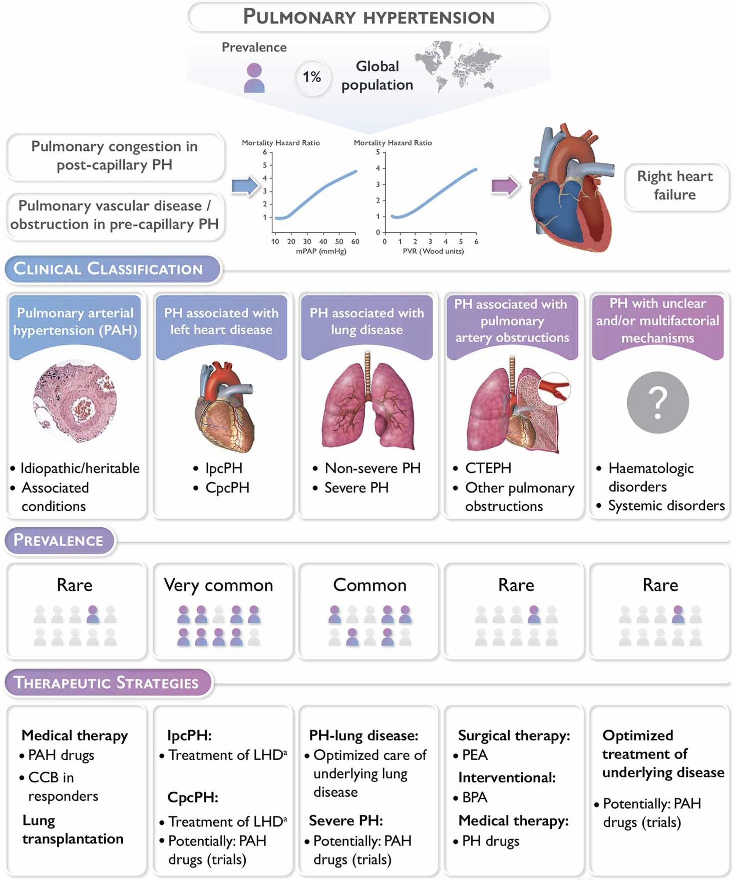
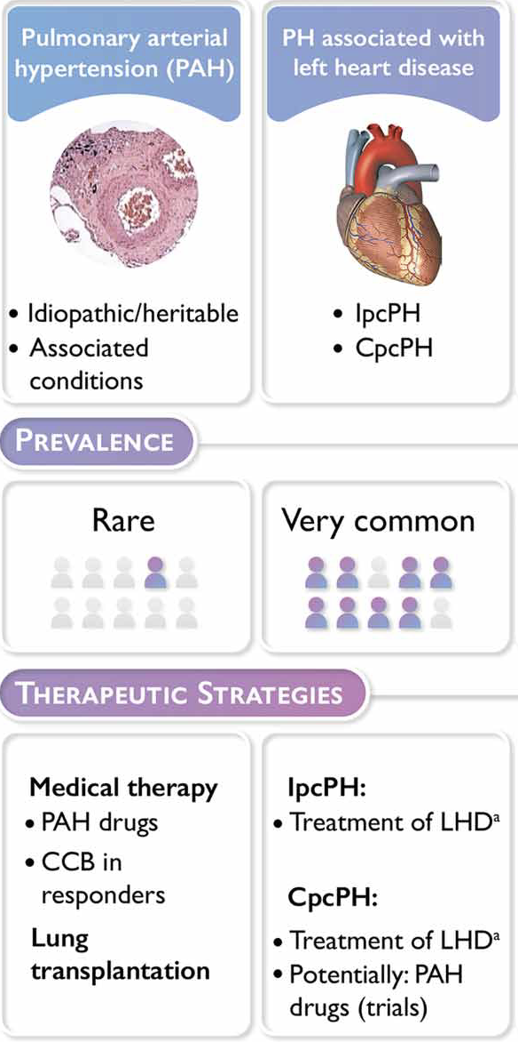
Echo: Differentiating Group 1 PH from Group 2 PH – Why is This Important?
Group 1 vs Group 2
Not the same prevalence
Not the same medical history
Not the same treatment

Slide 4
Echo: Differentiating Group 1 PH from Group 2 PH-How Can Echocardiography Help?
Independent of the etiology
PH leads to RV pressure overload RV dysfunction
Accurate echocardiography gives information on
RIGHT SIDE
LEFT SIDE

Slide 5
Echo: Differentiating Group 1 PH from Group 2 PH-How Can Echocardiography Help?
Morphology of the RV and the LV
Shape of the RV and the LV
RV Function
LV function
Valvular abnormalities
Estimate hemodynamic parameters
Can detect sign for PH associated with Left Heart Disease (LHD) or Congenital Heart Disease (CHD)

Slide 6
Echo: Differentiating Group 1 PH from Group 2 PH
To differentiate between Group 2 and Group 1 PH
Left atrium size (volume and surface) LA volume > 34 ml/m²
LV dimensions (dilatation)
LV function
Signs of LV hypertrophy (LV mass index 149 g/m² for men or 122 g/m² for women or RWT >0.42)
Doppler echocardiographic signs
  Color Doppler (valvular heart disease or congenital disease)
  Continuous Doppler (valvular heart disease or congenital disease)
  Pulse wave Doppler (E/A ratio) / LV diastolic dysfunction
  Tissue doppler imaging (E/e’ ratio for example E/e’>15) / LV diastolic dysfunction
  Contrast/TTE in some cases

Slide 7
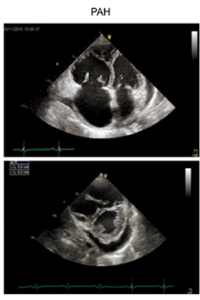
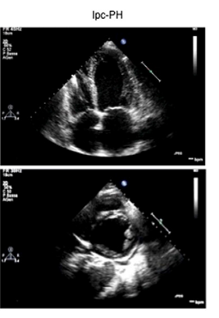
Echo: Differentiating Group 1 PH from Group 2 PH
Group 1 | Group 2
Flattening of the interventricular septum | Left heart valve abnormalities
Right atrial dilatation | Left atrial dilatation
Right ventricular dilatation | Left ventricular dilatation
RV systolic dysfunction | LV diastolic dysfunction
Notched pulsed-wave Doppler in the RVOT | LV systolic dysfunction
Inferior vena cava dilatation | Hypo or a-kinesis LV area
PAH
IpcPH

Slide 8
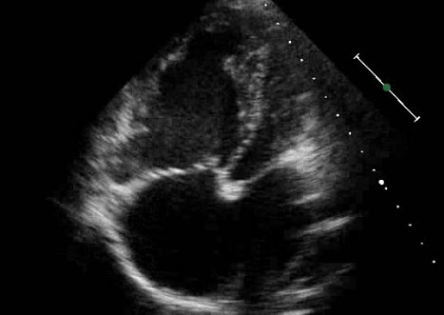
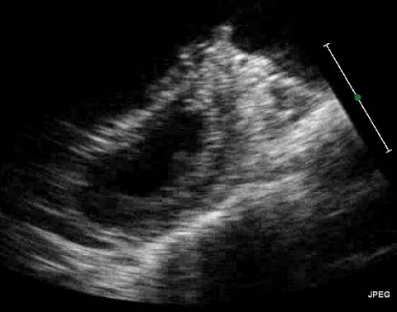
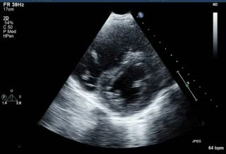
Echo: Differentiating Group 1 PH from Group 2 PH
Precapillary PH (Group 1)
Postcapillary PH (Group 2)
Reversal of septal curvature
Normal right
sided chambers
LV hypertrophy
RV dilation and
dysfunction
RV
RV
LV
LV
LV
RV
RA
LA
LA
RA
LA
RA dilation and
dysfunction
RA
Small LA with
shifted septum
LA enlargement
Right atrium (RA) and right ventricle (RV) are severely dilated
There is flattening and reversal of septal curvature
Left ventricle (LV) is small and compressed
RV
IVS
RV
IVS
LV
LV
Parasternal short-axis view of the interventricular septum (IVS) and left ventricle (LV) showing a D-shaped morphology
Parasternal short-axis view exhibiting the formation of a D-shaped left ventricle (LV) in a patient with Group 2 pulmonary hypertension

