Slide 1
What’s the Issue With Getting Hemodynamic Pressure Estimates Using Echo? – Part 2
Ahmed S. Sadek, MD
Assistant Professor, Medicine
Pulmonary Hypertension, Right Heart Failure and CTEPH program
Cardiology Division
Lewis Katz School of Medicine
Temple University
Philadelphia, PA

Slide 2
Disclaimer
The views and opinions expressed in this educational activity are those of the faculty and do not necessarily represent the views of TotalCME, Inc., the CME providers, or the companies providing educational grants. This presentation is not intended to define an exclusive course of patient management; the participant should use their clinical judgment, knowledge, experience, and diagnostic skills in applying or adopting for professional use any of the information provided herein. Any procedures, medications, or other courses of diagnosis or treatment discussed or suggested in this activity should not be used by clinicians without evaluation of their patient's conditions and possible contraindications or dangers in use, review of any applicable manufacturer’s product information, and comparison with recommendations of other authorities. Links to other sites may be provided as additional sources of information.

Slide 3
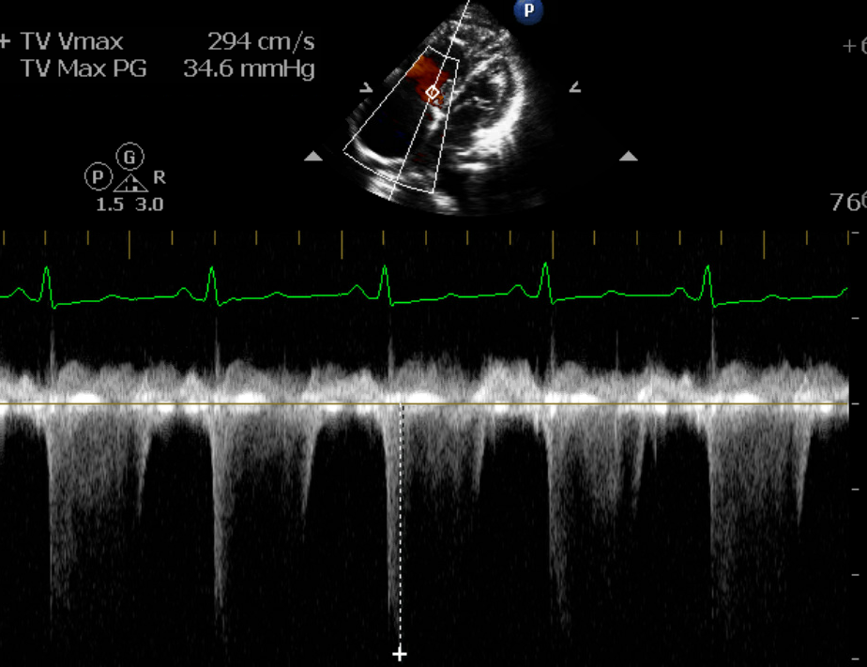
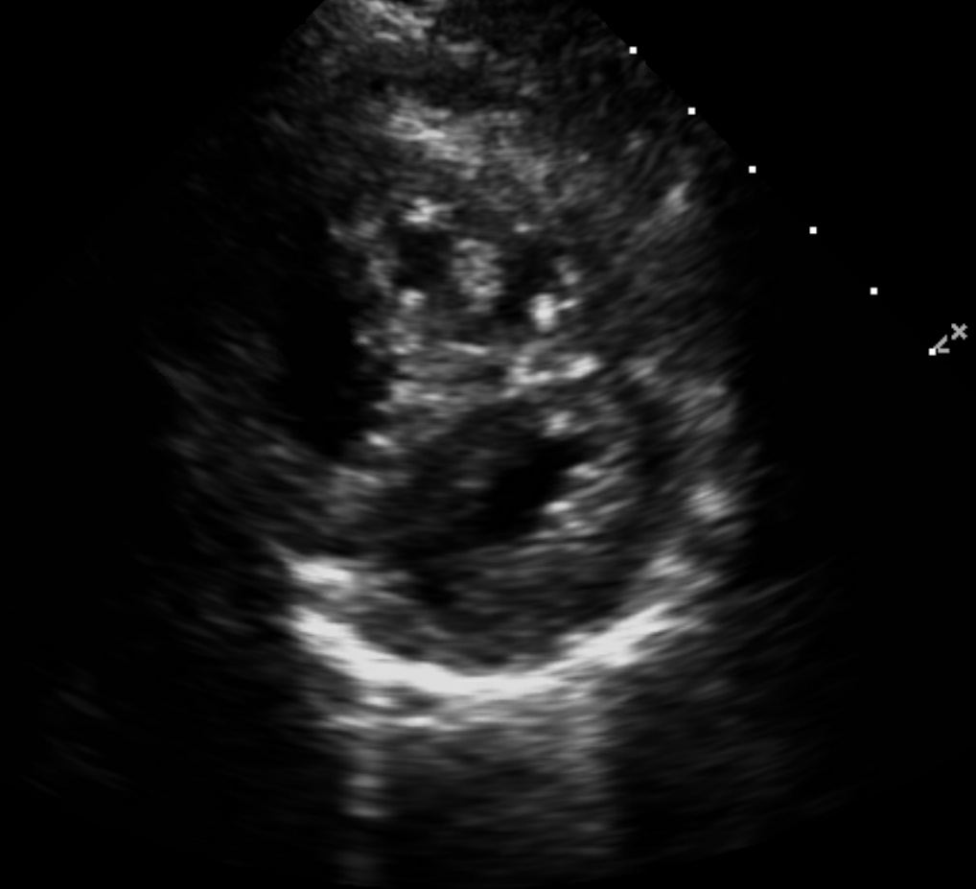
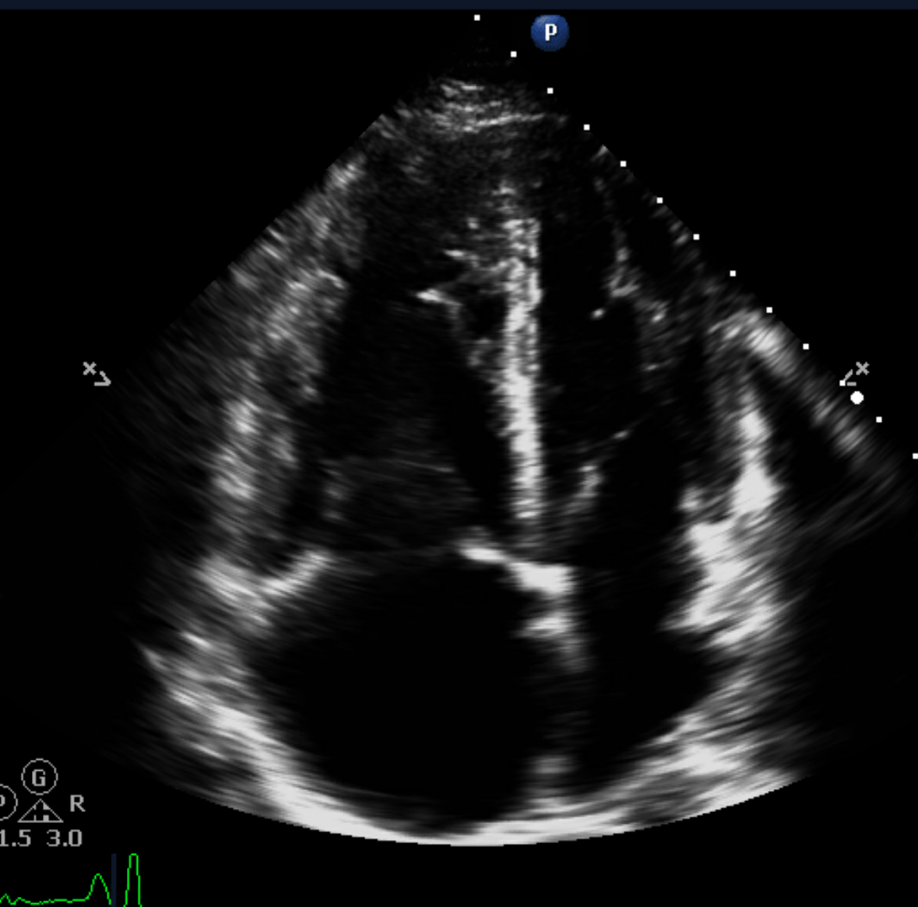
Case: 32 y.o. F With History of Exertional Syncope, Leg Swelling
TR Vmax 270 cm/s, gradient of 29 mm Hg
Severe interventricular septal flattening
Severe RV, RA enlargement RV:LV >1.5
RHC Data: RAP of 6, PAP 80/32 (51), PCWP of 8, PVR 8.66 WU
There is a reason why even when TR velocity is <2.8, the presence of other echocardiographic signs should raise suspicion for PH

Slide 4
Echo: Probability of PH in Symptomatic Patients with a Suspicion of PH - Don’t Forget the Other “PH Signs”
Peak Tricuspid Regurgitation Velocity (m·s^{–1}) | Presence of other Echocardiographic "PH Signs" | Echocardiographic Probability of PH
≤2.8 or not measurable | No | Low Risk
≤2.8 or not measurable 2.9–3.4 | Yes No | Intermediate Risk
2.9–3.4 >3.4 | Yes Not Required | High Risk

Slide 5
Comparison of PH Severity According to PASP Derived From RHC Versus PASP Estimated by Doppler Echo
PASP Underestimates
RHC | Doppler _{Est} | Category_{cath} | Category _{Doppler} | Error
70 | 48 | severe | mild | 2
76 | 46 | severe | mild | 2
65 | 43 | severe | mild | 2
90 | 54 | severe | mild | 2
72 | 51 | severe | mild | 2
118 | 56 | severe | moderate | 1
106 | 56 | severe | moderate | 1
105 | 94 | severe | severe | 0
76 | 59 | severe | moderate | 1
126 | 74 | severe | severe | 0
119 | 77 | severe | severe | 0
60 | 30 | moderate | none | 2
66 | 33 | moderate | none | 2
64 | 51 | moderate | mild | 1
61 | 50 | moderate | mild | 1
PASP Overestimates
RHC | Doppler _{Est} | Category_{cath} | Category _{Doppler} | Error
113 | 127 | severe | severe | 0
80 | 103 | severe | severe | 0
96 | 108 | severe | severe | 0
78 | 100 | severe | severe | 0
80 | 102 | severe | severe | 0
70 | 81 | severe | severe | 0
70 | 89 | severe | severe | 0
84 | 111 | severe | severe | 0
65 | 76 | moderate | severe | 0
64 | 120 | moderate | severe | 1
60 | 82 | moderate | severe | 1
63 | 78 | moderate | severe | 1
58 | 73 | moderate | severe | 1
62 | 73 | moderate | severe | 1
48 | 65 | mild | severe | 2
54 | 74 | mild | severe | 2
RHC versus echo Doppler-derived PASP
PH : Severe ( PASP>65 mm Hg), moderate (55-64 mm Hg), mild (<55 mm Hg)
In 29%, Doppler estimate discrepant by >1 category
18% were under-estimation by Doppler
20/29 patients with echo RAP>15, had RHC RAP <10
Etiology of 50% echo PASP overestimation
Classification of PH severity (category) by RHC or DE: severe (> 65 mm Hg); moderate (55–64 mm Hg); mild (40–54 mm Hg)
Degree of misclassification (error) of the severity of PH by DE is graded from 0–2 (0 = same category; 1 = 1 category of misclassification; 2 = 2 or more categories of misclassification)

Slide 6
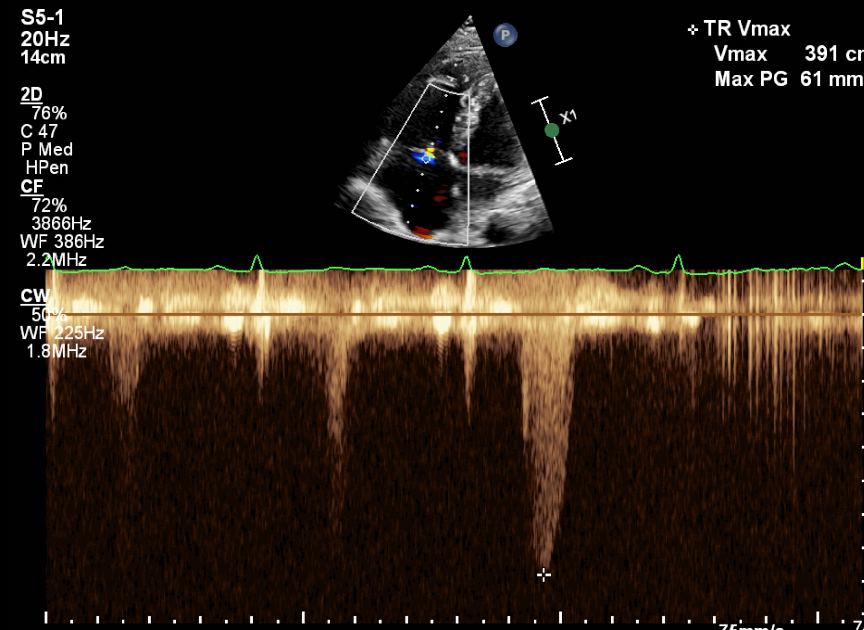
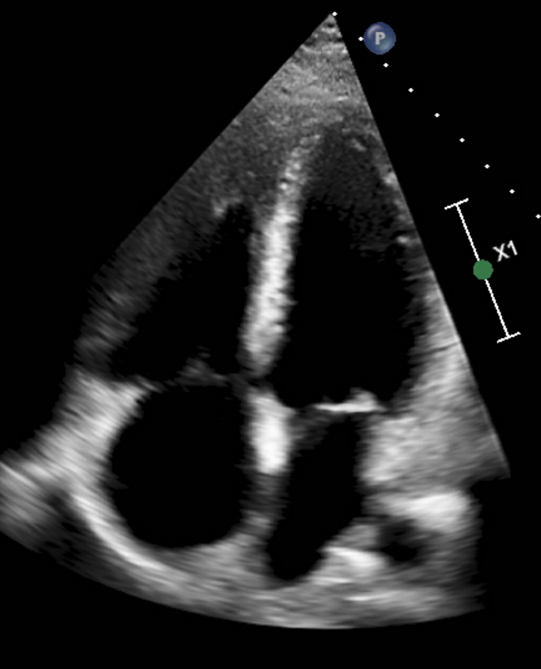
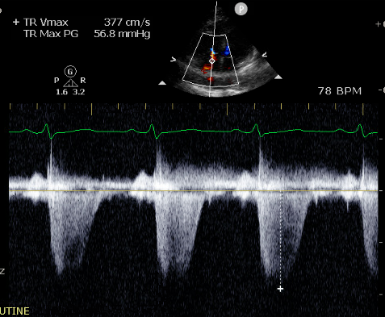
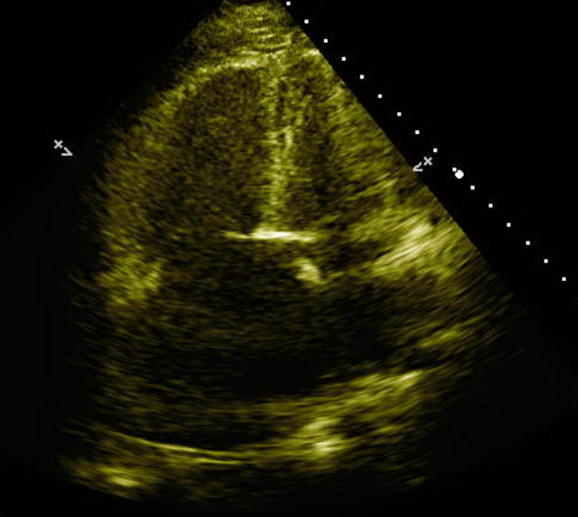
Which of These Patients Is at Higher Risk?
Patient 1
Patient 2
TR Vmax 4.2 m/s, estimated RVSP 74 mm Hg
Normal RV size, function, TAPSE 2.4 cm
TR Vmax of 3.77 m/s, estimated RVSP of 60 mm Hg
Severe RV, RA enlargement. TAPSE 1.4 cm
Office visit
BNP 25, functional class II symptoms, 6MWT 502 m
Admitted to CCU with HF, acute renal failure
FC III symptoms, BNP of 454
RHC: RAP of 5, PAP 80/27 (47), PCWP of 11, CO of 5.66, CI of 3.19, PVR of 6.36 WU
RHC: RAP of 7, PAP 63/33 (43), PCWP 10, PVR 10.7 WU, SVR 2178 WU, PVR SVR 0.39, cardiac index 1.77

Slide 7
Which of These Patients Is at Higher Risk?
Patient 1
Patient 2
TR Vmax 4.2 m/s, estimated RVSP 74 mm Hg
Normal RV size, function, TAPSE 2.4 cm
TR Vmax of 3.77 m/s, estimated RVSP of 60 mm Hg
Severe RV, RA enlargement. TAPSE 1.4 cm
Office visit.
BNP 25, Functional class II symptoms, 6MWT 502 m
Admitted to CCU with HF , acute renal failure.
FCIII symptoms, BNP of 454
RHC: RAP of 5, PAP 80/27 (47), PCWP of 11, CO of 5.66, CI of 3.19, PVR of 6.36 WU
RHC: RAP of 7, PAP 63/33 (43), PCWP 10, PVR 10.7 WU, SVR 2178 WU, PVR SVR 0.39, cardiac index 1.77
Hemodynamic pressure estimates in isolation may not adequately risk stratify severity of PH syndrome

Slide 8
PASP Does Not Differ Between Risk Groups
 | Mean ± SD or n (%)
 | Low | Intermediate | High | p-Value
RA Area, cm² | 18.9 ± 6.2 [n = 36] | 21.3 ± 7.6 [n = 67] | 27.4 ± 7.4 [n = 8] | 0.011
RV End-Systolic Area, cm² | 18.9 ± 7.1 [n = 35] | 21.1 ± 8.4 [n = 63] | 29.0 ± 7.4 [n = 7] | 0.010
RV End-Diastolic Area, cm² | 26.5 ± 8.0 [n = 35] | 28.5 ± 9.1 [n = 63] | 35.7 ± 6.9 [n = 7] | 0.041
Moderate/Severe RA Dilation * (vs. None/Mild) | 12 (33.3) [n = 36] | 26 (38.8) [n = 67] | 5 (62.5) [n = 8] | 0.353
Moderate/Severe RV Dilation (vs. None/Mild) | 9 (25.7) [n = 35] | 20 (31.8) [n = 63] | 3 (42.9) [n = 7] | 0.587
RV FAC, % | 30.1 ± 11.2[n = 42] | 27.8 ± 11.4 [n = 87] | 19.6 ± 9.9 [n = 14] | 0.011
TAPSE, mm | 19.6 ± 4.0 [n = 39] | 19.2 ± 5.1[n = 85] | 13.4 ± 3.1 [n = 14] | <0.001
PASP, mmHg | 47.5 ± 24.2 [n = 30] | 56.2 ± 24.9 [n = 60] | 52.8 ± 8.8 [n = 10] | 0.260
TAPSE/PASP, mm/mmHg | 0.65 ± 0.53 [n = 27] | 0.42 ± 0.28 [n = 56] | 0.26 ± 0.05 [n = 10] | 0.005
LVED Eccentricity Index | 1.04 ± 0.30 [n = 22] | 1.18 ± 0.35 [n = 54] | 1.27 ± 0.43 [n = 9] | 0.156
LVES Eccentricity Index | 0.98 ± 0.31 [n = 24] | 1.36 ± 0.87 [n = 46] | 1.88 ± 2.05 [n = 8] | 0.056
Moderate/Severe TR ” (vs. None/Trace/Mild) | 11 (25.6) [n = 43] | 27 (30.7) [n = 88] | 8 (61.5) [n = 13] | 0.044

