Slide 1
What’s the Issue With Getting Hemodynamic Pressure Estimates
Using Echo? – Part 1
Ahmed S. Sadek, MD
Assistant Professor, Medicine
Pulmonary Hypertension, Right Heart Failure and CTEPH program
Cardiology Division
Lewis Katz School of Medicine
Temple University
Philadelphia, PA

Slide 2
Disclaimer
The views and opinions expressed in this educational activity are those of the faculty and do not necessarily represent the views of TotalCME, Inc., the CME providers, or the companies providing educational grants. This presentation is not intended to define an exclusive course of patient management; the participant should use their clinical judgment, knowledge, experience, and diagnostic skills in applying or adopting for professional use any of the information provided herein. Any procedures, medications, or other courses of diagnosis or treatment discussed or suggested in this activity should not be used by clinicians without evaluation of their patient's conditions and possible contraindications or dangers in use, review of any applicable manufacturer’s product information, and comparison with recommendations of other authorities. Links to other sites may be provided as additional sources of information.

Slide 3
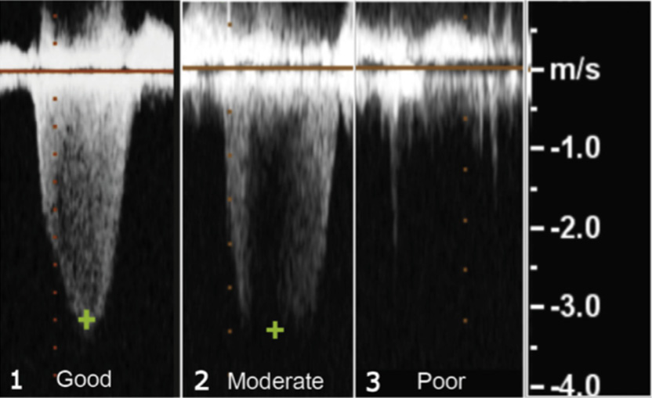
Echocardiogram: TR_{jet} Gives Only an Estimate of PAP
PAP is estimated from TR jet using simplified Bernoulli equation:
  RVSP = 4 x V² + RAP
The quality of the TR jet and the expertise of echocardiography reader matters!
Quality of TR jet
Review the echocardiography images

Slide 4
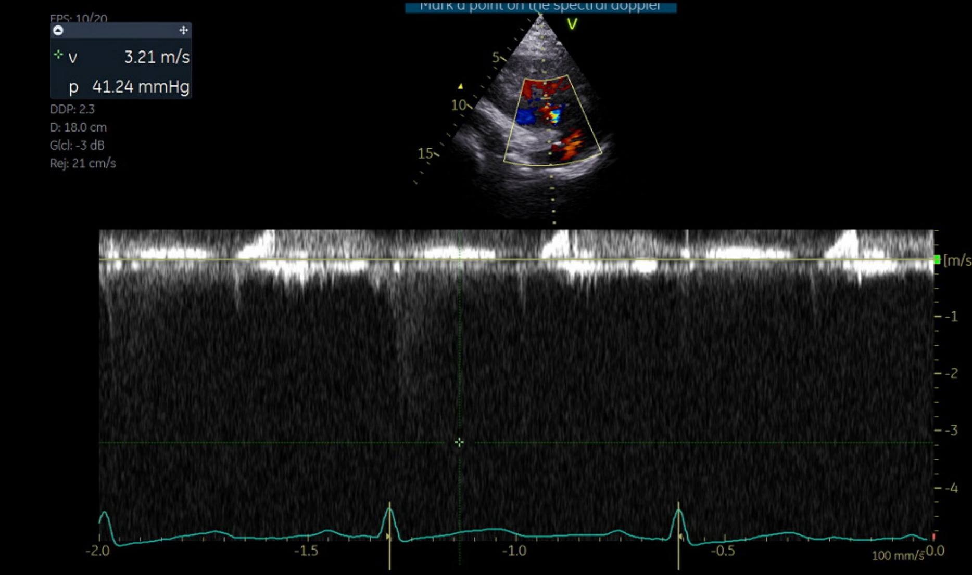
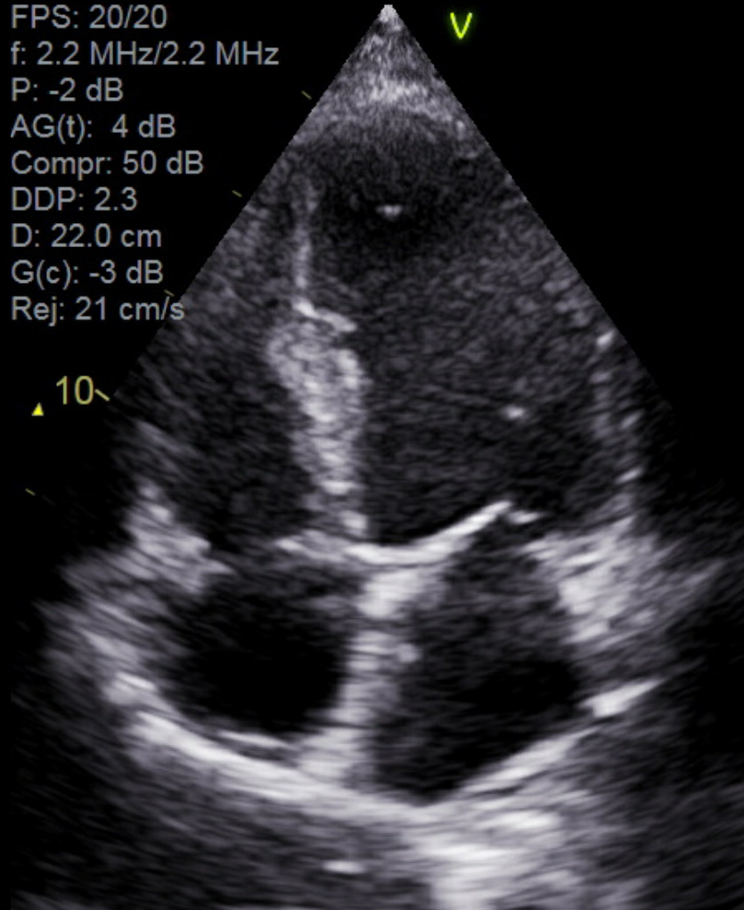
Case: 38 y.o. F 20 Weeks Gestation Referred for PH Evaluation
V: 3.21 MS.
Gradient :41.2 mm hg
Poor TR jet quality
RVSP reported as 44 mm Hg
Normal RV size and function, No other signs of PH

Slide 5
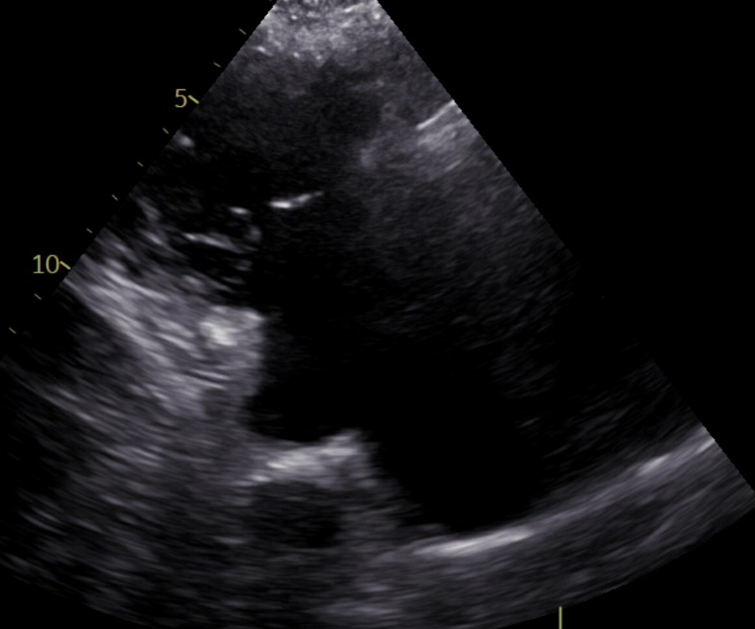
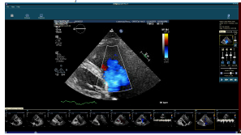
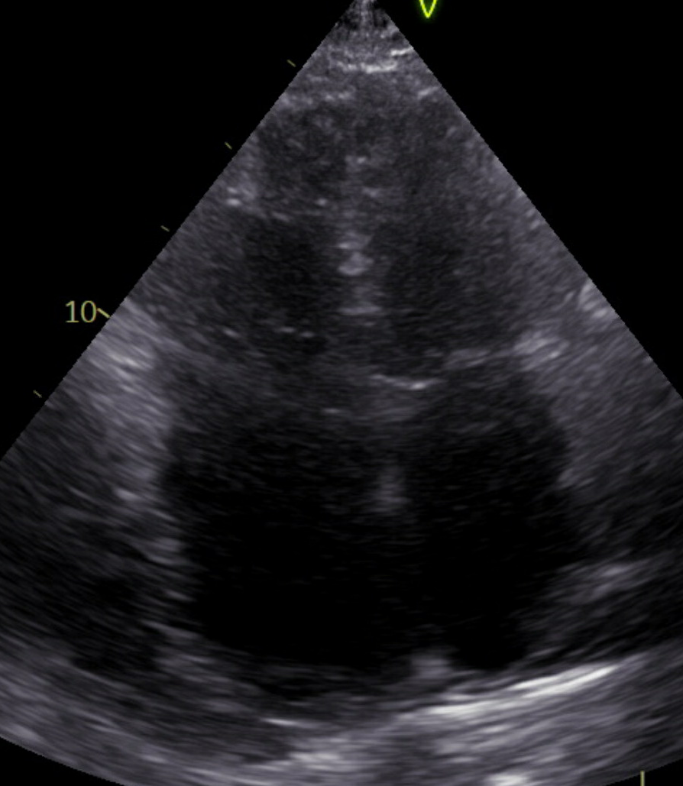
Case: 83 y.o. F, PMH of Sjøgrens and Atrial Fibrillation Presenting with Heart Failure
Tricuspid valve malcoaptation.
Severe TR
Biatrial enlargement, RA >LA, normal LVEF, RV dilation

Slide 6
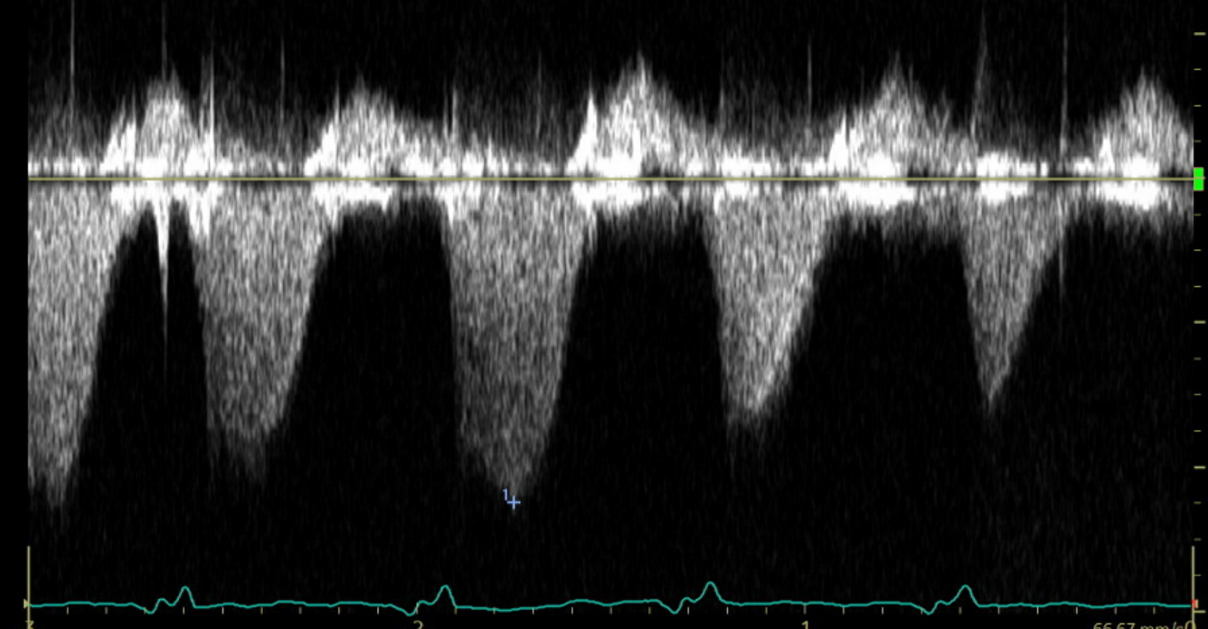
Case: Severe Tricuspid Regurgitation Results in Laminar Flow
Severe TR, absence of significant RA-RV pressure gradient (and therefore RA-PA pressure gradient.)
Underestimation of RVSP
Look for other signs of PH: systolic interventricular septal flattening, acceleration time of RVOT PW doppler, RVOT PW notching
TR Vmax 1.82 m/s, gradient of 13.2 mm Hg

Slide 7
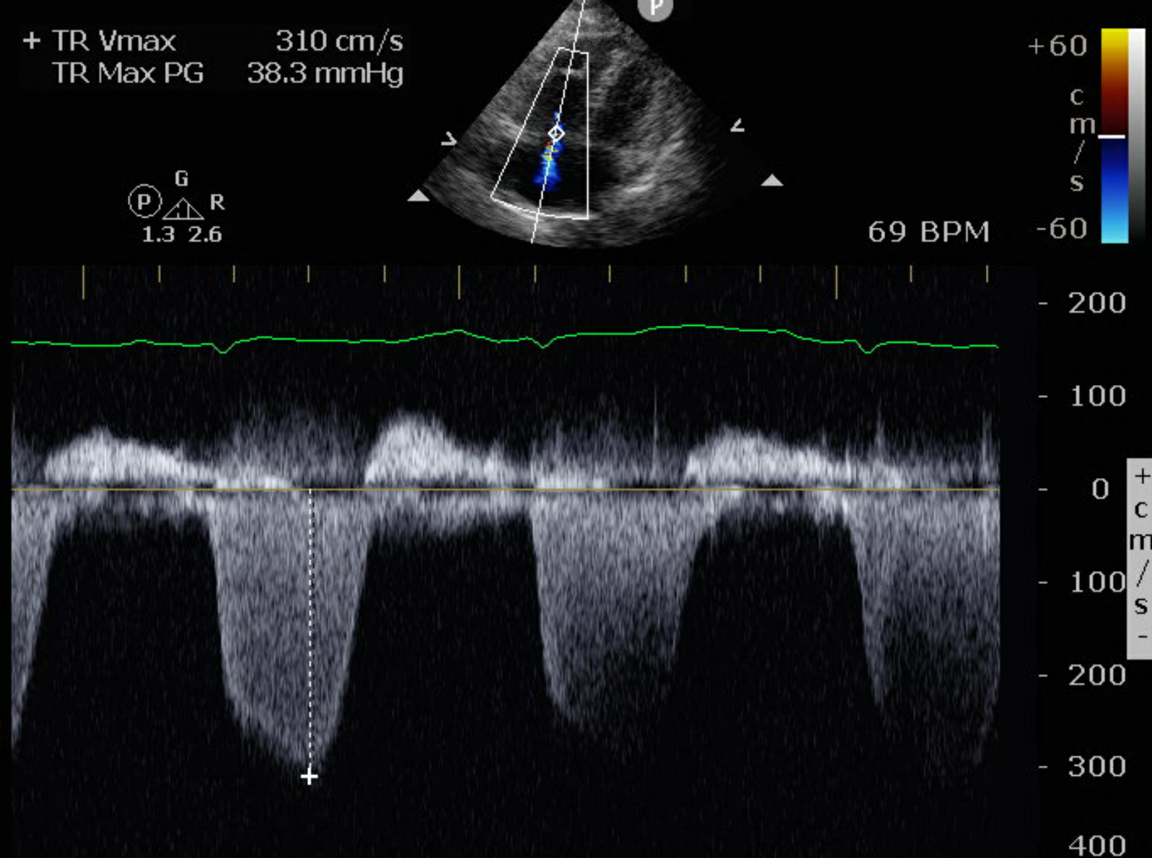
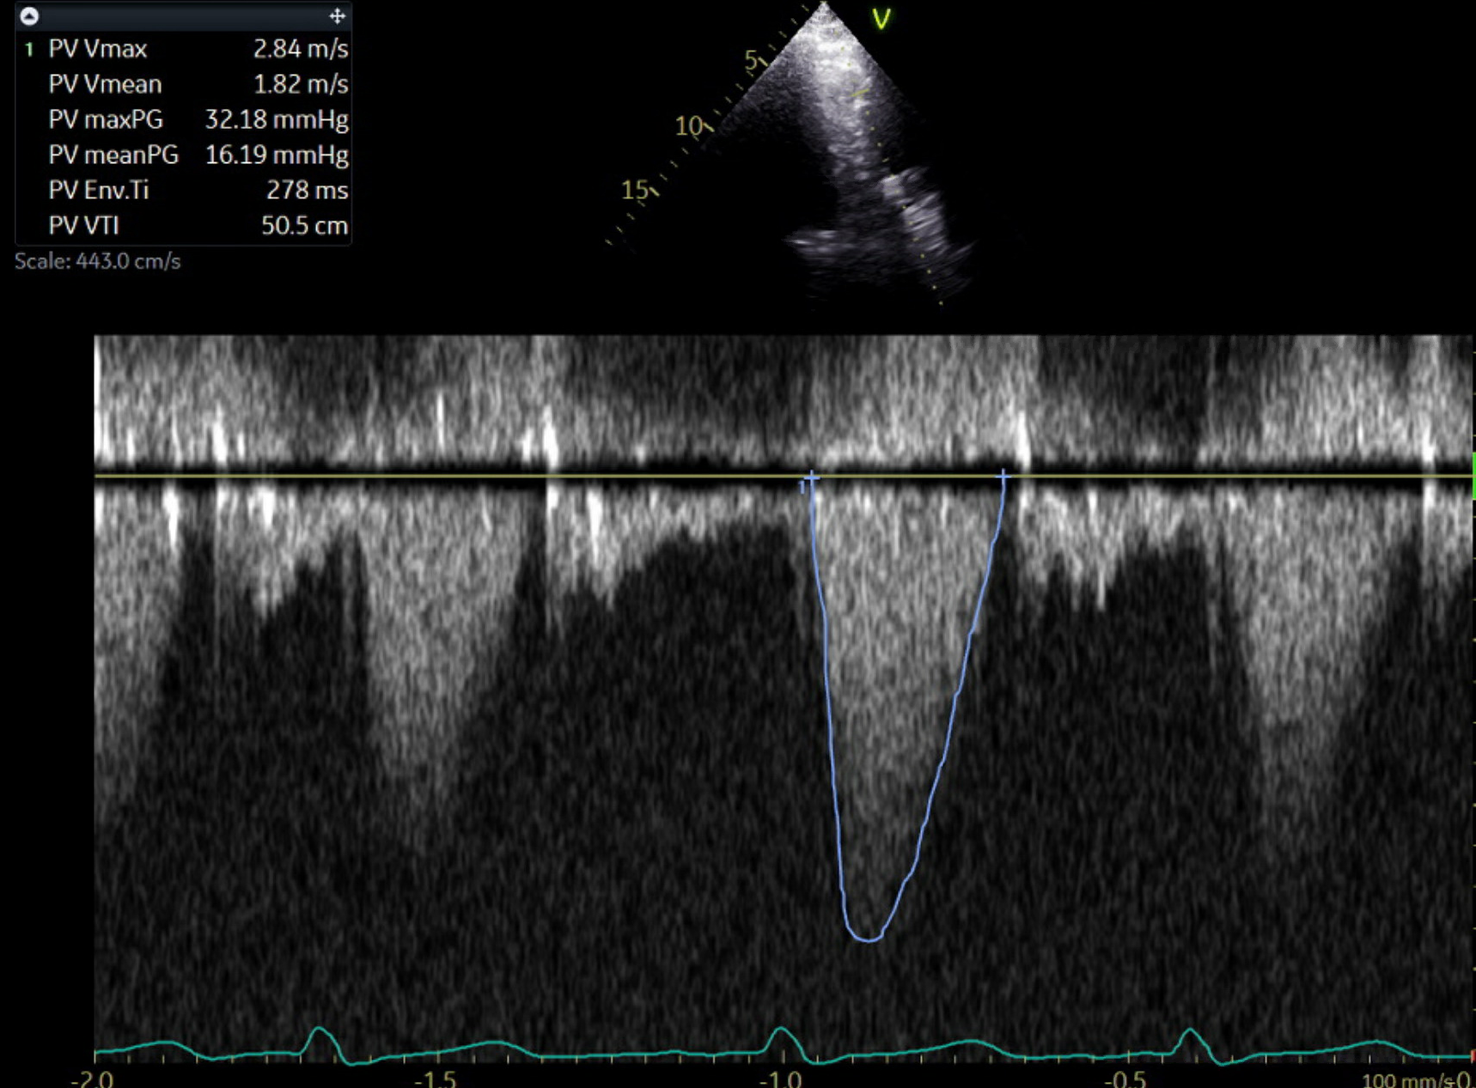
Case: 61 y.o. M with History of PDA s/p Ligation, Aortic Coarctation s/p repair, VSD s/p Closure, RVOT Reconstruction with Pulmonary Valve Replacement
Calculation of PASP in pulmonic stenosis:
RVSP-PV gradient.
53-32 = “true” PASP
of 21
TR Vmax 310 cm/s, gradient of 38.3 mm Hg
Estimated RVSP of 53
BUT with gradient across pulmonary valve: peak gradient 32 mm Hg, mean gradient of 17 mm Hg, mild to moderate Pulmonary valve stenosis

