Slide 1
How Will the New ERS/ESC PH Echocardiography Guidelines Apply to Your Practice?
Vallerie V. McLaughlin, MD Associate Chief Clinical Officer, Cardiovascular Services Director, Pulmonary Hypertension Program University of Michigan Ann Arbor, MI

Slide 2
Disclaimer
The views and opinions expressed in this educational activity are those of the faculty and do not necessarily represent the views of TotalCME, Inc., the CME providers, or the companies providing educational grants. This presentation is not intended to define an exclusive course of patient management; the participant should use their clinical judgment, knowledge, experience, and diagnostic skills in applying or adopting for professional use any of the information provided herein. Any procedures, medications, or other courses of diagnosis or treatment discussed or suggested in this activity should not be used by clinicians without evaluation of their patient's conditions and possible contraindications or dangers in use, review of any applicable manufacturer’s product information, and comparison with recommendations of other authorities. Links to other sites may be provided as additional sources of information.

Slide 3
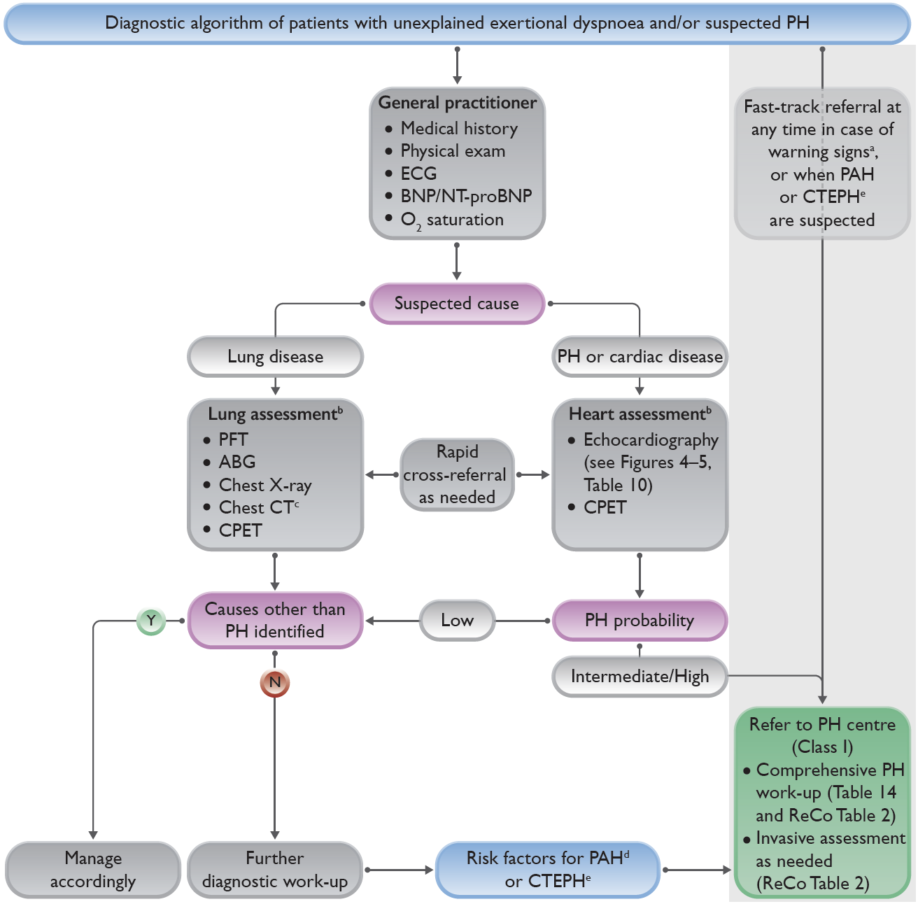
2022 Diagnostic Algorithm of Patients With Unexplained Dyspnea and/or Suspected Pulmonary Hypertension
Warning signs include rapid progression of symptoms, severely reduced exercise capacity, pre-syncope or syncope on mild exertion, and signs of right heart failure
Lung and heart assessments by specialist as per local practice
CT pulmonary angiography recommended if PH suspected
Includes connective tissue disease (especially systemic sclerosis), portal hypertension, HIV infection, and family history of PAH
History of PE, permanent intravascular devices, inflammatory bowel diseases, essential thrombocythemia, splenectomy, high-dose thyroid hormone replacement, or malignancy

Slide 4
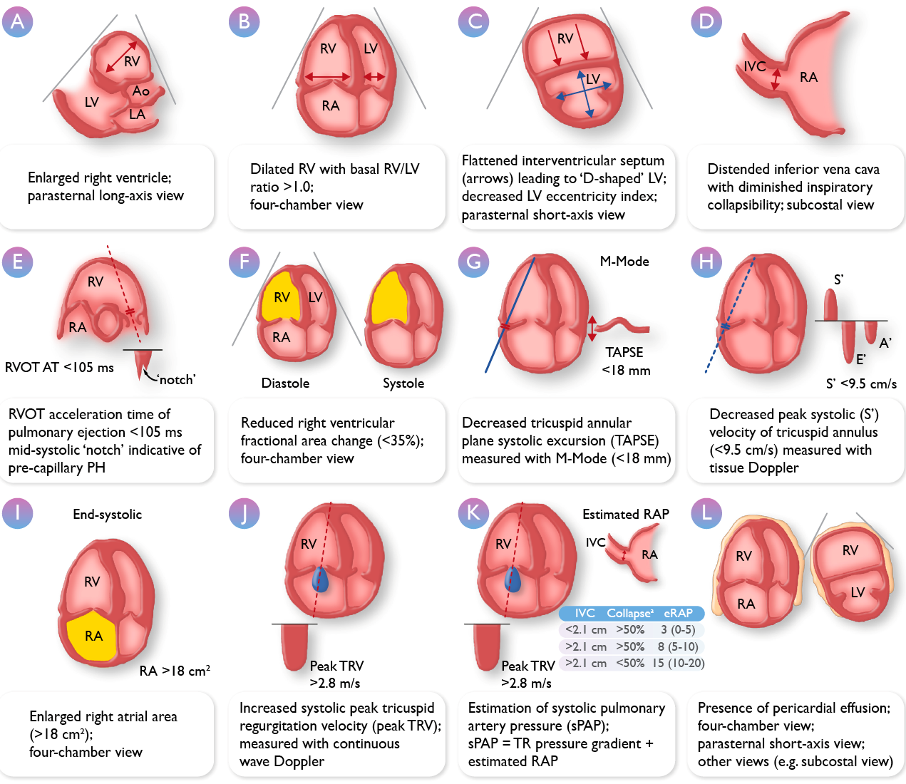
ERS/ESC 2022: Echo Parameters for Assessing PH
Transthoracic echocardiographic parameters in the assessment of pulmonary hypertension

Slide 5
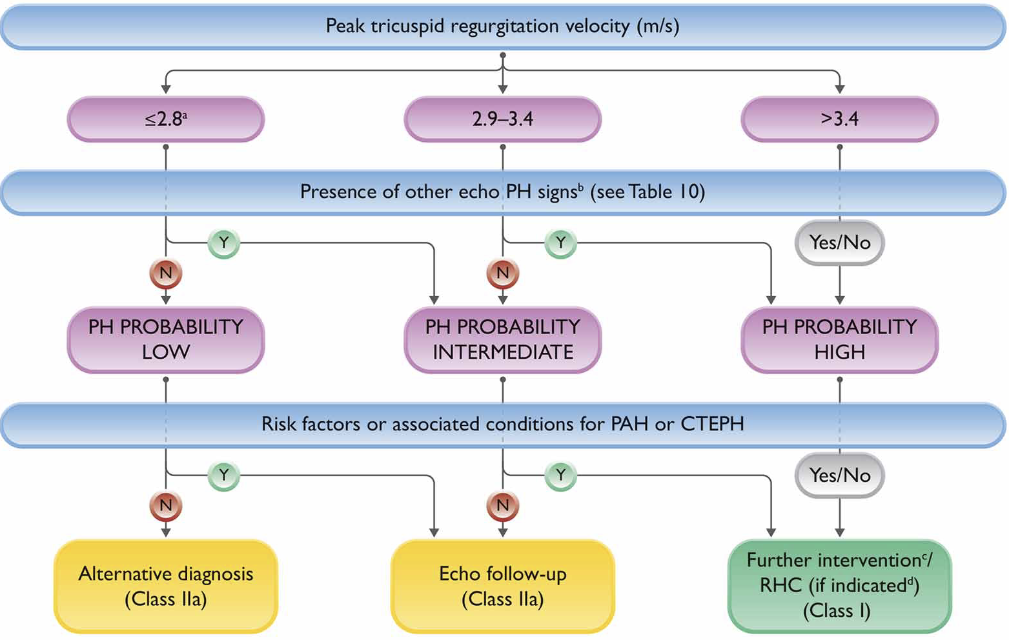
Echocardiographic Probability of PH and Recommendations for Further Assessment
ªOr unmeasurable. The TRV threshold of 2.8 m/s was not changed according to the updated hemodynamic definition of PH.
^{b}Signs from at least two categories in Table 10 (A/B/C) must be present to alter the level of echocardiographic probability of PH
^{c}Further testing may be necessary (e.g. imaging, CPET)
^{d}RHC should be performed if useful information/ or a therapeutic consequence is anticipated (e.g. suspected PAH or CTEPH), and may not be indicated in patients without risk factors or associated conditions for PAH or CTEPH (e.g. when mild PH and predominant LHD or lung disease are present).

