Slide 1
Maximizing Echo Image Utility for PH Diagnosis
Francois Haddad, MD, FAHA
Clinical Professor of Medicine
Director of Stanford Biomarker and Phenotypic Core Laboratory
Director of Stanford Echocardiography Laboratory Quality
Stanford University
Stanford, CA

Slide 2
Disclaimer
The views and opinions expressed in this educational activity are those of the faculty and do not necessarily represent the views of TotalCME, Inc., the CME providers, or the companies providing educational grants. This presentation is not intended to define an exclusive course of patient management; the participant should use their clinical judgment, knowledge, experience, and diagnostic skills in applying or adopting for professional use any of the information provided herein. Any procedures, medications, or other courses of diagnosis or treatment discussed or suggested in this activity should not be used by clinicians without evaluation of their patient's conditions and possible contraindications or dangers in use, review of any applicable manufacturer’s product information, and comparison with recommendations of other authorities. Links to other sites may be provided as additional sources of information.

Slide 3
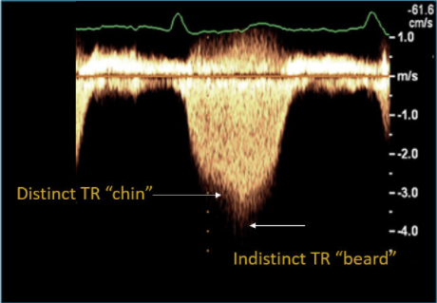

Pearl 1. The Chin and the Beard
“Chin” indicates modal frequency

Slide 4
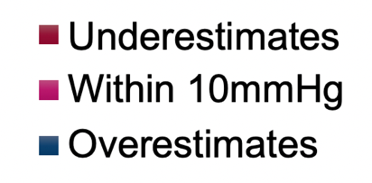
Echocardiogram Gives Only 40% PASP Accuracy* REVEAL Registry
N=98
N=481
*Accuracy defined as not >10 mmHg higher or lower than right heart catheterization.

Slide 5
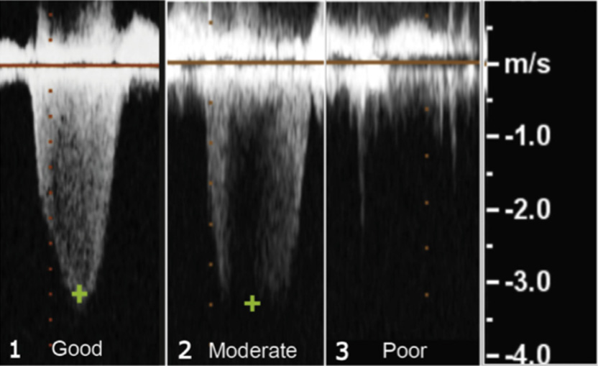
Echocardiogram: TR Jet Gives Only an Estimate of PAP
PAP is estimated from TR jet using simplified Bernoulli equation:
  Peak grad = 4 x V2 + RA
The quality of the TR jet and the expertise of echocardiography reader matters!
Quality of TR jet
Review the echocardiography images

Slide 6
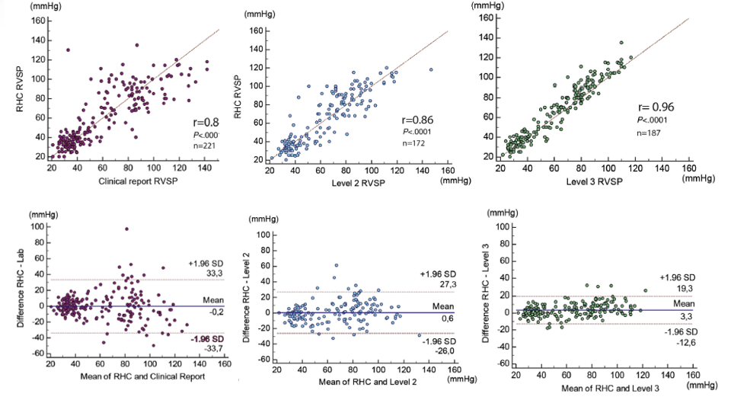
The “Beard” Is the Most Common Cause of Overestimation of PAP
Clinical Report
Level 2 Reader
Level 3 Reader

Slide 7
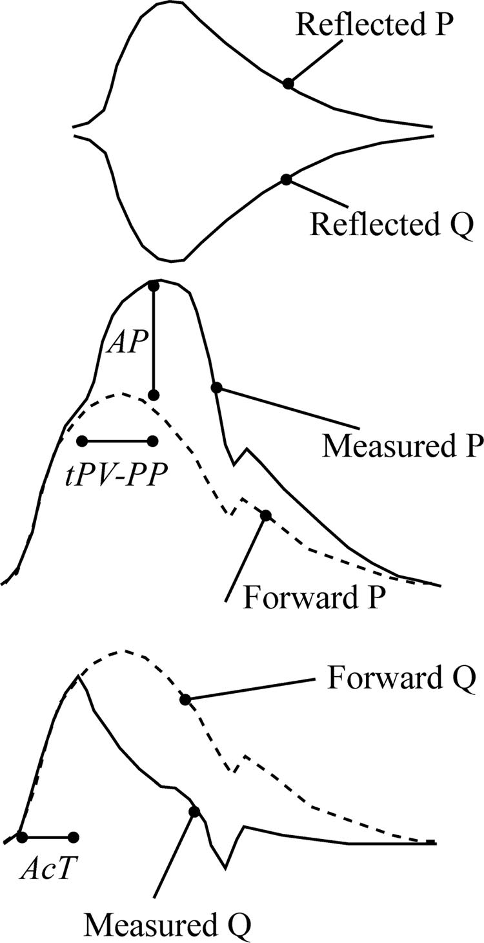
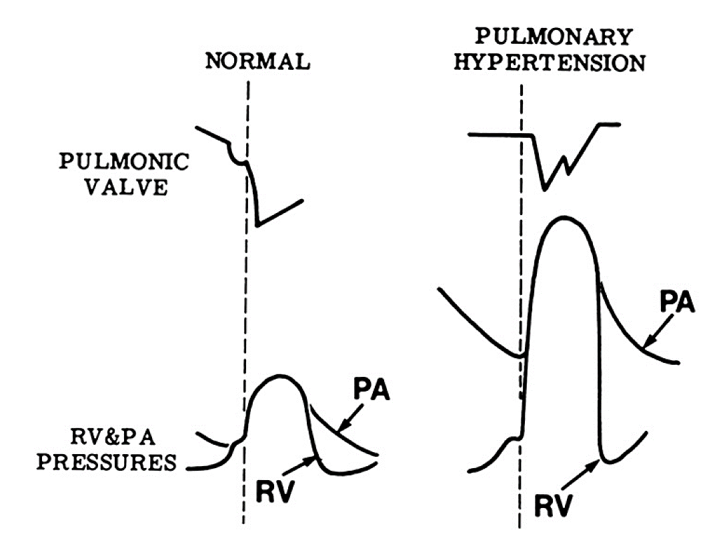
Pearl 2: Don’t Forget the Pulmonary Flow Profile

Slide 8
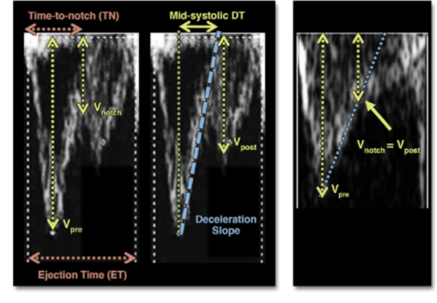
Pearl 2: Don’t Forget the Pulmonary Flow Profile
INSIGHTS INTO PULMONARY VASCULATURE FROM RVOT PROFILE
Severity
Normal | PH | PH | PH | PH
Profile | early peaking | notched | notched | notched
Pre-notch slope Dec time, 120 msec |  | long | short | short
Post notch velocity (62% Vpost/Vpre) |  |  | high | low

Slide 9
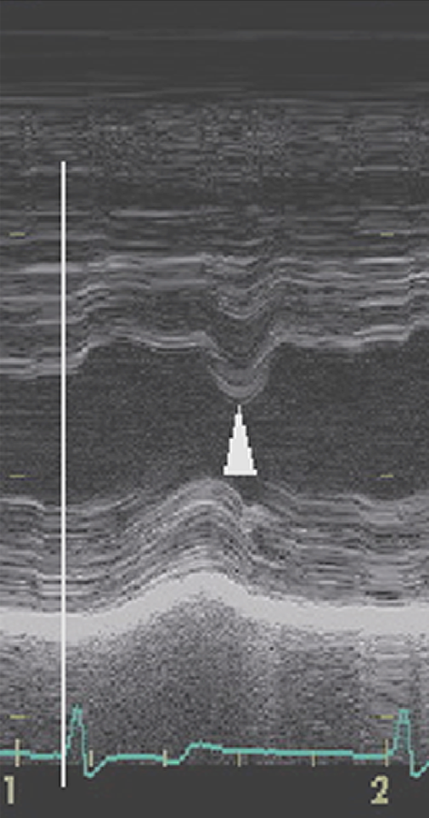
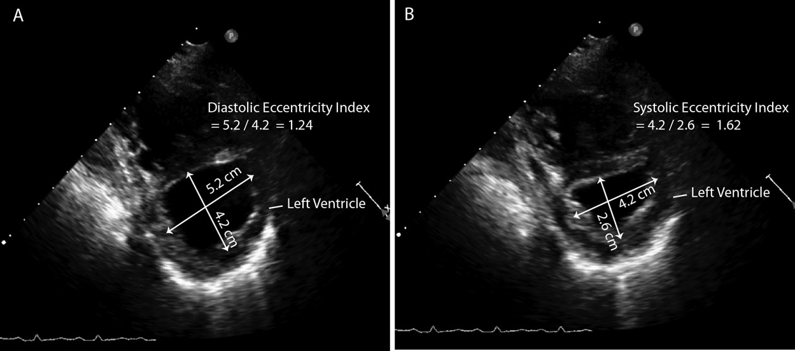
Pearl 3: The Interventricular Septum Is the Ultimate Negotiator

Slide 10
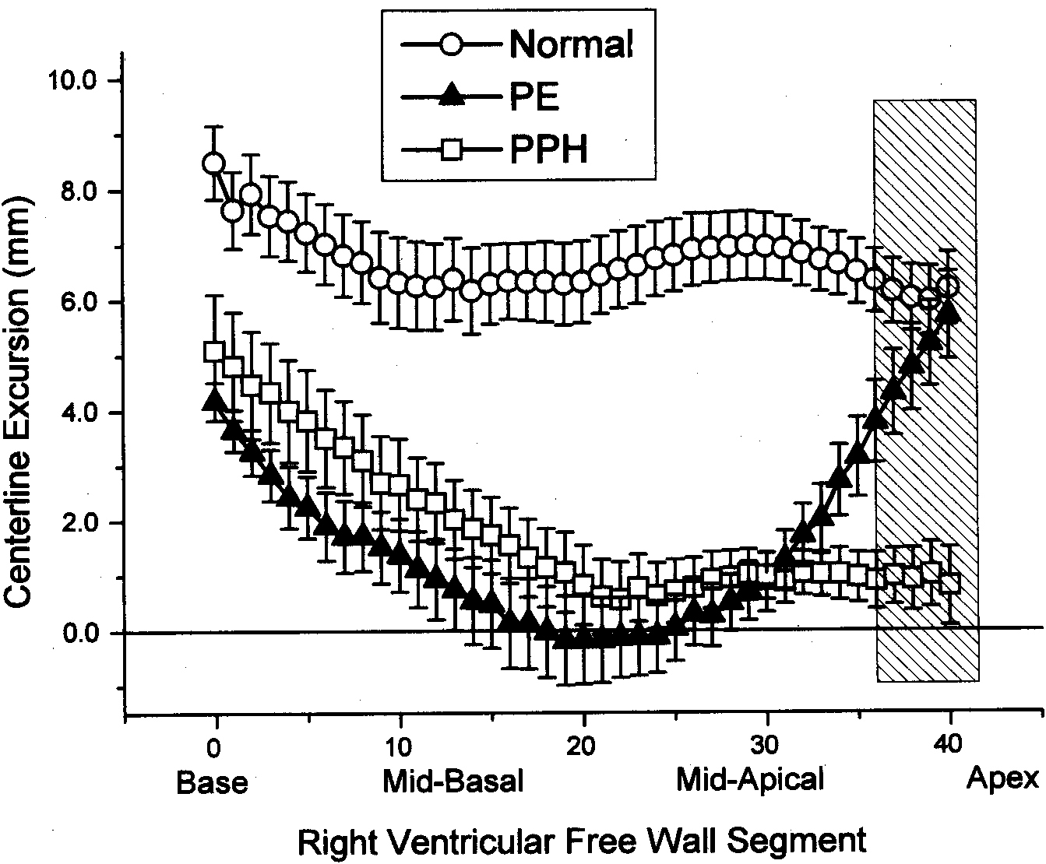
Pearl 4: Think of Regional Function Differences
Normal
PEARLS
The apical “wink”
Not specific for acute pulmonary embolism
Can be observed in many other acute pulmonary vascular diseases, and in acute right ventricular myocardial infarction
PE
PPH
Centerline Excursion (mm)
Base
Mid-Basal
Mid-Apical
Apex
Right Ventricular Free Wall Segment

Slide 11
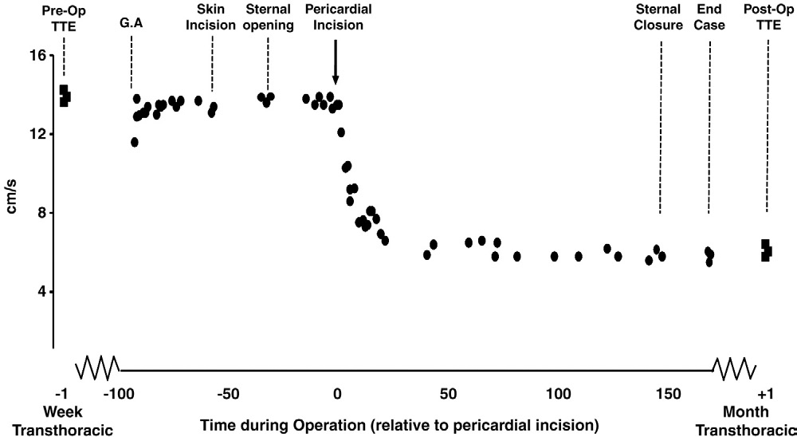
Pearl 4: Think of Regional Function Differences: One Pitfall
Intraoperative S′ velocity of the RV free wall during a routine off-pump CABG to left anterior descending and circumflex arteries
PEARLS
Focus on TAPSE-> overdiagnosis of post-op RV dysfunction (use FAC, 3D EF)
Important to focus on short axis for anterior wall motion

Slide 12
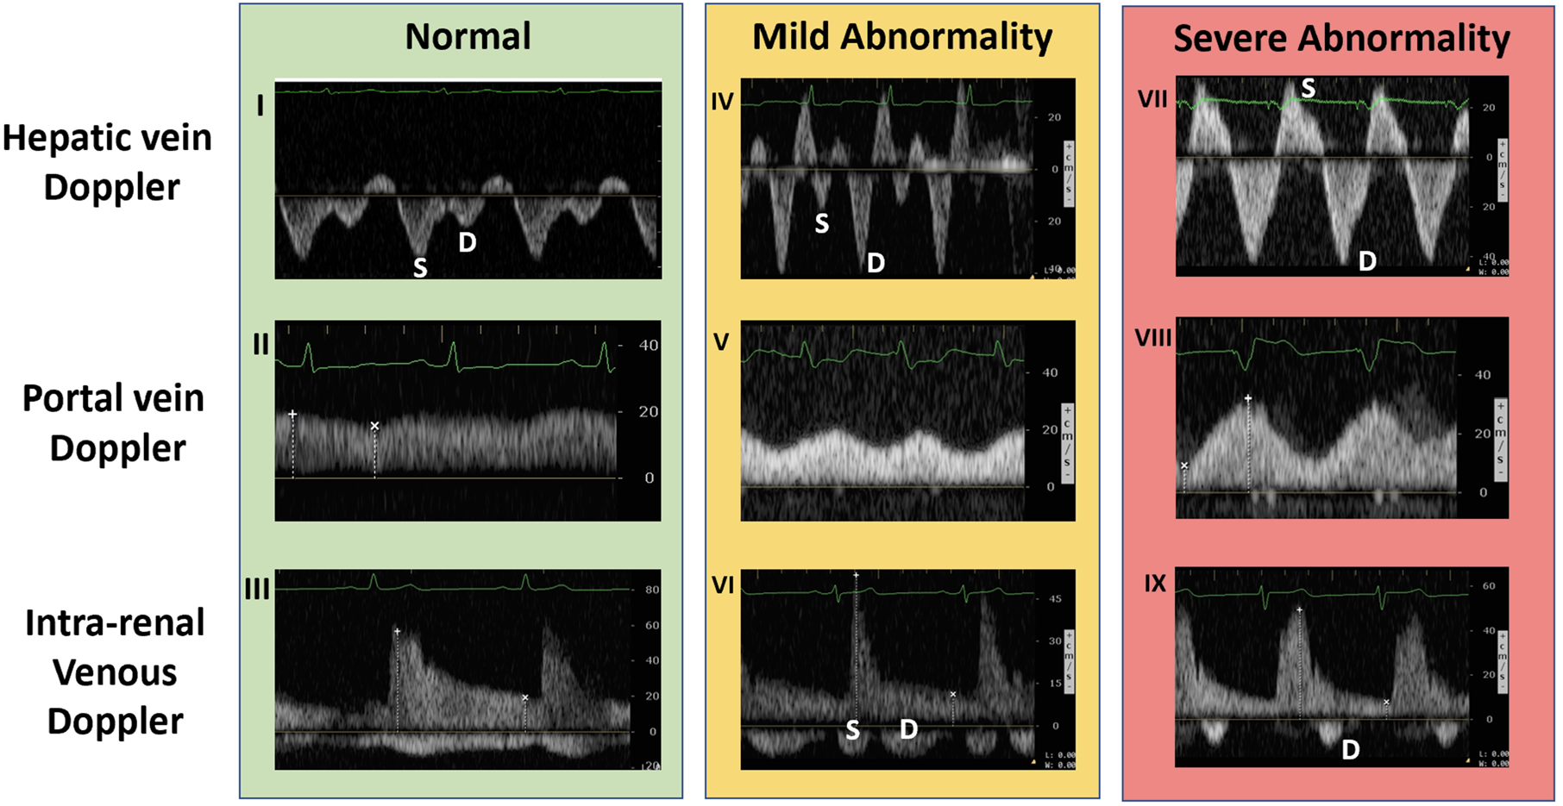
Pearl 5: The Era of Venous Excess Imaging (VExUS)
S indicates systolic phase; D, diastolic phase.

Slide 13
Summary
Quality of echo images is essential to diagnosing and monitoring PH, especially as it relates to RVSP estimates
In interpreting echo images, the practitioner must focus on heart structures, not just estimated pressures
Focus needs to be on both sides of the heart, not just the left
Numerous echo signs can aid in diagnosis of PH and to determine the specific type of disease present
The more compete the data, the better served is the patient and the PH Care Team

