Slide 1
Essential PH Imaging Techniques and Views
Francois Haddad, MD, FAHA
Clinical Professor of Medicine
Director of Stanford Biomarker and Phenotypic Core Laboratory
Director of Stanford Echocardiography Laboratory Quality
Stanford University
Stanford, CA

Slide 2
Disclaimer
The views and opinions expressed in this educational activity are those of the faculty and do not necessarily represent the views of TotalCME, Inc., the CME providers, or the companies providing educational grants. This presentation is not intended to define an exclusive course of patient management; the participant should use their clinical judgment, knowledge, experience, and diagnostic skills in applying or adopting for professional use any of the information provided herein. Any procedures, medications, or other courses of diagnosis or treatment discussed or suggested in this activity should not be used by clinicians without evaluation of their patient's conditions and possible contraindications or dangers in use, review of any applicable manufacturer’s product information, and comparison with recommendations of other authorities. Links to other sites may be provided as additional sources of information.

Slide 3
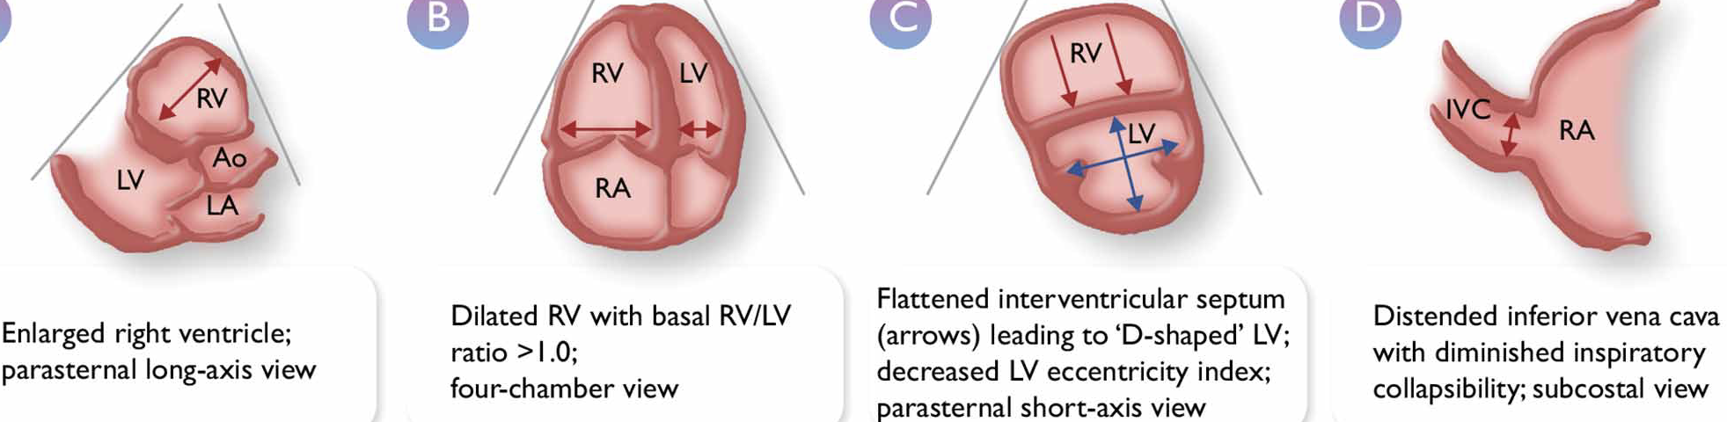
ERS/ESC 2022: Echo Parameters for Assessing PH
Ao, aorta
IVC, inferior vena cava
LA, left atrium
LV, left ventricle
PH, pulmonary hypertension
RA, right atrium
RV, right ventricle
TR, tricuspid regurgitation
Important Echo Measurements
Apical 4-chamber
Parasternal short axis
Tricuspid annular plane systolic excursion (TAPSE)
TR jet-based estimation of systolic pulmonary arterial pressure

Slide 4
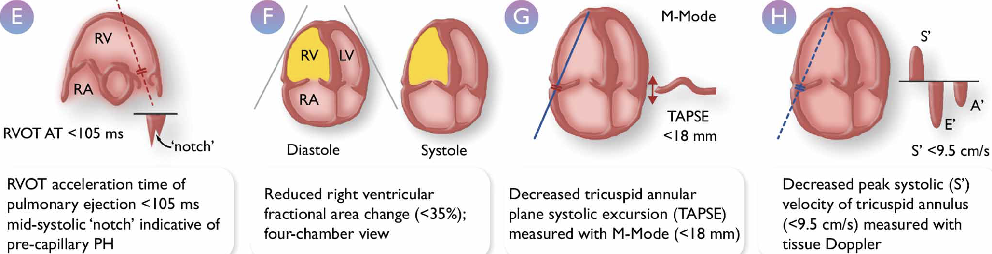
ERS/ESC 2022: Echo Parameters for Assessing PH
LV, left ventricle
RA, right atrium
RV, right ventricle
RVOT AT, right ventricular outflow tract acceleration time
Important Echo Measurements
Apical 4-chamber
Parasternal short axis
Tricuspid annular plane systolic excursion (TAPSE)
TR jet-based estimation of systolic pulmonary arterial pressure

Slide 5
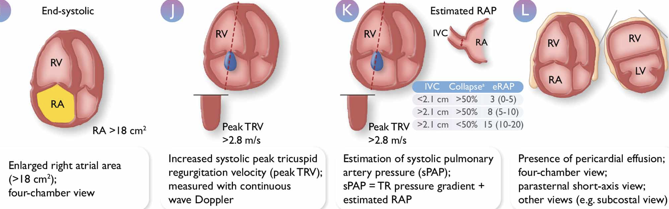
ERS/ESC 2022: Echo Parameters for Assessing PH
LV, left ventricle
RA, right atrium
RV, right ventricle
TR, tricuspid regurgitation
IVC, inferior vena cava
RAP, right atrial pressure;
sPAP, systolic pulmonary artery pressure
TRV, tricuspid regurgitation velocity
Important Echo Measurements
Apical 4-chamber
Parasternal short axis
Tricuspid annular plane systolic excursion (TAPSE)
TR jet-based estimation of systolic pulmonary arterial pressure

Slide 6
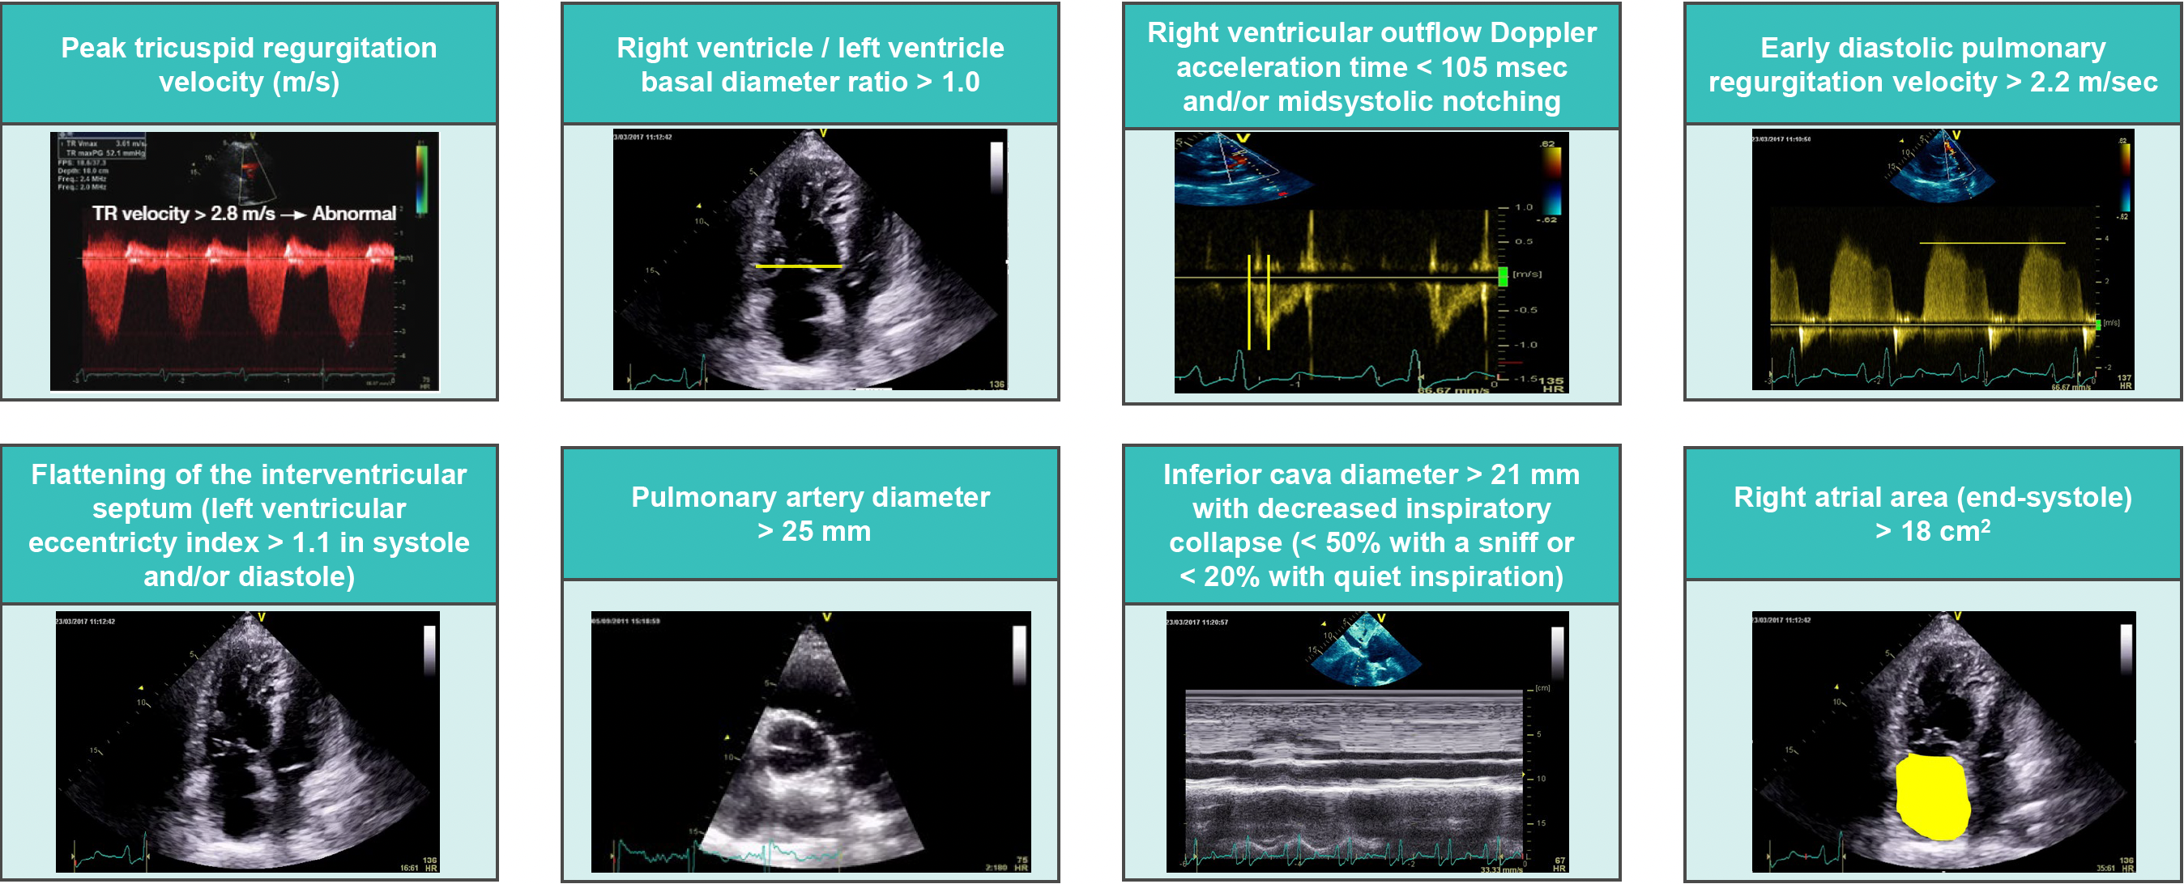
The Eight Signs of Pulmonary Hypertension

Slide 7
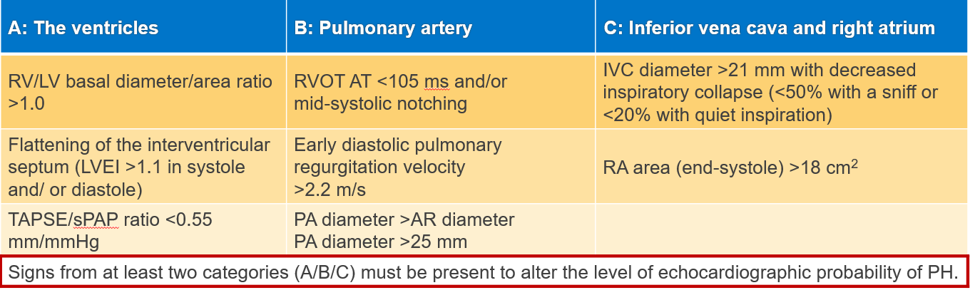
Key Features for the Diagnosis of PH/Pulmonary Vascular Disease
Peak tricuspid regurgitation velocity m/s^{–1} | Presence of other echocardiographic PH signs | Echocardiographic probability of PH
≤2.8 or not measurable | No | Low
≤2.8 or not measurable 2.9-3.4 | Yes No | Intermediate
2.9-3.4 >3.4 | Yes Not required | High
Central role hemodynamic measures (TRV)
Supportive signs

Slide 8
Key Prognostic Markers in PAH: Many Studies, Many Markers….
 |  |  | TR jet |  | Correlate with RA size/pressure |  |  | RV and LV structural and eccentricity measures |  |  |  | RVSF and related
Type | Etiology | N | RVSP or mPAP | Degree of TR | RA area or size | IVC distension | Pericardial effusion | Diastolic distension or area | Systolic area | Systolic eccentricity | Diastolic eccentricity | FAC | TAPSE | RVSF (qual) | MPI/Tei Index
¹ Single | IPAH | 53 | X | ✓ |  |  |  |  |  |  |  |  |  |  | ✓
² Single | IPAH | 60 |  |  |  |  | ✓ |  |  |  | ✓
³ Multi | IPAH | 81 | X |  | ✓ |  | ✓ | X |  | X | X | X
⁴ Single | Pre-Cap PH | 63 |  | ✓ | ✓ |  | ✓ |  |  |  | ✓ | ✓ | ✓
⁵ Multi | PAH | 2716 |  |  |  |  | ✓ |  |  |  |  |  |  | ✓ | X
⁶ Single | CTD | 50 | X |  | ✓ |  | X |  |  |  | ✓ | X | ✓
⁷ Two | PAH, CTEPH | 142 | X |  | X |  | X |  |  |  | X |  | ✓
⁸ Single | Pre-Cap PH | 406 | ✓ |  |  | ✓ | ✓ |  |  |  |  | ✓ | ✓ |  | ✓
⁹ Single | PAH, CTEPH | 78 | X | X |  |  | X | X |  |  |  |  | ✓ |  | X
¹⁰ Single | PAH, CTEPH | 777 | ✓ | ✓ | ✓ | ✓ | ✓ | ✓ |  | ✓ | ✓ | ✓ | ✓ | ✓ | ✓
¹¹ Two | IPAH | 106 |  | ✓ | ✓ |  |  | ✓ | ✓ | ✓ | ✓ | ✓ |  |  | ✓
¹² Single | PAH | 139 |  | ✓ |  |  |  |  |  | X |  | ✓ | X
¹³ Single | PAH | 702 |  | ✓ | ✓ | ✓ | ✓ |  |  |  |  |  |  | ✓ | X
¹⁴ Two | PAH | 175 | X | ✓ | ✓ | ✓ | ✓ |  |  |  |  | ✓ | X |  | ✓
¹⁵ Single | Pre-Cap PH | 228 |  | ✓ | ✓ | ✓ | ✓ | ✓ | ✓ | ✓ | ✓ | ✓ | X
Studies with N ≥50, precapillary PH and >50% group 1 PAH, death or death/transplant endpoint and multivariate analysis Blanks indicate not assessed; ✓, assessed and associated with outcome (p < 0.05); X, assessed, not associated with outcome.
Studies:
Yeo et al, 1998
Nagaya et al, 2000
Raymond et al, 2002
Forfia et al, 2006
Benza et al, 2010
Mathai et al, 2011
Emande et al, 2013
Fine et al, 2013
Ameloot et al, 2014
Grapsa et al, 2015
Haddad et al, 2015
Goda et al, 2016
Chen et al, 2017
Austin et al, 2017
Amsallem et al, 2017

Slide 9
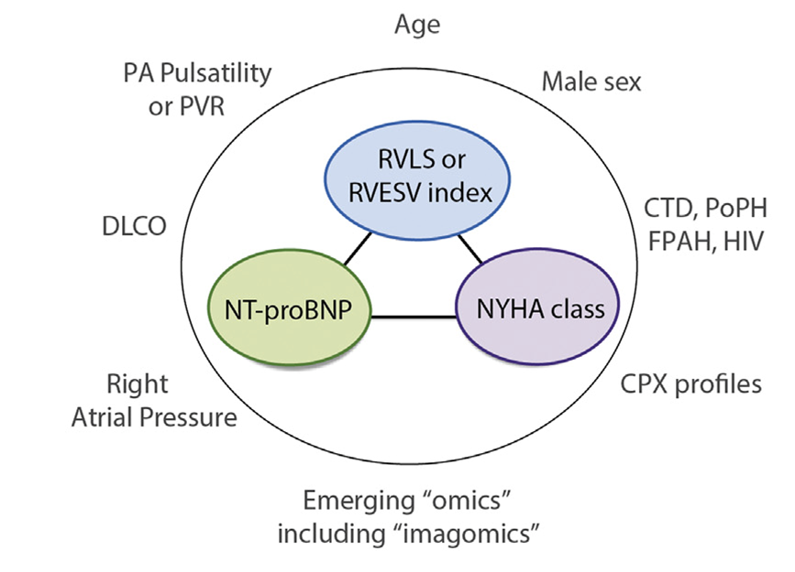
Imaging in the Context of Global Risk Prediction
Prognostic markers in
Pulmonary Arterial Hypertension
Some Pearls:
TAPSE most-used metric
RV longitudinal strain and RV end-systolic volume are strongly related to outcome
Emerging role of right atrial strain measures
Pericardial effusion is a marker of severity retained in REVEAL
* Choose in the laboratory the most reproducible metric

Slide 10
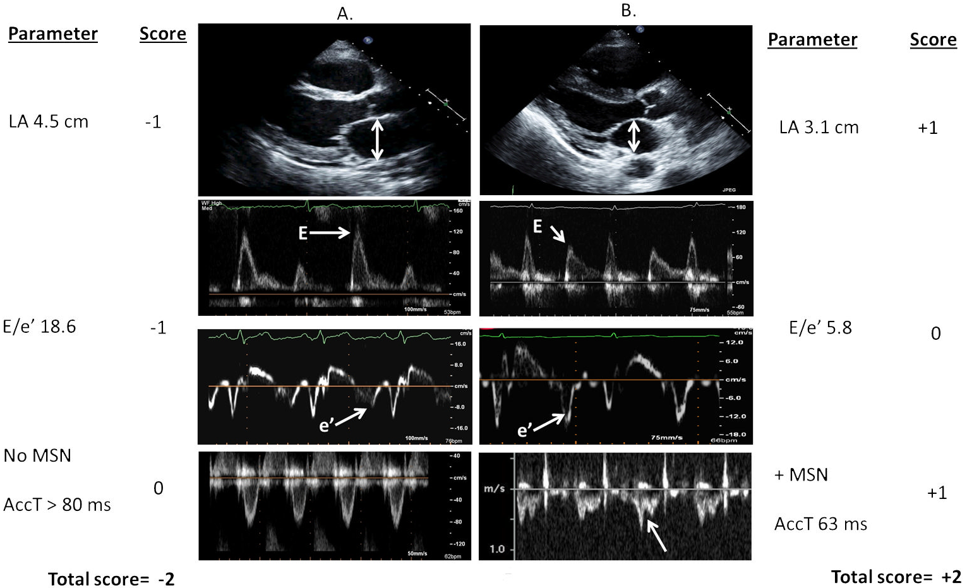
Imaging in Differentiating Types of Pulmonary Hypertension

