Slide 1
Current Remote Monitoring Technologies Are Understudied and Underutilized
Jean M. Elwing, MD
Professor of Medicine
Director, Pulmonary Hypertension Program
Division of Pulmonary, Critical Care and Sleep Medicine
University of Cincinnati
Cincinnati, OH

Slide 2
Disclaimer
The views and opinions expressed in this educational activity are those of the faculty and do not necessarily represent the views of TotalCME, Inc., the CME providers, or the companies providing educational grants. This presentation is not intended to define an exclusive course of patient management; the participant should use their clinical judgment, knowledge, experience, and diagnostic skills in applying or adopting for professional use any of the information provided herein. Any procedures, medications, or other courses of diagnosis or treatment discussed or suggested in this activity should not be used by clinicians without evaluation of their patient's conditions and possible contraindications or dangers in use, review of any applicable manufacturer’s product information, and comparison with recommendations of other authorities. Links to other sites may be provided as additional sources of information.

Slide 3
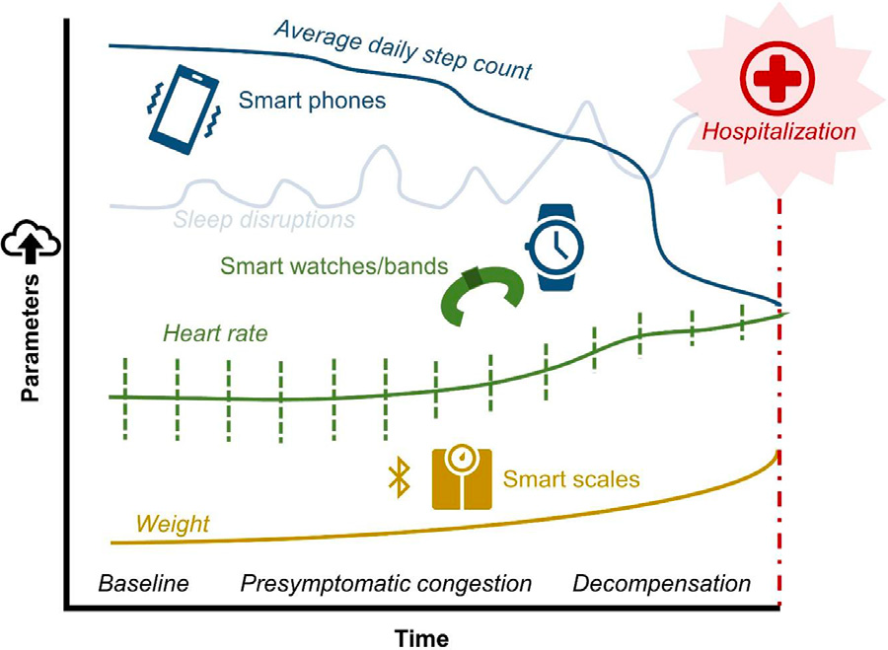
In COVID Era, Telehealth Visits Are Used More Frequently: Wearable Devices May Play a Role
Many wearable devices for monitoring patient activities and vital signs have not been fully vetted in the scientific literature
One of the most significant challenges in the evaluation of patients with PAH during telemedical visits is assessment of functional capacity, blood flow, and pressures (hemodynamics)
Technology-enabled devices have the potential to track and identify disturbances in biometric data before a decompensated state of cardiovascular disease arises.

Slide 4
What Patient Information Could We Routinely Obtain via Remote Monitoring for Use at Reassessment Visits?
What data for PAH risk assessment can we remotely obtain without being hands-on with the patient?
Observable, physical signs:
General appearance and behavior of the patient
Skin examination, including the appearance of wounds, catheter sites, device implant incisions, extremity swelling, or rashes; breathing patterns; physical movement
Daily physical activity (accelerometry, steps)
Pulse oximetry
Blood pressure and heart rate
Jugular venous pulsation (JVP)
Remote monitoring devices to measure these parameters not always validated for PAH population

Slide 5
Examples of Biometric Parameters Used in Telehealth and Potential Consumer-Marketed Data Sources for Each
Biometric Parameter | Potential Data Sources
Heart rate (average resting, min, max, variability) | Manual entry from unlinked BP cuff or pulse oximeter Smart watch or band with photo-plethysmographic sensor Other wearable device or clothing (e.g., ring, pendant, shirt, chest band, earphones)
Blood pressure | Smartphone-linked BP cuff—wrist or arm Manual entry from unlinked BP cuff
Step count (distance ambulated) | Smart watch or band acquiring accelerometric and/or GPS data Smartphone (carried for sufficient duration of day/period of physical activity) Other wearable device or clothing (e.g., ring, pendant, shirt, earphones) Manual entry from unlinked pedometer/step counter
Oxygen saturation | Smart pulse oximeter Manual entry from unlinked pulse oximeter
Sleep pattern | Smart watch, band, or other wearable worn during sleep
Cardiac rhythm | Smart watch or band with appropriate capability (e.g., Apple Watch) Non-worn/intermittently applied smart device (e.g., AliveCor KardiaMobile)

Slide 6
A Missing Link for Risk Assessment Using Telemedicine: The At-Home 6MWT
Current risk assessment tools include regular measurement of 6MWD to evaluate activity tolerance¹
Accelerometry devices (e.g., ActiLife, ActiGraph, LLC, Pensacola, FL) have been studied in patients with PAH, noting their potential to capture data complementary to the 6MWT, including duration of sedentary time in a patient’s daily life²
Recent study by Salvi et al.³ supported the 6MWT as feasible in the home environment using device-based applications, but such tools have yet to undergo validation amongst individuals with PAH

Slide 7
Can an Accurate 6MWT Be Remotely Performed?
Activity assessment in patients who are spending most of their time at home can be challenging
Increased time at home for most individuals has often led to substantial cardiopulmonary deconditioning
6MWT is a common clinical instrument for assessing patients’ functional capacity
Primary measurement of the test is the total distance walked
Secondary measurements can include fatigue and dyspnea, measured with a modified Borg or analogue scale and peripheral arterial O₂ saturation via pulse oximetry
With the advent of affordable digital devices and cell phones, it is possible to perform the test in (or near) the patient’s home using sensors such as accelerometers or the global positioning system (GPS) to estimate the distance walked

Slide 8
Is Step Counting the Answer to Functional Assessment?
Smartphones can regularly and easily obtain objective measures of physical activity
Apple iPhone includes a health app that summarizes step estimates derived from accelerometric and other embedded sensors generated with movement of the device when carried¹
Android-based and other smartphones offer similar options
In addition to smartphones other wearables include the following:
Fitbit, Garmin, Withings, and Polar
Novel accessories include earphones, necklaces, hats, and “smart shirt” garments, most of which provide some combination of biometric data such as steps taken, heart rate, and respiratory variability²

