Slide 1
What Are the Main Issues With Using Telemedicine for Risk Assessment for Monitoring PAH Patients?
Jean M. Elwing, MD
Professor of Medicine
Director, Pulmonary Hypertension Program
Division of Pulmonary, Critical Care and Sleep Medicine
University of Cincinnati
Cincinnati, OH

Slide 2
Disclaimer
The views and opinions expressed in this educational activity are those of the faculty and do not necessarily represent the views of TotalCME, Inc., the CME providers, or the companies providing educational grants. This presentation is not intended to define an exclusive course of patient management; the participant should use their clinical judgment, knowledge, experience, and diagnostic skills in applying or adopting for professional use any of the information provided herein. Any procedures, medications, or other courses of diagnosis or treatment discussed or suggested in this activity should not be used by clinicians without evaluation of their patient's conditions and possible contraindications or dangers in use, review of any applicable manufacturer’s product information, and comparison with recommendations of other authorities. Links to other sites may be provided as additional sources of information.

Slide 3
Telemedicine Environment Means Challenges for Routine Risk Assessment
Current Telemedicine Practices Patient Data Gathering | Continuing Telemedicine Challenges
Reported functional capacity | Lack of patient access to broadband
6MWT results | Lack of patient technical expertise
BNP/NT-proBNP levels | Lack of appropriate equipment for telemedicine
Echocardiographic findings | Lack of PH care team skills to maximize patient interaction during televisits
Are we able to get all we need?
Do we fully appreciate the barriers to virtual risk assessment and patient monitoring?

Slide 4
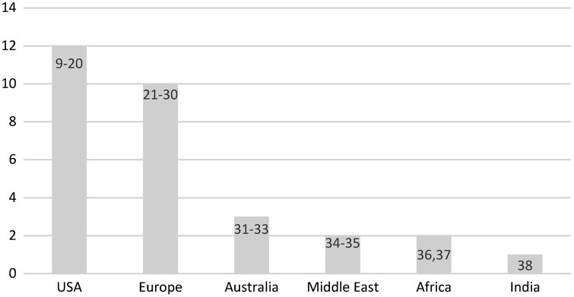
Physician-Perceived Barriers to Effective Telehealth
Perceived barriers from the physician side include the following:^{1,2}
  Lack of comprehensive physical examination
  Technically challenged staff and patients
  Public resistance to telehealth
  Cost
  Reimbursement issues
  Lower standards of care concerns
Barriers appear most prevalent in the US compared to other countries²

Slide 5
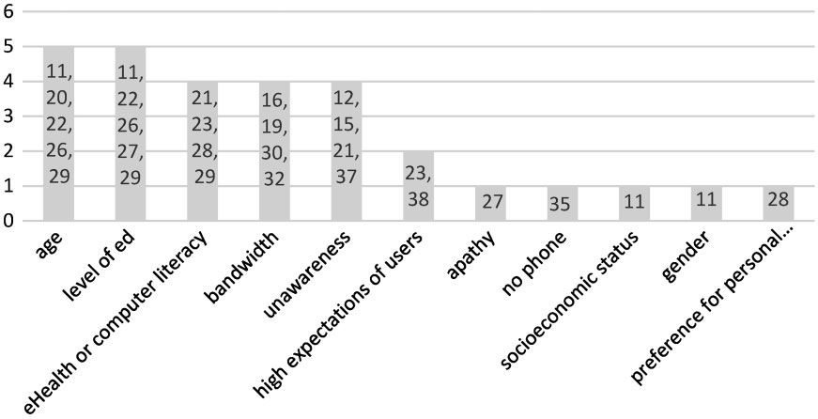
Patient-Perceived Barriers to Effective Telehealth

Slide 6
No Broadband Access = No Telemedicine
Particularly in (but not limited to) rural communities, the availability of high-speed internet or mobile data networks may be insufficient
Some individuals cannot afford to own or maintain connectivity for any camera-enabled device
Patients lack confidence in using the video device
  This factor can be especially prominent under the circumstances of a medical visit subject to the time pressures of practicing medicine
Certain patients may fear potential embarrassment or exposure of cognitive impairment if they are unable to successfully launch a videoconference

Slide 7
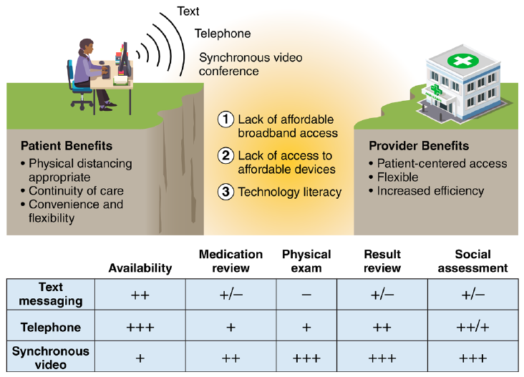
Telemedicine and the Forgotten America
19 million Americans lack broadband service
Telemedicine solutions come in two forms:
  Audio-only encounters are typically conducted via cell phone or landline telephone
  Synchronous two-way audio-video conferencing
Successful transition to telemedicine requires the intersection of at least three key factors:
  Access to broadband internet
  An internet-capable device
  Sufficient technology literacy to take advantage of the first two factors
  31% of New York City households are without broadband
  Lack of broadband access disproportionately affects Black and Latinx Americans
- = not available; + = minimally available; ++ = moderately available; +++ = easily available

