Slide 1
Bringing Medicine to the People:
The Rise Of Telemedicine in
PAH Management
Jean M. Elwing, MD
Professor of Medicine
Director, Pulmonary Hypertension Program
Division of Pulmonary, Critical Care and Sleep Medicine
University of Cincinnati
Cincinnati, OH

Slide 2
Disclaimer
The views and opinions expressed in this educational activity are those of the faculty and do not necessarily represent the views of TotalCME, Inc., the CME providers, or the companies providing educational grants. This presentation is not intended to define an exclusive course of patient management; the participant should use their clinical judgment, knowledge, experience, and diagnostic skills in applying or adopting for professional use any of the information provided herein. Any procedures, medications, or other courses of diagnosis or treatment discussed or suggested in this activity should not be used by clinicians without evaluation of their patient's conditions and possible contraindications or dangers in use, review of any applicable manufacturer’s product information, and comparison with recommendations of other authorities. Links to other sites may be provided as additional sources of information.

Slide 3
The COVID Pandemic Forced a “Rethinking” of
How PAH Patients are Managed
COVID-19 adversely influenced PAH care—especially during periods in which stay-at-home policies may decrease a patient’s confidence in the safety of an in-person visit
PAH expert centers have adopted telemedical tools to evaluate potentially complex patients
“Telehealth” may be broadly defined as “technology-enabled health care management and delivery systems that extend capacity and access”

Slide 4
Has There Been a Fundamental Change in the Manner of the PAH Patient Interaction?
No studies have yet demonstrated the effectiveness of the use of telehealth services to improve outcomes—specifically in patients with PAH
PAH patients rely on an aggressive multimodal regular evaluation of risk to determine whether subtle worsening of the disease occurs
Current guidelines for management of patients with PAH require ongoing, objective reassessment for risk of disease progression based on the following:
  Functional capacity, 6MWT, CPX
  BNP or NT-proBNP
  Echocardiographic and hemodynamic findings

Slide 5
COVID Lockdowns Reduced In-Office Visits and PAH Treatment Initiation
During the COVID-19 lockdowns, there was close to a 50% decline in new appointments for PAH evaluation, with a similar reduction in the initiation of PAH-specific therapy¹
US study showed fewer clinic visits and increased use of telemedicine in patients with PAH, as well as decreased individual diagnostic testing²
  Survey of 77 PH center directors as to practice patterns before/after COVID-19 pandemic
  Incidence of COVID-19 in PAH/CTEPH patients was 2.9/1000. Of these, 30% were hospitalized; 12% died
  Therefore, outcomes appear worse than in the general population
Delayed referral and assessment have clear potential to harm the overall outcomes of patients with PAH³

Slide 6
Impact of COVID Outbreak on Routine Clinic Operations
 | Relative to the Pandemic Outbreak of COVID-19
 | Before | After
Clinical Visits
Typical number of weekly outpatient visits, median (IQR) | 30 (20-45) | 12 (5-25)
Centers with routine use of formal telephone visits, n (%) | 4 (7) | 48 (83)
Centers with routine use of video-enabled visits, n (%) | 5 (9) | 54 (93)
Testing (n = 55 centers responding), n (%)
Centers obtaining fewer echocardiograms | Ref | 50 (1)
Of these, centers with 60%–99% reduction |  | 30 (60)
Of these, centers with total cessation |  | 5 (10)
Centers obtaining fewer RHCs | Ref | 49 (89)
Of these, centers with 60%–99% reduction |  | 34 (69)
Of these, centers with total cessation |  | 4 (8)
Centers obtaining fewer V/Q scans | Ref | 50 (91)
Of these, centers with 60%–99% reduction |  | 23 (46)
Of these, centers with total cessation |  | 4 (8)
Centers that have switched to Q scans only | Ref | 21 (38)
 | Relative to the Pandemic Outbreak of COVID-19 | Relative to the Pandemic outbreak of COVID-19
 | Before | After
Treatment (n = 56 centers responding), n (%)
Centers limiting new oral therapy prescriptions | Ref | 10 (18)
Of these, centers with 60%–99% reduction |  | 2 (20)
Of these, centers with total cessation |  | 0 (0)
Centers limiting new IV/SC prescriptions | Ref | 17 (30)
Of these, centers with 60%–99% reduction |  | 5 (29)
Of these, centers with total cessation |  | 3 (18)
Centers with fewer transplant referrals | Ref | 15 (27)
Of these, centers with 60%–99% reduction |  | 2 (13)
Of these, centers with total cessation |  | 3 (20)

Slide 7
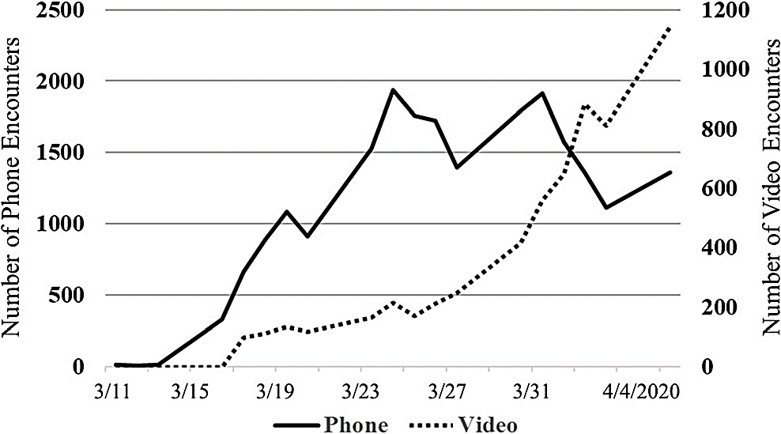
In 2020-21, Telemedicine Exponentially Expanded
In response to COVID-19, the use of telemedicine at a single academic institution increased from less than 100 visits/day to more than 2200 visits/day over a period of 24 days¹
The increase in telemedicine visitations appears even more pronounced for video-based physician-patient interactions
Study of trends at NYU Langone Health (New York, NY, USA) showed an 80% decline in in-person visits and a 683% increase in telemedicine visits between March 2 and April 14, 2020²
Telemedicine Use in Response to COVID-19 Pandemic¹
2500
2500
2000
2000
1500
1500
Number of Phone Encounters
Number of Video Encounters
1000
1000
500
500
0
0
3/11
3/15
3/19
3/23
3/27
3/31
4/4/20
Phone
Video

