Slide 1
How Do We Define an Underserved PAH Patient?
Jean M. Elwing, MD
Professor of Medicine
Director, Pulmonary Hypertension Program
Division of Pulmonary, Critical Care and Sleep Medicine
University of Cincinnati
Cincinnati, OH

Slide 2
Disclaimer
The views and opinions expressed in this educational activity are those of the faculty and do not necessarily represent the views of TotalCME, Inc., the CME providers, or the companies providing educational grants. This presentation is not intended to define an exclusive course of patient management; the participant should use their clinical judgment, knowledge, experience, and diagnostic skills in applying or adopting for professional use any of the information provided herein. Any procedures, medications, or other courses of diagnosis or treatment discussed or suggested in this activity should not be used by clinicians without evaluation of their patient's conditions and possible contraindications or dangers in use, review of any applicable manufacturer’s product information, and comparison with recommendations of other authorities. Links to other sites may be provided as additional sources of information.

Slide 3
Defining the Underserved PAH Patient: Not All Have Equal Access to Care
Social Barriers
Physically remote populations
Immigrant populations
Non-English speakers
Minority populations
Prejudice
Patient trepidations
Disbelief in medicine/science
Medical Barriers
Telemedicine
Delayed referrals
Physician awareness of PAH (symptoms and diagnoses)
Patient disabilities
Access to primary care
Economic Barriers
Insurance issues
Drug costs
Care costs
Lack of patient transportation
Lack of patient access to tools for telemedicine

Slide 4
Health Insurance Status of Minorities: Health Status in Relation to Health Insurance: The NHOPI Example
Native Hawaiians and Other Pacific Islanders (NHOPI) suffer from several poor health outcomes including high rates of overweight status, obesity, hypertension, and high rates of asthma and cancer mortality¹
Recent study using the Behavioral Risk Factor Surveillance System (BRFSS) 2012 data and logistic regression examined association between health insurance, an element for improved access to health care, other barriers to health care (e.g., cost and having a personal health care provider), on the health status of NHOPI compared to Asians
When all those factors were considered, insured NHOPI were still 66% more likely to experience fair or poor health as compared to Asians (OR: 1.66, 95% CI [1.34, 2.05])
Insured NHOPI were more likely to experience a cost barrier than insured Asians although there was no difference between groups regarding having a personal health care provider
Uninsured NHOPI were less likely to receive an annual routine checkup when compared to uninsured Asians
As ethnic minorities, NHOPI often experience social marginalization and racial discrimination in the health care setting resulting in poor health outcomes², deficiencies in cultural competency, local language skills and communication; additionally, conflicting perceptions, attitudes, beliefs, and values toward health and health care pose significant barriers to accessing care

Slide 5
The Gorilla In the Room: Prejudicial Attitudes Affect Patient Access
Racial discrimination is an emerging risk factor for disease and a contributor to racial disparities in health¹
According to a study from The Commonwealth Fund, about a quarter of Latino and Black older adults reported facing racial discrimination at the doctor’s office making it harder for them to receive the care they needed^{2,3}
Patients of color aged 60 or older were more likely to say they were unfairly treated or had their health concerns dismissed by medical professionals
One in four Black and Latino/Hispanic older adults report racial or ethnic discrimination when seeking health care, while relatively few older white adults report similar treatment
More than a quarter of U.S. older adults who experienced discrimination based on their race or ethnicity felt they did not get the care they needed as a result
Percent of Patients

Slide 6
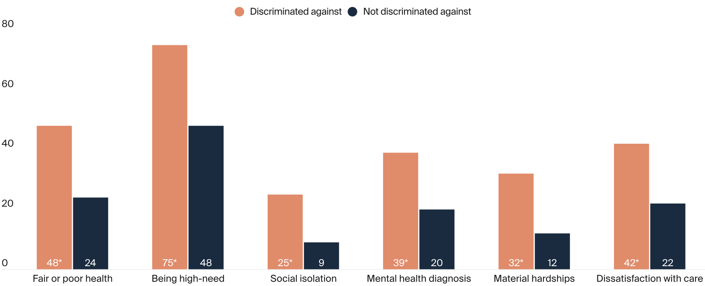
The Older Patient Experiencing Discrimination Has More Health Care Needs
Older patients experiencing race- or ethnicity-based discrimination have more health care needs and are more likely to report feelings of social isolation and material hardships and to feel dissatisfied with their care than older patients who do not report discrimination

Slide 7
How Can We Address Some of the Issues Affecting PAH Access to Care?
Practices to improve access to care
Addressing illiteracy and low health literacy
Identifying cost-effective resources
Expanding care offerings
Enhancing the patient–provider relationship
Cultivating a culture of teamwork and customer service
Helping patients find the least expensive options for transportation, insurance, and medication was the most compelling patient-centered strategy
Appointment reminders and confirmation of patient plans for transportation to appointments can reduce no-show rates

Slide 8
Possible Solutions
Promote transparency and accountability by identifying instances of discrimination and publicly reporting discrimination data
Develop medical school curricula to educate students about how the U.S. health care system has harmed patients of color and other historically marginalized communities
Reform policies that enable discrimination
Address the lack of diversity in the U.S. health care workforce
Provide culturally and contextually appropriate care that addresses patients’ communication needs and preferences

