Slide 1
Which TNBC Patients Are Eligible for ADCs?
Sara A. Hurvitz, MD, FACP
Professor of Medicine
University of California
Los Angeles, CA

Slide 2



Resource Information
About This Resource
These slides are one component of a continuing education program available online at MedEd On The Go titled Triple-Negative Breast Cancer (TNBC): Choosing the Right ADC for the Right Patient
Program Learning Objectives:
Explain the rationale for varying levels of ADC target positivity required for ADC efficacy and treatment eligibility
Identify patients with TNBC who are optimal candidates for ADCs
Develop evidence-based treatment strategies using ADCs in metastatic TNBC
Apply knowledge of barriers to access, care, and treatment that exist in the care of minority patients diagnosed with metastatic TNBC
Differentiate advantages of ADCs in special populations of patients with metastatic TNBC
Identify strategies for improving adherence through adverse effect management
MedEd On The Go®
www.mededonthego.com
This content or portions thereof may not be published, posted online or used in presentations without permission.
This content can be saved for personal use (non-commercial use only) with credit given to the resource authors.
To contact us regarding inaccuracies, omissions or permissions please email us at support@MedEdOTG.com

Slide 3
Disclaimer
The views and opinions expressed in this educational activity are those of the faculty and do not necessarily represent the views of Total CME, LLC, the CME providers, or the companies providing educational grants. This presentation is not intended to define an exclusive course of patient management; the participant should use their clinical judgment, knowledge, experience, and diagnostic skills in applying or adopting for professional use any of the information provided herein. Any procedures, medications, or other courses of diagnosis or treatment discussed or suggested in this activity should not be used by clinicians without evaluation of their patient's conditions and possible contraindications or dangers in use, review of any applicable manufacturer’s product information, and comparison with recommendations of other authorities. Links to other sites may be provided as additional sources of information.

Slide 4
Eligibility for Trials of ADCs
ASCENT Study of Sacituzumab Govitecan
Patients with mTNBC and ≥2 prior lines of CT (no upper limit)
1 line could include PD within 12 months of (neo)adjuvant therapy
Prior taxane
RECIST v1.1 measurable disease
ECOG PS 0/1
Brain mets not excluded if stable at least 4 weeks prior to treatment on study (not included in primary endpoint evaluation)
ALL PATIENTS HAD TNBC

Slide 5
Sacituzumab Govitecan (SG) Versus Single-Agent CT (TPC) in Metastatic TNBC after ≥2 Previous CT Regimens Phase 3 ASCENT: Efficacy
Progression-free survival
Overall survival
BICR Analysis | SG (n=235) | TPC (n=233)
No. of events | 166 | 150
Median PFS, mo (95% CI) | 5.6 (4.3-6.3) | 1.7 (1.5-2.6)
HR (95% CI), P-value | 0.41 (0.32-0.52), P < 0.001
 | SG (n=235) | TPC (n=233)
No. of events | 155 | 185
Median OS, mo (95% CI) | 12.1 (10.7-14.0) | 6.7 (5.8-7.7)
HR (95% CI), P-value | 0.48 (0.38-0.59), P < 0.001
100
100
80
80
60
60
Probability of PFS (%)
40
Probability
40
SG
TPC
SG
TPC
20
20
0
0
0
3
6
9
12
15
18
21
24
0
3
6
9
12
15
18
21
24
27
Months
Months
BICR, blinded independent central review; CI, confidence interval; HR, hazard ratio; OS, overall survival; PFS, progression-free survival; SG, sacituzumab govitecan; TPC, treatment of physician's choice. Bardia A, et al. N Engl J Med. 2021; 384:1529-41.

Slide 6
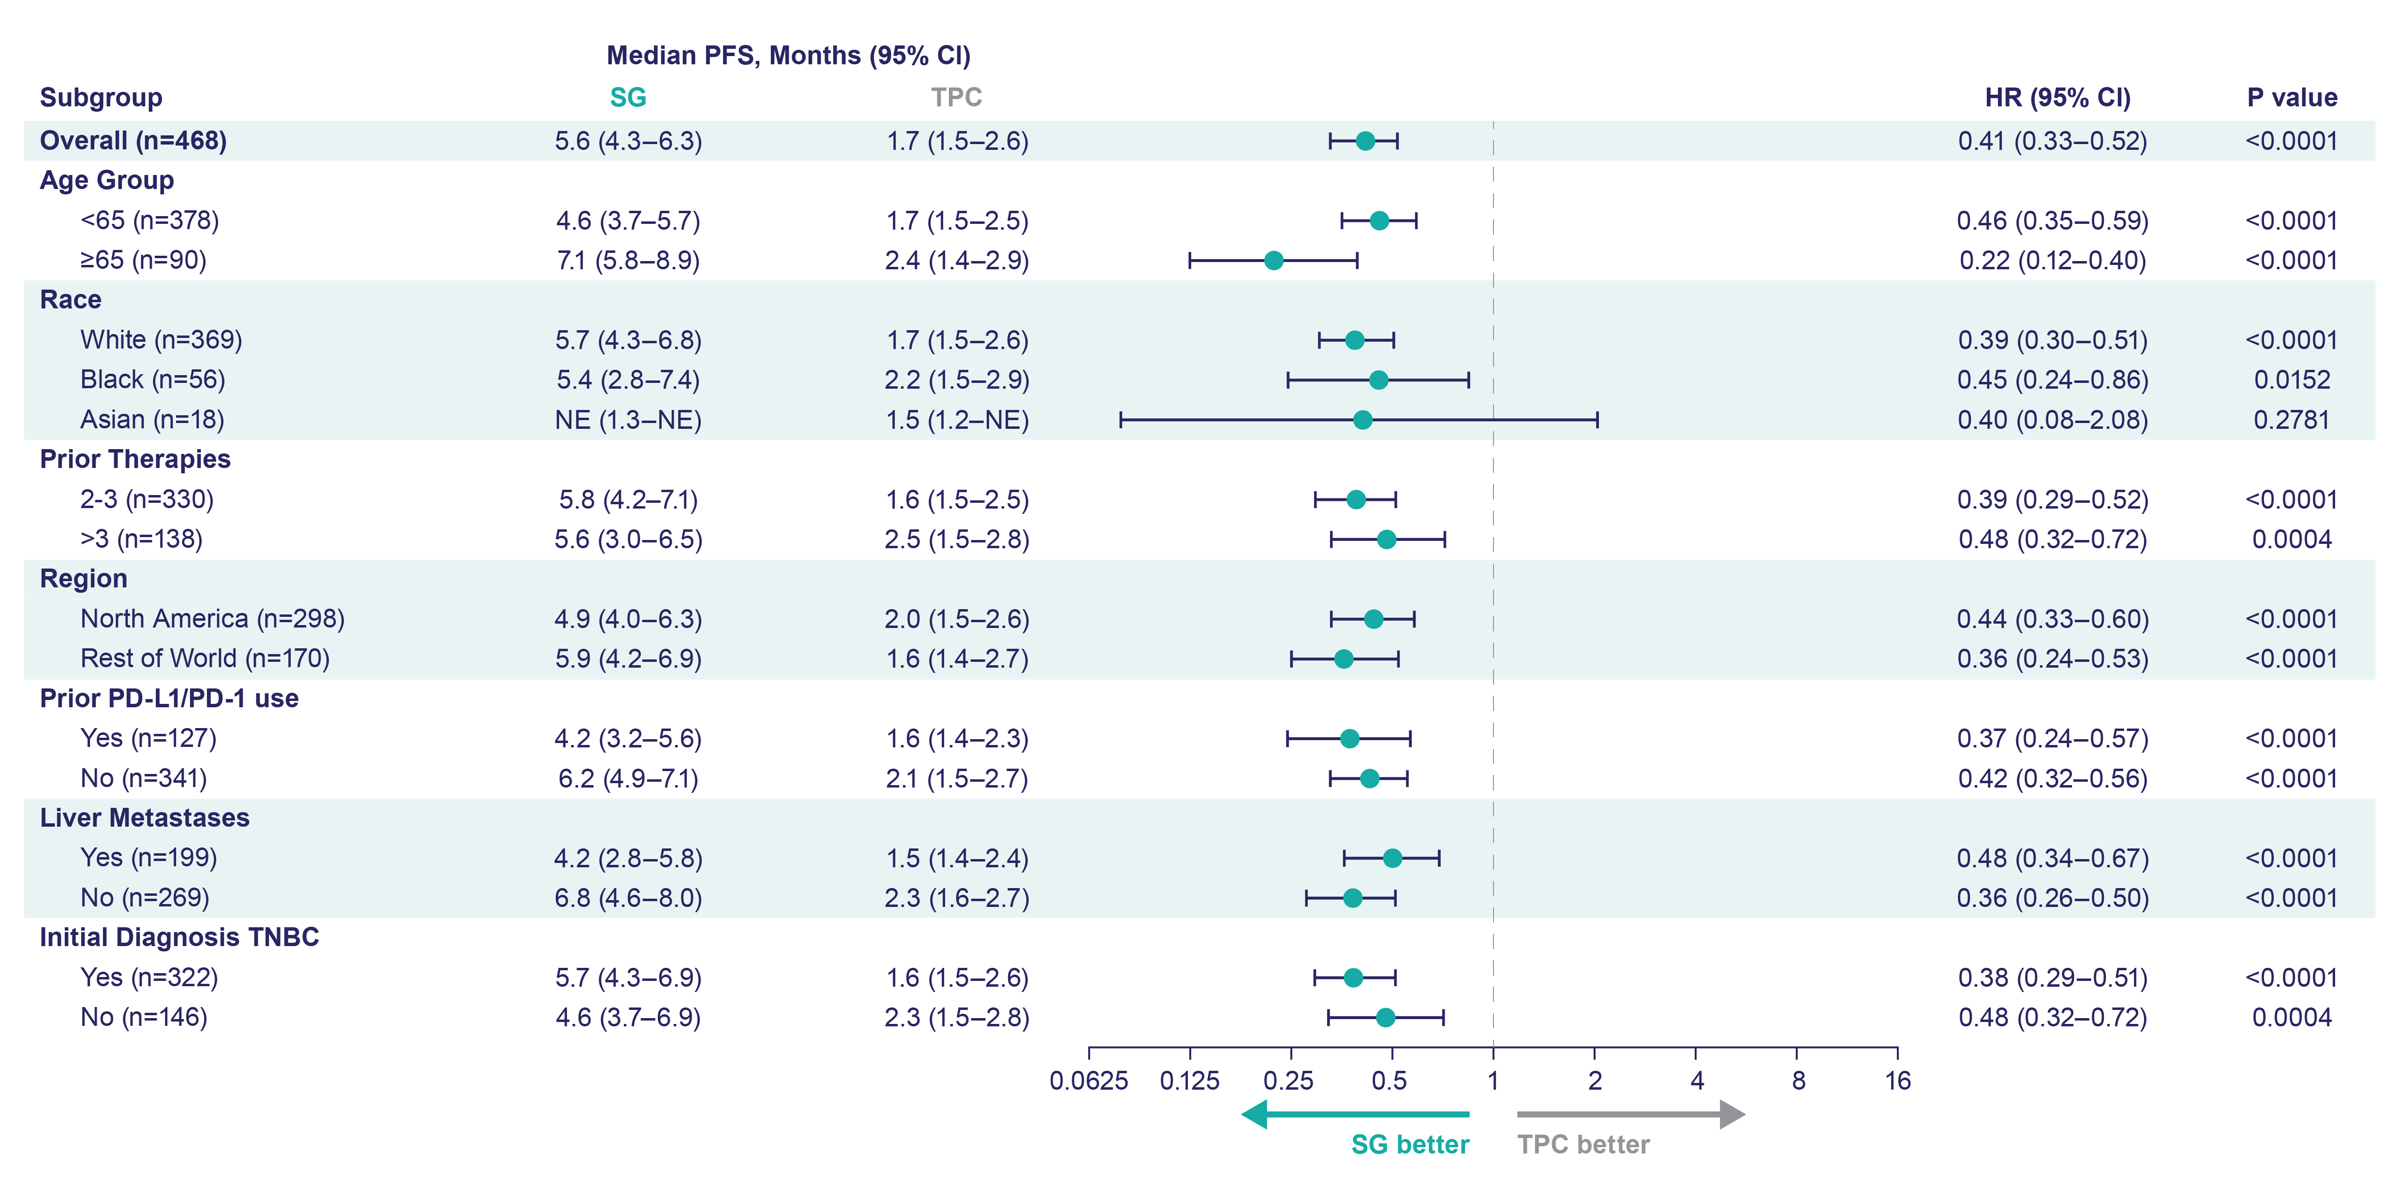
Progression-Free Survival by Subgroup
Progression-Free Survival by Subgroup

Slide 7
Clinical Benefit with SG Versus TPC Is Irrespective of Level of TROP2 Expression in ASCENT in Previously Treated Metastatic TNBC
Progression-free survival
Overall survival
 | Events/censored
SG: TROP2 High | 60/25
SG: TROP2 Medium | 26/13
SG: TROP2 Low | 19/8
TPC: TROP2 High | 47/25
TPC: TROP2 Medium | 24/11
TPC: TROP2 Low | 24/8
 | Events/censored
SG: TROP2 High | 53/32
SG: TROP2 Medium | 22/17
SG: TROP2 Low | 20/7
TPC: TROP2 High | 64/8
TPC: TROP2 Medium | 23/12
TPC: TROP2 Low | 25/7
100
100
80
80
60
60
PFS probability (%)
OS probability (%)
40
40
20
20
0
0
5
10
15
20
25
0
5
10
15
20
25
Time (months)
Time (months)
 | TROP2 High; H-score: 200–300 |  | TROP2 Medium; H-score: 100–200 |  | TROP2 Low; H-score: <100
 | SG (n=85) | TPC (n=72) | SG (n=39) | TPC (n=35) | SG (n=27) | TPC (n=32)
Median PFS, mo (95% CI) | 6.9 (5.8–7.4) | 2.5 (1.5–2.9) | 5.6 (2.9–8.2) | 2.2 (1.4–4.3) | 2.7 (1.4–5.8) | 1.6 (1.4–2.7)
Median OS, mo (95% CI) | 14.2 (11.3–17.5) | 6.9 (5.3–8.9) | 14.9 (6.9–NE) | 6.9 (4.6–10.1) | 9.3 (7.5–17.8) | 7.6 (5.0–9.6)
Clinical Benefit with SG Versus TPC Is Irrespective of Level of TROP2 Expression in ASCENT in Previously Treated Metastatic TNBC
H-score, histochemical score; mo, month; OS, overall survival; PFS, progression-free survival; SG, sacituzumab govitecan; TNBC, triple-negative breast cancer; TPC, treatment of physician’s choice. Hurvitz SA, et al. SABCS 2020. Abstract GS3-06; Bardia A, et al. Annals Oncol. 2021;32(9);1148-56).

Slide 8
ASCENT: ORR by Trop-2 Expression
 | Trop-2 High H-score: >200-300 (n=157) |  | Trop-2 Medium H-score: 100-200 (n=74) |  | Trop-2 Low H-score: 0 to <100 (n=59)
 | SG (n=85) | TPC (n=72) | SG (n=39) | TPC (n=35) | SG (n=27) | TPC (n=32)
ORR—% (no.) | 44% (37) | 1% (1) | 39% (15) | 11% (4) | 22% (6) | 6% (2)
95% CI | 33-55 | 0-8 | 23-55 | 3-27 | 9-42 | 1-21
Assessed in the brain metastases-negative population. ORR and PFS are assessed by BICR. Trop-2 expression determined in archival samples by validated immunohistochemistry assay and H-scoring.
ORR, objective response rate.
Bardia A, et al. Ann Oncol. 2021;32(9):1148-56.

Slide 9
ASCENT: Efficacy by Germline BRCA1/2 Status
Assessed in the brain metastases-negative population. ORR and PFS are assessed by BICR.
Bardia A, et al. Ann Oncol. 2021;32(9):1148-56.

Slide 10
Eligibility for Trials of ADCs
DESTINY-Breast04 trial of trastuzumab deruxtecan
HER2-low (IHC 1+ or IHC 2+/ISH-)
1-2 lines of chemotherapy in the metastatic setting (or recurrence ≤ 6 mos after adjuvant chemotherapy)
Patients with treated stable brain metastases were not excluded
Only 10% had TNBC
HER2, human epidermal growth factor 2; IHC, immunohistochemistry; ISH, in situ hybridization.

Slide 11
DESTINY-Breast04: Exploratory Analysis of PFS and OS in HR-/HER2-Low Cohort
HR, hormone receptor; MBC, metastatic breast cancer; mOS, median overall survival; mPFS, median progression-free survival; T-DXd, trastuzumab deruxtecan.
Modi S, et al. ASCO 2022. Abstract LBA3; Modi S, et al. N Engl J Med. 2022;387:9-20.

Slide 12
DESTINY-Breast04: Response in ER IHC 0% and 1-10% Cohorts^{1,2}
Patients with ER IHC 0%*
Patients with ER IHC 1-10%
60
T-DXd
CT
60
57.1
T-DXd
CT
50.0
ORR, %
(95% CI)
50.0
(33.8-66.2)
16.7
(3.6-41.4)
ORR, %
(95% CI)
57.1
(39.4-73.7)
5.9
(0.1-28.7)
50
50
40
40
Confirmed ORR (%)
Confirmed ORR (%)
30
30
20
16.7
20
10
10
5.9
0
0
T-Dxd (n = 40)
CT (n = 18)
T-Dxd (n = 35)
CT (n = 17)
Confirmed objective response higher with T-DXd compared with CT, regardless of ER expression level
*Reported as hormone receptor-negative cohort²
ER, estrogen receptor.
1. Cameron. ESMO 2023. Abstract 192MO. 2. Modi. N Engl J Med. 2022;387:9.

Slide 13



Looking for more resources on this topic?
CME/CE in minutes
Congress highlights
Late-breaking data
Quizzes
Webinars
In-person events
Slides & resources
www.MedEdOTG.com

