Slide 1
ADC Targets: Does Positivity Really Matter?
Sara M. Tolaney, MD, MPH
Chief, Division of Breast Oncology, Susan F. Smith Center for Women’s Cancers
Associate Director, Susan F. Smith Center for Women’s Cancers
Senior Physician, Dana-Farber Cancer Institute
Associate Professor of Medicine, Harvard Medical School
Boston, MA

Slide 2



Resource Information
About This Resource
These slides are one component of a continuing education program available online at MedEd On The Go titled Triple-Negative Breast Cancer (TNBC): Choosing the Right ADC for the Right Patient
Program Learning Objectives:
Explain the rationale for varying levels of ADC target positivity required for ADC efficacy and treatment eligibility
Identify patients with TNBC who are optimal candidates for ADCs
Develop evidence-based treatment strategies using ADCs in metastatic TNBC
Apply knowledge of barriers to access, care, and treatment that exist in the care of minority patients diagnosed with metastatic TNBC
Differentiate advantages of ADCs in special populations of patients with metastatic TNBC
Identify strategies for improving adherence through adverse effect management
MedEd On The Go®
www.mededonthego.com
This content or portions thereof may not be published, posted online or used in presentations without permission.
This content can be saved for personal use (non-commercial use only) with credit given to the resource authors.
To contact us regarding inaccuracies, omissions or permissions please email us at support@MedEdOTG.com

Slide 3
Disclaimer
The views and opinions expressed in this educational activity are those of the faculty and do not necessarily represent the views of Total CME, LLC, the CME providers, or the companies providing educational grants. This presentation is not intended to define an exclusive course of patient management; the participant should use their clinical judgment, knowledge, experience, and diagnostic skills in applying or adopting for professional use any of the information provided herein. Any procedures, medications, or other courses of diagnosis or treatment discussed or suggested in this activity should not be used by clinicians without evaluation of their patient's conditions and possible contraindications or dangers in use, review of any applicable manufacturer’s product information, and comparison with recommendations of other authorities. Links to other sites may be provided as additional sources of information.

Slide 4
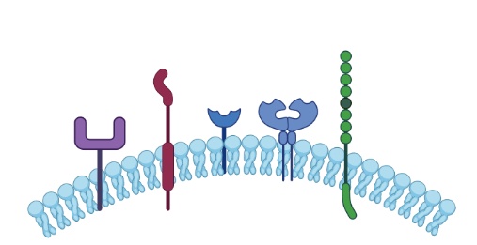

The Target Landscape of ADCs Is Expanding Rapidly
ADC: Payload potency, optimal DAR, bystander effect
Required target expression is lowering
NECTIN-4
TROP2
HER2
LIV-1
HER3
14 APPROVED ADCs
>140 ADCs in clinical development
Lower expression of the target is necessary
HER2: <150,000-10⁶
TROP2: 250,000
ADC, antibody-drug conjugate; DAR, drug-to-antibody ratio; HER, human epidermal growth factor receptor; TROP2, trophoblast cell-surface antigen 2. Pistilli B, et al. ASCO 2023. Metastatic Breast Cancer Discussion (Slide provided courtesy of Sara Tolaney, MD, MPH).

Slide 5
Clinical Benefit with SG Versus TPC Is Irrespective of Level of TROP2 Expression in ASCENT in Previously Treated Metastatic TNBC
Progression-free survival
Overall survival
 | Events/censored
SG: TROP2 High | 60/25
SG: TROP2 Medium | 26/13
SG: TROP2 Low | 19/8
TPC: TROP2 High | 47/25
TPC: TROP2 Medium | 24/11
TPC: TROP2 Low | 24/8
 | Events/censored
SG: TROP2 High | 53/32
SG: TROP2 Medium | 22/17
SG: TROP2 Low | 20/7
TPC: TROP2 High | 64/8
TPC: TROP2 Medium | 23/12
TPC: TROP2 Low | 25/7
100
100
80
80
60
60
PFS probability (%)
OS probability (%)
40
40
20
20
0
0
5
10
15
20
25
0
5
10
15
20
25
Time (months)
Time (months)
 | TROP2 High; H-score: 200–300 |  | TROP2 Medium; H-score: 100–200 |  | TROP2 Low; H-score: <100
 | SG (n=85) | TPC (n=72) | SG (n=39) | TPC (n=35) | SG (n=27) | TPC (n=32)
Median PFS, mo (95% CI) | 6.9 (5.8–7.4) | 2.5 (1.5–2.9) | 5.6 (2.9–8.2) | 2.2 (1.4–4.3) | 2.7 (1.4–5.8) | 1.6 (1.4–2.7)
Median OS, mo (95% CI) | 14.2 (11.3–17.5) | 6.9 (5.3–8.9) | 14.9 (6.9–NE) | 6.9 (4.6–10.1) | 9.3 (7.5–17.8) | 7.6 (5.0–9.6)
Clinical Benefit with SG Versus TPC Is Irrespective of Level of TROP2 Expression in ASCENT in Previously Treated Metastatic TNBC
H-score, histochemical score; mo, month; OS, overall survival; PFS, progression-free survival; SG, sacituzumab govitecan; TNBC, triple-negative breast cancer; TPC, treatment of physician’s choice. Hurvitz SA, et al. SABCS 2020. Abstract GS3-06; Bardia A, et al. Annals Oncol. 2021;32(9);1148-56).

Slide 6
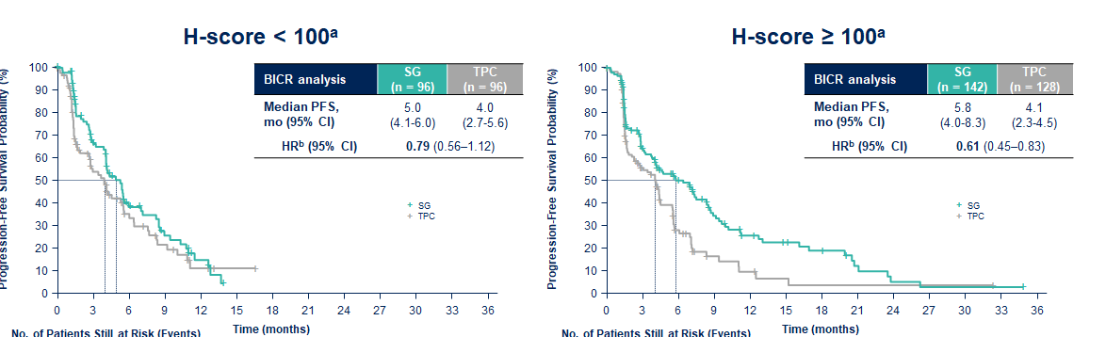
Does TROP2 Expression Matter?
PFS by TROP2 Expression in TROPiCS-02
 | H-Score <100 |  | H-Score ≥100 |  | H-Score ≤100 |  | H-Score >10 to <100
Median PFS | SG (n = 96) | TPC (n = 96) | SG (n = 142) | TPC (n = 128) | SG (n = 34) | TPC (n = 45) | SG (n = 62) | TPC (n = 51)
Median PFS, mo (95% Cl) | 5.3 (4.1-6.0) | 4.0 (2.8-5.6) | 6.4 (4.0-8.3) | 4.1 (2.1-4.5) | 5.5 (2.8-9.5) | 4.3 (1.7-6.4) | 5.0 (4.1-7.1) | 3.5 (1.6-5.6)
Unstratified HR (95% Cl) | 0.77 (0.54-1.09) |  | 0.60 (0.44-0.81) |  | 0.89 (0.51-1.57) |  | 0.67 (0.42-1.07)
ªTROP-2 H-score categories were defined by different cut-offs than ASCENT biomarker analysis.
BICR, blinded independent central review; HR, hazard ratio. Pistilli B, et al. ASCO 2023. Metastatic Breast Cancer Discussion; Rugo HS, et al. SABCS 2022. Abstract GS1-11; Tolaney S, et al. ASCO 2023. Abstract 1003.

Slide 7
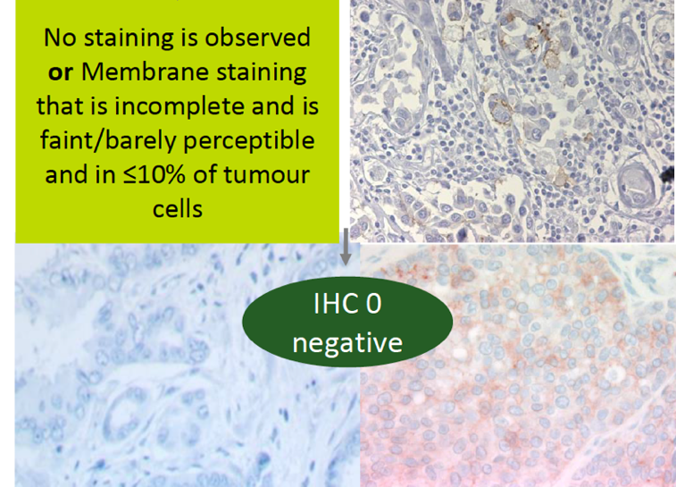
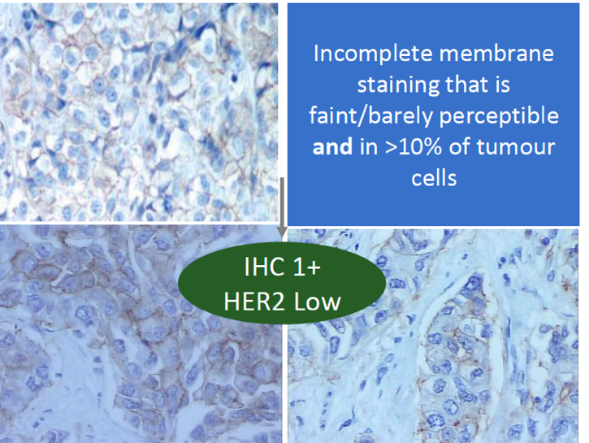
What About Target Expression for HER2-Low? Low Concordance Among Pathologists Between HER2 0 and HER2 1+
In a recent study, among 18 experienced pathologists there was only 26% concordance between the diagnoses of HER2 0 and HER2 1+
Importantly, HER2 0 does not mean absence of HER2, as it also includes tumors with “ultralow” expression
No staining is observed or
Membrane staining
that is incomplete and faint/barley perceptible and in ≤10% of tumor cells
Incomplete membrane staining that is faint/barely perceptible and in >10% of tumor cells
IHC 0 HER2-negative
IHC 1+ HER2-low
IHC, immunohistochemistry.
Fernandez AI, et al. JAMA Oncol. 2022;8(4):1-4.

Slide 8
Next Challenge: How LOW Can We Go?
DAISY TRIAL
IHC 3+ IHC 1+ or 2+ IHC 0
Decreasing ORR by degree of HER2 expression
BOR, best overall response; DOR, duration of response; ORR, objective response rate.
Dieras V, et al. SABCS 2021. Abstract PD8-01.

Slide 9
Potential Future Challenge: HER2 “Ultralow”
DESTINY-Breast06* phase 3 includes IHC 0 with “ultralow” expression and may expand the population of patients deriving benefit from T-DXd
Archived sample
HER2-low (IHC 1+ 2+)
or
HER2-ultralow (IHC >0 <1+)
HR+
≥2 lines ET or POD on first-line CDK4/6 inhibitor
Trastuzumab deruxtecan
R
Primary endpoint: PFS
N=850
Physician’s choice of single-agent
capecitabine, paclitaxel, nab-paclitaxel
Key differences with DESTINY-Breast04: Includes IHC 0+ (“ultralow”), larger (N=850), restricted to HR+ disease, and includes chemo-naïve patients
*ClinicalTrials.gov. Study of trastuzumab deruxtecan (T-DXd) vs investigator's choice chemotherapy in HER2-low, hormone receptor positive, metastatic breast cancer (DB-06). https://clinicaltrials.gov/study/NCT04494425.
CDK, cyclin-dependent kinase; ET, endocrine therapy; POD, progression of disease; R, randomized.

Slide 10
Target Expression for ADCs
At this time, there is no indication to test for TROP2 to select patients for TROP2-directed ADCs
Benefit of sacituzumab greater than chemotherapy at every level of expression
For now, selection of patients for T-DXd is based on HER2 IHC expression, but faced with challenges
Unstable, dynamic, inconsistent biomarker
Will need to await further studies to see if testing will be needed, or if better quantitative assays emerge

Slide 11



Looking for more resources on this topic?
CME/CE in minutes
Congress highlights
Late-breaking data
Quizzes
Webinars
In-person events
Slides & resources
www.MedEdOTG.com

