Slide 1
The Role of Radiotherapy in AHOD1331
Bradford Hoppe, MD, MPH Professor of Radiation Oncology Medical Director of Particle Therapy Mayo Clinic Jacksonville, FL

Slide 2
Disclaimer
The views and opinions expressed in this educational activity are those of the faculty and do not necessarily represent the views of TotalCME, Inc., the CME providers, or the companies providing educational grants. This presentation is not intended to define an exclusive course of patient management; the participant should use their clinical judgment, knowledge, experience, and diagnostic skills in applying or adopting for professional use any of the information provided herein. Any procedures, medications, or other courses of diagnosis or treatment discussed or suggested in this activity should not be used by clinicians without evaluation of their patient's conditions and possible contraindications or dangers in use, review of any applicable manufacturer’s product information, and comparison with recommendations of other authorities. Links to other sites may be provided as additional sources of information.

Slide 3
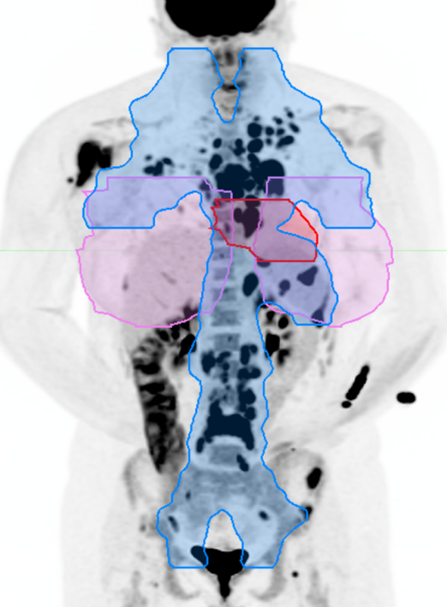
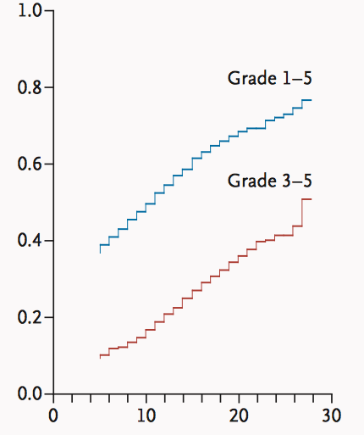
Late Effects From Combined Modality Therapy
POG 9425 RT fields
Hodgkin’s Disease (n=1876)
Cumulative Incidence
Years after Original Cancer Diagnosis
Common Terminology Criteria for Adverse Events version 3.0; mild (grade 1), moderate (grade 2), severe (grade 3), life-threatening/disabling (grade 4), fatal (grade 5)
RT, radiotherapy.
Oeffinger KC, et al. N Engl J Med. 2006;355(15):1572-1582.

Slide 4
Radiotherapy in AHOD1331
ISRT to 21 Gy was delivered
Sites of bulky mediastinal disease
SER sites (Deauville 4-5 after 2 cycles of systemic therapy)
9 Gy boost delivered
Sites in PR (Deauville 3-5) at completion of systemic therapy
3D-CRT, IMRT, and proton therapy allowed on trial
3D-CRT, 3-dimensional conformal radiation therapy; IMRT, intensity-modulated radiation therapy; ISRT, involved-site radiotherapy; PR, partial response; SER, slow early response. Castellino SM, et al. N Engl J Med. 2022;387(18):1649-1660.

Slide 5

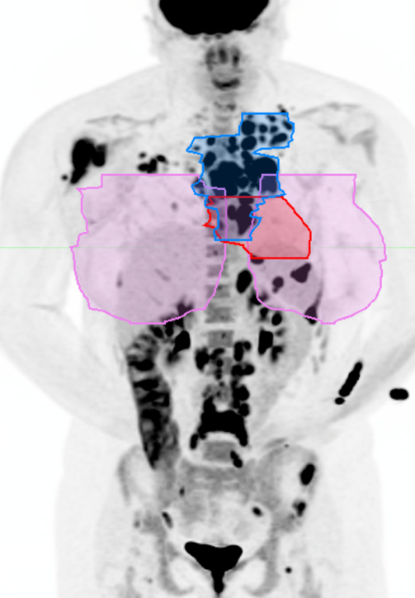
Reduced Size of Radiation Therapy Fields
POG 9425 RT
AHOD1331
Blue- total nodal radiation field Schwartz CL, et al. Blood. 2009;114(10):2051-2059; Castellino SM, et al. N Engl J Med. 2022;387(18):1649-1660.

Slide 6
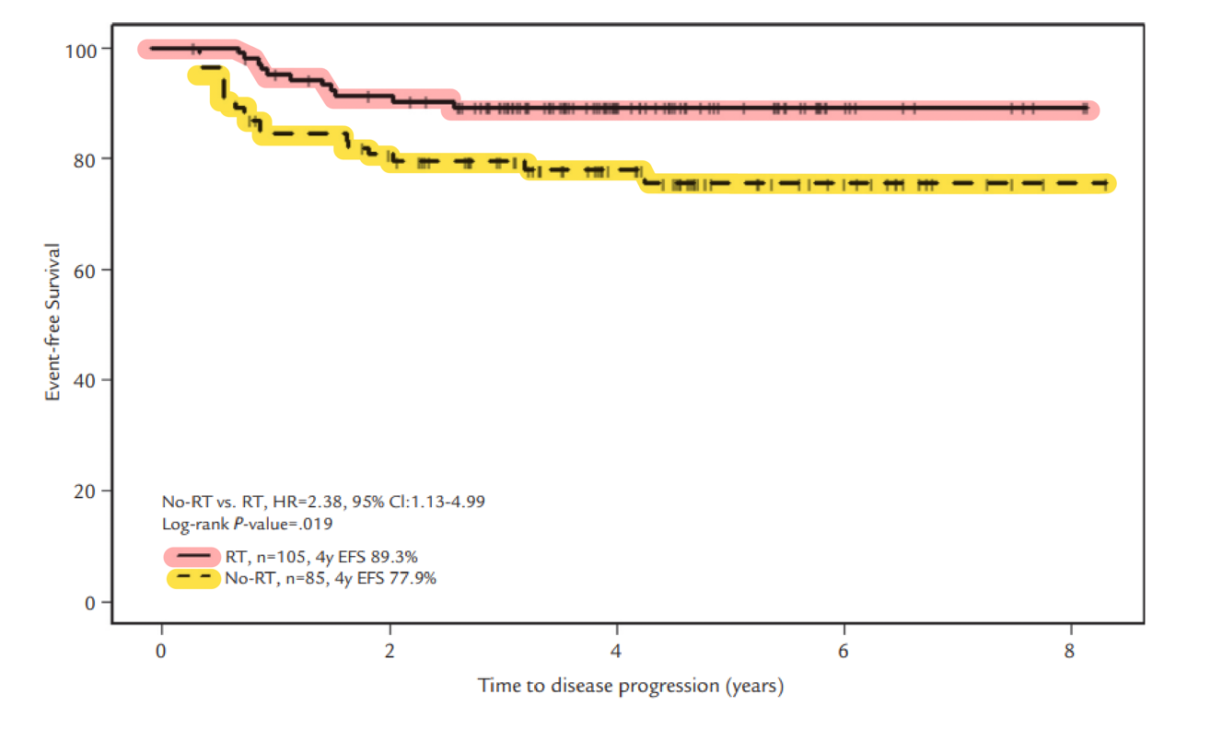
ISRT for LMA Based on AHOD0031
EFS, event-free survival; HR, hazard ratio; ISRT, involved site radiation therapy; LMA, large mediastinal adenopathy. Charpentier AM, et al. Int J Radiat Oncol Biol Phys. 2016;96(5):943-950.

Slide 7
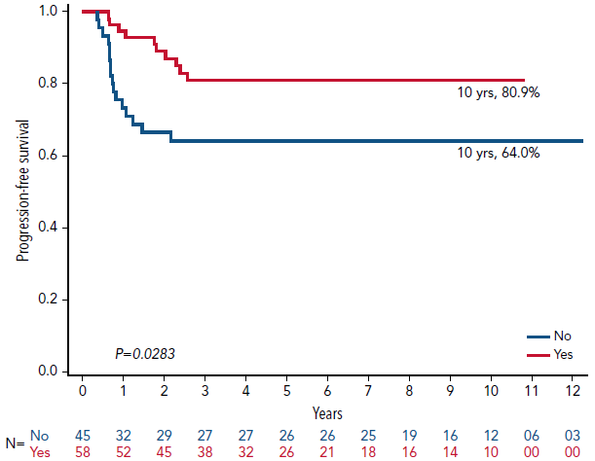
ISRT for SER (RT vs no RT)
PFS Among SER-Negative Patients Stratified by Up-Front ISRT
AHOD0431
56% relapses no RT,
occurred in SER site
ISRT, involved site radiation therapy; PFS, progression-free survival; RT, radiation therapy; SER, slow early response. Parekh A, et al. Blood. 2022;140(10):1086-1093.

Slide 8
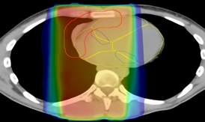
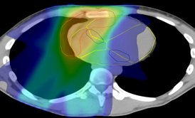
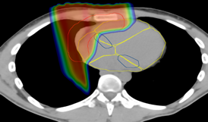
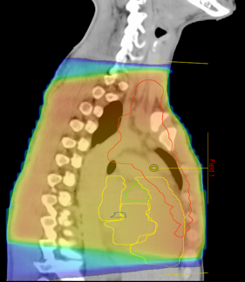
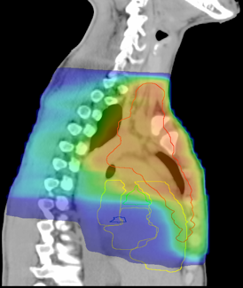
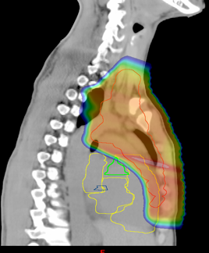
Radiation Exposure In AHOD1331
587 patients treated from 151 centers
317 (54.0%) received protocol RT
No difference per arm (P=0.33)
Reason for RT
94% for LMA
70% LMA only
31% for SER
7% SER only
24% for LMA and SER
Type of RT delivered
28.7% 3D
44.8% IMRT
26.5% PT
Axial
Sagittal
Mean dose | 3D-CRT | IMRT | Proton
Heart | 10 Gy | 11 Gy | 7 Gy
Breast | 3 Gy | 6 Gy | 2 Gy
Thyroid | 12 Gy | 12 Gy | 14 Gy
Radiation exposure: orange/red – 30 Gy (high dose); aqua – 15 Gy (intermediate dose); blue – 5 Gy (low dose)
3D-CRT, 3-dimensional conformal radiation therapy; IMRT, intensity-modulated radiation therapy; LMA, large mediastinal adenopathy; PR, partial response; PT, proton therapy; SER, slow early response. AHOD1331 data accepted for presentation. Courtesy of BS Hoppe. Hoppe BS, et al. Int J Radiat Oncol Biol Phys. 2012;84(2):449-455.

Slide 9
Summary
Radiotherapy played an important role in managing patients with bulky mediastinal disease and slowly responding sites in AHOD1331
Contemporary radiation fields and technology significantly reduced the radiation exposure to critical tissue and are expected to minimize risk of late effects from radiotherapy

