Slide 1
Integrating Targeted Therapy into Frontline Management of High-Risk Pediatric Hodgkin Lymphoma
Kara Kelly, MD
Waldemar J. Kaminski Endowed Chair of Pediatrics
Roswell Park Comprehensive Cancer Center
Division Chief, Pediatric Hematology/Oncology and Professor of Pediatrics
University at Buffalo Jacobs School of Medicine and Biomedical Sciences
Buffalo, NY

Slide 2
Disclaimer
The views and opinions expressed in this educational activity are those of the faculty and do not necessarily represent the views of TotalCME, Inc., the CME providers, or the companies providing educational grants. This presentation is not intended to define an exclusive course of patient management; the participant should use their clinical judgment, knowledge, experience, and diagnostic skills in applying or adopting for professional use any of the information provided herein. Any procedures, medications, or other courses of diagnosis or treatment discussed or suggested in this activity should not be used by clinicians without evaluation of their patient's conditions and possible contraindications or dangers in use, review of any applicable manufacturer’s product information, and comparison with recommendations of other authorities. Links to other sites may be provided as additional sources of information.

Slide 3
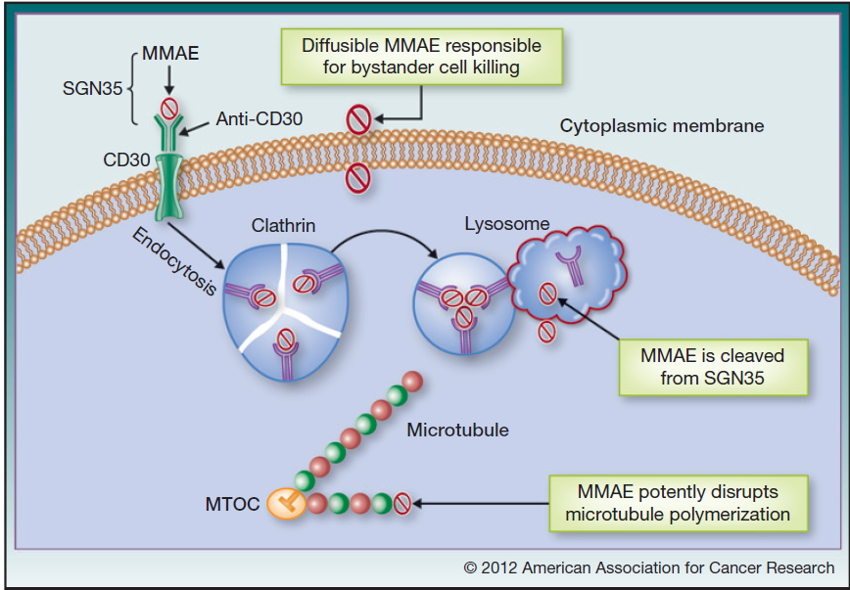
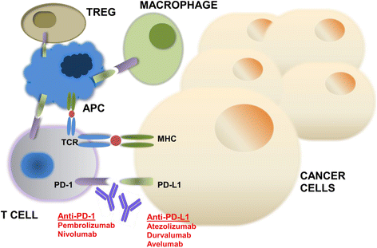
Targeted Therapies for High-Risk Pediatric
Hodgkin Lymphoma
CD30 Antibody-Drug Conjugates
Immune Checkpoint Inhibition
APC, antigen-presenting cell; MHC, major histocompatibility complex; MMAE, monomethyl auristatin E, an antimitotic agent; SGN-35, brentuximab vedotin. TCR, T-cell receptor; TREG, T-regulatory.
Deng C, et al. Clin Cancer Res. 2013;19(1):22-27.
Gong J, et al. J Immunother Cancer. 2018;6(1):8.

Slide 4
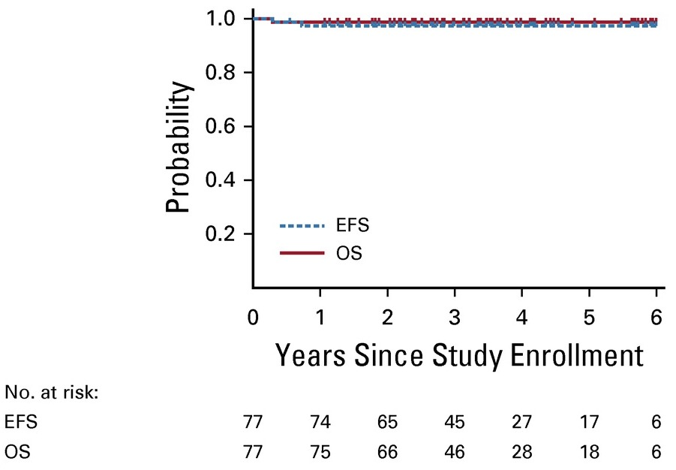
Brentuximab Vedotin (Bv) in Children with High-Risk Classic Hodgkin Lymphoma
Design: Single-arm, multicenter trial
Population: Children with high-risk classic Hodgkin lymphoma (n=77)
Treatment:
  Bv replaced vincristine (VCR) in OEPA/COPDac
  25.5 Gy radiotherapy to all sites not in complete response at early response assessment
Outcomes:
  3-year event-free survival, 97.4%
  Overall survival, 98.7%
COPDac, cyclophosphamide, vincristine, prednisone, dacarbazine: EFS, event-free survival; OEPA, vincristine, etoposide, prednisone, doxorubicin; OS, overall survival.
Metzger ML, et al. J Clin Oncol. 2021;39(20):2276-2283.

Slide 5
AHOD1331: Bv+Chemotherapy in Pediatric High-Risk Hodgkin Lymphoma
Study entry
Randomize (1:1) n=600
Bv-AVE-PCx2
ABVE-PCx2
PD
iPET
iPET
iPET: RRL:
5PS= -3; SRL: 5PS=4-5
Off protocol
therapy
Bv-AVE-PCx3
ABVE-PCx3
Radiotherapy
limited to SRL, LMA
Radiotherapy
limited to SRL, LMA
RT 21 Gy; 9 Gy boost
to SRL with 5PS>2
ABVE-PC, doxorubicin, bleomycin, vincristine, etoposide, prednisone, cyclophosphamide; Bv-AVE-PC, brentuximab vedotin, doxorubicin, vincristine, etoposide, prednisone, cyclophosphamide; iPET, interim FDG-PET-CT; LMA, large mediastinal adenopathy; PD, progressive disease; RRL, rapid responding lesions;
SRL, slow responding lesions.
Castellino SM, et al. N Engl J Med. 2022;387(18):1649-1660.

Slide 6
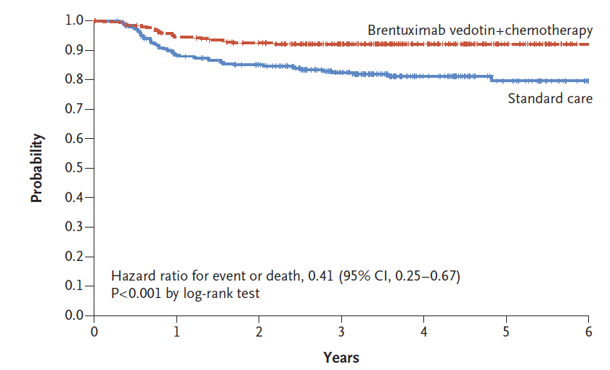
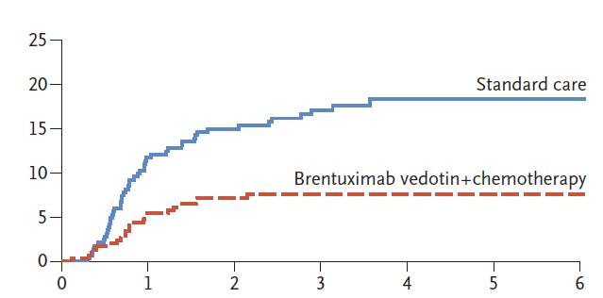

Brentuximab Vedotin (Bv)+Chemotherapy Improves EFS and Reduces Relapse
EFS
Relapse
3-yr EFS 92.1%
3-yr EFS 82.5%
November 2022: FDA approved Bv in combination with AVE-PC for patients aged 2 years and older with high-risk classic Hodgkin lymphoma
First pediatric approval for Bv
EFS, event-free survival; time to disease progression, a second malignant neoplasm, or death.
Castellino SM, et al. N Engl J Med. 2022;387(18):1649-1660.

Slide 7
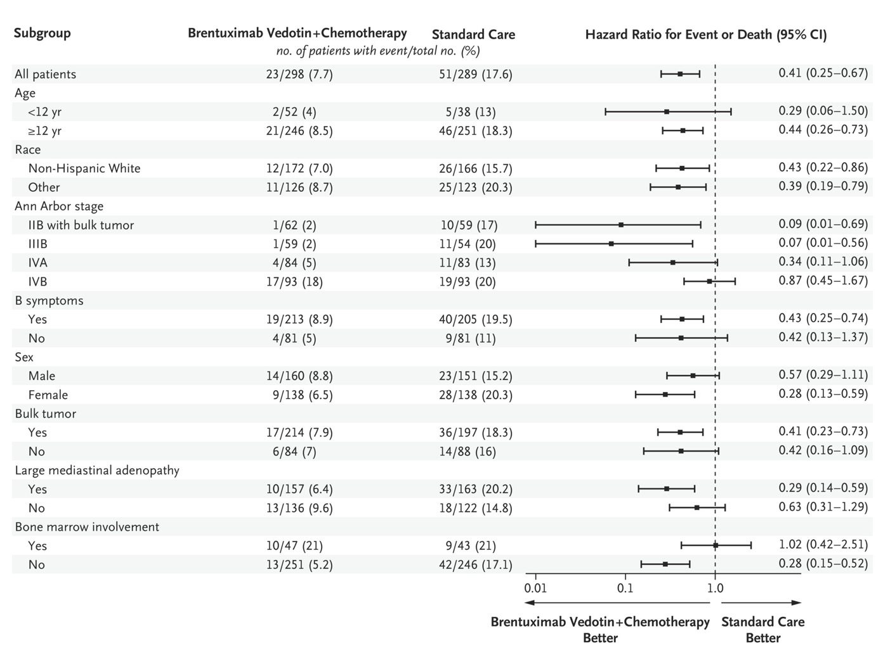
Benefit of Bv Extends Across Multiple
Prognostic Factors
CI, confidence interval.
Castellino SM, et al. N Engl J Med. 2022;387(18):1649-1660.

Slide 8
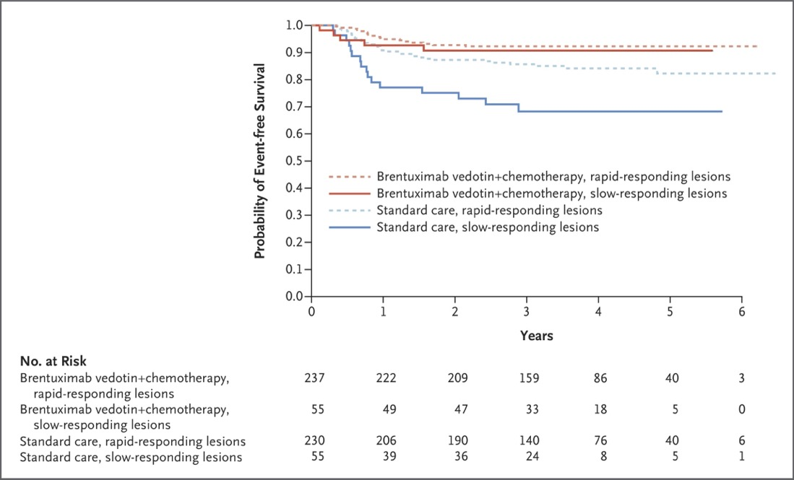
Benefit of Bv Extends Across Multiple Prognostic Factors
Post-hoc analysis
3-year EFS
(Bv+CT versus CT)
Rapid-responding lesions:
  92.3% versus 85.7% (HR, 0.48; 95% CI, 0.27 to 0.84)
Slow-responding lesions:
  90.7% versus 68.3% (HR, 0.28; 95% CI, 0.10 to 0.76)
Bv, brentuximab vedotin; CT, computerized tomography scan; HR, hazard ratio.
Castellino SM, et al. N Engl J Med. 2022;387(18):1649-1660.

Slide 9
Next Steps: SWOG1826: Phase III RCT of Nivo+Chemotherapy versus Bv+Chemotherapy
Newly diagnosed stage III-IV Hodgkin lymphoma
Stratification:
Age (12-17/18-60/>60)
IPS (012-17/18-60-3/4-7)
EOT RT eligible (Y/N)
Randomize (1:1) n=940
Nivo+AVD
6 cycles
Bv+AVD
6 cycles
*G-CSF required
Endpoints
Primary endpoint: PFS
Secondary endpoints:
EFS, OS, CR, PROs
EOT RT to residual FDG-avid areas allowed for pts declared RT-eligible prior to randomization with EOT:
DS 4-5
≥30% reduction in max transverse diameter
AND residual LN ≥2.5 cm OR residual extranodal lesion >1 cm
AVD, doxorubicin, vinblastine, dacarbazine; CR, complete response; DS, Deauville Score; EOT, end of treatment; G-CSF, granulocyte colony stimulating factor; IPS, International Prognostic Score; LN, lymph node; Nivo, nivolumab; PFS, progression-free survival; PRO, patient-reported outcome; RCT, randomized clinical trial; RT, radiation therapy.
Herrera AF, et al. Blood. 2020;136(suppl 1):23-24.

Slide 10
Summary
For pediatric patients with newly diagnosed high-risk classic Hodgkin lymphoma,
Bv with chemotherapy improves EFS
The benefits of Bv on EFS are observed across most subgroups, including patients with a positive interim PET scan
Alternative strategies may be needed for patients with stage
IVB disease

