Slide 1
Current Response-Based Treatment of Pediatric Hodgkin Lymphoma
Bradford Hoppe, MD, MPH Professor of Radiation Oncology Medical Director of Particle Therapy Mayo Clinic Jacksonville, FL

Slide 2
Disclaimer
The views and opinions expressed in this educational activity are those of the faculty and do not necessarily represent the views of TotalCME, Inc., the CME providers, or the companies providing educational grants. This presentation is not intended to define an exclusive course of patient management; the participant should use their clinical judgment, knowledge, experience, and diagnostic skills in applying or adopting for professional use any of the information provided herein. Any procedures, medications, or other courses of diagnosis or treatment discussed or suggested in this activity should not be used by clinicians without evaluation of their patient's conditions and possible contraindications or dangers in use, review of any applicable manufacturer’s product information, and comparison with recommendations of other authorities. Links to other sites may be provided as additional sources of information.

Slide 3
Risk-Adapted Therapy
Early favorable (low-risk)
Stage IA, IIA
No risk factors
Early unfavorable (intermediate-risk)
Stage I, II
Positive for risk factors
+/-Stage IIIA
Advanced (high-risk)
Stage IIIB/IV
+/-Stage IIB bulky, IIIA
Risk Factors
Bulky
B symptoms
Extranodal sites
ESR >30
Group | Treatment | 10-yr EFS
Low-risk | COPP/ABVx4+IFRT (n=94) | 100%
Intermediate-risk | COPP/ABVx6+IFRT (n=103) | 84%
High-risk | Intensive chemo+IFRT (n=36) | 88%
B Symptoms, unexplained loss of >10% of body weight, unexplained recurrent fever >38°C, and drenching night sweats; COPP/ABV, cyclophosphamide, vincristine, procarbazine, and prednisone/doxorubicin, bleomycin, and vinblastine; ESR, erythrocyte sedimentation rate; IFRT, involved-field radiation therapy.
Wolden SL, et al. J Clin Oncol. 2012;30(26):3174-3180.

Slide 4
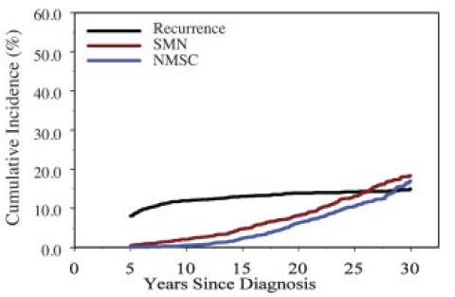
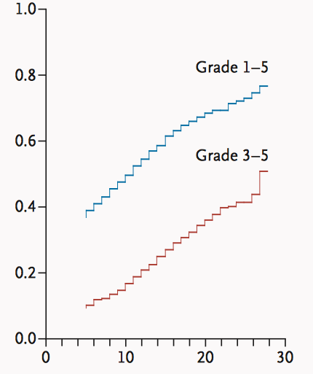
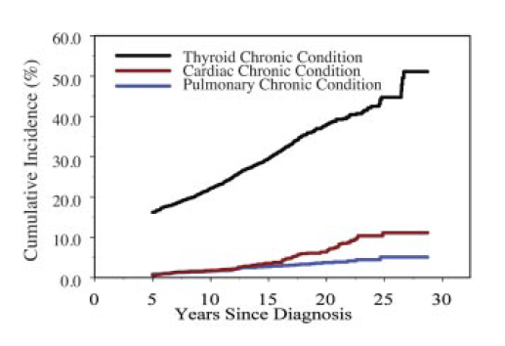
Morbidity of Combined Modality Therapy
Hodgkin’s Disease (n=1876)
All neoplasms
SMN, second malignant neoplasms
NMSC, nonmelanoma skin cancer
N=2742 survivors of Hodgkin lymphoma
Cumulative Incidence
Other nonneoplastic conditions
Years after Original Cancer Diagnosis
Common Terminology Criteria for Adverse Events version 3.0; mild (grade 1), moderate (grade 2), severe (grade 3), life-threatening/disabling (grade 4), fatal (grade 5)
Castellino SM, et al. Blood. 2011;117(6):1806-1816.
Oeffinger KC, et al. N Engl J Med. 2006;355(15):1572-1582.

Slide 5
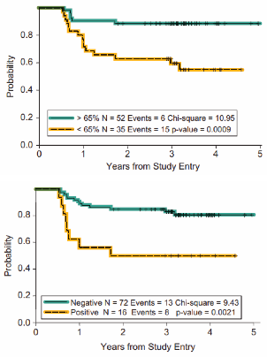
Response-Adapted Therapy
PET response
Imaging response by CT and/or FDG-PET after 1 to 2 cycles or at completion of systemic therapy is strong prognostic factor for relapse of adult and pediatric lymphoma
Favorable response: De-escalate therapy (omit RT)
Unfavorable response: No change/Intensify therapy
CT response
CT, computerized tomography scan; FDG, fluorodeoxyglucose; PET, positron emission tomography; RT, radiation therapy.
Kostakoglu L, et al. Leuk Lymphoma. 2012;53(11):2143-2150.

Slide 6
Response-Adapted Treatment: Euronet-PHL-C1
Euronet-PHL-C1¹
OEPAx2 | RER, Done | 5-yr EFS 87% | Response based on CT and PET (1-2 vs 3-5)
 | SER, 19.8 Gy IFRT | 5-yr EFS 89%
 | RER, COPDACx2 or 4 | 3-yr EFS 91%
 | SER, COPDACx2 or 4 +ISRT | 3-yr EFS 67%
Mauz-Korholz C, et al. Lancet Oncol. 2023;24(2-3):252-261
COPDAC, cyclophosphamide, vincristine sulfate, prednisone, and dacarbazine; EFS, event-free survival; IFRT, involved field radiation therapy; ISRT, involved site radiation therapy; OEPA, vincristine, etoposide, prednisone, doxorubicine; RER, rapid early responders; SER, slow early responders.

Slide 7
Response-Adapted Treatment: Low-Risk Hodgkin Lymphoma
COG (per adult CALGB)¹
ABVDx2 | RER, ABVDx2 | 3-yr EFS 91% | Response based on PET (1-3 vs 4-5)
 | SER, eBEACOPPx2 | 3-yr EFS 67% | 3yr EFS 67%
1. Straus DJ, et al. Blood. 2018;132(10):1013-1021.
ABVD, doxorubicin, bleomycin, vinblastine, dacarbazine; eBEACOPP, dose-intense bleomycin, etoposide, doxorubicin, cyclophosphamide, vincristine, procarbazine, prednisone; EFS, event-free survival; RER, rapid early responders; SER, slow early responders.

Slide 8
Response-Adapted Treatment: Intermediate-Risk Hodgkin Lymphoma
COG (AHOD0031)¹
ABVE-PCx2 | RER, ABVE-PCx2, CR | 4-yr EFS 84% | Response based on CT and PET (1-2 vs 3-5)
 | RER, ABVE-PCx2, PR+ISRT | 4-yr EFS 87%
 | SER, ABVE-PCx2 + ISRT | 4-yr EFS 75%
1. Friedman DL, et al. J Clin Oncol. 2014;32(32):3651-3658.
ABVE-PC, doxorubicin, bleomycin, vincristine, etoposide, cyclophosphamide, prednisone; CR, complete response; CT, computerized tomography scan; ISRT, involved site radiation therapy; PET, positron emission tomography; PR, partial response.

Slide 9
Response-Adapted Treatment: High-Risk Hodgkin Lymphoma
COG (AHOD1331)¹
Bv-AVEPCx2 | RER, Bv-AVEPCx3, LMA ISRT | 3-yr EFS 86% | Response per PET (1-3 vs 4-5)
 | SER, ABVE-PCx3, LMA ISRT+SER sites | 3-yr EFS 68%
1. Castelllino SM, et al. N Engl J Med. 2022;387(18):1649-1660.
Bv-AVEPC, brentuximab vedotin, doxorubicin, vincristine, etoposide, prednisone, cyclophosphamide; ISRT, involved site radiation therapy; LMA, large mediastinal adenopathy; PET, positron emission tomography; RER, rapid early responders; SER, slow early responders.

Slide 10
Conclusions
Low- and intermediate-risk pediatric Hodgkin lymphoma have high cure rates with combined modality therapy
A primary area of focus is delivering safer treatment to ensure healthy long-term survivors
High-risk pediatric Hodgkin lymphoma clinical outcomes with combined modality therapy need to improve
The addition of Bv to AVE-PC backbone significantly improved EFS on AHOD1331

