Slide 1
Life-Threatening Bleeding in the Anticoagulated Patient: Real World Evidence
Natalie Kreitzer, MD, MS Associate Professor, Emergency Medicine and Neurocritical Care University of Cincinnati Cincinnati, OH

Slide 2



Resource Information
About This Resource
These slides are one component of a continuing education program available online at MedEd On The Go titled The Life-Threatening Bleeding in the Anticoagulated Patient Journal Club: Real World Evidence for Effectiveness
Program Learning Objectives:
Evaluate recent practice-changing data that can be applied to practice in the presence of a life-threatening bleed in the presence of anticoagulation
Apply the latest evidence-based approaches to maximize management prognostic outcomes for life-threatening bleeds in the presence of anticoagulation
MedEd On The Go®
www.mededonthego.com
This content or portions thereof may not be published, posted online or used in presentations without permission.
This content can be saved for personal use (non-commercial use only) with credit given to the resource authors.
To contact us regarding inaccuracies, omissions or permissions please email us at support@MedEdOTG.com

Slide 3
Disclaimer
The views and opinions expressed in this educational activity are those of the faculty and do not necessarily represent the views of Total CME, LLC, the CME providers, or the companies providing educational grants. This presentation is not intended to define an exclusive course of patient management; the participant should use their clinical judgment, knowledge, experience, and diagnostic skills in applying or adopting for professional use any of the information provided herein. Any procedures, medications, or other courses of diagnosis or treatment discussed or suggested in this activity should not be used by clinicians without evaluation of their patient's conditions and possible contraindications or dangers in use, review of any applicable manufacturer’s product information, and comparison with recommendations of other authorities. Links to other sites may be provided as additional sources of information.

Slide 4
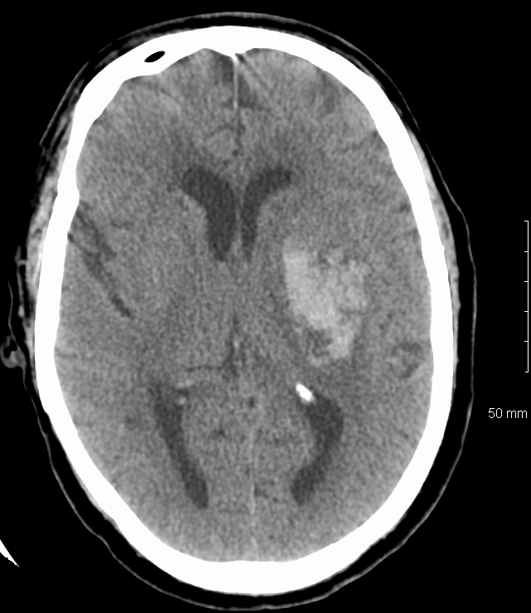
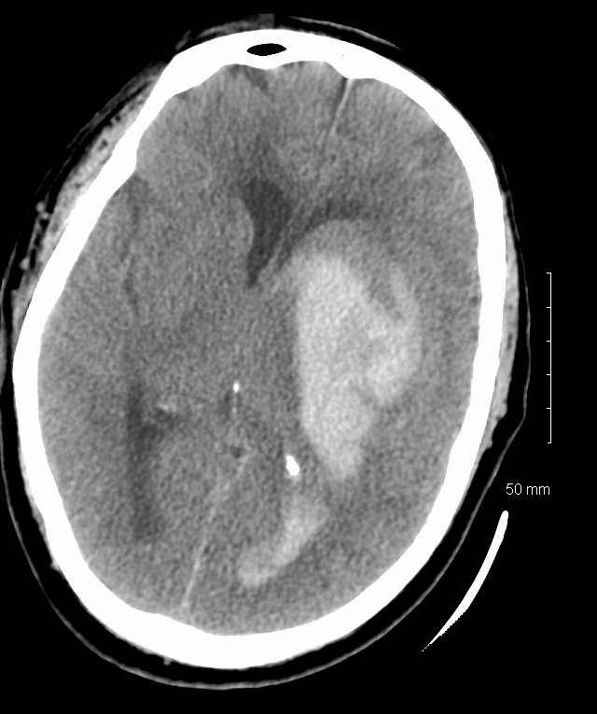
Hemorrhage Expansion

Slide 5
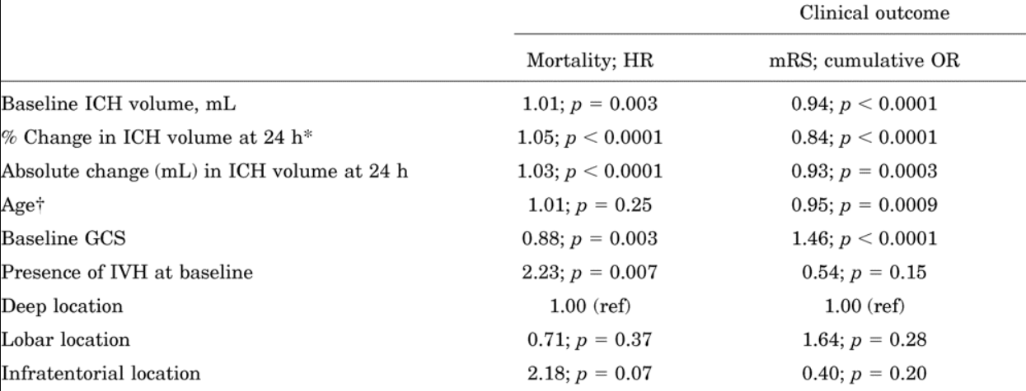
Hematoma Expansion Impacts Outcomes

Slide 6
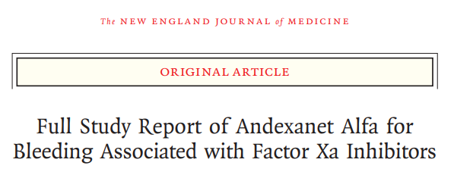
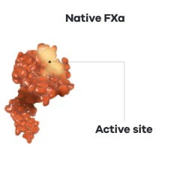
Reversal of Anti-Xa Agents
Recombinant modified human “decoy” factor Xa protein
May be needed if last dose within 18 hours
Lab to Follow: Anti-Xa Level
Dose: High dose or low dose
Xa Inhibitor dose
Time since taken

Slide 7
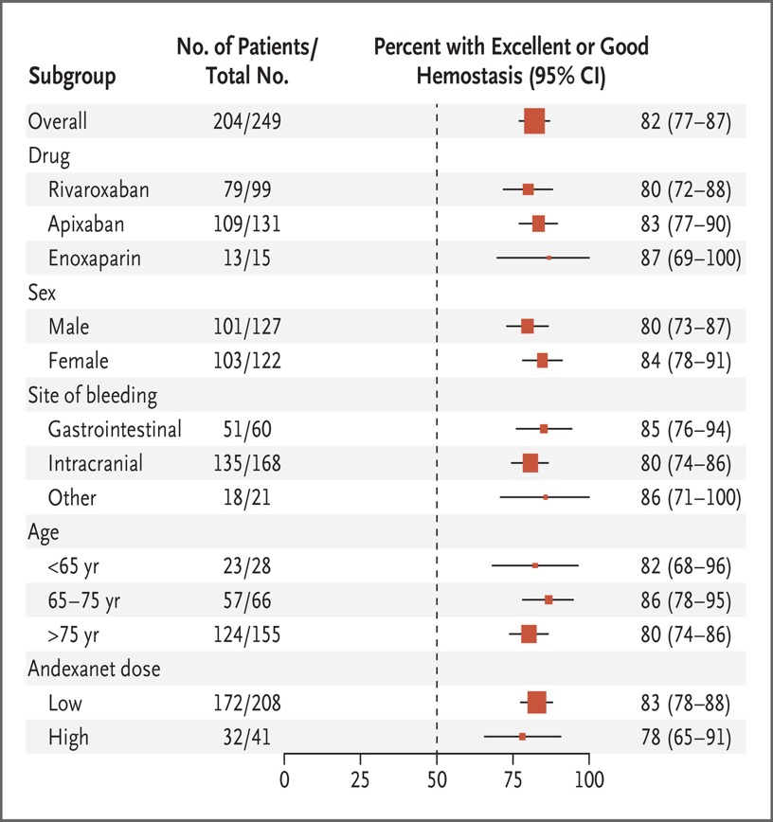
Limitations / Concerns with ANNEXA-4
Single Arm, no comparison
Nonrandomized
Participants reversed many hours after last seen well
One end point was a lab value
Small hemorrhages, high GCS
Risk of thromboembolic complications
More data was needed

Slide 8
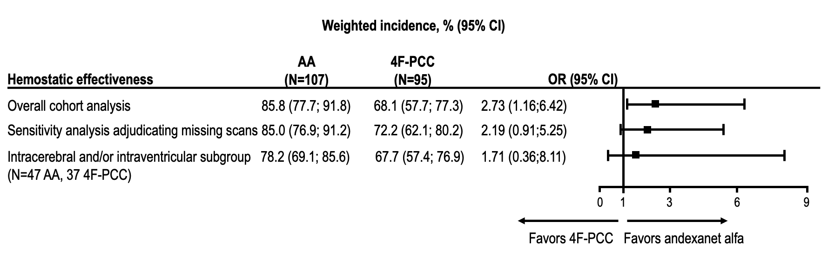
Hematoma Expansion in ICH Propensity Matched Retrospective Data

Slide 9
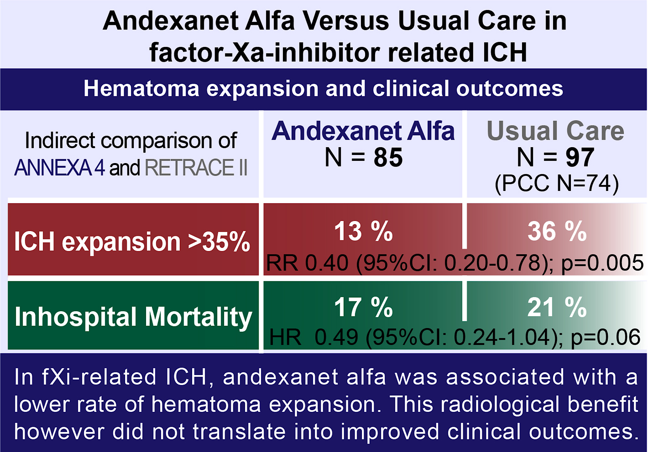
Hematoma Expansion in ICH Management Propensity Analysis
36 %
RR 0.40 (95%CI: 0.20-0.78); p=0.005
21 %
HR 0.49 (95%CI: 0.24-1.04); p=0.06

Slide 10

Study Design
Phase IV, multicenter, international
Randomized Controlled Trial
Protocol
Last seen well < 6 hours, within 15 hours last DOAC dose
Endpoint: hemostatic efficacy
Enrollment
Planned Enrollment 1200 participants
DSMB recommended trial to stop early, after 450 participants

Slide 11
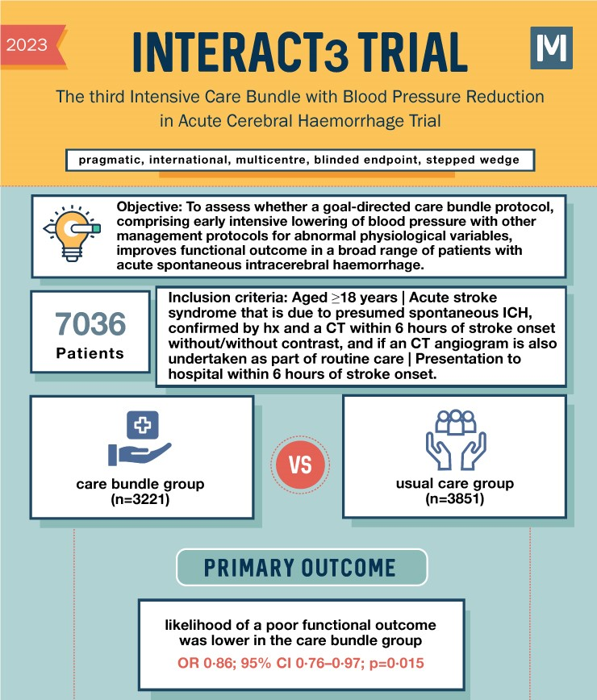
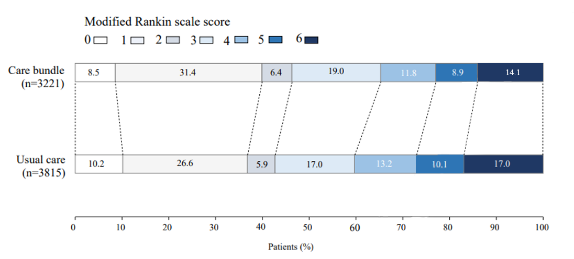
INTERACT 3

Slide 12



Looking for more resources on this topic?
CME/CE in minutes
Congress highlights
Late-breaking data
Quizzes
Webinars
In-person events
Slides & resources
www.MedEdOTG.com

