Slide 1
Pharmacy Perspective
Real-World Management of Factor Xa Inhibitor-Associated Bleeding Across 45 US Hospitals
Paul P. Dobesh, PharmD, FACC, FAHA, FCCP, BCPS, BCCP
Professor of Pharmacy Practice and Science
College of Pharmacy
University of Nebraska Medical Center
Omaha, NE

Slide 2
Disclaimer
The views and opinions expressed in this educational activity are those of the faculty and do not necessarily represent the views of TotalCME, Inc., the CME providers, or the companies providing educational grants. This presentation is not intended to define an exclusive course of patient management; the participant should use their clinical judgment, knowledge, experience, and diagnostic skills in applying or adopting for professional use any of the information provided herein. Any procedures, medications, or other courses of diagnosis or treatment discussed or suggested in this activity should not be used by clinicians without evaluation of their patient's conditions and possible contraindications or dangers in use, review of any applicable manufacturer’s product information, and comparison with recommendations of other authorities. Links to other sites may be provided as additional sources of information.

Slide 3
Disclosures
Dr. Dobesh has served as a consultant for the following entities:
  The Pfizer/BMS Alliance
  AstraZeneca
  Janssen Pharmaceuticals

Slide 4
Background
Direct factor Xa inhibitor use has increased steadily over the last several years
  In 2012, 98.7% of VTE patients treated with warfarin
  In 2017, 17.5% of VTE patients treated with warfarin
  In 2017, rivaroxaban and apixaban accounted for over 80% of all anticoagulant prescriptions
  Over 7 million patients currently on factor Xa inhibitors
While factor Xa inhibitors have less bleeding compared to warfarin, bleeding events still occur
Treatment of major bleeding episodes
  4F-PCC=nonspecific factor replacement
  Andexanet alfa=targeted reversal

Slide 5
Coleman CI, Dobesh PP, Danese S, Ulloa J, Lovelace B. Real-world management of oral factor Xa inhibitor-related bleeds with reversal of replacement agents including andexanet alfa and four-factor prothrombin complex concentrate: a multicenter study.
Future Cardiol. 2021;17(1):127-135.

Slide 6
Methods
Multicenter retrospective electronic medical records study
Data collected from 45 US-based hospitals
Inclusion criteria
  ICD-10 billing codes
    D68.32, hemorrhagic disorder due to extrinsic circulating anticoagulants
    T45.515, adverse effect of anticoagulant
    T45.525, adverse effect of antithrombotic
    D68.32, use of andexanet alfa
  Use of a direct factor Xa inhibitor prior to admission
Data Collection
  Age and gender
  Bleeding event
  LOS/ICU LOS
  Reversal management
  In-hospital mortality
Descriptive analysis – prevalence of each reversal agent used and associated in-hospital mortality – no inferential comparisons

Slide 7
Methods
Multicenter retrospective electronic medical records study
Data collected from 45 US-based hospitals
Inclusion criteria
  ICD-10 billing codes
    D68.32, hemorrhagic disorder due to extrinsic circulating anticoagulants
    T45.515, adverse effect of anticoagulant
    T45.525, adverse effect of antithrombotic
    D68.32, use of andexanet alfa
  Use of a direct factor Xa inhibitor prior to admission
Data Collection
  Age and gender
  Bleeding event
  LOS/ICU LOS
  Reversal management
  In-hospital mortality
Descriptive analysis – prevalence of each reversal agent used and associated in-hospital mortality – no inferential comparisons

Slide 8
Methods
Multicenter retrospective electronic medical records study
Data collected from 45 US-based hospitals
Inclusion criteria
  ICD-10 billing codes
    D68.32, hemorrhagic disorder due to extrinsic circulating anticoagulants
    T45.515, adverse effect of anticoagulant
    T45.525, adverse effect of antithrombotic
    D68.32, use of andexanet alfa
  Use of a direct factor Xa inhibitor prior to admission
Data Collection
  Age and gender
  Bleeding event
  LOS/ICU LOS
  Reversal management
  In-hospital mortality
Descriptive analysis – prevalence of each reversal agent used and associated in-hospital mortality – no inferential comparisons

Slide 9
Methods
Multicenter retrospective electronic medical records study
Data collected from 45 US-based hospitals
Inclusion criteria
  ICD-10 billing codes
    D68.32, hemorrhagic disorder due to extrinsic circulating anticoagulants
    T45.515, adverse effect of anticoagulant
    T45.525, adverse effect of antithrombotic
    D68.32, use of andexanet alfa
  Use of a direct factor Xa inhibitor prior to admission
Data Collection
  Age and gender
  Bleeding event
  LOS/ICU LOS
  Reversal management
  In-hospital mortality
Descriptive analysis – prevalence of each reversal agent used and associated in-hospital mortality – no inferential comparisons

Slide 10
Results
45 US-based hospitals
  Mean number of beds was 465
  56% with fewer than 500 beds and 44% with 500 or more beds
  67% were advanced primary stroke centers
  64% were Level 1 trauma centers, 36% were Level 2
14,418 hospitalizations for bleeding between 1/2016 and 9/2019
  3030 (21%) associated with oral factor Xa inhibitors
  Increased from 18% in 2017 to 21% in 2019
  49% rivaroxaban, 45% apixaban, 6% edoxaban, less than 1% betrixaban
  Mean age was 67.6 years, and 47% were women

Slide 11
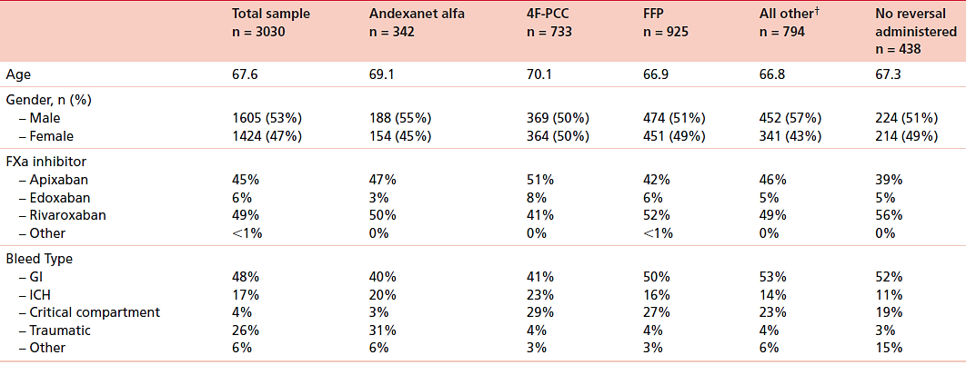
Results: Baseline Characteristics

Slide 12
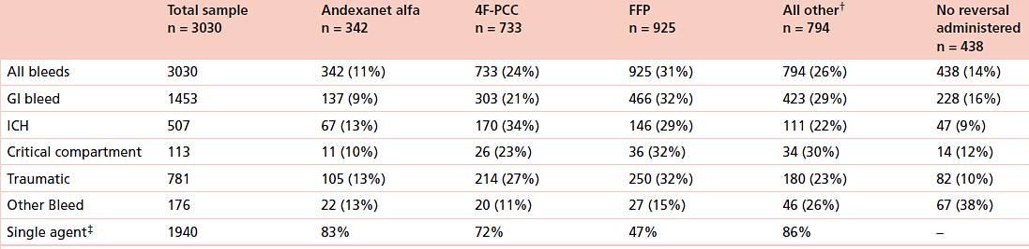
Results: Bleed Types by Management Approach

Slide 13
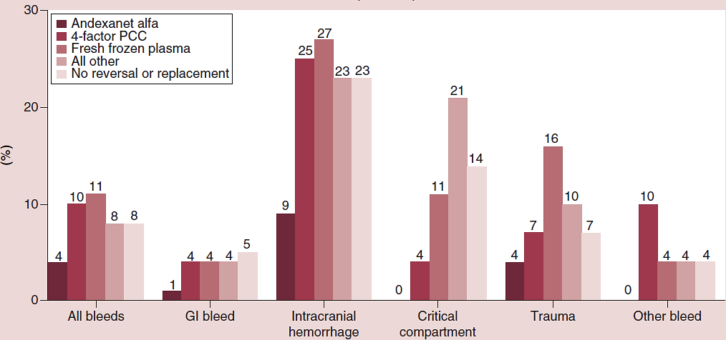
Results: In-Hospital Mortality

Slide 14
Summary
Strengths
  Multicenter data
  Over 3000 patients
  Evaluated multiple reversal and replacement strategies
Limitations
  Descriptive analysis
  Information of bleed severity not collected
Conclusions
  In this large sample of hospitalizations for oral factor Xa inhibitor-induced bleeding, in-hospital mortality differed by bleed type and reversal or replacement agent used
  Andexanet alfa was associated with the lowest in-hospital mortality across all bleed types

Slide 15
Summary
Strengths
  Multicenter data
  Over 3000 patients
  Evaluated multiple reversal and replacement strategies
Limitations
  Descriptive analysis
  Information of bleed severity not collected
Conclusions
  In this large sample of hospitalizations for oral factor Xa inhibitor-induced bleeding, in-hospital mortality differed by bleed type and reversal or replacement agent used
  Andexanet alfa was associated with the lowest in-hospital mortality across all bleed types

Slide 16
Summary
Strengths
  Multicenter data
  Over 3000 patients
  Evaluated multiple reversal and replacement strategies
Limitations
  Descriptive analysis
  Information of bleed severity not collected
Conclusions
  In this large sample of hospitalizations for oral factor Xa inhibitor-induced bleeding, in-hospital mortality differed by bleed type and reversal or replacement agent used
  Andexanet alfa was associated with the lowest in-hospital mortality across all bleed types

