Slide 1
Targeted Versus Nonspecific Approaches to Anticoagulation Reversal
Gregory J. Fermann, MD Professor and Executive Vice Chairman Department of Emergency Medicine University of Cincinnati College of Medicine Cincinnati, OH

Slide 2
Disclaimer
The views and opinions expressed in this educational activity are those of the faculty and do not necessarily represent the views of TotalCME, Inc., the CME providers, or the companies providing educational grants. This presentation is not intended to define an exclusive course of patient management; the participant should use their clinical judgment, knowledge, experience, and diagnostic skills in applying or adopting for professional use any of the information provided herein. Any procedures, medications, or other courses of diagnosis or treatment discussed or suggested in this activity should not be used by clinicians without evaluation of their patient's conditions and possible contraindications or dangers in use, review of any applicable manufacturer’s product information, and comparison with recommendations of other authorities. Links to other sites may be provided as additional sources of information.

Slide 3
Disclosures
Speakers Bureau: Janssen, AstraZeneca
Research Support: Abbott, InCarda, Siemens
Advisory Board: Milestone Pharmaceuticals

Slide 4
Context
Primary adverse event associated with OAC use is hemorrhage
Most OAC-related hemorrhage is minor, some are not
Bleeding equals emergency care
Our task:
Resuscitate when necessary
Differentiate major from minor bleeding
Decide if reversal/repletion is part of the picture
Acknowledge that reversal returns patient to pretreatment thrombotic risk

Slide 5
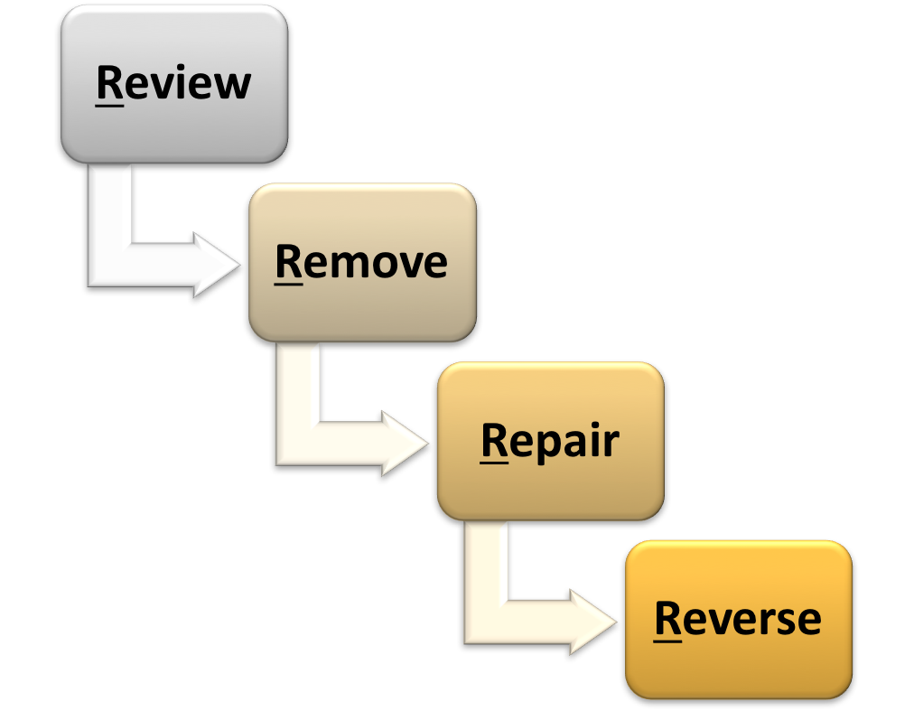
Managing DOAC-Associated Bleeding: The 4 Rs
• Timing of last dose • Comorbidities • Source of bleeding • Baseline labs
➔Simultaneous RESUSCITATION
• Gastric lavage for recent ingestion • Oral charcoal
• Source control: Assess need for surgery, interventional radiology, endoscopy
• PCCs➔Nonspecific
• Andexanet alfa➔Targeted

Slide 6
Targeted Versus Nonspecific: What Do We Mean?
Targeted
Molecule designed for bind specific class of OACs
Factor Xa inhibitors-andexanet alfa
Direct thrombin inhibitor-idarucizumab
Nonspecific
4-factor PCCs-lyophylized factors
Vitamin K-dependent- 2, 7, 9, 10
Approved for warfarin repletion
Off-label for DOAC reversal

Slide 7
Real-World Evidence*
Objective
Multicenter retrospective chart review study of adults in the United States hospitalized with oral FXa inhibitor- or enoxaparin-related bleeds who received andexanet alfa or 4F-PCC between May 17, 2018, and September 30, 2021
Inclusion criteria:
Older than 18 years
ICD-10 diagnosis code of D68.32 as part of inpatient admission
Taking either an oral FXa inhibitor or enoxaparin at the time of the bleeding event
Treated with either andexanet alfa or 4F-PCC during index hospitalization
Had a documented discharge disposition
Patient chart data were collected from 184 US hospitals across 36 states
To compare in-hospital mortality in patients hospitalized with oral FXa inhibitor- or enoxaparin-related ICH or GI bleeds who were treated with andexanet alfa or 4F-PCC

Slide 8

Baseline Characteristics: All Bleed Types
Characteristic | Quibeatem niment | Andexanet alfa (n=1,366) | 4F-PCC (n=1,464) | P value
Age, years, mean; median (IQR) |  | 64; 65 (19) | 65; 66 (20) | 0.092
Male, n (%) |  | 754 (55) | 834 (57) | 0.343
Anticoagulant use, n (%) | Apixaban Rivaroxaban Edoxaban Enoxaparin | 543 (40) 383 (28) 69 (5) 370 (27) | 591 (40) 372 (25) 48 (3) 449 (31) | 0.738 0.114 0.018 0.036
Time since last anticoagulant dose, n (%) | <8 hours 8-18 hours >18 hours | 570 (42) 569 (42) 227 (17) | 590 (40) 615 (42) 259 (18) | 0.441 0.849 0.449
Bleed location, n (%) | GI ICH Critical compartment / noncompressible bleed Other bleed (non-GI, non-ICH) | 836 (61) 360 (26) 156 (11) 14 (1) | 861 (59) 394 (27) 174 (12) 35 (2) | 0.195 0.737 0.7 0.005

Slide 9


In-Hospital Mortality: ICH
Among patients with ICH, in-hospital mortality was significantly lower with andexanet alfa compared to 4F-PCC (13.6% [49 of 360] versus 19.8% [78 of 394], P=0.024)
Mortality was lower for both spontaneous and traumatic ICH treated with andexanet alfa versus 4F-PCC
Variable |  | Spontaneous ICH |  | Traumatic ICH
Characteristic |  | Andexanet alfa (n=163) | 4F-PCC (n=173) | Andexanet alfa (n=197) | 4F-PCC (n=221)
In-hospital mortality, n (%) |  | 16 (9.8) | 25 (14.5) | 33 (16.8) | 53 (24.0)
Stroke severity, n (%)* | GCS mild [13-15] GCS moderate [9-12] GCS severe [≤8] | 22 (31.9) 22 (31.9) 25 (36.2) | 34 (31.5) 43 (39.8) 31 (28.7) | 25 (20.8) 49 (40.8) 46 (38.3) | 29 (25.4) 42 (36.8) 43 (37.7)
Impaired mental status, n (%)† |  | 80 (55.9) | 91 (58.7) | 111 (62.7) | 139 (67.8)
DNR order, n (%) |  | 48 (29.4) | 64 (37.0) | 54 (27.4) | 66 (29.9)
Systolic BP, mmHg |  | 144 (33) | 135 (35) | 136 (33) | 133 (34)
INR§ |  | 3.1 (2.1) | 2.8 (2.0) | 2.6 (2.0) | 2.8 (2.0)

Slide 10
In-Hospital Mortality: GI Bleeds
Among patients with GI bleeds, the incidence of in-hospital mortality was 2.5% (21 of 836) with andexanet alfa and 3.6% (31 of 861) with 4F-PCC (P=0.194)
Variable |  | Andexanet alfa (n=836) | 4F-PCC (n=861)
In-hospital mortality, n (%) |  | 21 (2.5) | 31 (3.6)
GI bleed location, n (%) | Upper GI Lower GI Diffuse Unknown | 312 (37.3) 272 (32.5) 139 (16.6) 113 (13.5) | 338 (39.3) 269 (31.2) 123 (14.3) 131 (15.2)
Impaired mental status, n (%)* |  | 216 (25.8) | 212 (24.6)
Vital signs and laboratory measures, mean (SD) | Systolic BP, mmHg Albumin, g/dL† INR‡ | 132 (31) 3.7 (1.1) 2.8 (1.8) | 126 (31) 3.6 (1.5) 2.8 (1.8)
AIMS65, n (%)§ | 2 or more 0 or 1 | 168 (62%) 105 (38%) | 208 (64%) 118 (36%)
Surgeries and procedures, n (%) | Any type Endoscopy Colonoscopy | 371 (44%) 241 (29%) 174 (21%) | 374 (43%) 271 (31%) 164 (19%)

Slide 11
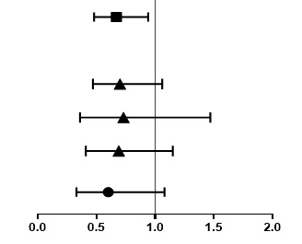
Impact of Andexanet Alfa on In-Hospital Mortality
Treatment with andexanet alfa demonstrated a 33% lower likelihood of in-hospital mortality compared to 4F-PCC in an analysis of combined bleed types and causes (OR, 0.67; 95% CI, 0.48-0.94), adjusted for anticoagulants used and time since last dose, bleed type, traumatic versus spontaneous origin, age, sex, systolic BP, mental status, DNR status, and comorbidities
Factor (weighted)
Andexanet alfa (vs 4F-PCC)
Adjusted OR (95% CI)
P value
Overall weighted
0.67 (0.48, 0.94)
0.02
ICH
ICH overall
0.70 (0.47, 1.06)
0.10
ICH spontaneous
0.73 (0.36, 1.47)
0.37
ICH trauma
0.69 (0.41, 1.15)
0.15
GI bleeds
0.60 (0.33, 1.08)
0.09
Adjusted OR (95% CI)

Slide 12
Conclusions
In this large retrospective study of patients admitted with oral FXa inhibitor- or enoxaparin-related major bleeding, treatment with andexanet alfa was associated with a 33% reduction in odds of in-hospital mortality compared to 4F-PCC, with a similar relative reduction in both ICH and GI bleeds subgroups
The effectiveness of andexanet alfa versus 4F-PCC was consistent across both ICH and GI bleeds and for both spontaneous and traumatic ICH
Limitations of this study include its retrospective design and, because this study was based on chart review, the data obtained were dependent on the quality and accuracy of routine documentation
Results of this study with an additional 1565 subjects from 2021 to 2022 are pending peer review

