Slide 1
Primary Thromboprophylaxis of Patient at High Risk of VTE Who Is Receiving Systemic Anticancer Therapy
Cihan Ay, MD
Professor of Haematology
Clinical Division of Haematology and Haemostaseology
Department of Medicine
Comprehensive Cancer Center Vienna
Medical University of Vienna, Vienna, Austria
Twitter: @Cihan_Ay_MD

Slide 2
Disclaimer
The views and opinions expressed in this educational activity are those of the faculty and do not necessarily represent the views of TotalCME, Inc., the CME providers, or the companies providing educational grants. This presentation is not intended to define an exclusive course of patient management; the participant should use their clinical judgment, knowledge, experience, and diagnostic skills in applying or adopting for professional use any of the information provided herein. Any procedures, medications, or other courses of diagnosis or treatment discussed or suggested in this activity should not be used by clinicians without evaluation of their patient's conditions and possible contraindications or dangers in use, review of any applicable manufacturer’s product information, and comparison with recommendations of other authorities. Links to other sites may be provided as additional sources of information.

Slide 3
Case Presentation
66-year-old man (BMI 32 kg/m²) with metastatic pancreatic cancer (liver metastasis). Ambulatory chemotherapy will be initiated
Prechemotherapy blood counts/analysis: Hemoglobin 10.8 g/dL; WBC 12.9 ×10⁹/L; Platelets 412 ×10⁹/L; D-dimer 2.6 µg/mL (<0.5 µg/mL); KPS 70% /ECOG 1)

Slide 4

Case Presentation
66-year-old man (BMI 32 kg/m²) with metastatic pancreatic cancer (liver metastasis). Ambulatory chemotherapy will be initiated
Prechemotherapy blood counts/analysis: Hemoglobin 10.8 g/dL; WBC 12.9 ×10⁹/L; Platelets 412 ×10⁹/L; D-dimer 2.6 µg/mL (<0.5 µg/mL); KPS 70% /ECOG 1)
Does this patient have an indication for primary thromboprophylaxis?

Slide 5


Prevention of VTE in Patients With Cancer
Primary Thromboprophylaxis
Cancer patients
Clinical setting
Major cancer surgery
Hospitalization for acute medical illness
Outpatients
(chemotherapy)

Slide 6
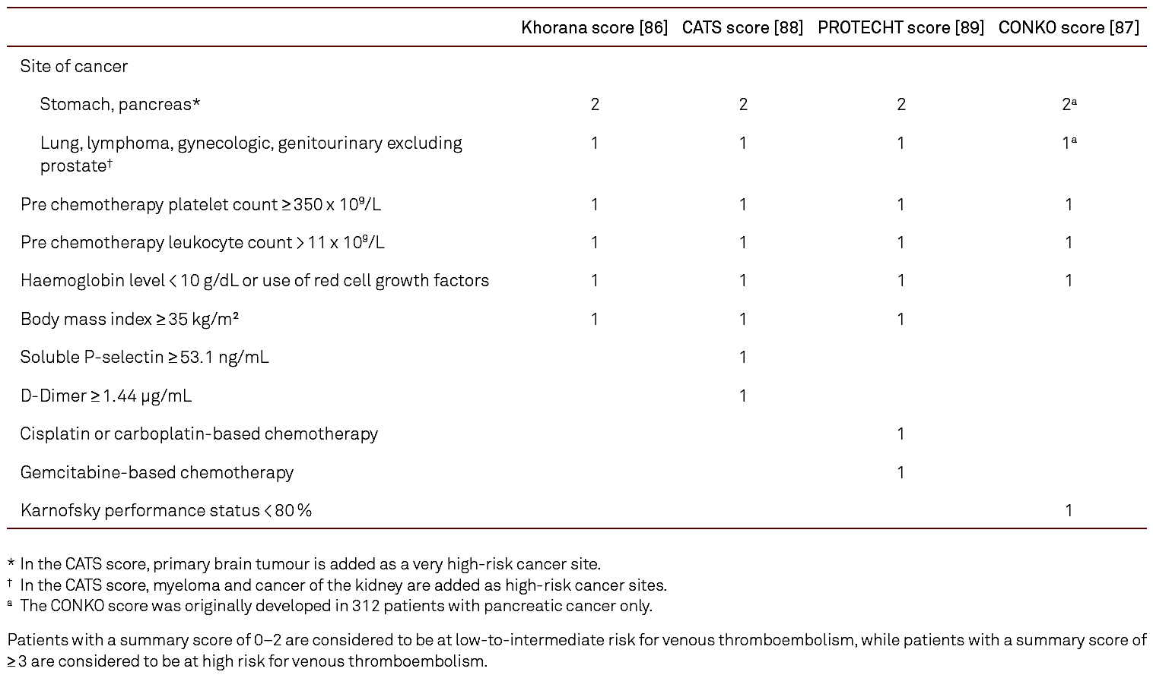
Khorana Score: Risk Assessment of VTE in Patients With Cancer

Slide 7
Khorana Score: Risk Assessment of VTE in Patients With Cancer

Slide 8
Khorana Score: Risk Assessment of VTE in Patients With Cancer
Case:
4 point

Slide 9
Khorana Score: Risk Assessment of VTE in Patients With Cancer
Case:
4 point

Slide 10
Khorana Score: Risk Assessment of VTE in Patients With Cancer
Case:
4 point

Slide 11
Khorana Score: Risk Assessment of VTE in Patients With Cancer
Case:
4 point

Slide 12
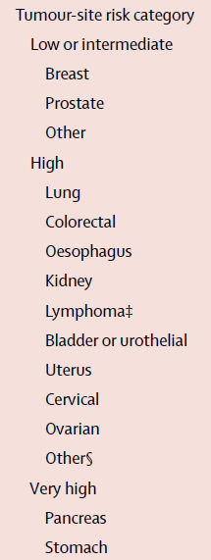
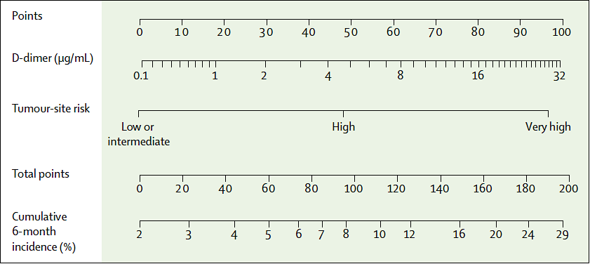
Simplified Risk Prediction Model for Assessing Individual VTE Risk

Slide 13
Simplified Risk Prediction Model for Assessing Individual VTE Risk
Case:
~15% %

Slide 14
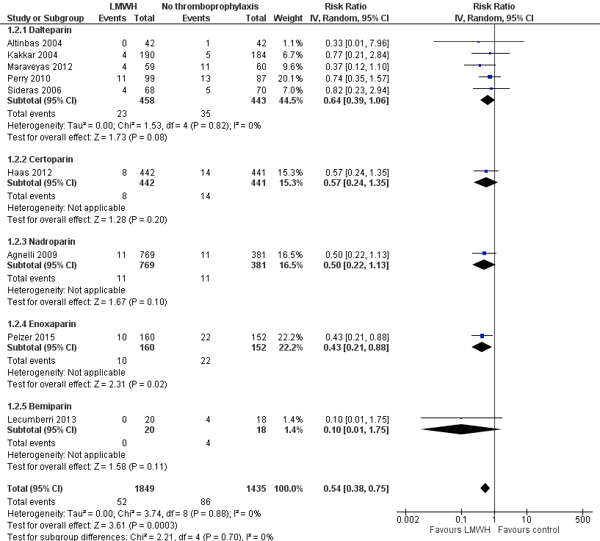
Meta-analysis: Primary Thrombo-prophylaxis With LMWH in Ambulatory Cancer Patients
VTE rate
Primary thrombo-prophylaxis:
2.81%
VTE rate
No thrombo-prophylaxis:
6.00%
RR (95% CI): 0.54 (0.38-0.75)

Slide 15
Primary Thromboprophylaxis with DOAC Based on Risk Assessment* (Randomized-controlled Trials)
*Patients with a Khorana Score of 2 or higher were eligible for the study (estimated baseline VTE risk of 9.6% during the first 6 months of chemotherapy according to results from the Vienna CATS study, Ay C et al. Blood 2010)

Slide 16
Primary Thromboprophylaxis with DOAC Based on Risk Assessment* (Randomized-controlled Trials)
*Patients with a Khorana Score of 2 or higher were eligible for the study (estimated baseline VTE risk of 9.6% during the first 6 months of chemotherapy according to results from the Vienna CATS study, Ay C et al. Blood 2010)
Low bleeding risk with DOAC in AVERT and CASSINI

Slide 17


Primary Thromboprophylaxis in the Ambulatory Setting: What Do the Guidelines Say?
Venous Thromboembolism in Cancer Patients: ESMO Clinical Practice Guideline
Farge D, et al. Lancet Oncol. 2022;23(7):e334-e347.
Falanga A, et al. Ann Oncol. 2023;S0923-7534(22):04786-X.
Primary pharmacological prophylaxis of VTE with LMWH (grade 1A) or with direct oral anticoagulants (rivaroxaban or apixaban; grade 1B) is indicated in ambulatory patients with locally advanced or metastatic pancreatic cancer treated with systemic anticancer therapy, and who have a low risk of bleeding
In ambulatory cancer patients starting systemic anticancer treatment who have a high thrombosis risk, apixaban, rivaroxaban, or LMWH may be considered for primary thromboprophylaxis for a maximum of 6 months [I, B]
For ambulatory pancreatic cancer patients on first line systemic anticancer treatment, LMWH given at a higher dose (150/IU/kg dalteparin or 1 mg/kg enoxaparin) for a maximum of 3 months may be considered [II, C]
Where concerns of DOAC safety exist and the patient is perceived as having clinically important risk for VTE, LMWH at conventional primary thromboprophylaxis dosing may be administered [II, C]

Slide 18
Primary Thromboprophylaxis in the Ambulatory Setting: How to Select Patients?
Venous Thromboembolism in Cancer Patients: ESMO Clinical Practice Guideline
Farge D, et al. Lancet Oncol. 2022;23(7):e334-e347.
Falanga A, et al. Ann Oncol. 2023;S0923-7534(22):04786-X.
Primary prophylaxis is recommended in ambulatory patients who are receiving systemic anticancer therapy and are at intermediate-to-high-risk of VTE, identified by a validated risk assessment model (ie, a Khorana score ≥2), and not actively bleeding or not at a high risk for bleeding (grade 1B)
Cancer patients should be offered a CAT risk assessment and have an opportunity to discuss their particular risk [III, B]
VTE risk assessment should be based on validated RAMs such as the KRS, COMPASS-CAT or the Vienna-CATS nomogram score [III, C]
An estimated risk of VTE >8%-10% at 6 months is suggested as threshold for discussing primary thromboprophylaxis [II, C]. This risk is observed in patients with a KRS ≥2 and can individually be calculated with the Vienna-CATS nomogram score and the COMPASS score

Slide 19

Implementation in Clinical Practice
We have evidence-based suggestions from guidelines of different organizations (ASCO, ASH, ESMO, ITAC, ISTH, …)
Are we already implementing this new evidence
in clinical practice?
  Slow implementation
Next step: Develop implementation
strategies. Science and
local protocols needed

