Slide 1
Treatment of a Patient With Cancer and With Catheter-Related Thrombosis
Cihan Ay, MD Professor of Haematology Clinical Division of Haematology and Haemostaseology Department of Medicine Comprehensive Cancer Center Vienna Medical University of Vienna, Vienna, Austria
Twitter: @Cihan_Ay_MD

Slide 2
Disclaimer
The views and opinions expressed in this educational activity are those of the faculty and do not necessarily represent the views of TotalCME, Inc., the CME providers, or the companies providing educational grants. This presentation is not intended to define an exclusive course of patient management; the participant should use their clinical judgment, knowledge, experience, and diagnostic skills in applying or adopting for professional use any of the information provided herein. Any procedures, medications, or other courses of diagnosis or treatment discussed or suggested in this activity should not be used by clinicians without evaluation of their patient's conditions and possible contraindications or dangers in use, review of any applicable manufacturer’s product information, and comparison with recommendations of other authorities. Links to other sites may be provided as additional sources of information.

Slide 3
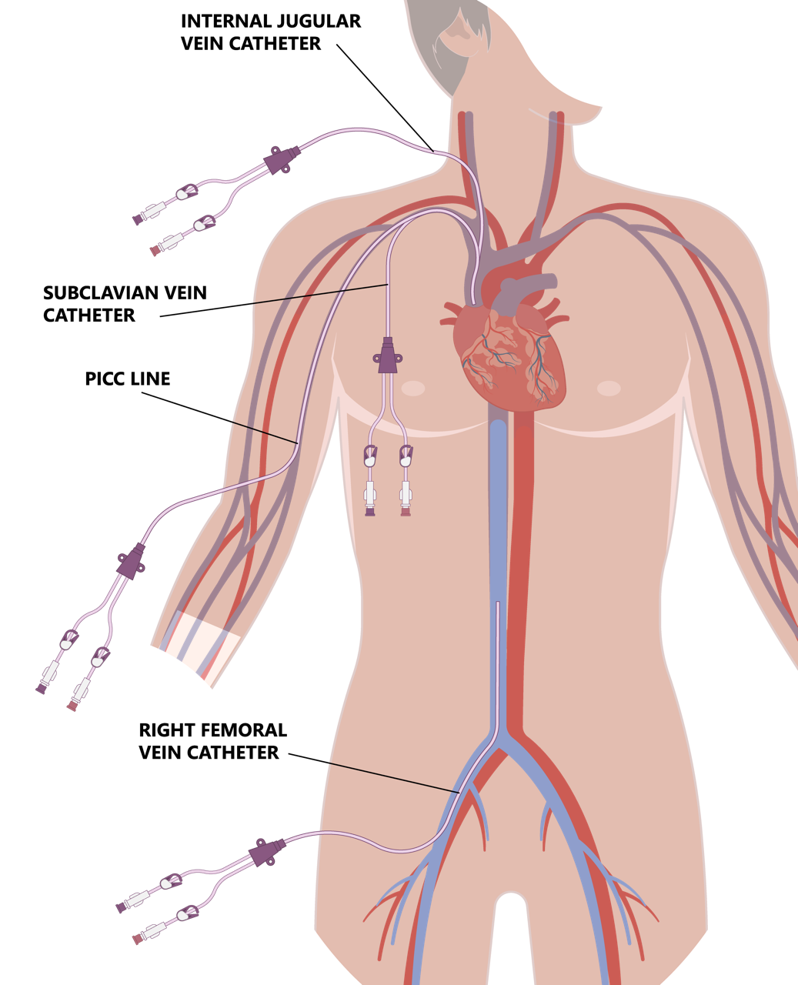
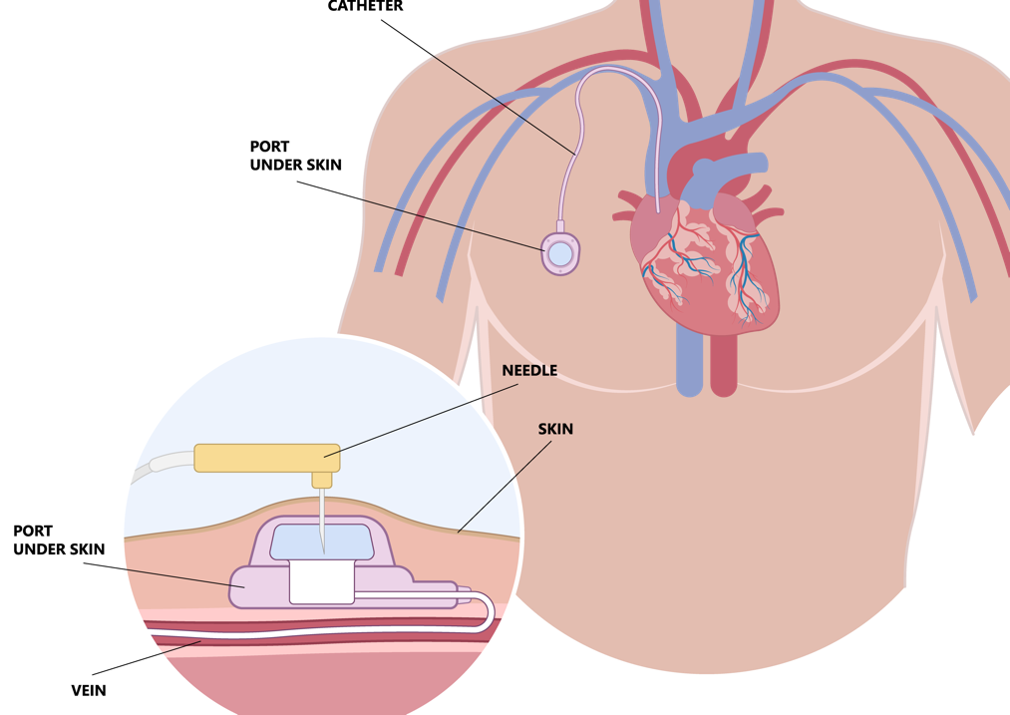
Case Presentation
A 71-year-old woman with rectal cancer is currently undergoing induction chemoradiotherapy
Insertion of a central venous catheters (CVCs) for administration of chemotherapy

Slide 4
Case Presentation
A 71-year-old woman with rectal cancer is currently undergoing induction chemoradiotherapy
After two cycles of therapy, administered via right-sided peripherally inserted central catheter (PICC), her treating physician notices diffuse swelling of her entire right arm and pitting edema. Upon questioning, the patient reports intermittent pain in the affected arm for 3 days, and no chest pain, dyspnea, or hemoptysis
Ultrasonography reveals obstruction/occlusion of the axillary and subclavian veins. She has no history of bleeding, her renal function is within the normal range, and her platelet count is 89 G/L. There are no signs of infection

Slide 5
Case Presentation
A 71-year-old woman with rectal cancer is currently undergoing induction chemoradiotherapy
After two cycles of therapy, administered via right-sided peripherally inserted central catheter (PICC), her treating physician notices diffuse swelling of her entire right arm and pitting edema. Upon questioning, the patient reports intermittent pain in the affected arm for 3 days, and no chest pain, dyspnea, or hemoptysis
Ultrasonography reveals obstruction/occlusion of the axillary and subclavian veins. She has no history of bleeding, her renal function is within the normal range, and her platelet count is 89 G/L. There are no signs of infection
Diagnosis: Catheter-related deep vein thrombosis of the right upper extremity

Slide 6

Which of the following is the preferred therapy for catheter-related thrombosis in patients with cancer?

Slide 7
Management and Treatment of Catheter-Related Thrombosis is a “Gray Zone”
Lack of high-quality evidence
Recommendations on modality of therapeutic anticoagulation are mostly based on extrapolations of data from clinical trials on cancer-associated DVT/PE and on observational studies
Systematic review of treatment of CRT¹
Rates of recurrent VTE of 7.0%
Rates of major bleeding of 2.8% to 4.9% of anticoagulated patients
Large variations in treatment modality and duration
Retrospective multicenter analysis of therapeutic strategies in CRT²
Treatment approaches in clinical practice are heterogeneous
Significant percentage of patients (less than 20%) who do not receive anticoagulation but rather are being treated with removal of the catheter alone

Slide 8


Treatment Recommendations for CRT
Falanga A, et al. Ann Oncol. 2023;S0923-7534(22):04786-X.
Farge D, et al. Lancet Oncol. 2022;23(7):e334-e347.
For the treatment of symptomatic catheter-related thrombosis in patients with cancer, anticoagulant treatment is recommended for a minimum of 3 months and as long as the central venous catheter is in place; in this setting, LMWHs are suggested and direct comparisons between LMWHs, direct oral anticoagulants, and vitamin K antagonists have not been made (guidance)
For the treatment of symptomatic CRT in cancer patients, anticoagulant treatment is recommended for a minimum of 3 months [III, A]
LMWH is suggested, although, in the absence of direct comparisons between anticoagulants in this setting, VKA or DOAC may be considered alternative options [IV, C]

Slide 9
Keep or Remove the Catheter?
Falanga A, et al. Ann Oncol. 2023;S0923-7534(22):04786-X.
Farge D, et al. Lancet Oncol. 2022;23(7):e334-e347.
In patients with cancer and with catheter-related thrombosis, the central venous catheter can be kept in place if it is functional, well positioned, and not infected, with good resolution of symptoms under close surveillance while anticoagulation therapy is administered
No standard approach in terms of duration of anticoagulation is established (guidance)
It is recommended to remove the catheter if it is not needed or is infected, anticoagulant treatment is contraindicated, or there is clinical deterioration due to thrombus extension despite treatment [III, B]
In patients with CRT who have completed 3 months of anticoagulant treatment, extended anticoagulation until catheter removal is suggested if the patient´s bleeding risk is low [IV, C]

Slide 10
Prophylaxis of CRT
Falanga A, et al. Ann Oncol. 2023;S0923-7534(22):04786-X.
Farge D, et al. Lancet Oncol. 2022;23(7):e334-e347.
Use of anticoagulation for routine prophylaxis of catheter-related thrombosis is not recommended (grade 1A). Values and preferences: bleeding risk with anticoagulants
Catheters should be inserted on the right side, in the jugular vein, and the distal extremity of the central catheter should be located at the junction of the superior vena cava and the right atrium (grade 1B)
In patients requiring central venous catheters, we suggest the use of implanted ports over peripherally inserted central catheter lines (guidance)
Routine pharmacological prophylaxis of CRT is not recommended [II, D]

Slide 11

Management of the Case
A 71-year-old woman with rectal cancer is currently undergoing induction chemoradiotherapy with catheter-related deep vein thrombosis of the right upper extremity
Anticoagulation with full-dose LMWH initiated
Her catheter was functional and left in place
Symptoms of CRT resolved during anticoagulant treatment
Received next cycles of adjuvant chemotherapy via her CVC
No recurrent VTE or bleeding complications
After 4 months, decision to terminate anticoagulation and CVC was removed

