Slide 1
Prophylaxis of Medically Treated Patient With Cancer and Reduced Mobility in Hospital
Alok A. Khorana, MD, FACP, FASCO
Sondra and Stephen Hardis Chair in Oncology Research
Professor of Medicine, Cleveland Clinic Lerner College of Medicine
Taussig Cancer Institute and Case Comprehensive Cancer Center
Cleveland, OH

Slide 2
Disclaimer
The views and opinions expressed in this educational activity are those of the faculty and do not necessarily represent the views of TotalCME, Inc., the CME providers, or the companies providing educational grants. This presentation is not intended to define an exclusive course of patient management; the participant should use their clinical judgment, knowledge, experience, and diagnostic skills in applying or adopting for professional use any of the information provided herein. Any procedures, medications, or other courses of diagnosis or treatment discussed or suggested in this activity should not be used by clinicians without evaluation of their patient's conditions and possible contraindications or dangers in use, review of any applicable manufacturer’s product information, and comparison with recommendations of other authorities. Links to other sites may be provided as additional sources of information.

Slide 3
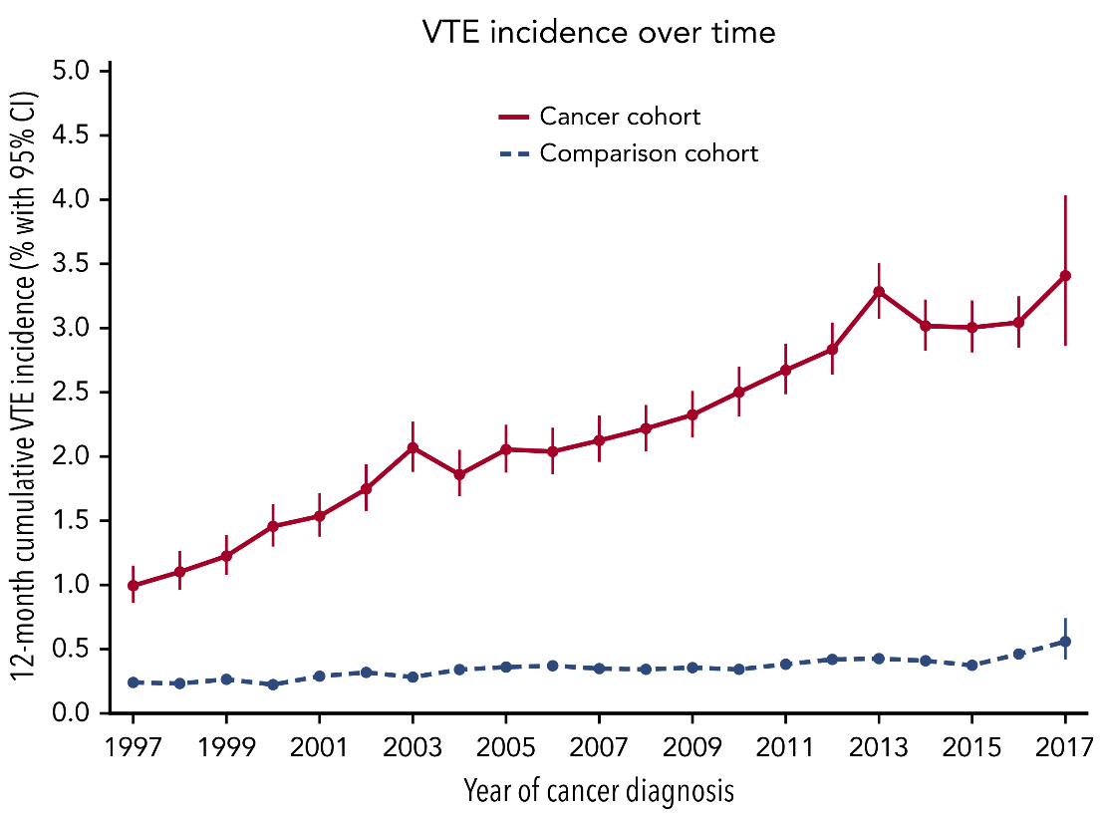
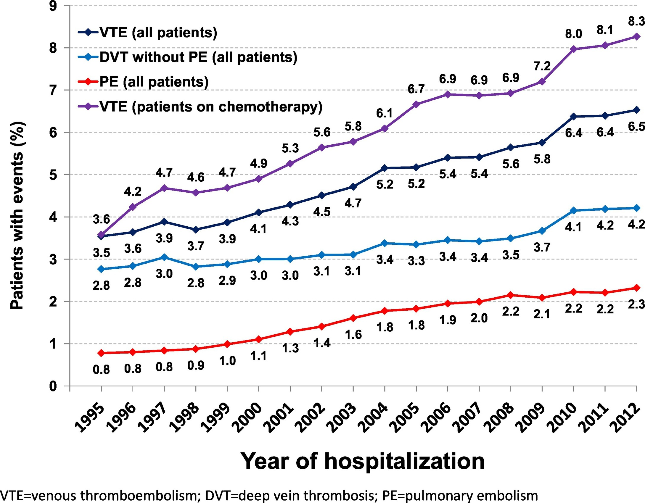
Alarming Rise in Cancer-Associated VTE

Slide 4
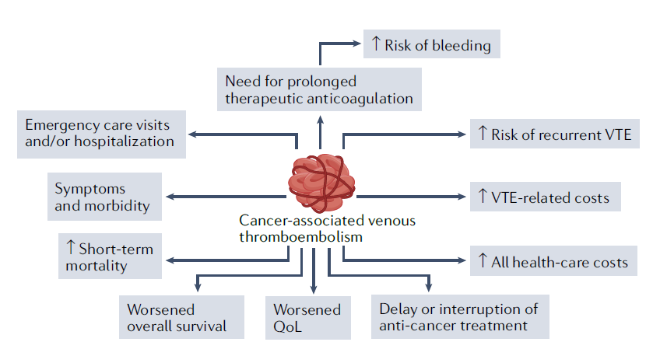
Risk of bleeding
Need for prolonged
Therapeutic anticoagulation
Emergency care visits
and/or hospitalization
Risk of recurrent VTE
Symptoms
and morbidity
VTE-related costs
Cancer-associated venous
thromboembolism
Short-term
mortality
All-health-care costs
Worsened
overall survival
Worsened
QoL
Delay or interruption of
anti-cancer treatment

Slide 5

Postsurgical
FAME, CANBESURE, Enoxacan-1,2, PROLAPS-II, PERIOP
Preventing CAT
Medical inpatient
MEDENOX, PREVENT, ARTEMIS
Implementation science
Outpatient
PROTECHT, SAVE-ONCO, CONKO-04, FRAGEM, CASSINI, AVERT

Slide 6
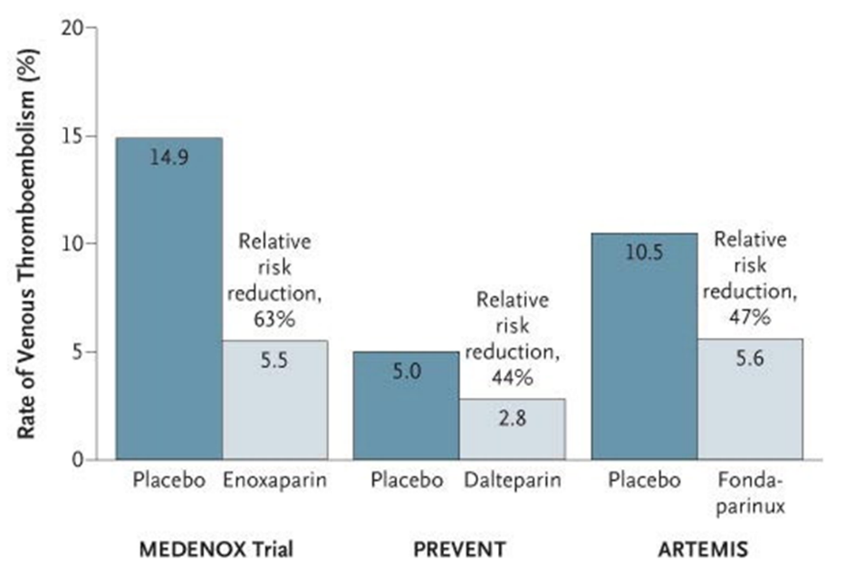
Medical Cancer Patients: Benefit in Acutely Ill Hospitalized Patients
Relative risk reduction 63%
Relative risk reduction 47%
Relative risk reduction 44%
Placebo
Enoxaparin
Placebo
Dalteparin
Placebo
Fondaparinux

Slide 7
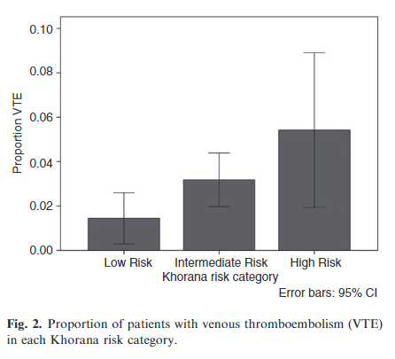
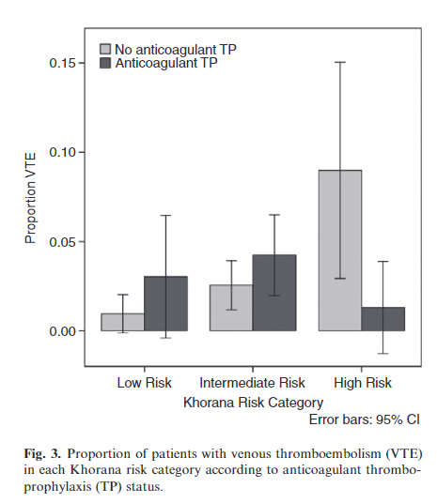
Risk Status and Benefit From Inpatient Thromboprophylaxis
Canadian Multicenter Retrospective Cohort Study, N=1,398
Optimal cutoff score ≥2; VTE rate 4.5% vs 2% (OR 2.3, 95% CI 1.2-4.3)

Slide 8
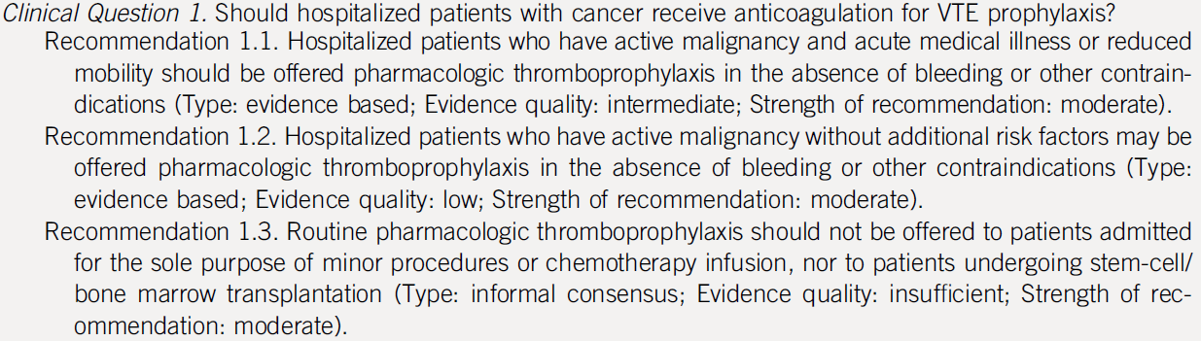

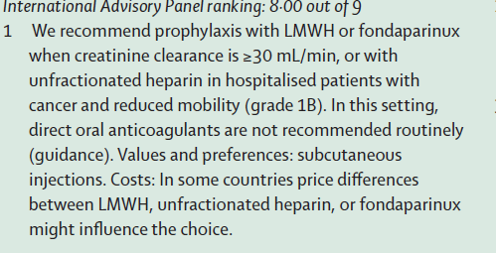

Guidelines Recommend Thromboprophylaxis

Slide 9
What Can Health Systems Do?
What Can
Clinicians Do?
Educate patients
Educate patients
Assess risk for both VTE
and bleeding
Create risk assessment programs
Consider thromboprophylaxis in appropriate settings
Infrastructure to offer thromboprophylaxis to
at-risk patients

