Slide 1
Patient Case: Timing and Selection of NRG1-Fusion Targeted Eligible Patients
Efrat Dotan, MD
Associate Professor, Department of Medical Oncology
Division Chief of Gastrointestinal Cancer Program
Hematology Oncology Fellowship Associate Program Director
Fox Chase Cancer Center
Philadelphia, PA

Slide 2
Case #1: Patient with Metastatic Pancreatic Cancer
70-year-old female with past medical history if asthma, OA, psoriasis and Raynaud's
Diagnosed with metastatic pancreatic cancer in 2017. FoundationOne® NGS DNA testing at time of diagnosis showed BCOR E867 mutation. KRAS Wt
Sept 2017-Sept 2020: treated on a clinical trial with gemcitabine/NAB-paclitaxel + investigational agent until disease progression
Sept 2020-July 2021: FOLFOX followed by 5FU maintenance until disease progression
Aug 2021-Feb 2022: clinical trial with investigational agent until disease progression

Slide 3
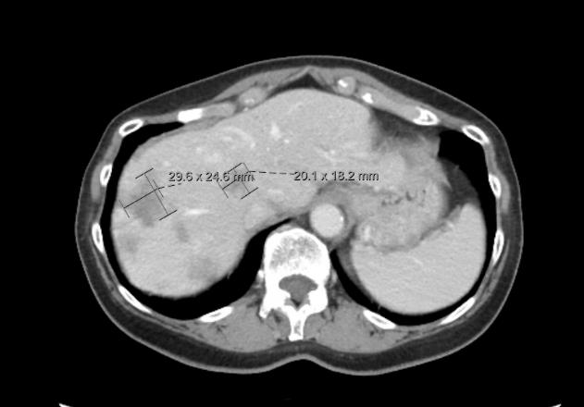
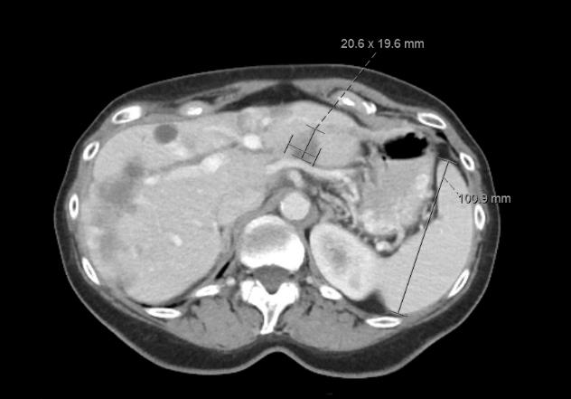
Case #1: CT Images of Liver Metastases Feb 2022

Slide 4

Case #1: Molecular Profiling – October 2020
Repeat NGS was done at time of first progression including RNA sequencing revealing a NRG1 fusion
NRG1 Seq RNA-Tumor Pathogenic Fusion APP-NRG1 6 -

Slide 5
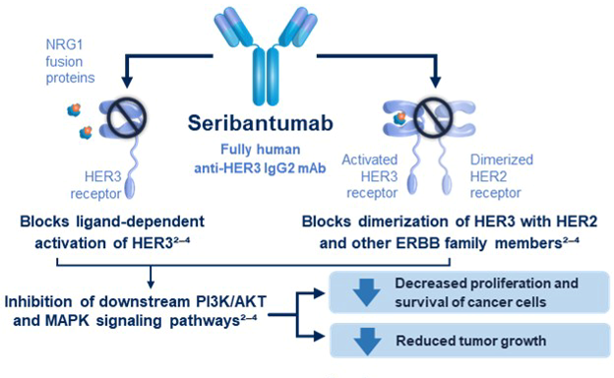
Case #1: Targeted Therapy
February 2022 – enrollment on CRESTONE study with seribantumab: Fully human IgG monoclonal antibody against HER3

Slide 6
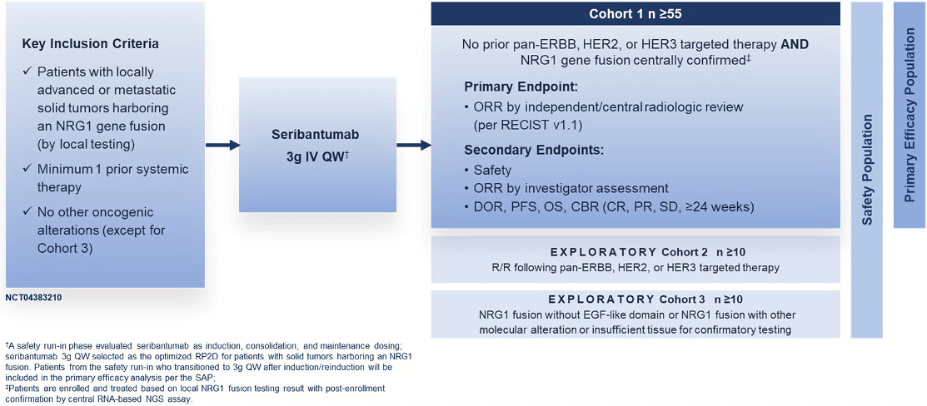
CRESTONE: A Phase 2 Study of the Anti-HER3 mAb Seribantumab in Solid Tumors With NRG1 Fusions

Slide 7
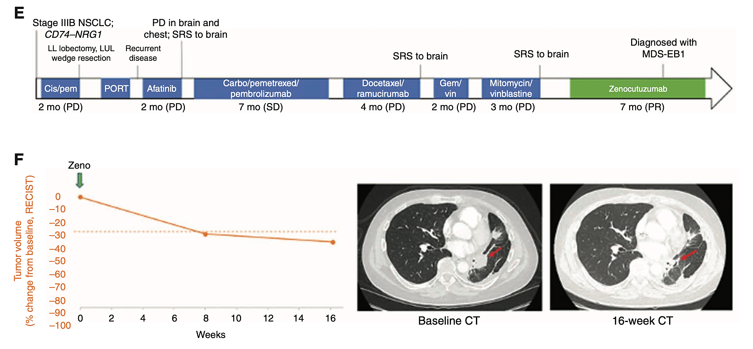
Case #2: Patient with Stage IIIB NSCLC
52-year-old man with stage IIIB NSCLC, mixed mucinous and non-mucinous adenocarcinoma
Nonsmoker
DNA sequencing: no driver alterations in EGFR, KRAS, ALK, ROS-1, RET, BRAF, HER2, METex14, NTRK
RNA sequencing: NRG1 fusion with CD74

Slide 8
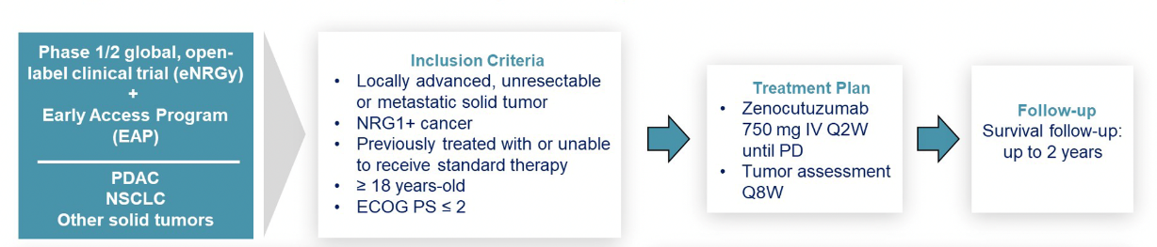
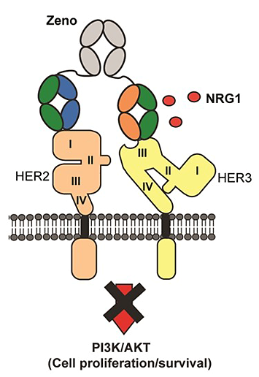
Global, Multicenter Zenocutuzumab Development Program
Zenocutuzumab is a HER2/HER3 bispecific humanized IgG1 antibody
Docks on HER2 and blocks NRG1 binding site to HER3

Slide 9
Summary
RNA sequencing can detect NRG1 fusions in tumors and identify patients who are eligible for targeted therapies
It is important to insist on this type of testing for patients with tumors that have higher incidence of these fusions such as invasive mucinous adenocarcinoma of the lung, and KRAS wild type pancreatic cancer
NRG1 fusions found in many other tumors that do not harbor driver mutations

