Slide 1
Can my Patient Participate in NRG1–Targeted Clinical Trials?
Stephen Liu, MD
Associate Professor of Medicine
Director of Thoracic Oncology
Georgetown University Hospital
Washington, DC

Slide 2
Disclaimer
The views and opinions expressed in this educational activity are those of the faculty and do not necessarily represent the views of TotalCME, Inc., the CME providers, or the companies providing educational grants. This presentation is not intended to define an exclusive course of patient management; the participant should use their clinical judgment, knowledge, experience, and diagnostic skills in applying or adopting for professional use any of the information provided herein. Any procedures, medications, or other courses of diagnosis or treatment discussed or suggested in this activity should not be used by clinicians without evaluation of their patient's conditions and possible contraindications or dangers in use, review of any applicable manufacturer’s product information, and comparison with recommendations of other authorities. Links to other sites may be provided as additional sources of information.

Slide 3
Disclosures
Advisory Board / Consultant:
Amgen, AstraZeneca, Bayer, Beigene, Blueprint, Boehringer-Ingelheim, Bristol-Myers Squibb, Catalyst, Daiichi Sankyo, Eisai, Elevation Oncology, Genentech/Roche, Gilead, Guardant Health, Janssen, Jazz Pharmaceuticals, Lilly, Merck/MSD, Novartis, Regeneron, Sanofi, Takeda, Turning Point Therapeutics
Research grant (to institution):
Alkermes, Bayer, Blueprint, Bristol-Myers Squibb, Elevation Oncology, Genentech, Gilead, Lilly, Merck, Merus, Nuvalent, Pfizer, Rain Therapeutics, RAPT, Turning Point Therapeutics

Slide 4
NRG1 Targeted Therapy
No FDA approved treatments
Several ongoing clinical trials
Primarily tumor agnostic designs
Challenges
Rare events
RNA-based testing needed for identification
Poor outcomes with standard therapy

Slide 5
NRG1
NRG1 fusions are actionable
No FDA approved agents (yet)
Afatinib (pan-Erb kinase inhibitor)
Multiple case reports/series showing responses
Unclear denominator
ASCO TAPUR²
Decentralized study³
Liu SV, et al. ESMO 2019. Abstract 4097;

Slide 6
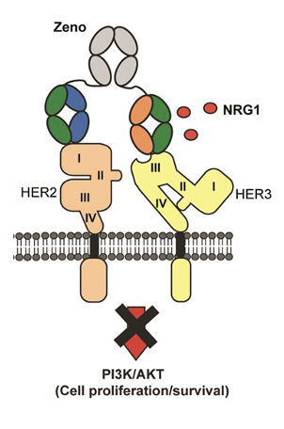
Zenocutuzumab (MCLA-128)
Bispecific antibody (HER2 and HER3) with ADCC
Blocks NRG1 from binding HER3
FDA fast track designation
eNRGy trial
Single arm phase II
Zenocutuzumab 750mg IV q2wk
All NRG1+ cancers
Primary endpoint: RR

Slide 7
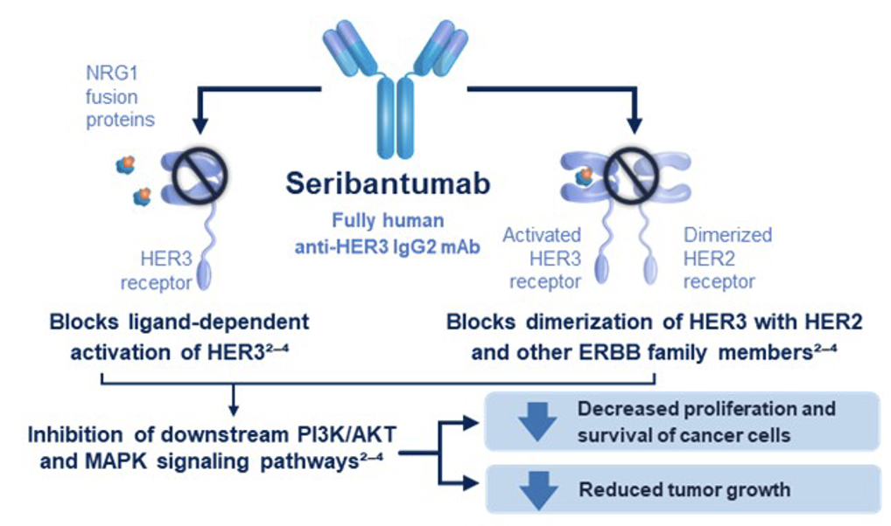
Seribantumab
Monoclonal antibody (HER3 IgG2)
Blocks NRG1 from binding HER3
FDA fast track designation
CRESTONE trial
Single arm phase II
Seribantumab IV weekly
All NRG1+ cancers
Primary endpoint: RR

Slide 8
NRG1 Trials
Seek input about NRG1 trials as soon as possible
Even if the current therapy is working well
eNRGy trial:
Merus inquiries: 1-833-NRG-1234
CRESTONE trial:
Patient contact: 1-716-371-1125
Physician/researcher contact: 1-716-371-1125
Review inclusion criteria to plan treatment strategies
Understand the study schedules
Keep abreast of study and landscape updates
eNRGy trial: NCT02912949
CRESTONE trial: NCT04383210

Slide 9
NRG1 Trials
Greatest barrier is detecting NRG1 fusions when present
RNA sequencing is the most effective way to detect these rare fusions
Once confirmed, several tools can help with trial involvement
Clinicaltrials.gov
Contact sites and investigators/coordinators
Note schedule and need to travel (sometimes costs defrayed)
Patient advocacy groups
Do not be afraid to ask for help!

