Slide 1
What Are the Novel Targeted Therapies for NRG1 Fusion Tumors?
Efrat Dotan, MD
Associate Professor, Department of Medical Oncology
Division Chief of Gastrointestinal Cancer Program
Hematology Oncology Fellowship Associate Program Director
Fox Chase Cancer Center
Philadelphia, PA

Slide 2
Disclaimer
The views and opinions expressed in this educational activity are those of the faculty and do not necessarily represent the views of TotalCME, Inc., the CME providers, or the companies providing educational grants. This presentation is not intended to define an exclusive course of patient management; the participant should use their clinical judgment, knowledge, experience, and diagnostic skills in applying or adopting for professional use any of the information provided herein. Any procedures, medications, or other courses of diagnosis or treatment discussed or suggested in this activity should not be used by clinicians without evaluation of their patient's conditions and possible contraindications or dangers in use, review of any applicable manufacturer’s product information, and comparison with recommendations of other authorities. Links to other sites may be provided as additional sources of information.

Slide 3
Targeting NRG1 Fusion
Neuregulin (NRG1) is a ligand that binds to HER3 receptor and promotes dimerization of HER2 and HER3 receptors and downstream activation of the PI3K/AKT/mTOR signaling pathways
Targeted treatments are focused on targeting HER2/HER3 and the interaction of NRG1 with HER3

Slide 4
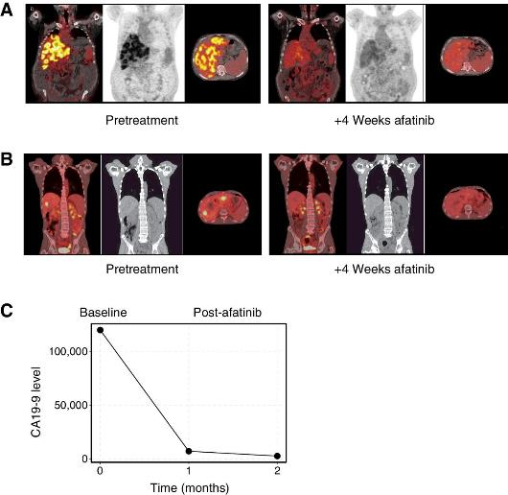
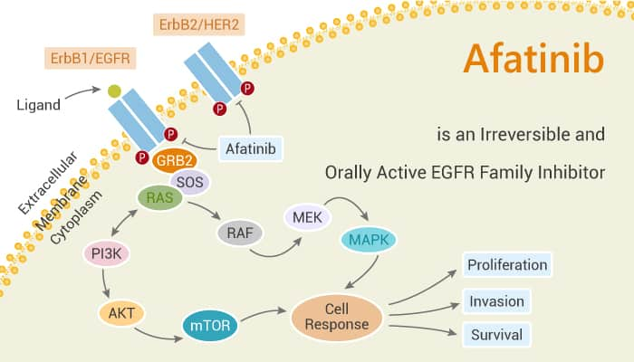
Afatinib
NRG1 fusion–positive PDAC

Slide 5
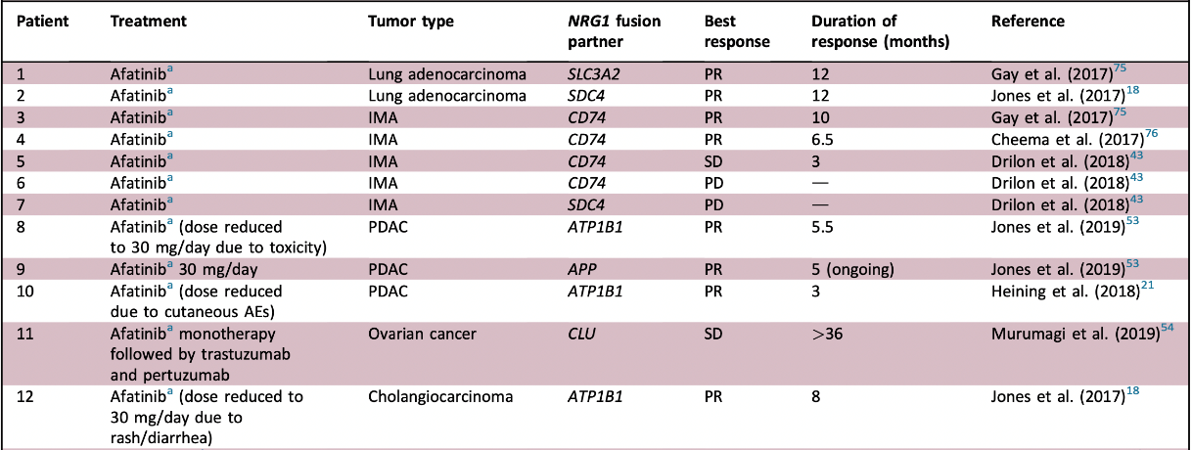
Reported Cases of ERBB-Targeted Treatment in Patients With NRG1 Fusion-Positive Tumors

Slide 6
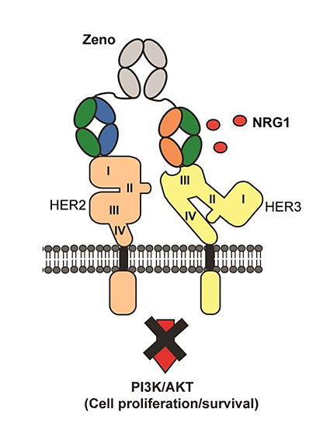
Zenocutuzumab
HER2/HER3 bispecific humanized IgG1 antibody
Docks on HER2 and blocks NRG1 binding site to HER3
Preventing dimerization of HER2/HER3 and downstream signaling

Slide 7
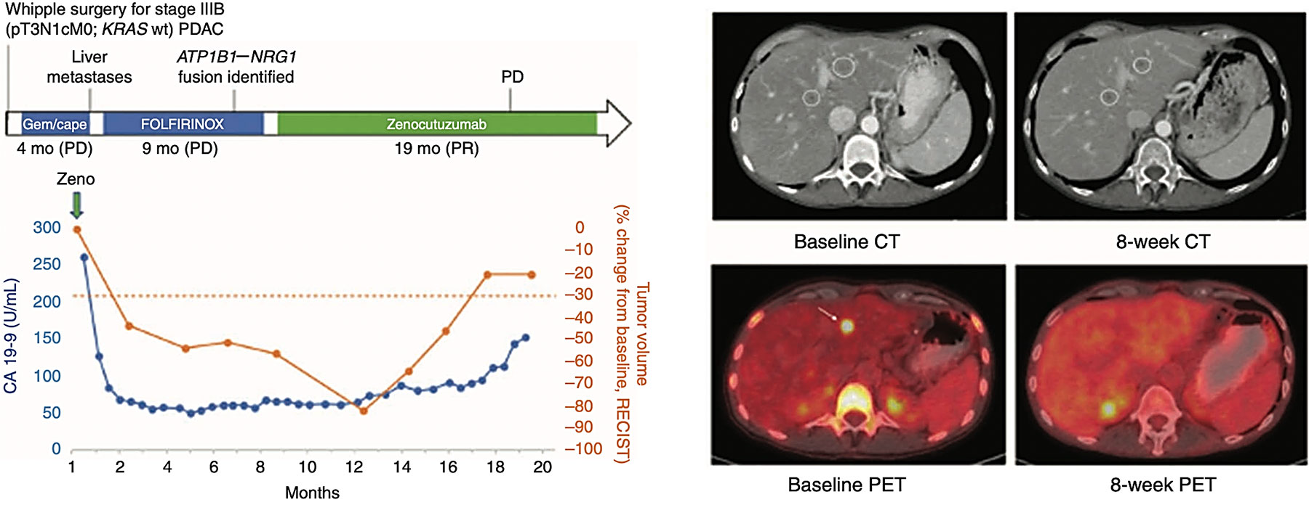
Zenocutuzumab

Slide 8
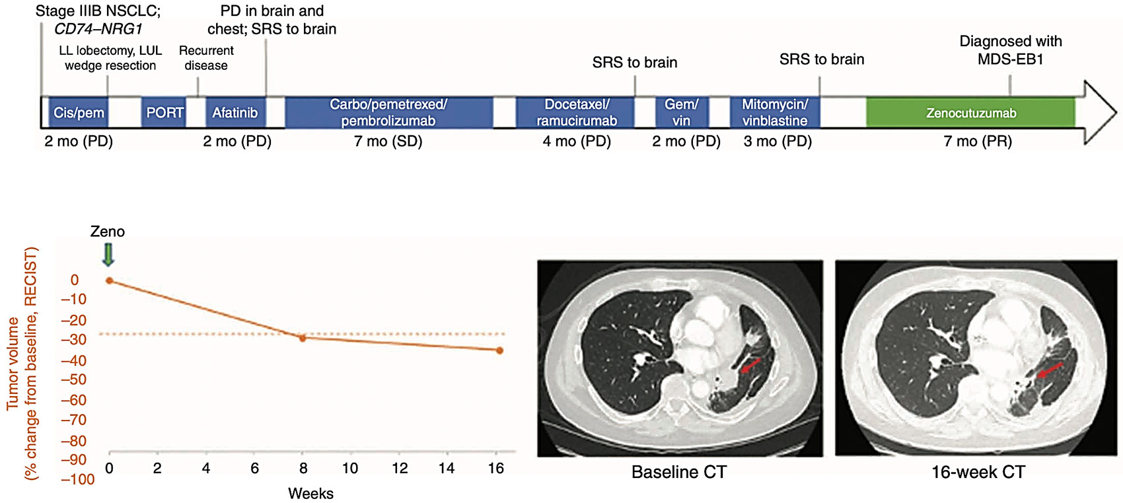
Zenocutuzumab

Slide 9
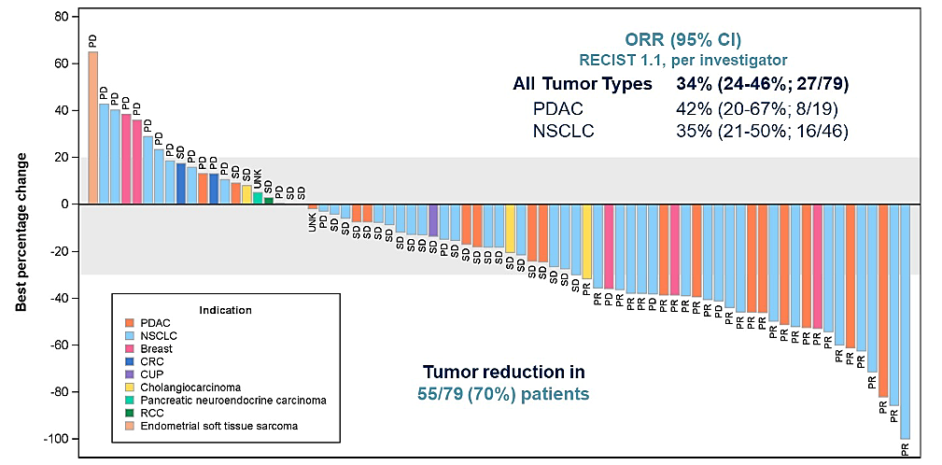
Zenocutuzumab: Global Phase 1/2 Clinical Trial

Slide 10
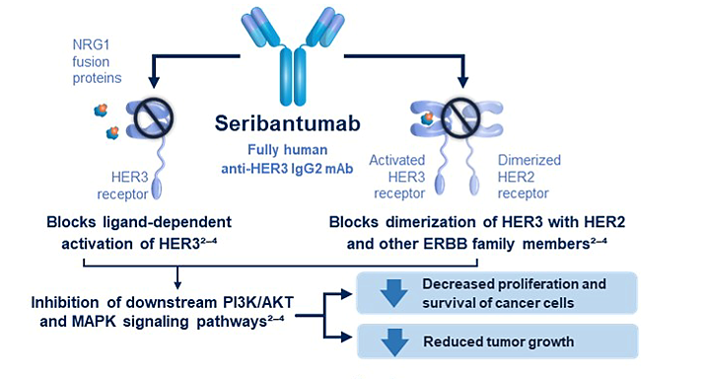
Seribantumab
Fully human immunoglobulin monoclonal antibody against HER3
Competes with NRG1 in binding to HER3
Inhibits dimerization and phosphorylation of HER3 and other ERBB family members
Inhibits downstream PI3K/AKT and MAPK/ERK pathways signaling

Slide 11
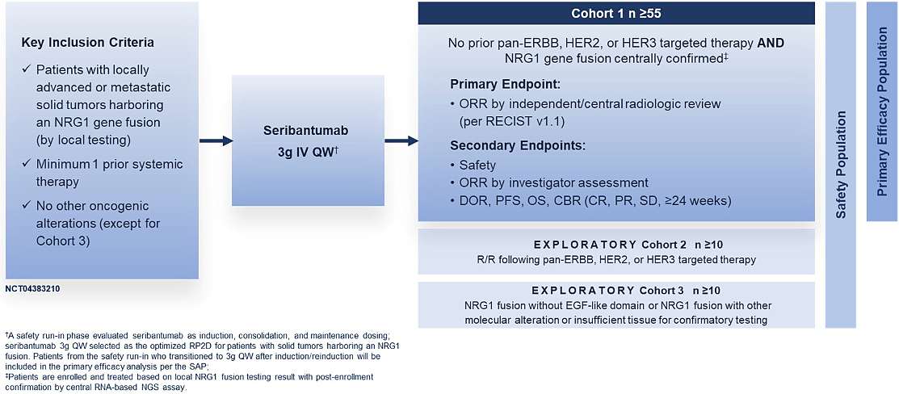
CRESTONE: A Phase 2 Study of the Anti-HER3 mAb Seribantumab in Solid Tumors With NRG1 Fusions

Slide 12
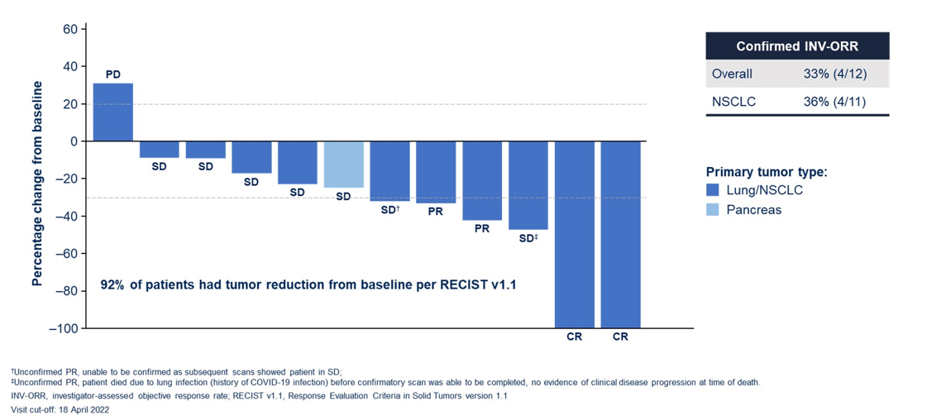
CRESTONE Phase 2 Study With Seribantumab

Slide 13
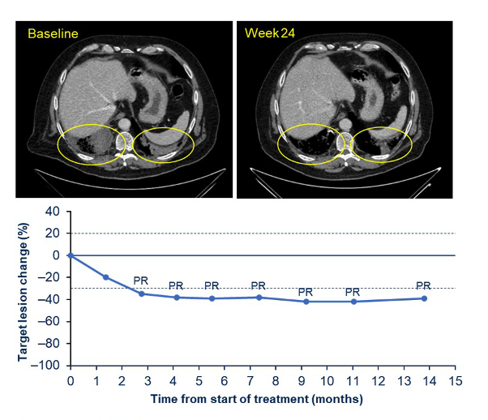
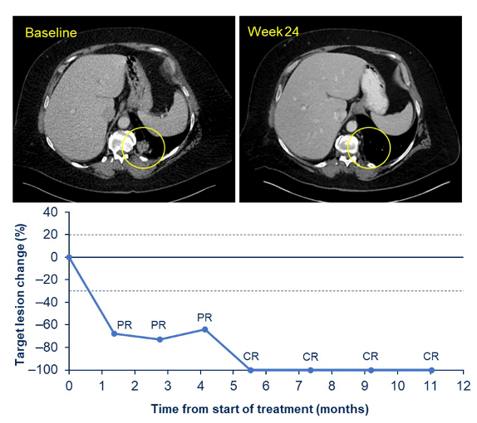
CRESTONE Phase 2 Study With Seribantumab

Slide 14
Summary
Novel agents are available and under investigation for targeting tumors harboring NRG1 fusion
Seribantumab and zenocutuzumab can provide significant clinical benefit, and durable responses
Seribantumab and zenocutuzumab are well tolerated with limited adverse events
Routine testing for NRG1 is necessary for identification of patients who are candidates for these treatment approaches

