Slide 1
How Do I Detect NRG1 Fusions?
Efrat Dotan, MD
Associate Professor, Department of Medical Oncology
Division Chief of Gastrointestinal Cancer Program
Hematology Oncology Fellowship Associate Program Director
Fox Chase Cancer Center
Philadelphia, PA

Slide 2
Disclaimer
The views and opinions expressed in this educational activity are those of the faculty and do not necessarily represent the views of TotalCME, Inc., the CME providers, or the companies providing educational grants. This presentation is not intended to define an exclusive course of patient management; the participant should use their clinical judgment, knowledge, experience, and diagnostic skills in applying or adopting for professional use any of the information provided herein. Any procedures, medications, or other courses of diagnosis or treatment discussed or suggested in this activity should not be used by clinicians without evaluation of their patient's conditions and possible contraindications or dangers in use, review of any applicable manufacturer’s product information, and comparison with recommendations of other authorities. Links to other sites may be provided as additional sources of information.

Slide 3
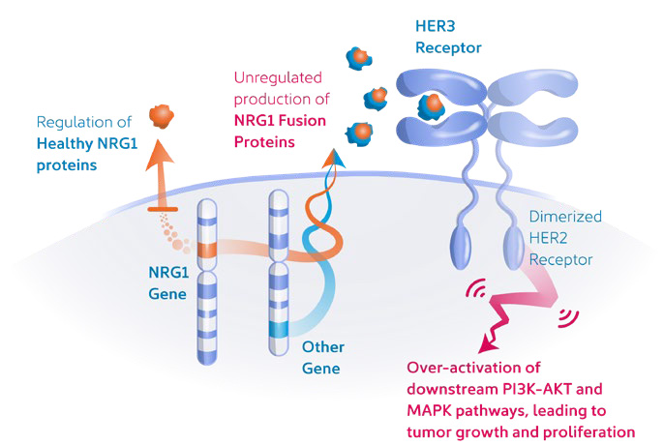
NRG1 Fusion
Neuregulin (NRG1) is a ligand that binds to HER3 receptor and promotes dimerization of HER2 and HER3 receptors and downstream activation of the PI3K/AKT/mTOR signaling pathways
NRG1 fusions result in aberrant expression of the of the NRG1 protein which induces formation of heterodimers and leads to pathologic activation of the PI3K/AKT, MAPK and other signaling pathways

Slide 4
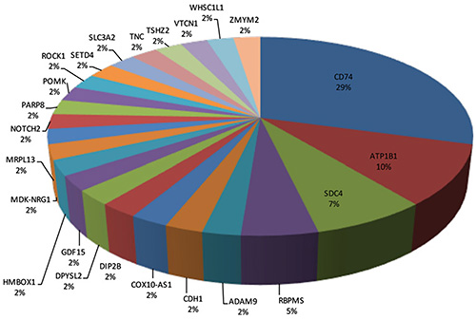
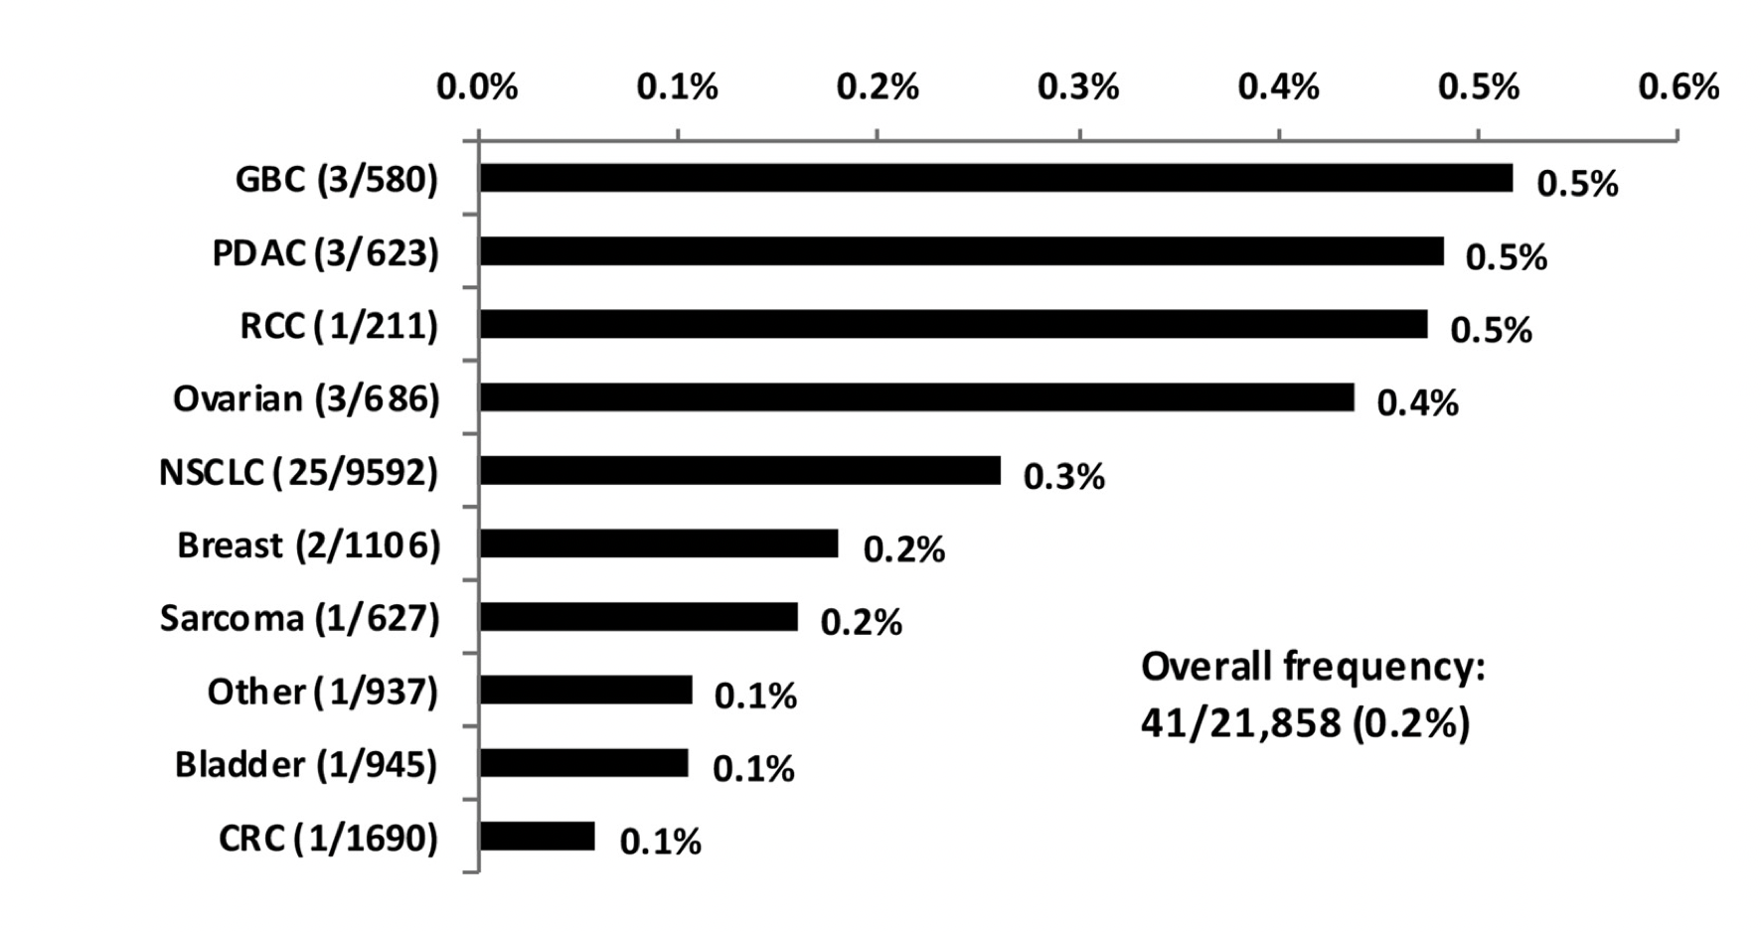
NRG1 Fusion
An analysis of 21,858 tumor specimens found 41 cases (0.2%) if NRG1 fusions
The first NRG1 fusion was reported in 2014: CD74-NRG1 the most common partner followed by ATP1B1

Slide 5
Detection of NRG1 Fusion
Challenges:
Extremely rare
Diversity of NRG1 fusion partners
Diversity of fusion architecture
Large intronic regions characteristic to NRG1
RNA sequencing is the preferred method for detection of NRG1 fusions

Slide 6
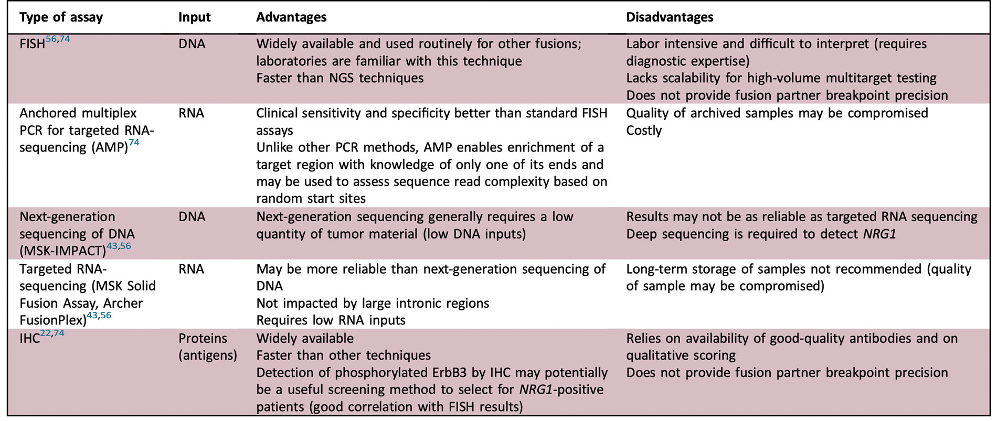
The Advantages and Disadvantages of Different Assays Available For the Detection of NRG1 and Other Gene Fusions

Slide 7
The Advantages and Disadvantages of Different Assays Available For the Detection of NRG1 and Other Gene Fusions

Slide 8
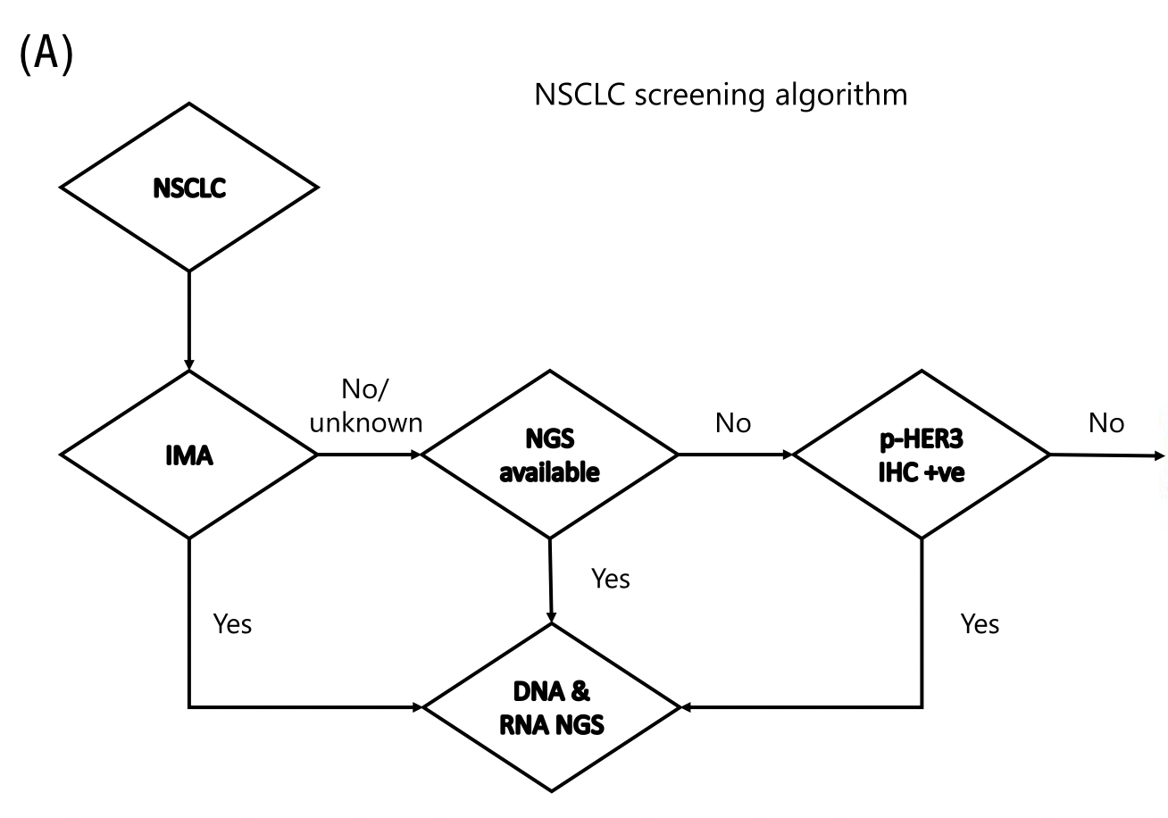

When Should We Insist on Testing?
NSCLC screening algorithm

Slide 9
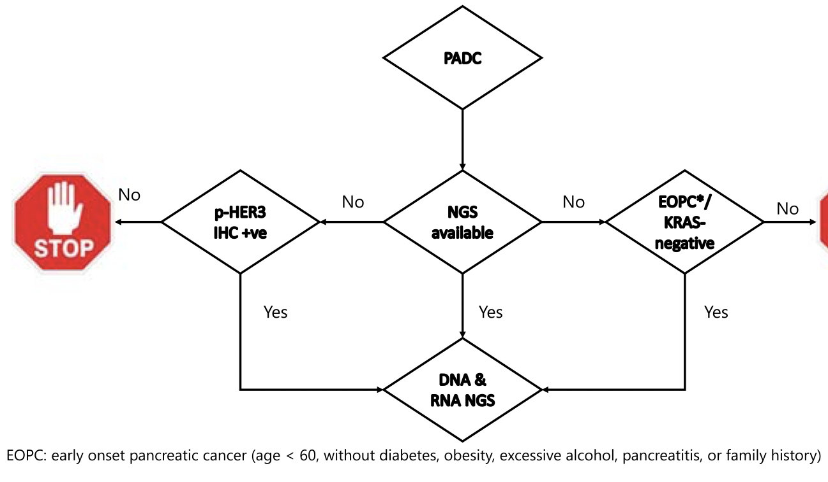
When Should We Insist on Testing?
Pancreatic ductal adenocarcinoma screening algorithm
PDAC

Slide 10
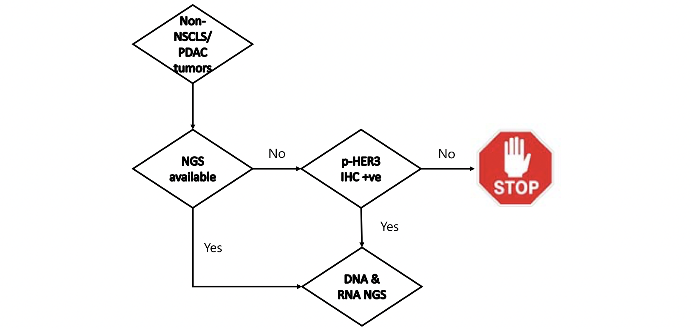
When Should We Insist on Testing?
Non-NSCLC/non-PDAC solid tumor screening algorithm

Slide 11
Summary
NRG1 fusion is a rare molecular alteration found in various cancers, most commonly NSCLC and PDAC
NRG1 fusions can have many different partners and are challenging to detect
RNA sequencing is the most sensitive and effective way to detect these rare fusions
Insist on RNA sequencing especially in NSCLC with invasive mucinous adenocarcinoma and KRAS-WT PDAC patients

