Slide 1
What Are NRG1 Gene Fusions and the Rationale for Targeting ERbB?
Stephen Liu, MD
Associate Professor of Medicine
Director of Thoracic Oncology
Georgetown University Hospital
Washington, DC

Slide 2
Disclaimer
The views and opinions expressed in this educational activity are those of the faculty and do not necessarily represent the views of TotalCME, Inc., the CME providers, or the companies providing educational grants. This presentation is not intended to define an exclusive course of patient management; the participant should use their clinical judgment, knowledge, experience, and diagnostic skills in applying or adopting for professional use any of the information provided herein. Any procedures, medications, or other courses of diagnosis or treatment discussed or suggested in this activity should not be used by clinicians without evaluation of their patient's conditions and possible contraindications or dangers in use, review of any applicable manufacturer’s product information, and comparison with recommendations of other authorities. Links to other sites may be provided as additional sources of information.

Slide 3
Disclosures
Advisory board/consultant:
Amgen, AstraZeneca, Bayer, Beigene, Blueprint, Boehringer-Ingelheim, Bristol-Myers Squibb, Catalyst, Daiichi Sankyo, Eisai, Elevation Oncology, Genentech/Roche, Gilead, Guardant Health, Janssen, Jazz Pharmaceuticals, Lilly, Merck/MSD, Novartis, Regeneron, Sanofi, Takeda, Turning Point Therapeutics
Research grant (to institution):
Alkermes, Bayer, Blueprint, Bristol-Myers Squibb, Elevation Oncology, Genentech, Gilead, Lilly, Merck, Merus, Nuvalent, Pfizer, Rain Therapeutics, RAPT, Turning Point Therapeutics

Slide 4
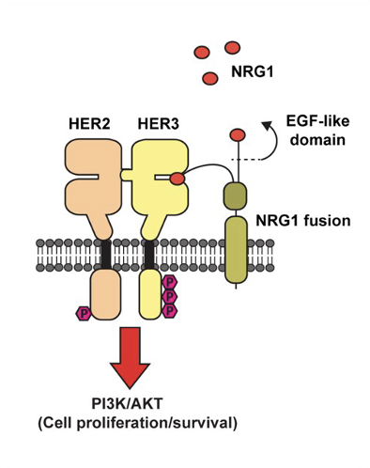
NRG1
Neuregulin 1 (NRG1)
Contains EGF-like domain that serves as ligand for HER3
NRG1 binding prompts HER3 heterodimerization
HER2 favored partner
Downstream signaling cascades

Slide 5
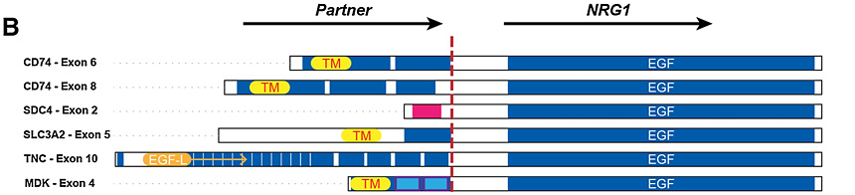
NRG1 Fusions
Retain EGF-like domain of NRG1
Partner provides a transmembrane domain to tether ligand in close proximity to HER3
HER3 and its partner HER2 are thus rational therapeutic targets
Early reports have demonstrated efficacy of targeting HER2 and/or HER3 in cancers with NRG1 fusions
NRG1
NRG1 fusion

Slide 6
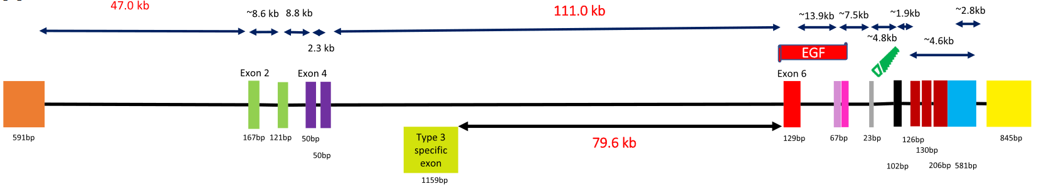
NRG1 Fusions
NRG1 fusions are very difficult to identify
Very large gene (1/2000th of the entire genome)
Mostly intronic (<0.3% coding)
Poor coverage with DNA-based NGS
RNA-based NGS needed for reliable detection

Slide 7
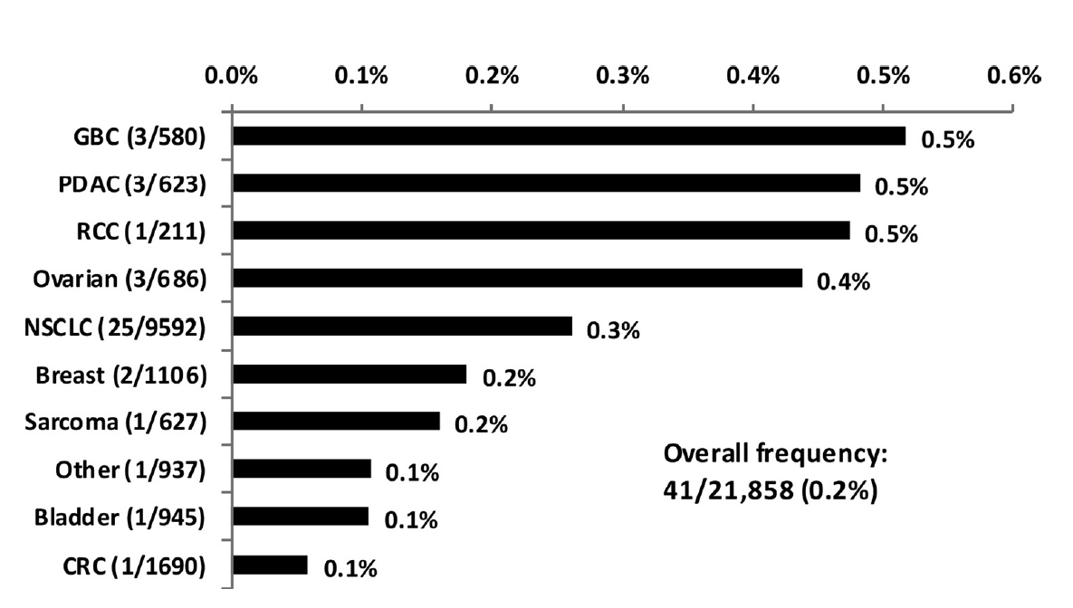
NRG1 Fusions
Retrospective analysis of specimens tested at Caris Life Sciences from 2015 to 2019
RNA-sequencing with ArcherDx or whole transcriptome seq
Rare events overall
Seen in 0.2% of cases
Seen across cancers
Some enrichment for invasive mucinous lung adenocarcinoma and KRAS wild type pancreatic cancer
Cholangiocarcinoma, sarcoma, ovarian, CRC, NSCLC, breast

Slide 8
NRG1 Fusions
Rare but actionable driver events
Lead to abnormal signaling primarily through the ErbB pathway which is now a viable therapeutic target
Detection requires RNA sequencing
Multiple agents have shown efficacy and are under investigation

