Slide 1
Clinical Practice Guidelines for
Resistant Hypertension –
What Are the Recommendations?
George L. Bakris, MD
Professor of Medicine
Director, American Heart Association Comprehensive Hypertension Center
University of Chicago Medicine
Chicago, IL USA

Slide 2
Disclaimer
The views and opinions expressed in this educational activity are those of the faculty and do not necessarily represent the views of TotalCME, Inc., the CME providers, or the companies providing educational grants. This presentation is not intended to define an exclusive course of patient management; the participant should use their clinical judgment, knowledge, experience, and diagnostic skills in applying or adopting for professional use any of the information provided herein. Any procedures, medications, or other courses of diagnosis or treatment discussed or suggested in this activity should not be used by clinicians without evaluation of their patient's conditions and possible contraindications or dangers in use, review of any applicable manufacturer’s product information, and comparison with recommendations of other authorities. Links to other sites may be provided as additional sources of information.

Slide 3
Best Proven Nonpharmacologic Interventions for Prevention and
Treatment of Hypertension
​ | ​ | ​ | Approximate Impact on SBP
 | Nonpharmacologic Intervention | Dose | Hypertension | Normotension
Physical activity | Aerobic | ● 90-150 min/wk ● 65%-75% heart rate reserve | -5/8 mm Hg | -2/4 mm Hg
 | Dynamic Resistance | ● 90-150 min/wk ● 50%-80% 1 rep maximum ● 6 exercises, 3 sets/exercise, 10 repetitions/set | -4 mm Hg | -2 mm Hg
 | Isometric Resistance | ● 4 x 2 min (hand grip), 1 min rest between exercises, 30%-40% maximum voluntary contraction, 3 sessions/wk ● 8-10 wk | -5 mm Hg | -4 mm Hg
Healthy diet | DASH dietary pattern | Diet rich in fruits, vegetables, whole grains, and low-fat dairy products with reduced content of saturated and total fat | -11 mm Hg | -3 mm Hg
Weight loss | Weight/body fat | Ideal body weight is best goal but at least 1 kg reduction in body weight for most adults who are overweight | -5 mm Hg | -2/3 mm Hg
Reduced intake of dietary sodium | Dietary sodium | <1,500 mg/d is optimal goal but at least 1,000 mg/d reduction in most adults | -5/6 mm Hg | -2/3 mm Hg
Enhanced intake of dietary potassium | Dietary potassium | 3,500-5,000 mg/d, preferably by consumption of a diet rich in potassium | -4/5 mm Hg | -2 mm Hg
Moderation in alcohol intake | Alcohol consumption | In individuals who drink alcohol, reduce alcohol to: ● Men: <2 drinks daily ● Women: <1 drink daily | -4 mm Hg | -3 mm Hg

Slide 4
Initial Combinations of Medications
ACE inhibitors
or
ARBs
Diuretics
Calcium
antagonists
* Compelling indications may modify this.

Slide 5
SBP achieved (mm Hg)
Trial
ALLHAT 138
HOT 138
ACCOMPLISH 132
SPRINT (intensive) 121
ACCORD (intensive)* 119
ACCORD (standard)* 133
INVEST 133
IDNT 138
RENAAL 141
VA Nephron D 127
ABCD 132
UKPDS 144
MDRD 132
AASK 128
Hypertension
Diabetes
Kidney
disease
1
2
3
4
Bold italic studies: both diabetes and kidney disease outcomes
No. of BP medications

Slide 6
SBP achieved (mm Hg)
Trial
ALLHAT 138
HOT 138
ACCOMPLISH 132
SPRINT (intensive) 121
ACCORD (intensive)* 119
ACCORD (standard)* 133
INVEST 133
IDNT 138
RENAAL 141
VA Nephron D 127
ABCD 132
UKPDS 144
MDRD 132
AASK 128
Hypertension
Average number of antihypertensive medications in trials in 2.6 meds
Diabetes
Kidney
disease
1
2
3
4
Bold italic studies: both diabetes and kidney disease outcomes
No. of BP medications

Slide 7
Ratio of Observed-to-Expected Incremental BP-Lowering Effects of Adding a Drug or Doubling the Dose According to Drug Class
Adding a drug from another class (on average standard doses)
Doubling dose of same drug (from standard dose to twice standard)
1.40
1.20
1.00
1.16
1.01
0.80
1.04
Incremental SBP reduction ratio
of observed-to-expected additive effects
1.00
0.60
0.89
0.40
0.20
0.37
0.2
0.22
0.19
0.23
0
Thiazide
Beta blocker
ACE inhibitor
Calcium- channel blocker
All classes

Slide 8
American Society of Hypertension Evidence-Based
Fixed-Dose Antihypertensive Combinations
Preferred
Angiotensin Converting Enzyme (ACE) inhibitor/diuretic* Angiotensin II Receptor Blockers (ARB)/diuretic* ACE inhibitor/Calcium Channel Blockers (CCB)* ARB/CCB*
Acceptable
Beta blocker/diuretic* CCB (dihydropyridine)/β-blocker CCB/diuretic Renin inhibitor/diuretic* Renin inhibitor/ARB* Thiazide diuretics/K+ sparing diuretics*
Less Effective
ACE inhibitor/ARB ACE inhibitor/β-blocker ARB/β-blocker CCB (non-dihydropyridine)/β-blocker Centrally acting agent/β-blocker

Slide 9
American Heart Association/American Cardiology Congress 2017
COR | LOE | Recommendations for Choice of Initial Medication
I | A^{SR} | For initiation of antihypertensive drug therapy, first-line agents include thiazide diuretics, CCBs, and ACE inhibitors or ARBs
COR | LOE | Recommendations for Choice of Initial Monotherapy Versus Initial Combination Drug Therapy
I | C-EO | Initiation of antihypertensive drug therapy with 2 first-line agents of different classes, either as separate agents or in a fixed-dose combination, is recommended in adults with stage 2 hypertension and an average BP more than 20/10 mm Hg above their target
IIa | C-EO | Initiation of antihypertensive drug therapy with a single antihypertensive drug is reasonable in adults with stage 1 hypertension and BP goal <130/80 mm Hg with dosage titration and sequential addition of other agents to achieve the PB target

Slide 10
European Society of Cardiology/European Society of Hypertension 2018

Slide 11
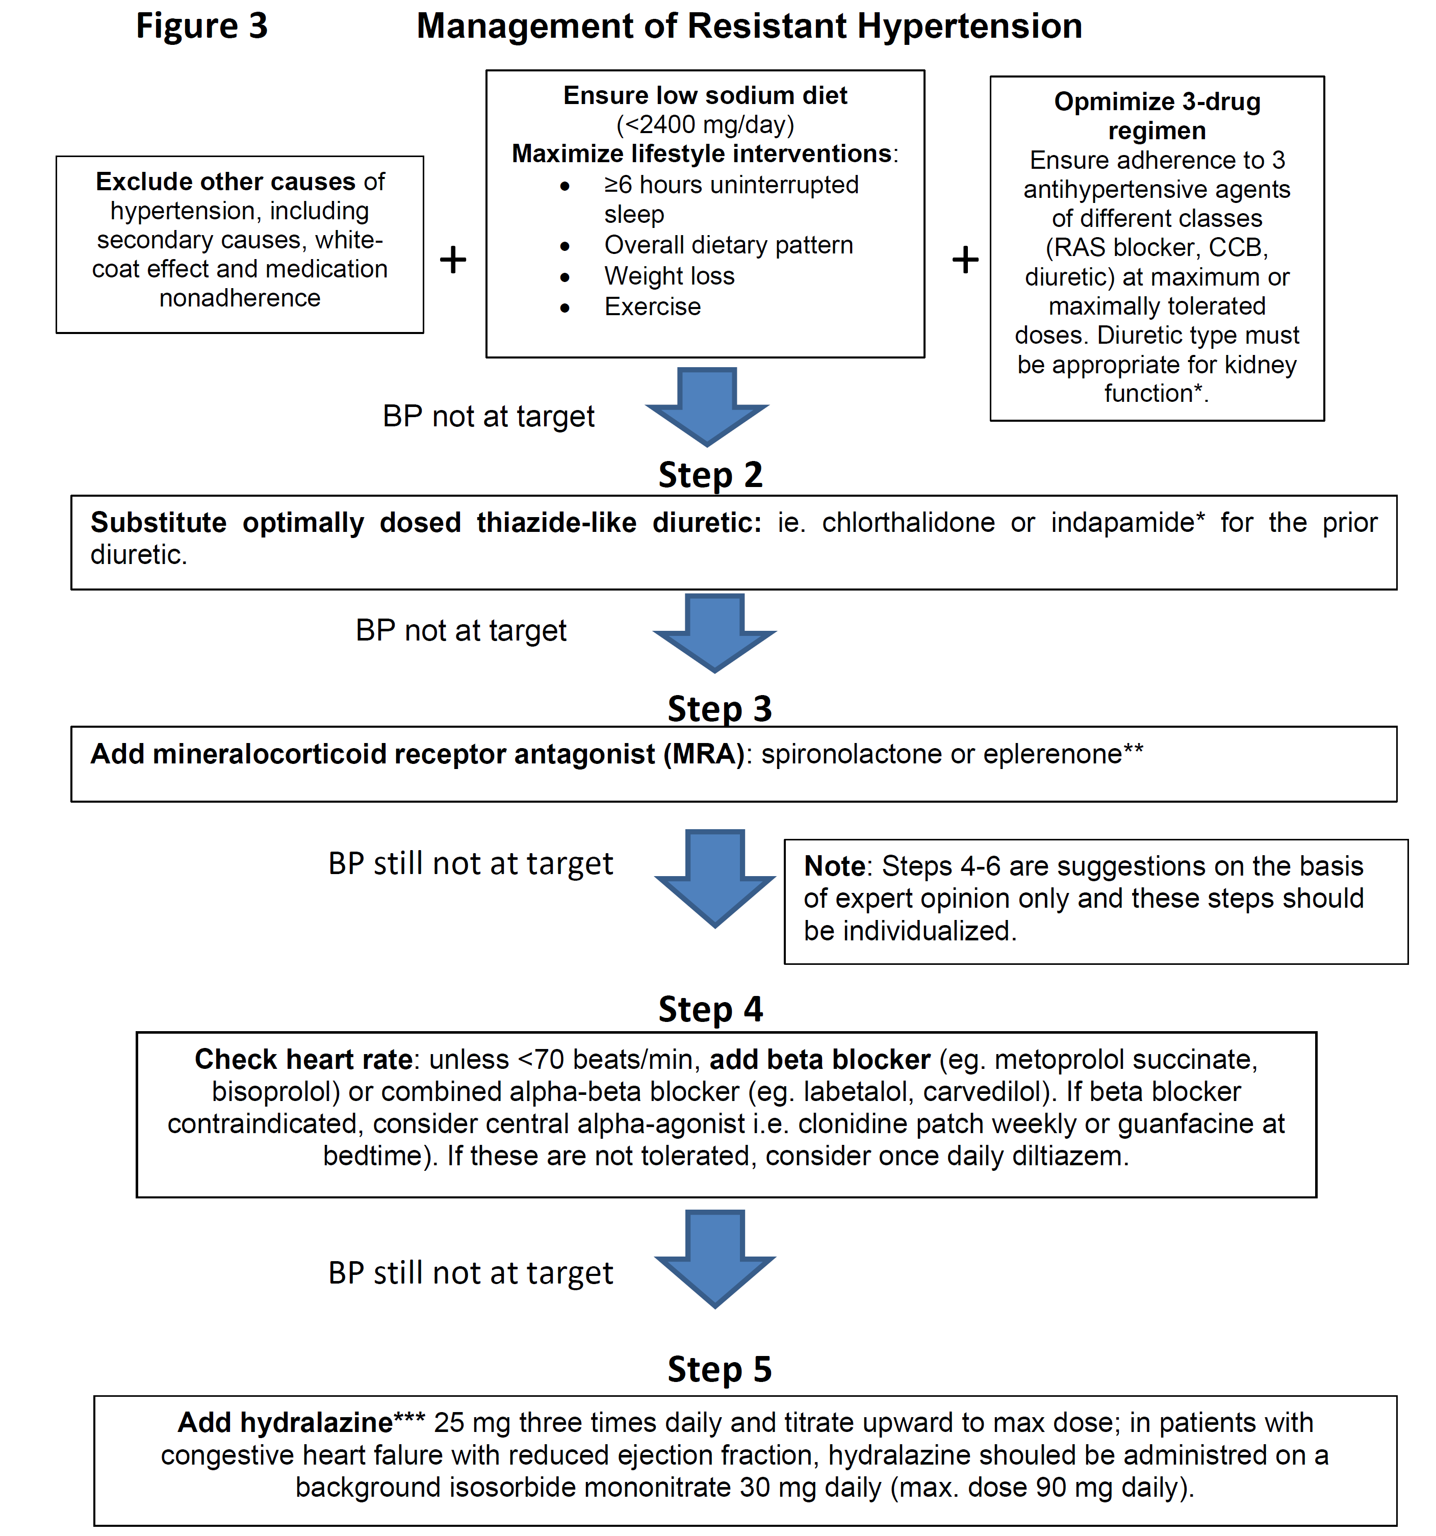
Management of
Resistant
Hypertension

Slide 12
Management of
Resistant
Hypertension

Slide 13
Management of
Resistant
Hypertension

Slide 14

BP Still Not at Target

Slide 15
Summary
To treat resistant hypertension, you need to ensure you have ruled out secondary causes like primary hyperaldosteronism
They are adhering to a low-sodium diet and sleeping adequately
They are taking the 3 complementary different classes of drugs daily
They are not also taking other substances that will raise BP, like NSAIDs, amphetamines, etc
If not controlled on 3 medications, consider adding spironolactone or referring to a certified hypertension specialist

