Slide 1
What Does a “Typical” Resistant Hypertension Patient Look Like?
George L. Bakris, MD
Professor of Medicine
Director, American Heart Association Comprehensive Hypertension Center
University of Chicago Medicine
Chicago, IL USA

Slide 2
Updated Definition of Apparent Resistant Hypertension (RHTN)
Failure to reach goal BP <130/80 mm Hg Despite adhering to full doses of an appropriate three-drug antihypertensive regimen including an appropriate diuretic for kidney function, a CCB and a RAS blocker maximally dosed
True Resistant Hypertension
Failure to reach goal BP <130/80 mm Hg while documenting ingestion of three-drug antihypertensive regimen including an appropriate diuretic for kidney function, a CCB and a RAS blocker maximally dosed
The MAJOR DIFFERENCE in Apparent RHTN you are trusting them taking the meds. In True RHTN you documented they are taking the drugs

Slide 3
Updated Definition of Apparent Resistant Hypertension (RHTN)
Failure to reach goal BP <130/80 mm Hg Despite adhering to full doses of an appropriate three-drug antihypertensive regimen including an appropriate diuretic for kidney function, a CCB and a RAS blocker maximally dosed
True Resistant Hypertension
Failure to reach goal BP <130/80 mm Hg while documenting ingestion of three-drug antihypertensive regimen including an appropriate diuretic for kidney function, a CCB and a RAS blocker maximally dosed
The MAJOR DIFFERENCE in Apparent RHTN you are trusting them taking the meds. In True RHTN you documented they are taking the drugs

Slide 4
Two Most Common Non-Disease Causes for Apparent Resistant Hypertension

Slide 5
Two Most Common Non-Disease Causes for Apparent Resistant Hypertension
White Coat Hypertension (Anxiety)
Poor Medication Adherence

Slide 6
Two Most Common Non-Disease Causes for Apparent Resistant Hypertension
White Coat Hypertension (Anxiety)
Poor Medication Adherence

Slide 7
ALL the Following Need To Be Present Before Diagnosing Someone As Having TRUE Resistant Hypertension
Adherence with: Low Sodium Diet Intake and Medication
Good Sleep Quality (i.e., minimum of 6-7 hours of uninterrupted sleep a night)
Substitutions of drugs with greater effect within the Same Class i.e. Angiotensin Receptor Blockers and diuretics
Rule out all Secondary Causes of Hypertension
Before saying anyone is resistant must rule out the most common secondary cause of hypertension:
PRIMARY ALDOSTERONISM

Slide 8
ALL the Following Need To Be Present Before Diagnosing Someone As Having TRUE Resistant Hypertension
Adherence with: Low Sodium Diet Intake and Medication
Good Sleep Quality (i.e., minimum of 6-7 hours of uninterrupted sleep a night)
Substitutions of drugs with greater effect within the Same Class i.e. Angiotensin Receptor Blockers and diuretics
Rule out all Secondary Causes of Hypertension
Before saying anyone is resistant must rule out the most common secondary cause of hypertension:
PRIMARY ALDOSTERONISM

Slide 9
ALL the Following Need To Be Present Before Diagnosing Someone As Having TRUE Resistant Hypertension
Adherence with: Low Sodium Diet Intake and Medication
Good Sleep Quality (i.e., minimum of 6-7 hours of uninterrupted sleep a night)
Substitutions of drugs with greater effect within the Same Class i.e. Angiotensin Receptor Blockers and diuretics
Rule out all Secondary Causes of Hypertension
Before saying anyone is resistant must rule out the most common secondary cause of hypertension:
PRIMARY ALDOSTERONISM

Slide 10
ALL the Following Need To Be Present Before Diagnosing Someone As Having TRUE Resistant Hypertension
Adherence with: Low Sodium Diet Intake and Medication
Good Sleep Quality (i.e., minimum of 6-7 hours of uninterrupted sleep a night)
Substitutions of drugs with greater effect within the Same Class i.e. Angiotensin Receptor Blockers and diuretics
Rule out all Secondary Causes of Hypertension
Before saying anyone is resistant must rule out the most common secondary cause of hypertension:
PRIMARY ALDOSTERONISM

Slide 11
ALL the Following Need To Be Present Before Diagnosing Someone As Having TRUE Resistant Hypertension
Adherence with: Low Sodium Diet Intake and Medication
Good Sleep Quality (i.e., minimum of 6-7 hours of uninterrupted sleep a night)
Substitutions of drugs with greater effect within the Same Class i.e. Angiotensin Receptor Blockers and diuretics
Rule out all Secondary Causes of Hypertension
Before saying anyone is resistant must rule out the most common secondary cause of hypertension:
PRIMARY ALDOSTERONISM

Slide 12
ALL the Following Need To Be Present Before Diagnosing Someone As Having TRUE Resistant Hypertension
Adherence with: Low Sodium Diet Intake and Medication
Good Sleep Quality (i.e., minimum of 6-7 hours of uninterrupted sleep a night)
Substitutions of drugs with greater effect within the Same Class i.e. Angiotensin Receptor Blockers and diuretics
Rule out all Secondary Causes of Hypertension
Before saying anyone is resistant must rule out the most common secondary cause of hypertension:
PRIMARY ALDOSTERONISM

Slide 13
ALL the Following Need To Be Present Before Diagnosing Someone As Having TRUE Resistant Hypertension
Adherence with: Low Sodium Diet Intake and Medication
Good Sleep Quality (i.e., minimum of 6-7 hours of uninterrupted sleep a night)
Substitutions of drugs with greater effect within the Same Class i.e. Angiotensin Receptor Blockers and diuretics
Rule out all Secondary Causes of Hypertension
Before saying anyone is resistant must rule out the most common secondary cause of hypertension:
PRIMARY ALDOSTERONISM

Slide 14
Best Proven Nonpharmacologic Interventions for Prevention and Treatment of Hypertension
​ | ​ | ​ | Approximate Impact on SBP
 | Nonpharmacologic Intervention | Dose | Hypertension | Normotension
Physical activity | Aerobic | ● 90-150 min/wk ● 65%-75% heart rate reserve | -5/8 mm Hg | -2/4 mm Hg
 | Dynamic Resistance | ● 90-150 min/wk ● 50%-80% 1 rep maximum ● 6 exercises, 3 sets/exercise, 10 repetitions/set | -4 mm Hg | -2 mm Hg
 | Isometric Resistance | ● 4 x 2 min (hand grip), 1 min rest between exercises, 30%-40% maximum voluntary contraction, 3 sessions/wk ● 8-10 wk | -5 mm Hg | -4 mm Hg
Healthy diet | DASH dietary pattern | Diet rich in fruits, vegetables, whole grains, and low-fat dairy products with reduced content of saturated and total fat | -11 mm Hg | -3 mm Hg
Weight loss | Weight/body fat | Ideal body weight is best goal but at least 1 kg reduction in body weight for most adults who are overweight | -5 mm Hg | -2/3 mm Hg
Reduced intake of dietary sodium | Dietary sodium | <1,500 mg/d is optimal goal but at least 1,000 mg/d reduction in most adults | -5/6 mm Hg | -2/3 mm Hg
Enhanced intake of dietary potassium | Dietary potassium | 3,500-5,000 mg/d, preferably by consumption of a diet rich in potassium | -4/5 mm Hg | -2 mm Hg
Moderation in alcohol intake | Alcohol consumption | In individuals who drink alcohol, reduce alcohol to: ● Men: <2 drinks daily ● Women: <1 drink daily | -4 mm Hg | -3 mm Hg

Slide 15
Sleep, Insomnia, and Hypertension: Current Findings and Future Directions
S. Justin Thomas PhDª, David Calhoun MD^{b}
Department of Epidemiology, University of Alabama at Birmingham, AL, USA
Department of Medicine, Division of Cardiovascular Disease, University of Alabama at Birmingham, Birmingham, AL, USA
Received 10 October 2016, Accepted 26 November 2016, Available online 29 December 2016, Version of Record 25 April 2017.
Reported associations between insomnia and hypertension have been inconsistent.
Insomnia combined with a short sleep duration (<5 hours, but not > 5 hours) is associated with a significantly increased risk of hypertension.

Slide 16
Sleep, Insomnia, and Hypertension: Current Findings and Future Directions
S. Justin Thomas PhDª, David Calhoun MD^{b}
Department of Epidemiology, University of Alabama at Birmingham, AL, USA
Department of Medicine, Division of Cardiovascular Disease, University of Alabama at Birmingham, Birmingham, AL, USA
Received 10 October 2016, Accepted 26 November 2016, Available online 29 December 2016, Version of Record 25 April 2017.
Reported associations between insomnia and hypertension have been inconsistent.
Insomnia combined with a short sleep duration (<5 hours, but not > 5 hours) is associated with a significantly increased risk of hypertension.

Slide 17
Sleep, Insomnia, and Hypertension: Current Findings and Future Directions
S. Justin Thomas PhDª, David Calhoun MD^{b}
Department of Epidemiology, University of Alabama at Birmingham, AL, USA
Department of Medicine, Division of Cardiovascular Disease, University of Alabama at Birmingham, Birmingham, AL, USA
Received 10 October 2016, Accepted 26 November 2016, Available online 29 December 2016, Version of Record 25 April 2017.
Reported associations between insomnia and hypertension have been inconsistent
Insomnia combined with a short sleep duration (<5 hours, but not > 5 hours) is associated with a significantly increased risk of hypertension

Slide 18
Nurses’ Health Study
71,617 women 45-65 years 10 year follow-up of Incident CHD
Sleep Duration | Relative Risk | Confidence Interval
5 hours | 1.82 | 1.34 – 2.41
6 hours | 1.30 | 1.08 – 1.57
7 hours | 1.06 | 0.89 – 1.26
8 hours | 1 | 1
(Ayas et al 2003)

Slide 19
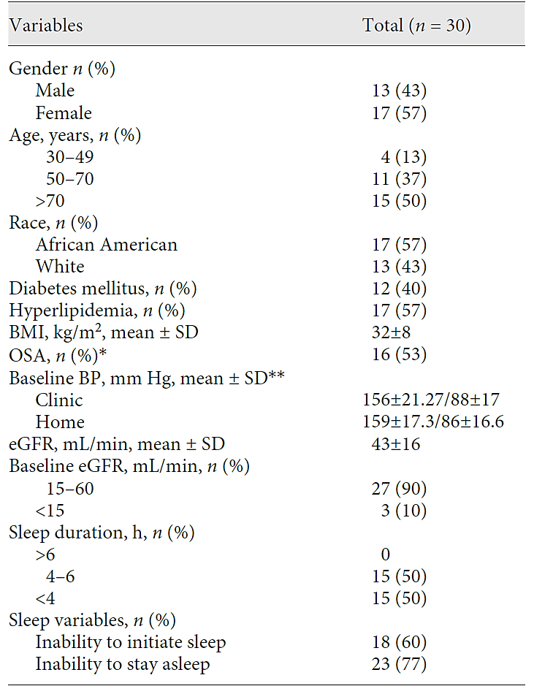
BP Change after Months of Restored Sleep Duration

Slide 20
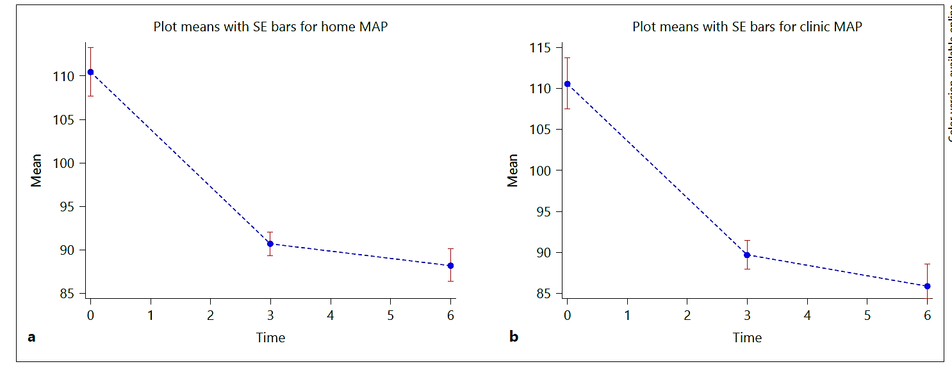
BP Change after Months of Restored Sleep Duration

Slide 21
BP Change after Months of Restored Sleep Duration
150/90
150/90
130/80
130/80
120/80
120/80
115/75
115/75

