Slide 1
Translating Blood Pressure Lowering to Reductions in End-Organ Damage
Michael G. Nanna, MD, MHS
Assistant Professor of Medicine
Section of Cardiovascular Medicine
Yale School of Medicine
New Haven, CT

Slide 2
Disclosures
Dr. Nanna is supported by:
The American College of Cardiology Foundation, supported by the George F. and Ann Harris Bellows Foundation
The National Institute on Aging/National Institutes of Health from R03AG074067 (GEMSSTAR award)

Slide 3
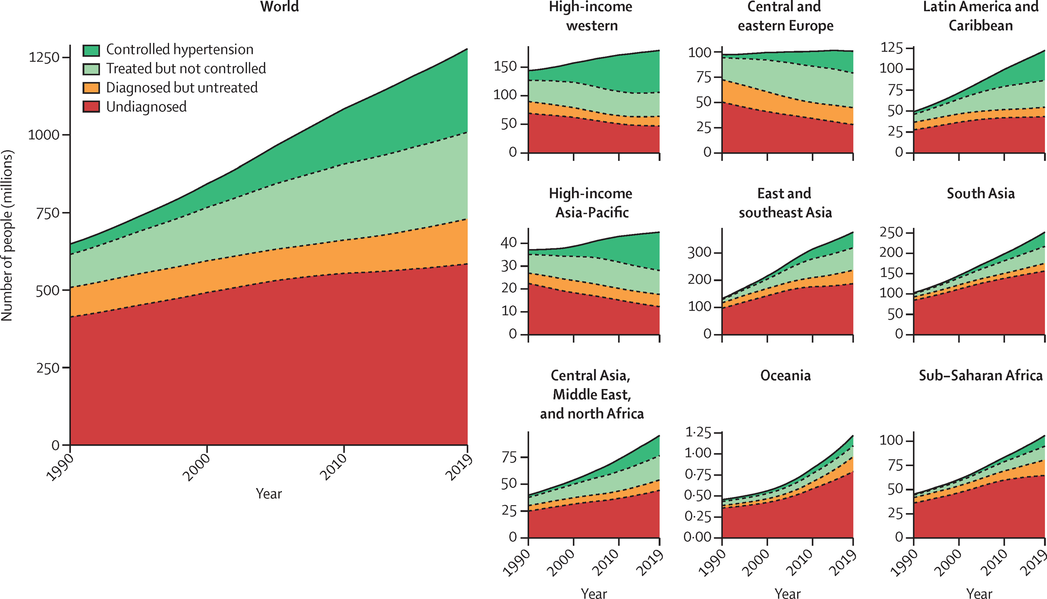
Prevalence of Hypertension
Figure 6

Slide 4
Prevalence of Hypertension
Figure 6

Slide 5
Prevalence of Hypertension
Figure 6

Slide 6
Prevalence of Hypertension
Figure 6

Slide 7
Prevalence of Hypertension
Figure 6

Slide 8
Prevalence of Hypertension
Figure 6

Slide 9
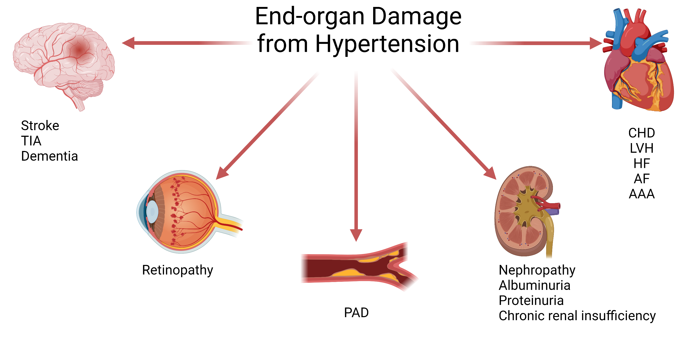
What Is the Burden of End-Organ Damage From HTN?

Slide 10
What Is the Burden of End-Organ Damage From HTN?

Slide 11
What Is the Burden of End-Organ Damage From HTN?

Slide 12
What Is the Burden of End-Organ Damage From HTN?

Slide 13
What Is the Burden of End-Organ Damage From HTN?

Slide 14
What Is the Burden of End-Organ Damage From HTN?

Slide 15
What Is the Burden of End-Organ Damage From HTN?

Slide 16
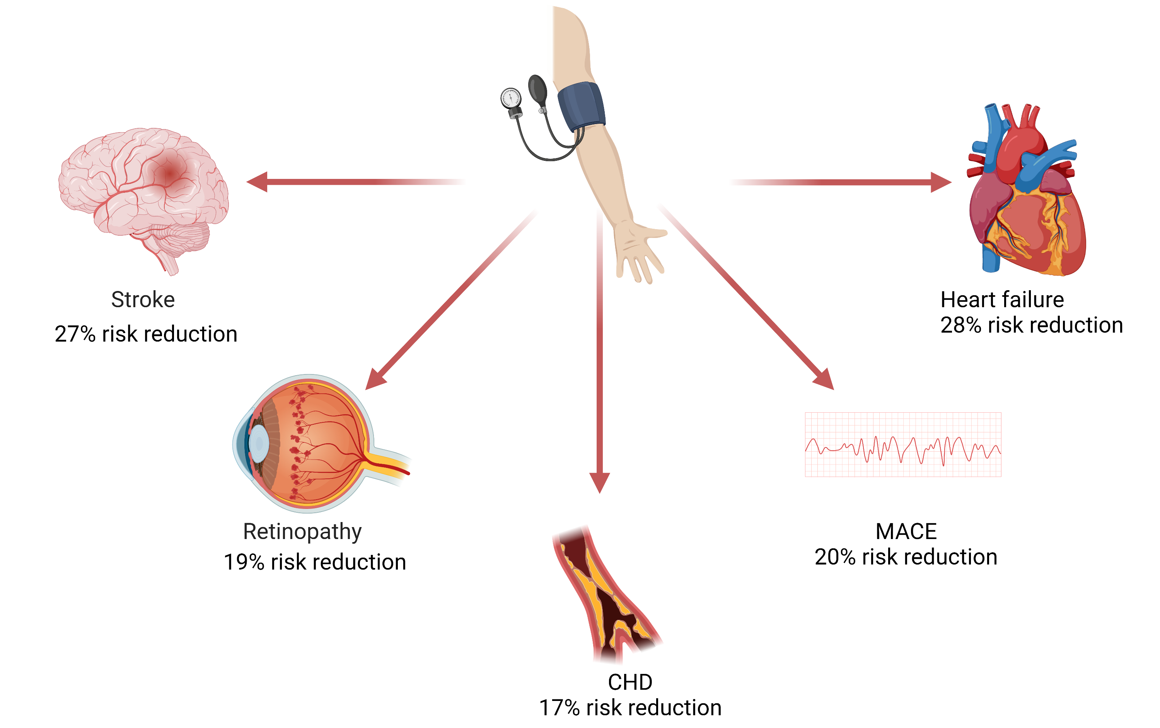
For Every 10 mmHg Decrease in Systolic Blood Pressure…
Figure 3

Slide 17
For Every 10 mmHg Decrease in Systolic Blood Pressure…
Figure 3

Slide 18
For Every 10 mmHg Decrease in Systolic Blood Pressure…
Figure 3

Slide 19
For Every 10 mmHg Decrease in Systolic Blood Pressure…
Figure 3

Slide 20
For Every 10 mmHg Decrease in Systolic Blood Pressure…
Figure 3

Slide 21
For Every 10 mmHg Decrease in Systolic Blood Pressure…
Figure 3

Slide 22
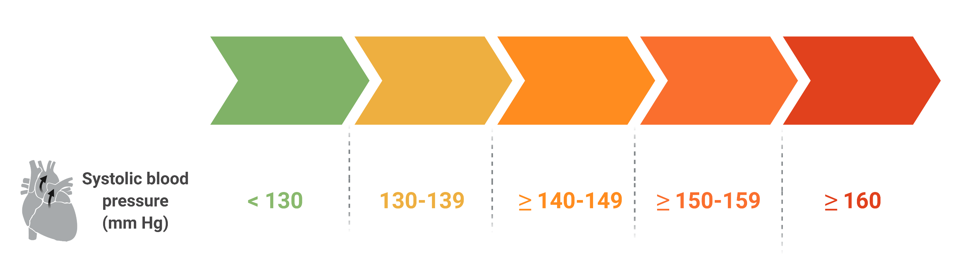
Benefits Are Consistent Across Baseline Blood Pressures per 10 mmHg Reduction

Slide 23
Clinical Relevance
Major burden of end-organ damage due to HTN
Evidence is clear on the association between blood pressure lowering and risk reduction
Across different outcomes
Across different baseline BPs
Onus is on clinicians to aggressively target BP lowering to reduce risk

