Slide 1
Cardiac Magnetic Resonance Imaging (CMRI)

Slide 2
Disclaimer
The views and opinions expressed in this educational activity are those of the faculty and do not necessarily represent the views of TotalCME, Inc., the CME providers, or the companies providing educational grants. This presentation is not intended to define an exclusive course of patient management; the participant should use their clinical judgment, knowledge, experience, and diagnostic skills in applying or adopting for professional use any of the information provided herein. Any procedures, medications, or other courses of diagnosis or treatment discussed or suggested in this activity should not be used by clinicians without evaluation of their patient's conditions and possible contraindications or dangers in use, review of any applicable manufacturer’s product information, and comparison with recommendations of other authorities. Links to other sites may be provided as additional sources of information.

Slide 3
Cardiac And Lung Perfusion MRI
MRI can provides anatomical and functional assessment of both pulmonary circulation and heart, with the major advantage of not using ionized radiation
Diagnostic for congenital abnormalities
With video techniques, gives robust qualitative and quantitative assessment of right ventricle (RV) with EDV, ESV, EF and CI¹
Curvature of the LV septal wall is a classic sign to depict elevated RV systolic pressure²
Phase-contrast MRI can quantify blood flow and peak velocity not only in the main pulmonary artery but also in all of vessels of the chest
Sequences assess differential blood flow to the right and left lung³ and seem to reflect PAP measurements obtained by invasive RHC⁴

Slide 4
Is There a Role For Cardiac Magnetic Resonance Imaging (CMRI) In PH?
Three dimensional imaging technique that provides detailed morphology of cardiac
chambers and accurate quantification of volumes, mass and flow.
Pros
Non-invasive and highly reproducible
Aids in diagnosis and prognosis
Accurate RV function assessment
Able to evaluate potential congenital or associated conditions
Difficult for patients receiving pump therapy
Claustrophobia
Cons

Slide 5
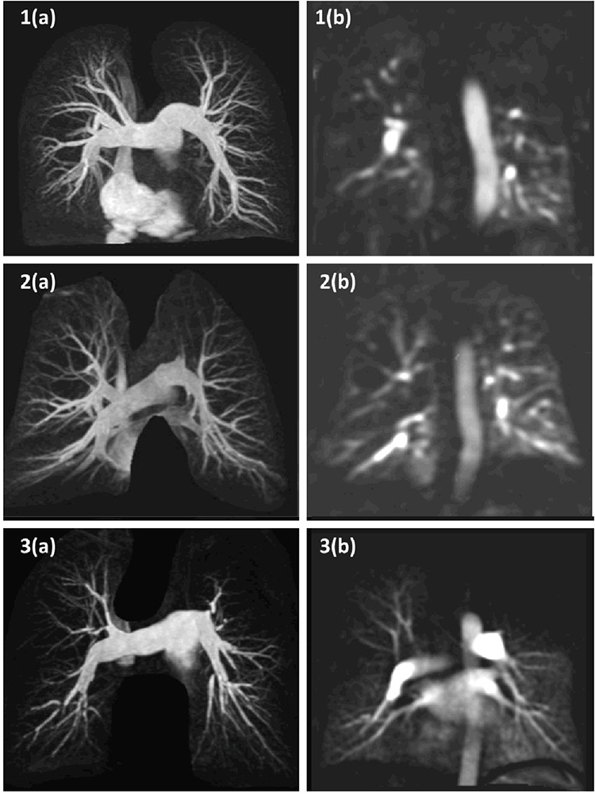
Magnetic Resonance Angiograms (a) and Perfusion Images (b)
IPAH:
Shows vessel tortuosity and
patchy perfusion
PH-COPD:
Typical vessel splaying seen in patients with COPD/emphysema and associated reduced perfusion in the upper zones
CTEPH:
Vessel stenoses and occlusions typical of a patient with CTEPH and the associated segmental perfusion defects

Slide 6
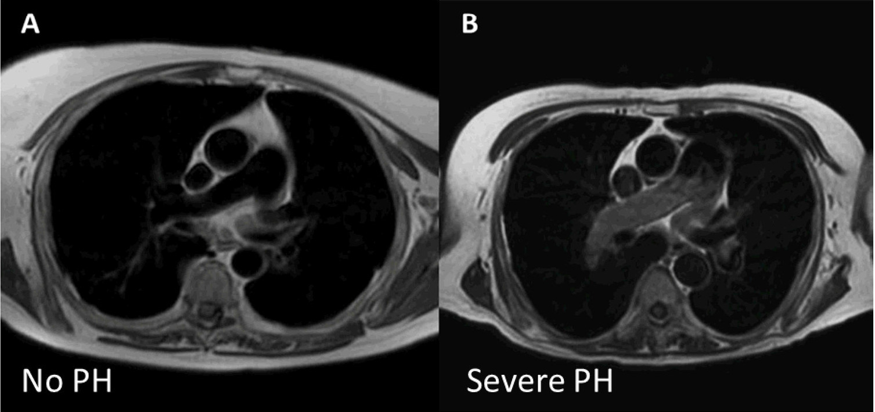
MRI Investigation of Suspected PH: What We Can Learn
Axial Black Blood Images

Slide 7
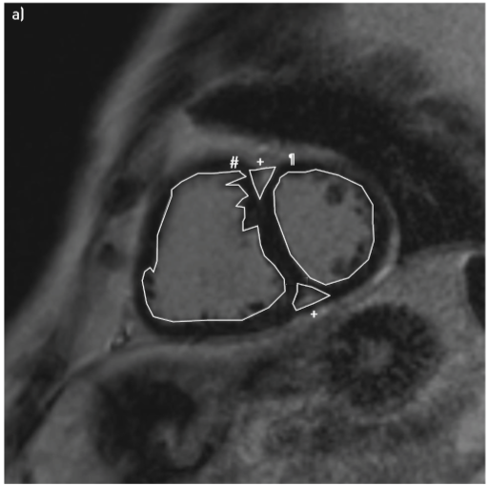
Certain cMRI Features Can Help Predict Outcomes in PAH
Short Axis with Late Gadolinium Enhancement
RV Ejection Fraction and Survival in Medically Treated PAH Patients
100
RV Insertion Points
Stable/
increased RVEF
(n=39)
80
60
Survival (%)
40
Decreased RVEF
(n=13)
20
P<0.001
0
12
50
100
Time (months)

