Slide 1
Using Echocardiography To Get a Handle on Heart Structure and Function in PH

Slide 2
Disclaimer
The views and opinions expressed in this educational activity are those of the faculty and do not necessarily represent the views of TotalCME, Inc., the CME providers, or the companies providing educational grants. This presentation is not intended to define an exclusive course of patient management; the participant should use their clinical judgment, knowledge, experience, and diagnostic skills in applying or adopting for professional use any of the information provided herein. Any procedures, medications, or other courses of diagnosis or treatment discussed or suggested in this activity should not be used by clinicians without evaluation of their patient's conditions and possible contraindications or dangers in use, review of any applicable manufacturer’s product information, and comparison with recommendations of other authorities. Links to other sites may be provided as additional sources of information.

Slide 3
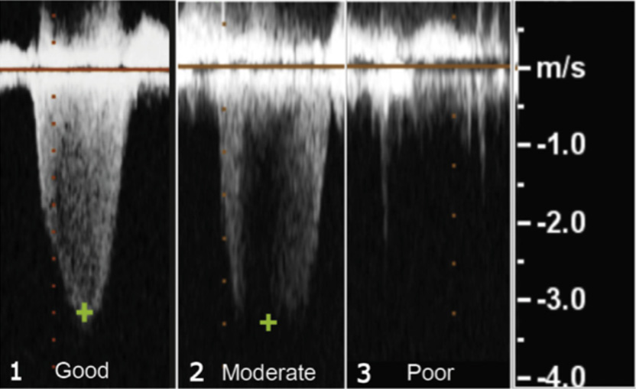
Echocardiogram: TR_{jet} Gives Only an Estimate Of PAP
PAP is estimated from TR jet using simplified Bernoulli equation:
  Peak grad = 4 x V2 + RA
The quality of the TR jet and the expertise of echocardiography reader matters!
Quality of TR jet
Review the echocardiography images

Slide 4
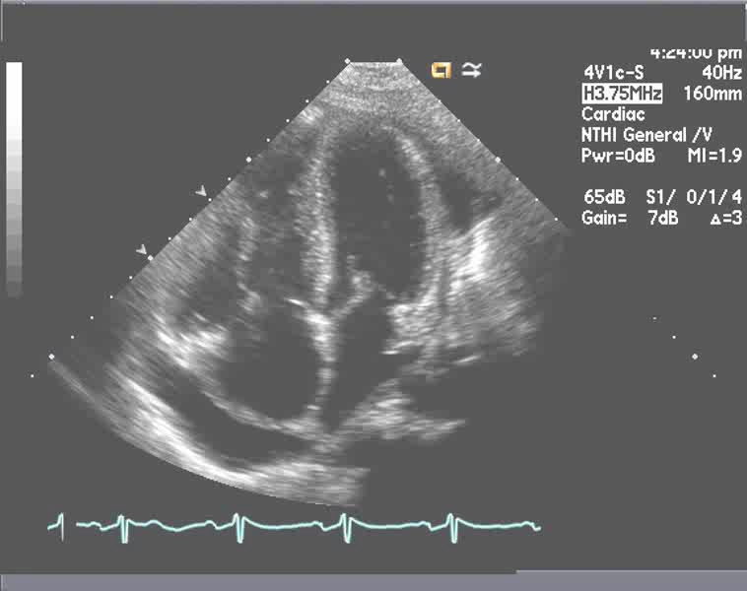
ECHO: It’s Not All About Pressures –
Structural Images Can Tell Us A Lot!
RV Dilation and
Dysfunction
Normal Right
Sided Chambers
LVH
RV
LV
LV
Precapillary PH
RV
Postcapillary PH
RA
LA
RA
LA
Pericardial Effusion
Small LA w
Shifted Septum
LA Enlargement
LA=left atrium/atrial
LV=left ventricle/ventricular
RA=right atrium/atrial
RV=right ventricle/ventricular

Slide 5
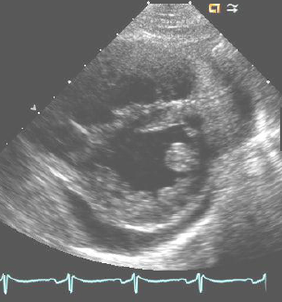
Other Echocardiographic Parameters That May Be Useful
Parasternal Short Axis View
Apical 4 Chamber View
Flattened Septum
D1
D2
Eccentricity Index (D1/D2) > 1.1
RV/LV Ratio > 1
RA Area > 18 cm²
RV is enlarged
Dilation of Right Sided Chambers

Slide 6
Other Echocardiographic Parameters That May Be Useful
Tissue Doppler TV Annulus
Tissue Doppler (S’)
S’ wave
Indicative of RV function
Simple and reproducible
Represents regional wall motion
Fractional Area Change (FAC)
RV Area Measured in Diastole and Systole
Indicative of RV function
High inter-observer variability
May be a good test for follow up
Diastole
Systole

