Slide 1
Echocardiography: Not Definitive for PH, but Essential To Determine Need for Referral to PH Center

Slide 2
Disclaimer
The views and opinions expressed in this educational activity are those of the faculty and do not necessarily represent the views of TotalCME, Inc., the CME providers, or the companies providing educational grants. This presentation is not intended to define an exclusive course of patient management; the participant should use their clinical judgment, knowledge, experience, and diagnostic skills in applying or adopting for professional use any of the information provided herein. Any procedures, medications, or other courses of diagnosis or treatment discussed or suggested in this activity should not be used by clinicians without evaluation of their patient's conditions and possible contraindications or dangers in use, review of any applicable manufacturer’s product information, and comparison with recommendations of other authorities. Links to other sites may be provided as additional sources of information.

Slide 3
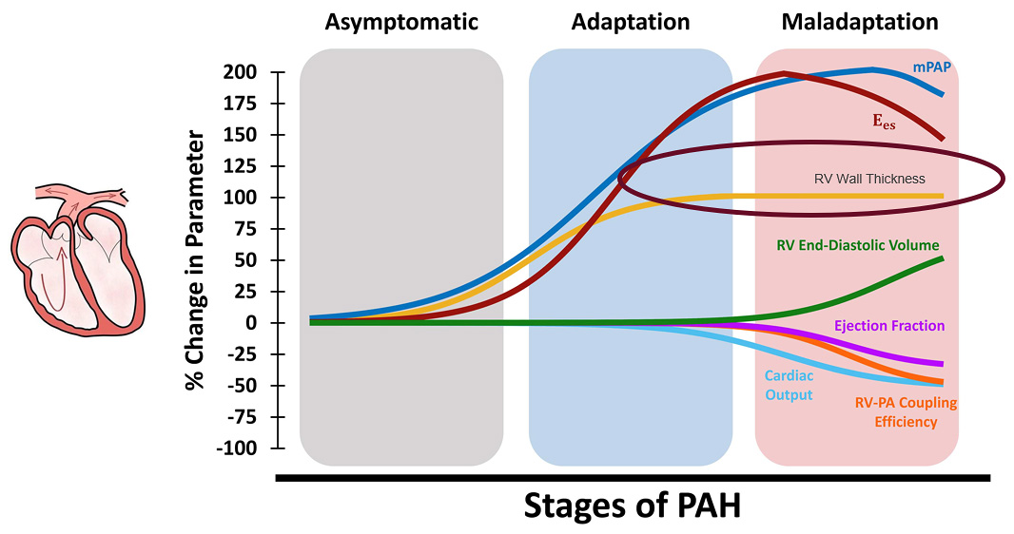
Importance of Structural Changes in the RV in PAH
Right ventricular (RV) function is the single most important prognostic determinant of survival in various forms of pulmonary hypertension (PH)¹
Pulmonary arterial hypertension has been shown to result in RV remodeling at different scales (organ-level hemodynamics to tissue stiffening, fiber reorientation, and altered myocyte contractility and mitochondrial energetics)²
The RV initially responds to increased pressures in PAH by undergoing concentric hypertrophy, which helps reducing RV wall stress and results in increased organ-level contractility
Increased wall thickness results in maintained cardiac output and ejection fraction during the early stages of RV remodeling with further progression of PAH, RV hypertrophy reaches a plateau³ while PA pressures continue to rise⁴

Slide 4
Using ECHO to Uncover PH
The most common opportunity to spot a new PAH patient is either in the ECHO review or in the ECHO report
Emphasis of echocardiogram should not be on pressures, but on structural changes associated with the heart
Tricuspid regurgitant velocity
Right ventricular size (right ventricle/left ventricle basal diameter ratio >1.0)
RA size (RA area [end-systole] >18 cm²)
RA function
Interventricular septal function
IVC diameter fluctuations with respiratory cycles (IVC diameter >21 mm with decreasing inspiratory collapse)
Pattern of systolic flow velocity
Early diastolic pulmonary regurgitant velocity
Diameter of the pulmonary artery (>25 mm)
Key Structural Features of the Heart in PAH
Pressures you can get with the right heart cath!

Slide 5
Echo: Probability of PH in Symptomatic Patients With a Suspicion of PH – Key Considerations
Peak tricuspid regurgitation velocity m·s^{–1} | Presence of other echocardiographic "PH signs" | Echocardiographic probability of PH
≤2.8 or not measurable | No | Low
≤2.8 or not measurable 2.9–3.4 | Yes No | Intermediate
2.9–3.4 >3.4 | Yes Not Required | High

Slide 6
Echo Signs Suggesting PH Can Be Used To Assess the Probability of PH in Addition to TRjet Velocity Measurement
A: The ventricles | B: Pulmonary artery | C: Inferior vena cava and right atrium
Right ventricle/left ventricle basal diameter ratio >1.0 | Right ventricular outflow Doppler acceleration time <105 ms and/or mid-systolic notching | Inferior vena cava diameter >21 mm with decreased inspiratory collapse (<50% with a sniff or <20% with quiet inspiration)
Flattening of the interventricular septum (left ventricular eccentricity index >1.1 in systole and/or diastole) | Early diastolic pulmonary regurgitation velocity >2.2 m·s^{–1} Pulmonary artery diameter >25 mm | Right atrial area (end-systole) >18 cm²
Echocardiographic signs from at least two different categories (A/B/C) from the list should be present to alter the level of echocardiographic probability of PH.

