Slide 1
If Unexplained Dyspnea Is Not Fully Explored, What Are the Implications…Especially if It Is PH?

Slide 2
Disclaimer
The views and opinions expressed in this educational activity are those of the faculty and do not necessarily represent the views of TotalCME, Inc., the CME providers, or the companies providing educational grants. This presentation is not intended to define an exclusive course of patient management; the participant should use their clinical judgment, knowledge, experience, and diagnostic skills in applying or adopting for professional use any of the information provided herein. Any procedures, medications, or other courses of diagnosis or treatment discussed or suggested in this activity should not be used by clinicians without evaluation of their patient's conditions and possible contraindications or dangers in use, review of any applicable manufacturer’s product information, and comparison with recommendations of other authorities. Links to other sites may be provided as additional sources of information.

Slide 3
Common Pitfalls in PAH Patient Care
It is easy to dismiss dyspnea as something else¹
This often results in physicians waiting too long after patients are symptomatic to refer patients to a PH specialty center
Lack of screening of at-risk PH populations²
E.g. Scleroderma, MCTD, familial PAH (genetic screens)
Relying on sPAP measurements from the ECHO imaging instead of obtaining evidence for structural signs of RV dysfunction
Not confirming diagnosis with a right heart catheterization
Lack of risk reassessment leading to delay in correct therapy and escalation

Slide 4
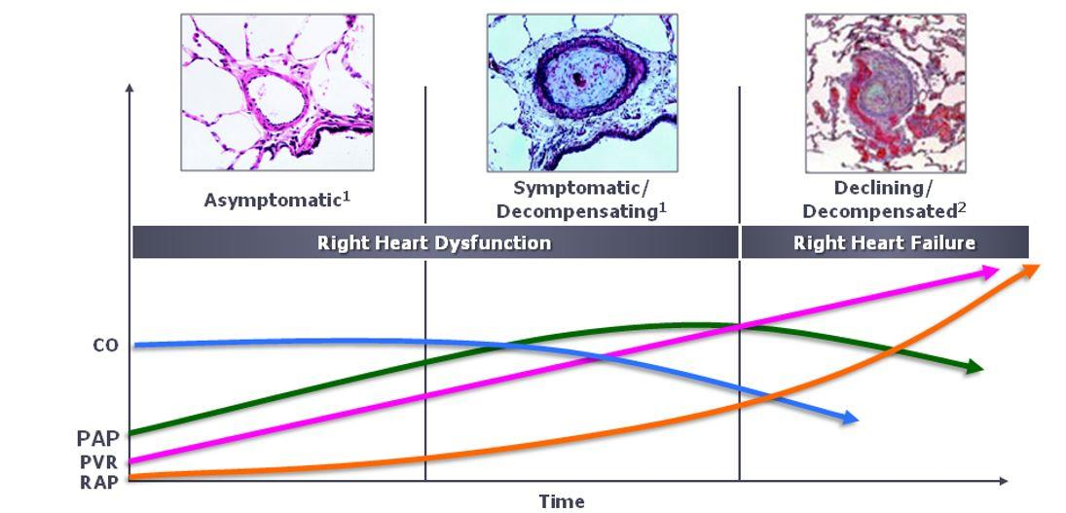
PAH Is Progressive – Structural Changes Start Before Functional Changes*
*These observations are based on reports from in vitro, animal, and human trials.

Slide 5
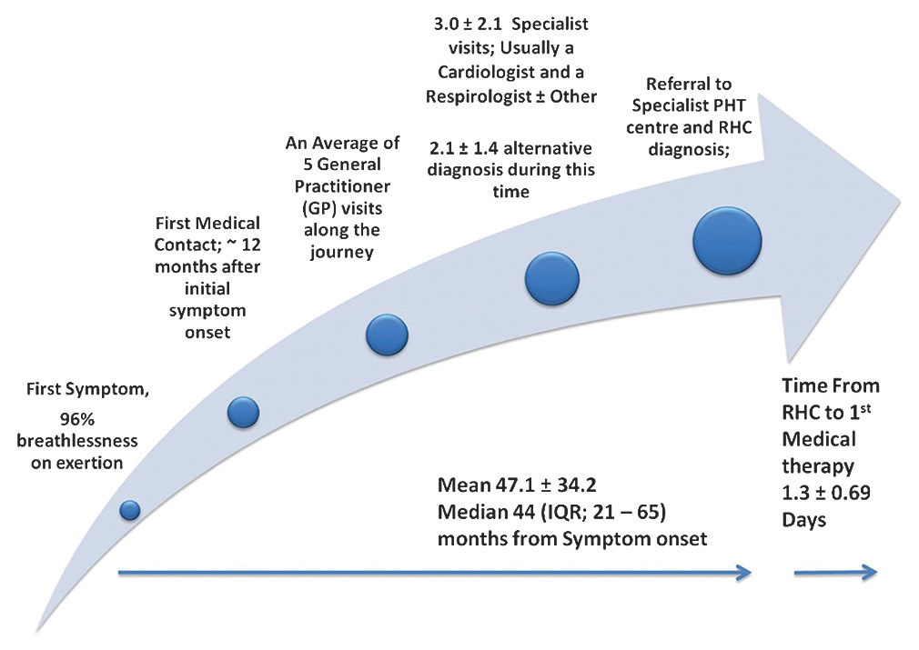
What Factors Influence Time to Definitive PAH Diagnosis?
Time between patient‑reported onset of symptoms and a definitive iPAH diagnosis is consistently delayed
The DELAY study (Australia) retrospectively examined factors contributing to diagnostic delays and the time to definitive iPAH diagnosis
In 32 patients (69% female) reporting exertional dyspnea, mean time from symptom onset to diagnosis was 47 ± 34 mo.
Patients reported 5.3 ± 3.8 general practitioner (GP) visits and 3.0 ± 2.1 specialist reviews before being seen at a PH center
Factors significantly associated with delayed diagnosis were:
advanced age
number of GP visits
heart rate
systolic blood pressure
From the time of first medical contact to the time of RHC diagnosis, women moved through this phase in significantly shorter time vs. men (24 ± 30.31 months vs. 45 ± 39.95 months, respectively, P=.043).

