Slide 1
Dyspnea: Many Possible Causes, Always To Be Taken Seriously

Slide 2
Disclaimer
The views and opinions expressed in this educational activity are those of the faculty and do not necessarily represent the views of TotalCME, Inc., the CME providers, or the companies providing educational grants. This presentation is not intended to define an exclusive course of patient management; the participant should use their clinical judgment, knowledge, experience, and diagnostic skills in applying or adopting for professional use any of the information provided herein. Any procedures, medications, or other courses of diagnosis or treatment discussed or suggested in this activity should not be used by clinicians without evaluation of their patient's conditions and possible contraindications or dangers in use, review of any applicable manufacturer’s product information, and comparison with recommendations of other authorities. Links to other sites may be provided as additional sources of information.

Slide 3
Revisiting Unexplained Dyspnea – Possible Causes
Acute dyspnea could be due to…well…almost any medical condition, it seems…
Possible Causes of Unexplained Dyspnea
Asthma | CO Exposure | Pleurisy / Inflammation
Lung Infections | Collapsed Lung | COPD/ILD
Anxiety | Hypotension | Heart Failure
Choking/Blocked Airway | Hiatal Hernia | Pulmonary Embolism
Allergic Reactions | Croup | Pulmonary Edema
Anemia | Traumatic Lung Injury | Sarcoidosis
Serious Blood Loss | Lung Cancer | Pulmonary Hypertension
These conditions all have direct relation to PH!
It is essential to ask the right questions and do the correct diagnostics to determine the cause of the patient’s dyspnea.
You cannot assume it is due to the simplest, most common cause

Slide 4
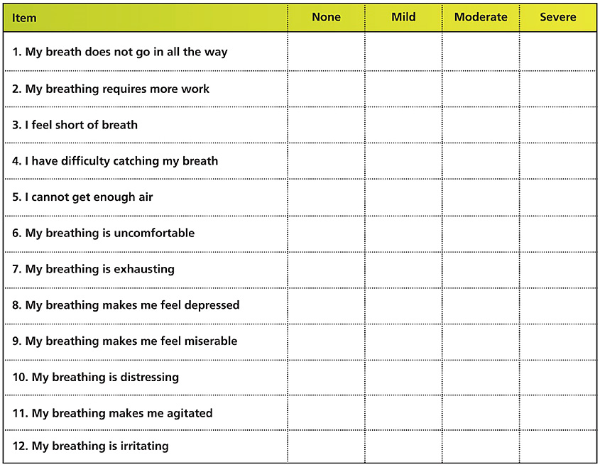
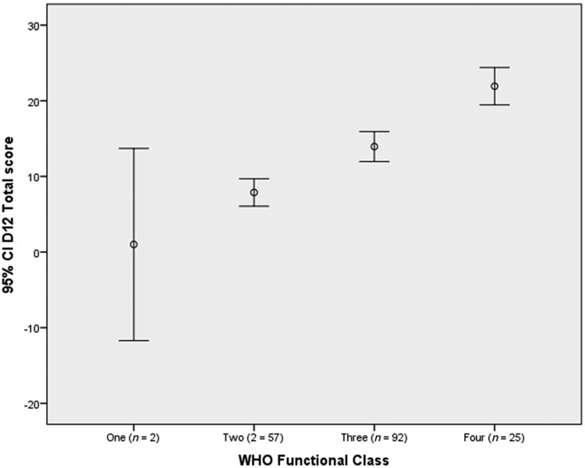
How Bad Is It? – Assessing Your Patients’ Dyspnea
Breathlessness is a predominant symptom among patients with cardiopulmonary disease and has been shown to have a strong correlation with anxiety, depression, health-related quality of life (HRQL), activity limitation and mortality
The Dyspnoea-12 (D-12) is a short instrument that assesses breathlessness severity and taps its physical and emotional components¹
The D-12 has acceptable reliability and validity for use in patients with PAH and correlates with WHO Functional Class²
DYSPNEA 12 Questionnaire

Slide 5
Always Suspect It Could Be PAH, But Never ASSUME It’s PAH
Pulmonary artery systolic pressure (PASP) Doppler est. = 51 mmHg
PASP (measured)
Right Heart Catheterization = 68 mmHg
What’s type of PH is this?
Know the Clues to PAH!
Differential Diagnosis
Heart failure, Valvular disease (high wedge pressure)
COPD, Sleep apnea
Pulmonary embolism
PAH
Inaccurate systolic pulmonary artery pressure (SPAP) measurement
Pulmonary Hypertension has a broad differential diagnosis—best to never assume you’re dealing only with PAH

Slide 6
When the Patient Has Underlying Disease^{1,2}, You Expect Them to Be at Risk for PAH and You Must Test for It
Systemic sclerosis (SSc)
Lupus erythematosus
Pulmonary fibrosis
Connective tissue diseases (MCTD, rheumatoid arthritis, etc.)
Congenital heart disease
Liver disease
HIV
Obstructive sleep apnea (OSA)
Sickle cell disease
Pulmonary embolism (risk for CTEPH)
Schistosomiasis

