Slide 1
What Are the Short-Term and Long-Term Toxicities With CAR T Cells?
Noopur Raje, MD
Center for Multiple Myeloma
MGH Cancer Center
Professor of Medicine
Harvard Medical School

Slide 2
Disclaimer
The views and opinions expressed in this educational activity are those of the faculty and do not necessarily represent the views of TotalCME, Inc., the CME providers, or the companies providing educational grants. This presentation is not intended to define an exclusive course of patient management; the participant should use their clinical judgment, knowledge, experience, and diagnostic skills in applying or adopting for professional use any of the information provided herein. Any procedures, medications, or other courses of diagnosis or treatment discussed or suggested in this activity should not be used by clinicians without evaluation of their patient's conditions and possible contraindications or dangers in use, review of any applicable manufacturer’s product information, and comparison with recommendations of other authorities. Links to other sites may be provided as additional sources of information.

Slide 3
Considerations for Treatment
Managing CAR T cell toxicities

Slide 4
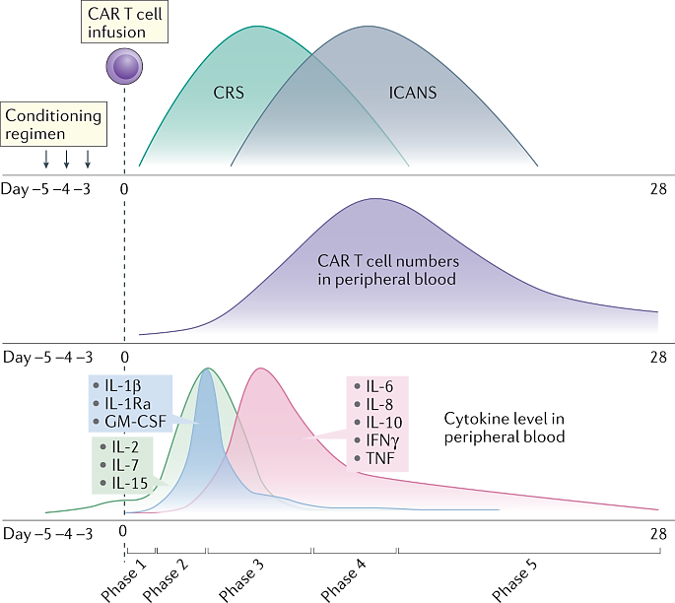
Cytokine Release Syndrome
Triggered by: Activation of T-cells → release cytokines/chemokines (esp. IL-6, IFN-gamma)
Onset: Typically within first week
Risk factors: Bulky disease, comorbidities, sepsis
Suspect if: 1+ of the following
Fever
Hypotension < 90 mm Hg
Hypoxia < 90%
Evidence of organ toxicity

Slide 5
Cytokine Release Syndrome
Triggered by: Activation of T-cells → release cytokines/chemokines (esp. IL-6, IFN-gamma)
Onset: Typically within first week
Risk factors: Bulky disease, comorbidities, sepsis
Suspect if: 1+ of the following
Fever
Hypotension < 90 mm Hg
Hypoxia < 90%
Evidence of organ toxicity

Slide 6
Cytokine Release Syndrome
Triggered by: Activation of T-cells → release cytokines/chemokines (esp. IL-6, IFN-gamma)
Onset: Typically within first week
Risk factors: Bulky disease, comorbidities, sepsis
Suspect if: 1+ of the following
Fever
Hypotension < 90 mm Hg
Hypoxia < 90%
Evidence of organ toxicity

Slide 7
Cytokine Release Syndrome
Triggered by: Activation of T-cells → release cytokines/chemokines (esp. IL-6, IFN-gamma)
Onset: Typically within first week
Risk factors: Bulky disease, comorbidities, sepsis
Suspect if: 1+ of the following
Fever
Hypotension < 90 mm Hg
Hypoxia < 90%
Evidence of organ toxicity

Slide 8
Cytokine Release Syndrome
Triggered by: Activation of T-cells → release cytokines/chemokines (esp. IL-6, IFN-gamma)
Onset: Typically within first week
Risk factors: Bulky disease, comorbidities, sepsis
Suspect if: 1+ of the following
Fever
Hypotension < 90 mm Hg
Hypoxia < 90%
Evidence of organ toxicity

Slide 9
CRS Grading and Management
 | CRS Grade 1 | CRS Grade 2 | CRS Grade 3 | CRS Grade 4
Fever | Temperature > 38ºC
With Either
Hypotension | None | Not requiring vasopressors | Requiring one vasopressor (w/ or w/o vasopressin) | Requiring multiple vasopressors (excluding vasopressin) | Requiring multiple vasopressors (excluding vasopressin)
And/Or
Hypoxia | None | O2 NC (< 6 L/min) or blow-by | High-flow NC (> 6 L/min), facemask, non-rebreather, or venturi mask | CPAP, BiPAP, intubation | CPAP, BiPAP, intubation
Management
 | - Antipyretics - Infectious w/u - Antibiotics *<24 hrs: Consider tocilizumab if not responsive to antipyretics | IV Fluids Tocilizumab q8hr up to 2-3 doses If early onset or no response to toci: Dexamethasone 10 mg IV | ICU monitoring Tocilizumab Dexamethasone 10 mg q8-12 hrs until < grade 1 | ICU management Tocilizumab Dexamethasone 20 mg IV q6 hrs If no improvement after 24 hours: Methylpred 1g/d and/or anakinra | ICU management Tocilizumab Dexamethasone 20 mg IV q6 hrs If no improvement after 24 hours: Methylpred 1g/d and/or anakinra

Slide 10
CRS Grading and Management
 | CRS Grade 1 | CRS Grade 2 | CRS Grade 3 | CRS Grade 4
Fever | Temperature > 38ºC
With Either
Hypotension | None | Not requiring vasopressors | Requiring one vasopressor (w/ or w/o vasopressin) | Requiring multiple vasopressors (excluding vasopressin) | Requiring multiple vasopressors (excluding vasopressin)
And/Or
Hypoxia | None | O2 NC (< 6 L/min) or blow-by | High-flow NC (> 6 L/min), facemask, non-rebreather, or venturi mask | CPAP, BiPAP, intubation | CPAP, BiPAP, intubation
Management
 | - Antipyretics - Infectious w/u - Antibiotics *<24 hrs: Consider tocilizumab if not responsive to antipyretics | IV Fluids Tocilizumab q8hr up to 2-3 doses If early onset or no response to toci: Dexamethasone 10 mg IV | ICU monitoring Tocilizumab Dexamethasone 10 mg q8-12 hrs until < grade 1 | ICU management Tocilizumab Dexamethasone 20 mg IV q6 hrs If no improvement after 24 hours: Methylpred 1g/d and/or anakinra | ICU management Tocilizumab Dexamethasone 20 mg IV q6 hrs If no improvement after 24 hours: Methylpred 1g/d and/or anakinra

Slide 11
CRS Grading and Management
 | CRS Grade 1 | CRS Grade 2 | CRS Grade 3 | CRS Grade 4
Fever | Temperature > 38ºC
With Either
Hypotension | None | Not requiring vasopressors | Requiring one vasopressor (w/ or w/o vasopressin) | Requiring multiple vasopressors (excluding vasopressin) | Requiring multiple vasopressors (excluding vasopressin)
And/Or
Hypoxia | None | O2 NC (< 6 L/min) or blow-by | High-flow NC (> 6 L/min), facemask, non-rebreather, or venturi mask | CPAP, BiPAP, intubation | CPAP, BiPAP, intubation
Management
 | - Antipyretics - Infectious w/u - Antibiotics *<24 hrs: Consider tocilizumab if not responsive to antipyretics | IV Fluids Tocilizumab q8hr up to 2-3 doses If early onset or no response to toci: Dexamethasone 10 mg IV | ICU monitoring Tocilizumab Dexamethasone 10 mg q8-12 hrs until < grade 1 | ICU management Tocilizumab Dexamethasone 20 mg IV q6 hrs If no improvement after 24 hours: Methylpred 1g/d and/or anakinra | ICU management Tocilizumab Dexamethasone 20 mg IV q6 hrs If no improvement after 24 hours: Methylpred 1g/d and/or anakinra

Slide 12
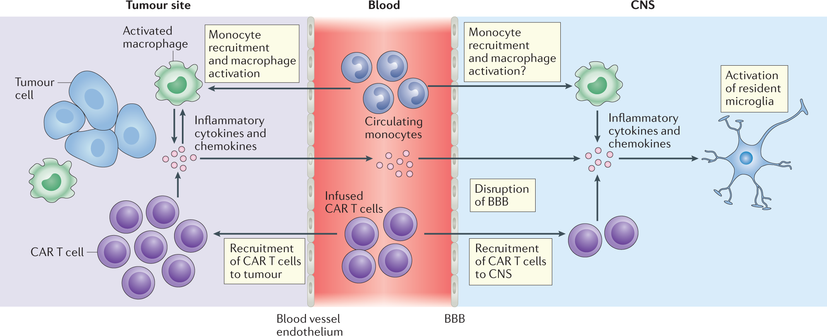
ICANS: Immune Effector Cell-Associated Neurotoxicity Syndrome
Triggered by: Passive diffusion of cytokines into the brain, trafficking of CAR T-cells into CNS, monocyte recruitment and macrophage activation
Onset: Biphasic (early or after CRS resolved)
Suspect if:
Diminished attention
Language disturbance
Impaired handwriting
Confusion, disorientation
Agitation
Aphasia, somnolence
Tremors, seizures
Motor weakness, incontinence

Slide 13
ICANS: Immune Effector Cell-Associated Neurotoxicity Syndrome
Triggered by: Passive diffusion of cytokines into the brain, trafficking of CAR T-cells into CNS, monocyte recruitment and macrophage activation
Onset: Biphasic (early or after CRS resolved)
Suspect if:
Diminished attention
Language disturbance
Impaired handwriting
Confusion, disorientation
Agitation
Aphasia, somnolence
Tremors, seizures
Motor weakness, incontinence

Slide 14
ICANS: Immune Effector Cell-Associated Neurotoxicity Syndrome
Triggered by: Passive diffusion of cytokines into the brain, trafficking of CAR T-cells into CNS, monocyte recruitment and macrophage activation
Onset: Biphasic (early or after CRS resolved)
Suspect if:
Diminished attention
Language disturbance
Impaired handwriting
Confusion, disorientation
Agitation
Aphasia, somnolence
Tremors, seizures
Motor weakness, incontinence

Slide 15
ICANS: Immune Effector Cell-Associated Neurotoxicity Syndrome
Triggered by: Passive diffusion of cytokines into the brain, trafficking of CAR T-cells into CNS, monocyte recruitment and macrophage activation
Onset: Biphasic (early or after CRS resolved)
Suspect if:
Diminished attention
Language disturbance
Impaired handwriting
Confusion, disorientation
Agitation
Aphasia, somnolence
Tremors, seizures
Motor weakness, incontinence

Slide 16
ICANS Grading and Management
 | Grade 1 | Grade 2 | Grade 3 | Grade 4
ICE Score | 7-9 | 3-6 | 0-2 | 0 (unarousable or unable to perform)
Depressed level of consciousness | Awakens spontaneously | Awakens to voice | Awakens only to tactile stimulus | Unarousable or requires repetitive tactile stimuli to arouse; stupor or coma
Seizure | N/A | N/A |  | Prolonged seizure / status epilepticus
Motor findings | N/A | N/A |  | Paralysis
Raised ICP/ cerebral edema | N/A | N/A | Focal/local edema on imaging | Diffuse edema on imaging; posturing; CN6 palsy; papilledema; Cushing’s triad
Management | Head CT MRI? LP? EEG? Dex if high-risk | G1 + - Dex 10 mg q8-12 hours until grade < 1, then taper | G2 + Dex 10-20 mg IV q6-12 hrs until grade < 1 Cerebral edema management Antiepileptics | G3 + Dex 20 mg q6hrs until grade < 1 Methlpred 1g/d if no improvement Anakinra? Siltuximab? IT chemo?

Slide 17
ICANS Grading and Management
 | Grade 1 | Grade 2 | Grade 3 | Grade 4
ICE Score | 7-9 | 3-6 | 0-2 | 0 (unarousable or unable to perform)
Depressed level of consciousness | Awakens spontaneously | Awakens to voice | Awakens only to tactile stimulus | Unarousable or requires repetitive tactile stimuli to arouse; stupor or coma
Seizure | N/A | N/A |  | Prolonged seizure / status epilepticus
Motor findings | N/A | N/A |  | Paralysis
Raised ICP/ cerebral edema | N/A | N/A | Focal/local edema on imaging | Diffuse edema on imaging; posturing; CN6 palsy; papilledema; Cushing’s triad
Management | Head CT MRI? LP? EEG? Dex if high-risk | G1 + - Dex 10 mg q8-12 hours until grade < 1, then taper | G2 + Dex 10-20 mg IV q6-12 hrs until grade < 1 Cerebral edema management Antiepileptics | G3 + Dex 20 mg q6hrs until grade < 1 Methlpred 1g/d if no improvement Anakinra? Siltuximab? IT chemo?

Slide 18
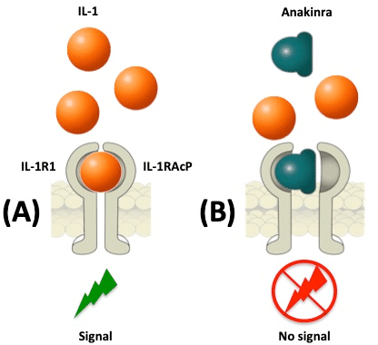
Other CAR T Cell Toxicities
Cytopenias
Supportive care
Macrophage activation-like syndrome
Measure ferritin, IL-2R, NK cell activation, coagulation profile
Anakinra
Immunosuppression
Intravenous Immunoglobulin therapy (IVIg)
Antimicrobial prophylaxis

Slide 19
Other CAR T Cell Toxicities
Cytopenias
Supportive care
Macrophage activation-like syndrome
Measure ferritin, IL-2R, NK cell activation, coagulation profile
Anakinra
Immunosuppression
Intravenous Immunoglobulin therapy (IVIg)
Antimicrobial prophylaxis

Slide 20
Other CAR T Cell Toxicities
Cytopenias
Supportive care
Macrophage activation-like syndrome
Measure ferritin, IL-2R, NK cell activation, coagulation profile
Anakinra
Immunosuppression
Intravenous Immunoglobulin therapy (IVIg)
Antimicrobial prophylaxis

Slide 21
Other CAR T Cell Toxicities
Cytopenias
Supportive care
Macrophage activation-like syndrome
Measure ferritin, IL-2R, NK cell activation, coagulation profile
Anakinra
Immunosuppression
Intravenous Immunoglobulin therapy (IVIg)
Antimicrobial prophylaxis

Slide 22
Neurocognitive and Hypokinetic Movement Disorder with Features of Parkinsonism After BCMA-Targeting CAR T Cell Therapy

Slide 23
Other CAR T Cell Toxicities
Infections
IVIg
Antimicrobial prophylaxis
Antiviral prophylaxis
Pneumocystis jirovecii pneumonia (PJP) prophylaxis
COVID-19
Vaccination
Tixagevimab co-packaged with cilgavimab (Evusheld™) – Emergency Use Authorization (EUA)

Slide 24
Other CAR T Cell Toxicities
Infections
IVIg
Antimicrobial prophylaxis
Antiviral prophylaxis
Pneumocystis jirovecii pneumonia (PJP) prophylaxis
COVID-19
Vaccination
Tixagevimab co-packaged with cilgavimab (Evusheld™) – Emergency Use Authorization (EUA)

Slide 25
Take Home Points
Understanding toxicities is critical
Using prophylactic strategies will help mitigate toxicities

Slide 26
Take Home Points
Understanding toxicities is critical
Using prophylactic strategies will help mitigate toxicities

