Slide 1
Can I Expect Better Outcomes with Ciltacabtagene Autoleucel Therapy Compared to Other Treatment Options in the Triple-Class Refractory Myeloma Patient?
Adam D. Cohen, MD
Associate Professor, Medicine
Director, Myeloma Immunotherapy
University of Pennsylvania
Philadelphia, PA

Slide 2
Disclaimer
The views and opinions expressed in this educational activity are those of the faculty and do not necessarily represent the views of TotalCME, Inc., the CME providers, or the companies providing educational grants. This presentation is not intended to define an exclusive course of patient management; the participant should use their clinical judgment, knowledge, experience, and diagnostic skills in applying or adopting for professional use any of the information provided herein. Any procedures, medications, or other courses of diagnosis or treatment discussed or suggested in this activity should not be used by clinicians without evaluation of their patient's conditions and possible contraindications or dangers in use, review of any applicable manufacturer’s product information, and comparison with recommendations of other authorities. Links to other sites may be provided as additional sources of information.

Slide 3
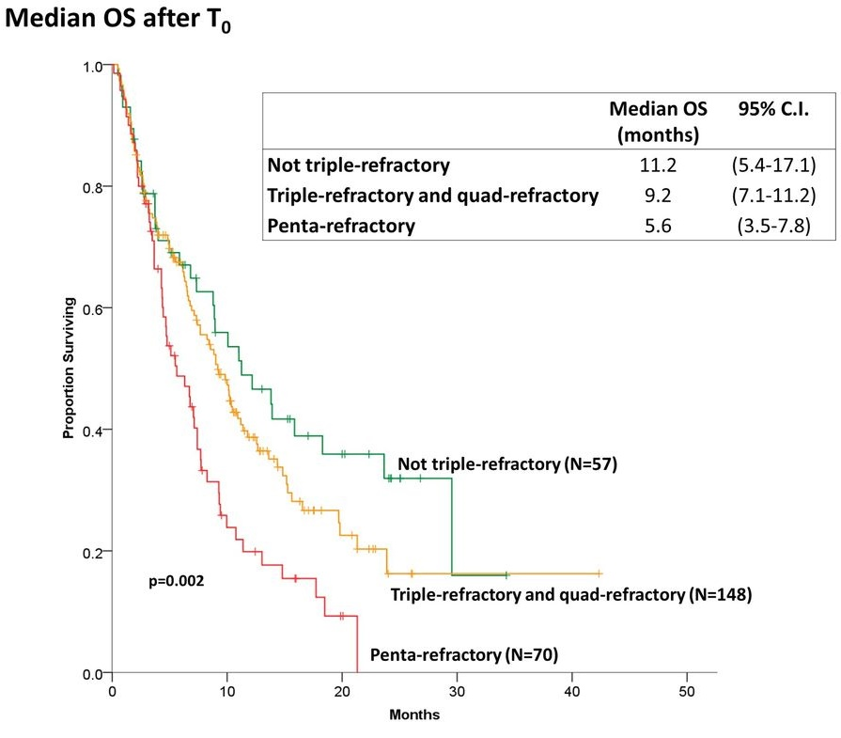
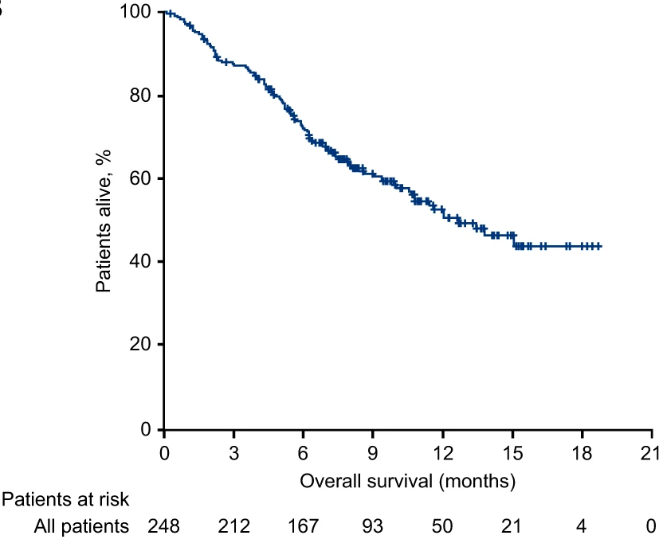
Triple-Class Refractory (TCR) Myeloma
MAMMOTH study (n = 275)
LocoMMotion study (n = 248)
80% TCR
74% TCR
ORR 31%
Med PFS 3.4 mos
ORR 30%
Med PFS 4.6 mos
Mateos, et al. Leukemia. 2022;36:1371-1376.

Slide 4
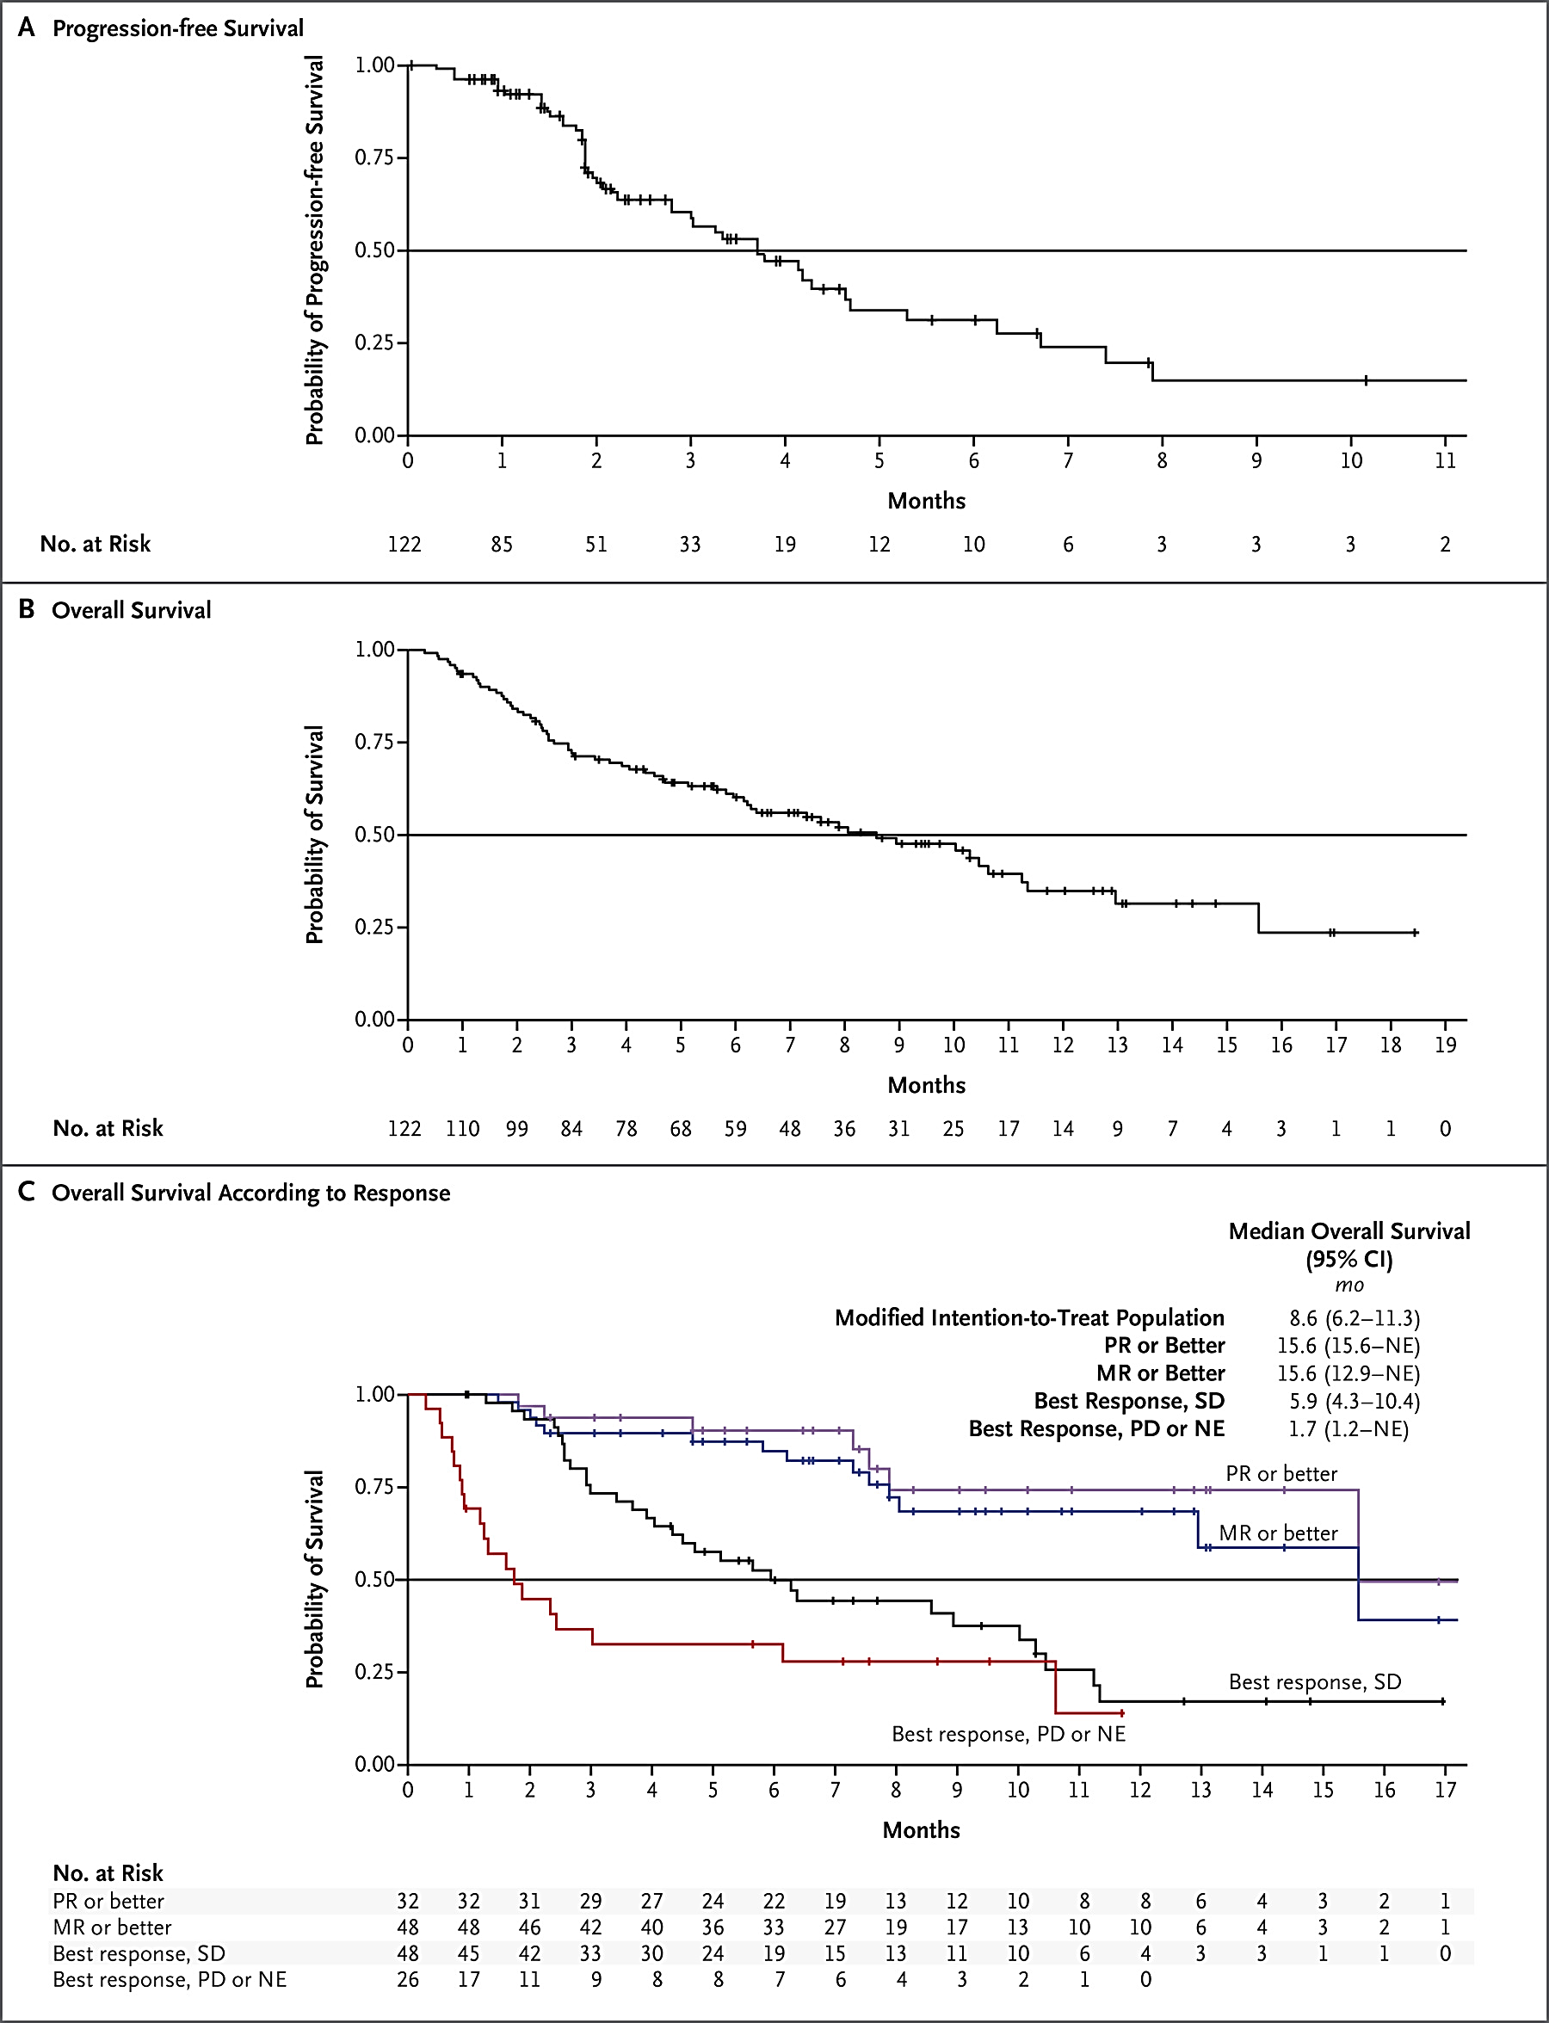
Novel Drugs for Triple-Class Refractory MM
Belantamab 2.5 mg/kg (DREAMM-2)
Selinexor/Dex (STORM)
ORR 31%
Med PFS 2.8 mos
Med DOR 11 mos
ORR 26%
Med PFS 3.7 mos
Chari, et al. NEJM. 2019;381:727-738.

Slide 5
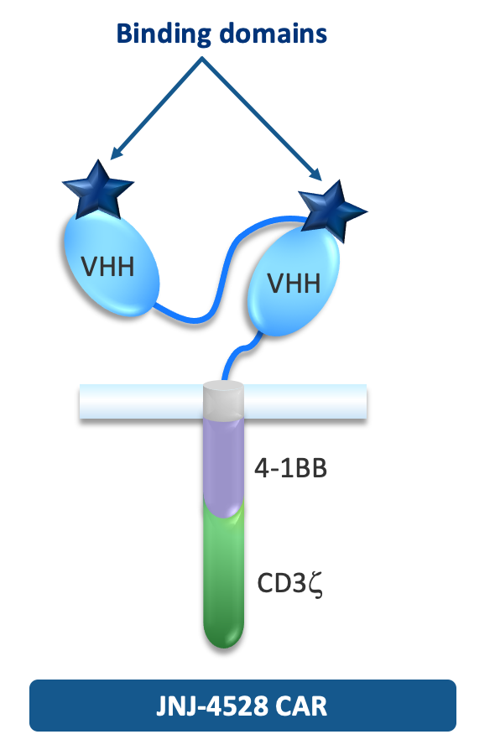






Ciltacabtagene Autoleucel: CARTITUDE-1 Phase 1/2 Study
Primary Objectives
Phase 1b: Characterize the safety of cilta-cel and confirm the recommended Phase 2 dose
Phase 2: Evaluate the efficacy of cilta-cel
Key Eligibility Criteria
Progressive MM per IMWG criteria
ECOG PS ≤ 1
Measurable disease
≥ Three prior therapies or double refractory
Prior PI, IMiD, anti-CD38 antibody exposure
Screening (1 to ≤28 days)
Apheresis
Bridging therapy (as needed)
Cy (300 mg/m²) + Flu (30 mg/m²)
(day -5 to -3)
Cilta-cel infusion
Target: 0.75×10⁶ (0.5–1.0×10⁶)
CAR+ viable T cells/kg (day 1)
Postinfusion assessments (day 1 to 100)
Safety, efficacy, PK, PD, biomarker
Posttreatment assessments (day 101 up to end of cohort)
Safety, efficacy, PK, PD, biomarker
Follow-up

Slide 6
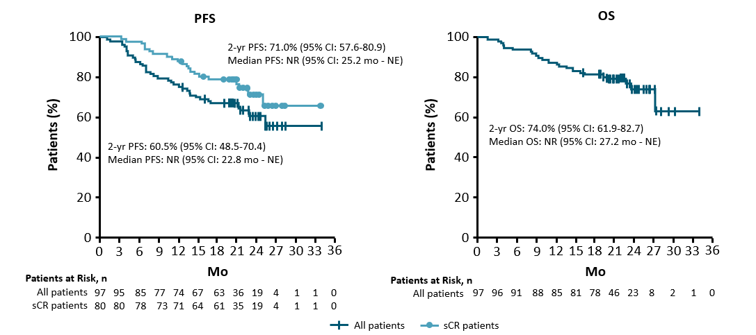
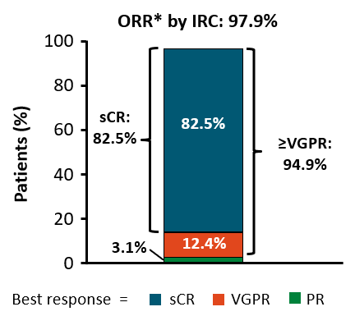
CARTITUDE-1 Update (cilta-cel): Two Year Follow-Up
Median six prior lines 85% triple-refractory
*ORR assessed by independent review committee.

Slide 7
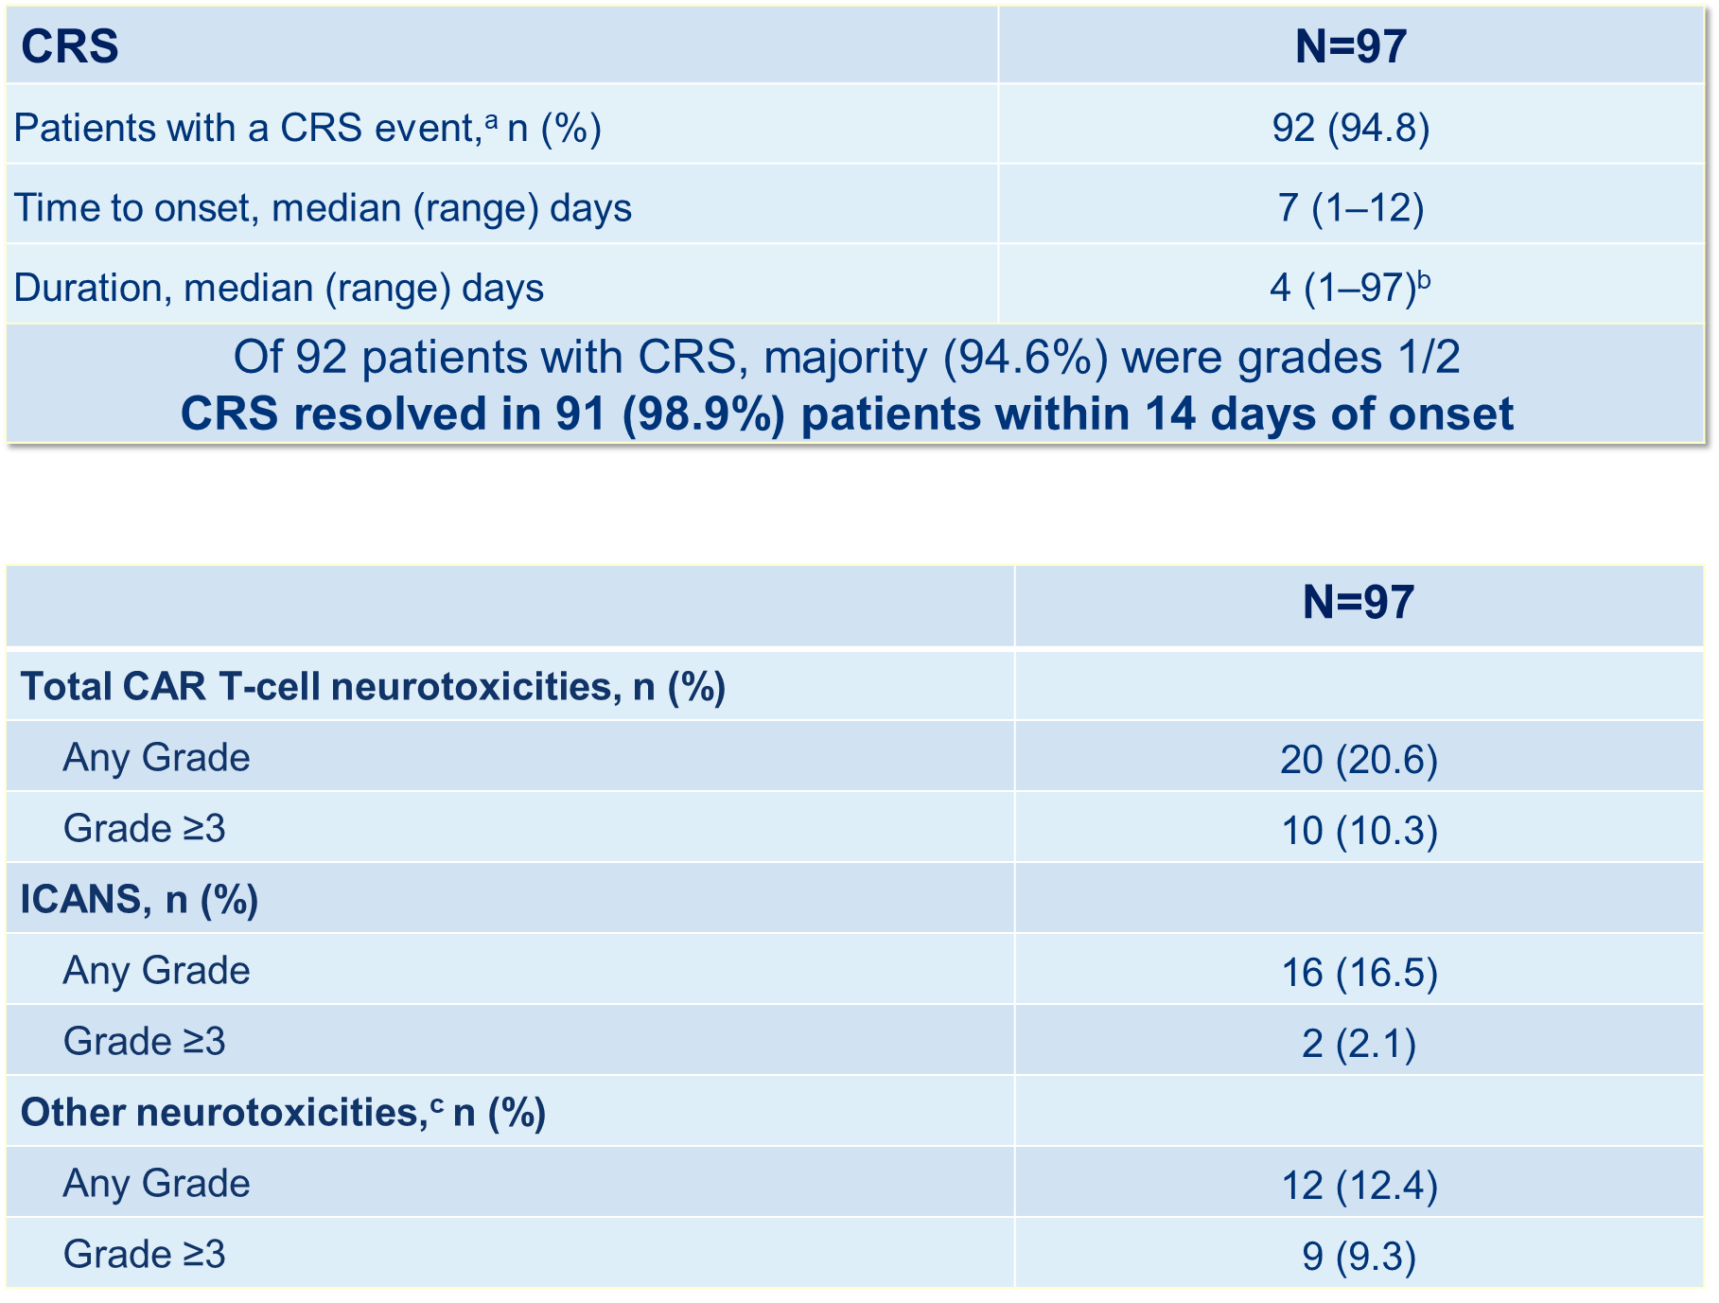
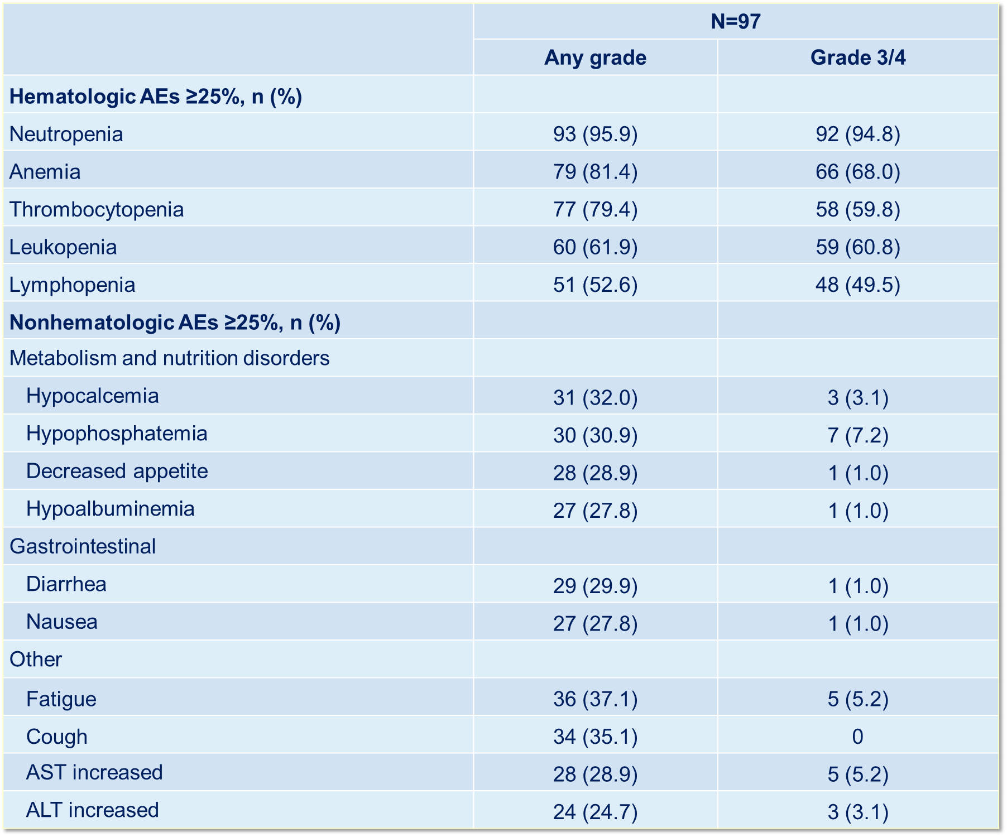
Cilta-cel: Toxicities in CARTITUDE-1

Slide 8
Cilta-cel: Conclusions and Future Directions
FDA-approved for RRMM after four or more lines, including PI, IMID, anti-CD38 mAb
Represents new standard of care treatment option for triple-class refractory myeloma
CARTITUDE-2
Phase 2 study in multiple cohorts
Early relapse, post-induction
CARTITUDE-4
Phase 3 randomized study of cilta-cel vs SOC in RRMM
CARTITUDE-5
Phase 3 randomized study of cilta-cel vs Rd maintenance after VRd induction for NDMM
CARTITUDE-6
Phase 3 randomized study of cilta-cel vs autoSCT after D-VRd induction for NDMM

